Slide 1

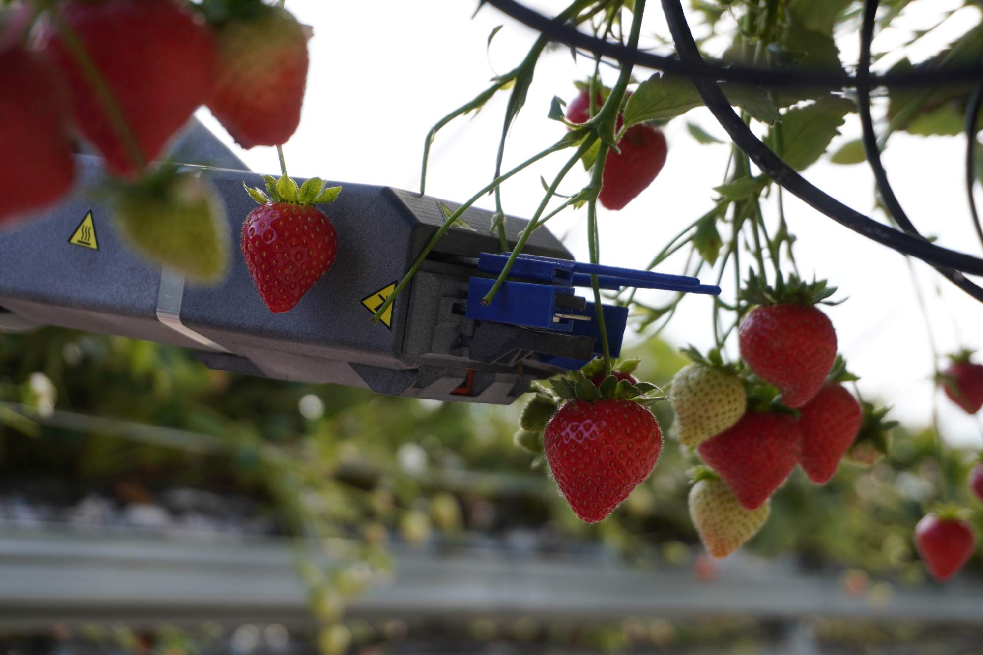
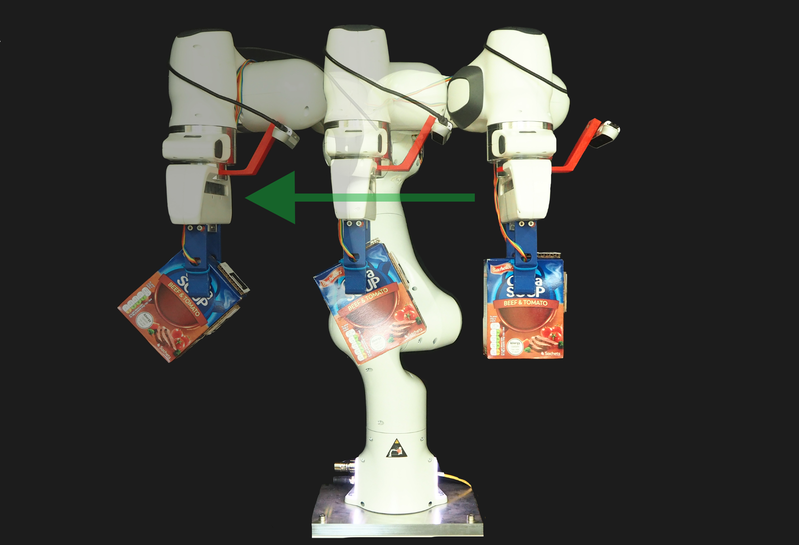
Intelligent Manipulation Lab
Exhibited at COP26

Slide 2
Intelligent Manipulation Lab
Exhibited at COP26

