Slide 1

Housing Loan Approval Predication
Qonesha Hunter, Hayden Jackson, Iman Malih, A'Nayah McCollough, John Olton, Ryan Woyce

Slide 2
Home Loan Approval Independent Variables
Home Loan Approval Dependent Variable
Gender,
Marriage,
Dependents,
Education,
Self-Employment,
Applicant Income,
Co-Applicant Income,
Loan Amount,
The Loan Term,
Credit History,
And Property Area
Loan Status

Slide 3

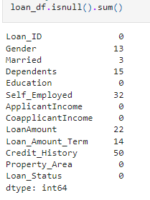
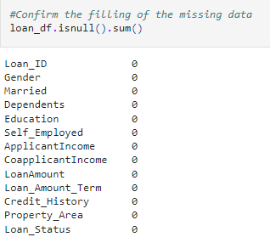
Understanding the Data
Reading in the csv
Getting the data information
Checking the statistical importance of each numerical column
Checking for null values then applying the measures of central tendency to fill in the missing data.
Before
After

Slide 4
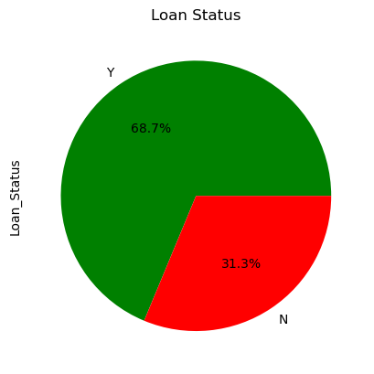
The Percentage Rates of Applicants Who are Approved vs Those Who are Not
The approval of a home loan is approximately 69%.

Slide 5
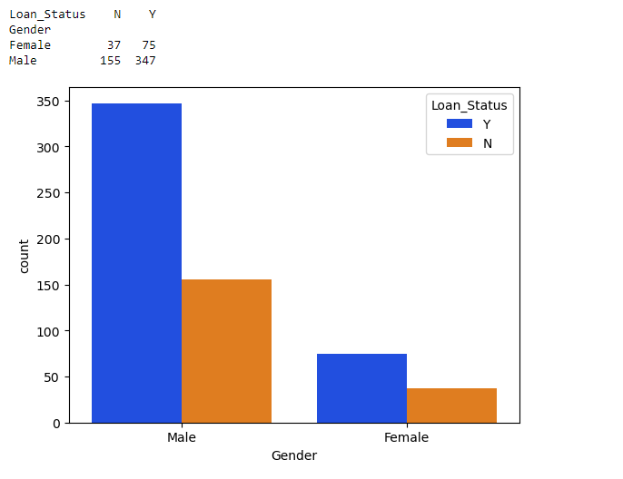
Comparison Between Genders
Males are more likely to be approved for a home loan then a female.

Slide 6
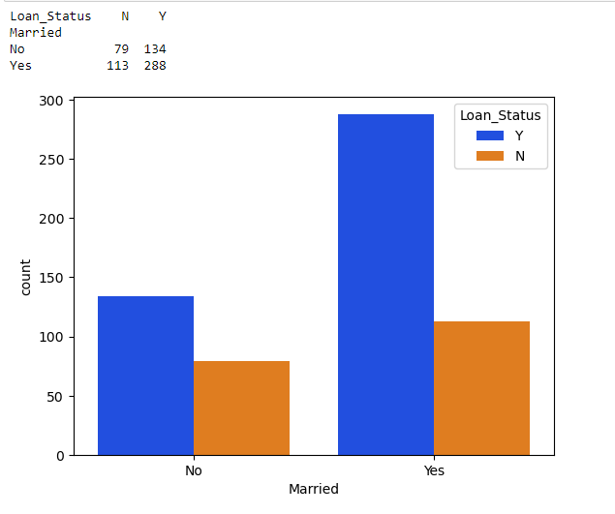
Comparison Between Married Status
From the studies you can see that being married has a major impact rather than being single to try and get a home loan.

Slide 7
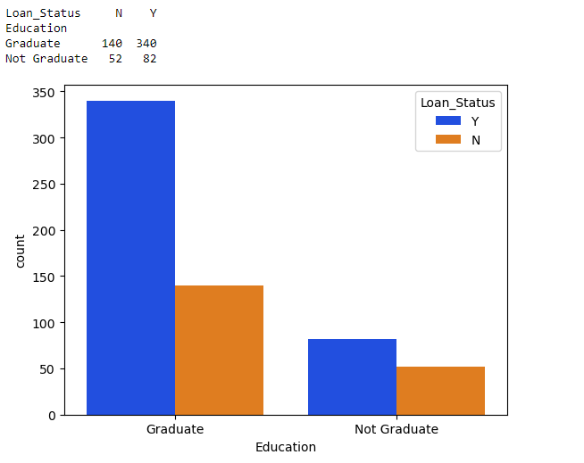
Comparison Between Education Status
From the studies you can see that being a graduate has a major impact rather than being non-grad to try and get a home loan.

Slide 8
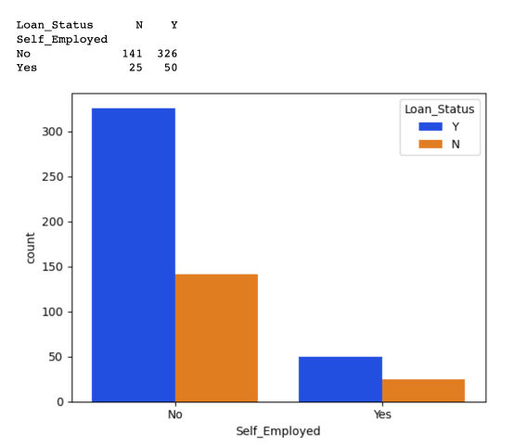
Comparison Between Self-Employed or Not
From the studies you can see that a person that isn’t self-employed has a major impact rather than being self-employed to try and get a home loan.

Slide 9
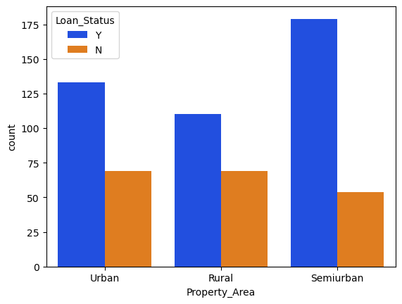
Comparison Between Property Area
Semiurban has best and worst chance of approval and denial.

Slide 10
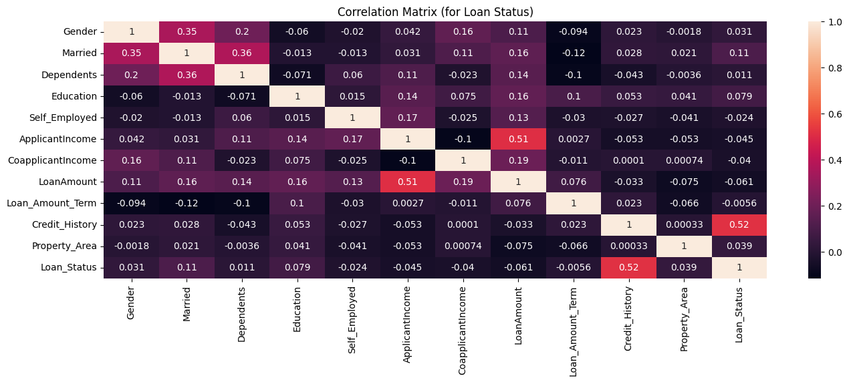

Slide 11
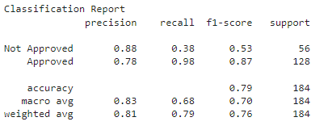
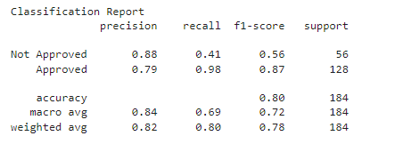
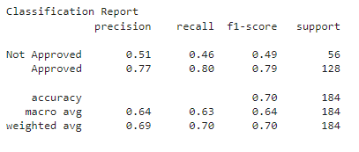
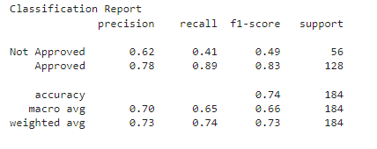
Model Building
Logistic Regression
Support Vector Machine
Decision Tree
K-Nearest Neighbors

Slide 12
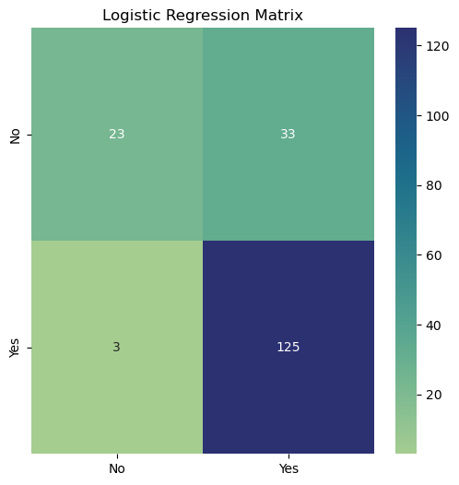
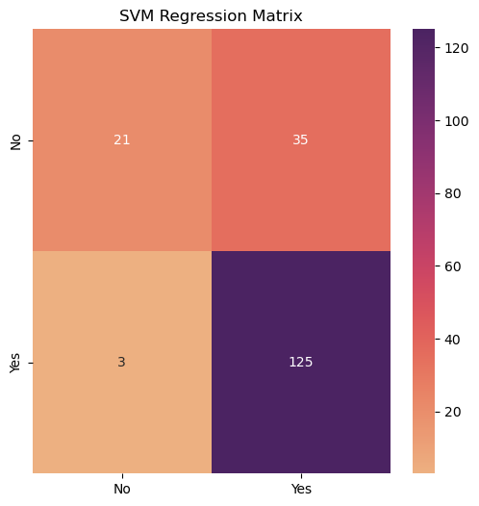
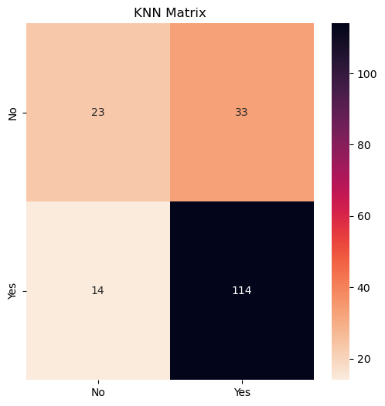
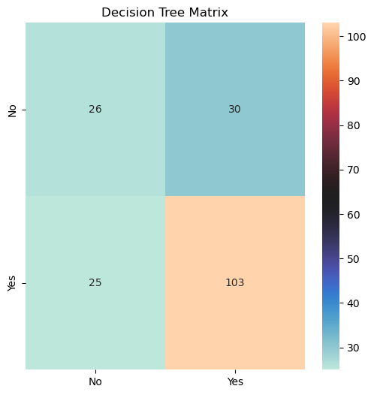
Model Building cont.
Model Accuracy
0 Logistic Regression 80.434783
1 SVM 79.347826
3 KNN 74.456522
2 Decision Tree 68.478261

Slide 13
Conclusion
As for the machine learning algorithm, we tested a few models such as Logistic Regression, Support Vector Machine, Decision Tree, and K-Nearest Neighbors and it suggests that the Logistic Regression algorithm gives us the maximum accuracy of 79%. Compared to the other 3 Machine Learning Classification Algorithms, the logistic regression model fits best overall.

