Slide 1
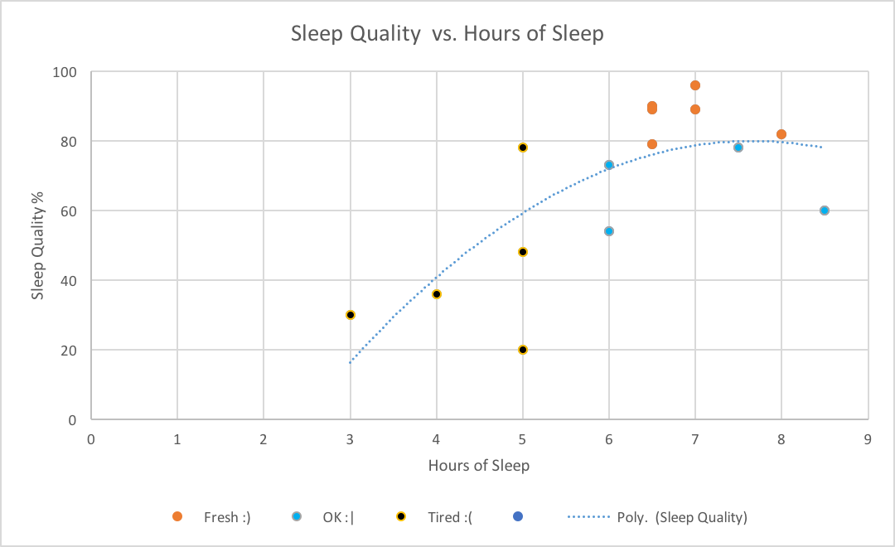
Wake up Mood Prediction
Victoria is going to sleep about
7 hours tonight. Predict her
mood when she wakes up
tomorrow morning.
Sleep Quality %
Mood
75 - 100
Fresh ☺
50 - 75
OK 😐
0 - 50
Tired ☹
Iman Rezaei

