Slide 1
Basic Concepts of Statistics

Slide 2
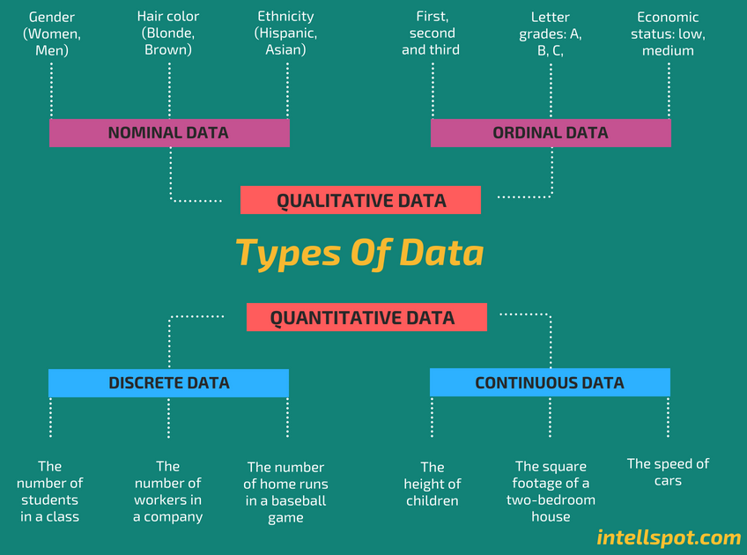

Slide 3
Qualitative Data Types
Qualitative data represent categories or labels and can't be measured in a numerical way.
Nominal Data
Nominal data represents categories with no inherent order or ranking.
Example: Hair color (e.g., red, brown, blonde)
Ordinal Data:
Ordinal data has categories with a meaningful order or ranking.
Example: Education level (e.g., high school, college, graduate)

Slide 4
Quantitative Data Types
Quantitative data represent measurable quantities and can be expressed in numerical terms.
Discrete Data:
Discrete data can only take specific, distinct values with no values in between.
Example: Number of cars in a parking lot (1, 2, 3, ...)
Continuous Data:
Continuous data can take any value within a given range and can be divided into smaller parts, including decimal values.
Example: Height of individuals (can be any value within a range, e.g., 150.5 cm, 163.2 cm, ...)

Slide 5
Discrete Vs continuous data
Discrete data (countable) is information that can only take certain values. These values don’t have to be whole numbers, but they are fixed values – such as shoe size, number of teeth, number of kids, etc.
Discrete data includes discrete variables that are finite, numeric, countable, and non-negative integers (5, 10, 15, and so on).
Continuous data (measurable) is data that can take any value. Height, weight, temperature and length are all examples of continuous data.
Continuous data changes over time and can have different values at different time intervals like weight of a person.

Slide 6
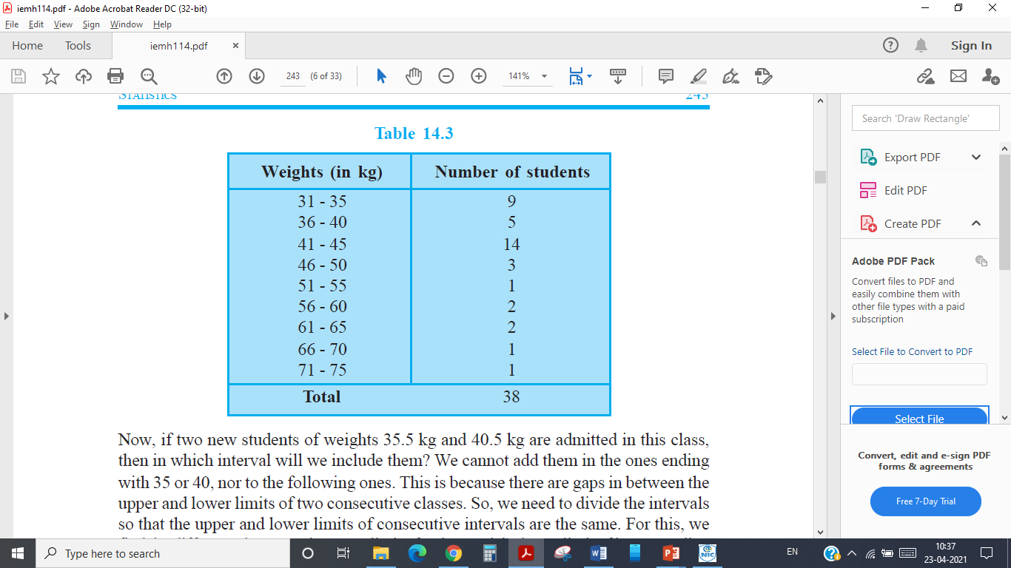
Frequency distribution
Frequency distribution refers to data classified on the basis of some variable that can be measured such as prices, weight, height, wages etc.

Slide 7
Frequency distribution
The following technical terms are important when a continuous frequency distribution is formed
Class limits: Class limits are the lowest and highest values that can be included in a class. For example take the class 51-55. The lowest value of the class is 51 and the highest value is 55. In this class there can be no value lesser than 51 or more than 55. 51 is the lower class limit and 55 is the upper class limit.
Class interval: The difference between the upper and lower limit of a class is known as class interval of that class.
Class frequency: The number of observations corresponding to a particular class is known as the frequency of that class

Slide 8
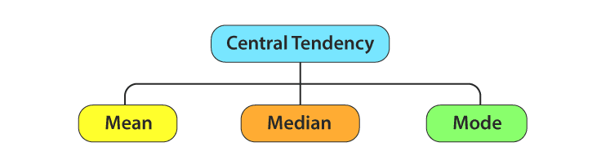
Measures of Centre Tendency
In statistics, the central tendency is the descriptive summary of a data set.
Through the single value from the dataset, it reflects the centre of the data distribution.
Moreover, it does not provide information regarding individual data from the dataset, where it gives a summary of the dataset. Generally, the central tendency of a dataset can be defined using some of the measures in statistics.

Slide 9
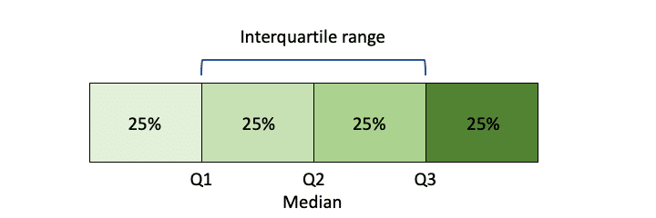
Range
It is the simplest method of measurement of dispersion.
It is defined as the difference between the largest and the smallest item in a given distribution.
Range = Largest item (L) – Smallest item (S)
Interquartile Range
It is defined as the difference between the Upper Quartile and Lower Quartile of a given distribution.
Interquartile Range = Upper Quartile (Q₃)–Lower Quartile(Q₁)

Slide 10
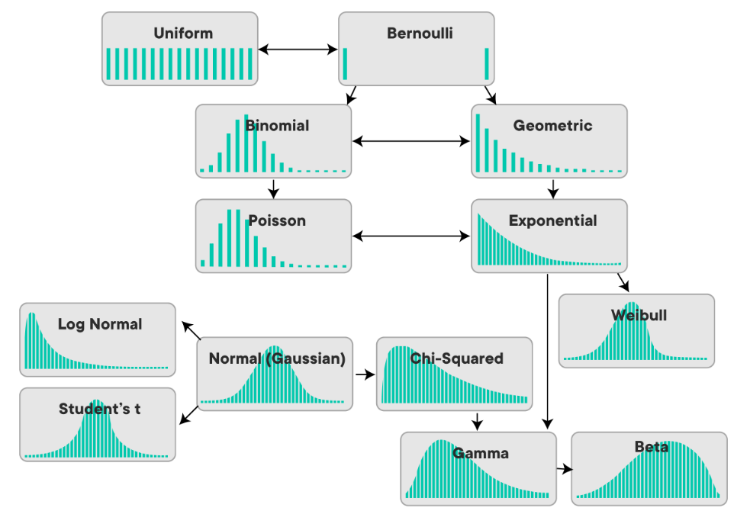
Types of Distributions

Slide 11
Normal Distribution
In probability theory and statistics, the Normal Distribution, also called the Gaussian Distribution, is the most significant continuous probability distribution.
A large number of random variables are either nearly or exactly represented by the normal distribution, in every physical science and economics.
In a normal distribution, the mean, mean and mode are equal.(i.e., Mean = Median= Mode). The normally distributed curve should be symmetric at the centre.

Slide 12
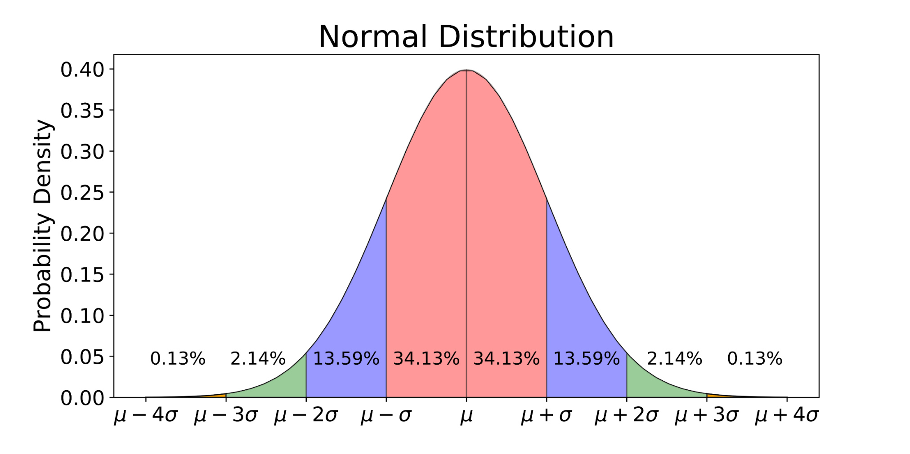
Normal Distribution

