Slide 1

Todos los derechos reservados a “Barones de la Birra S.A. (Sociedad Alcohólica)”
A continuación los actores protagonistas…

Slide 2
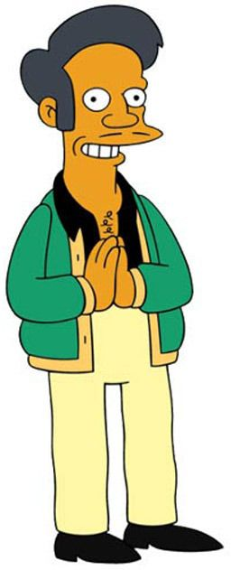
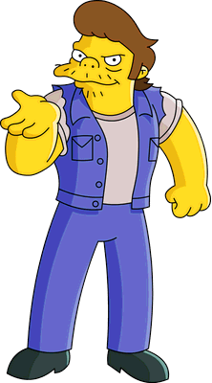
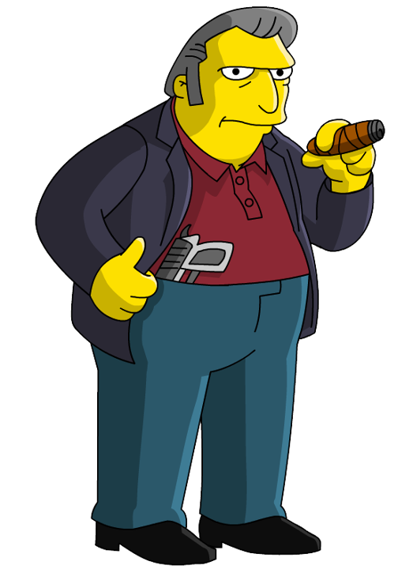
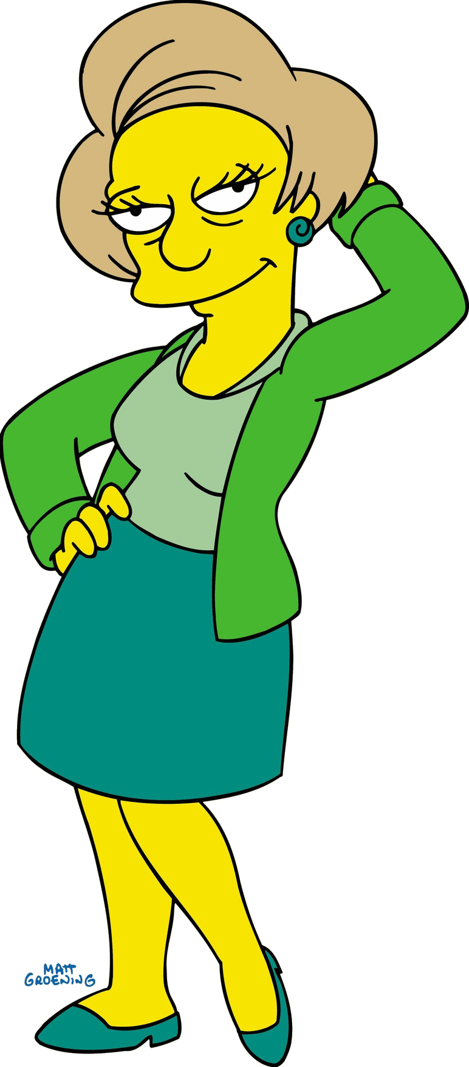
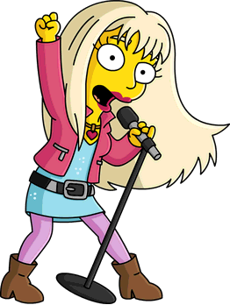
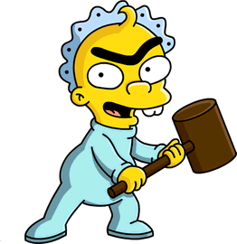
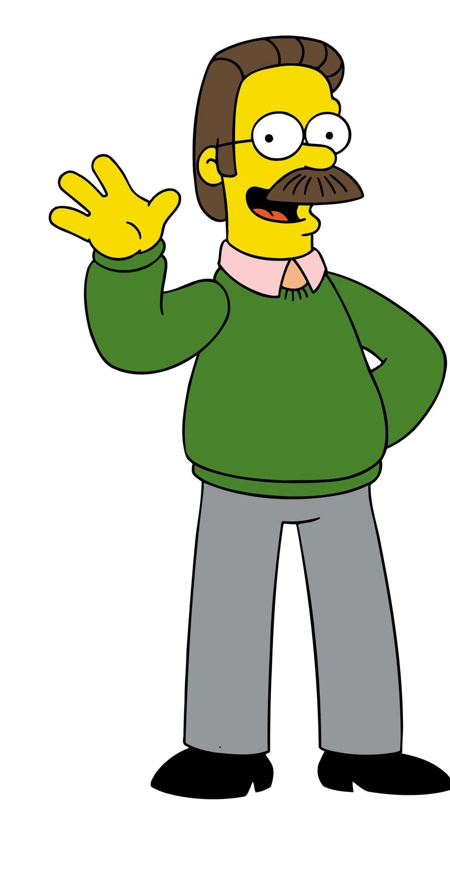
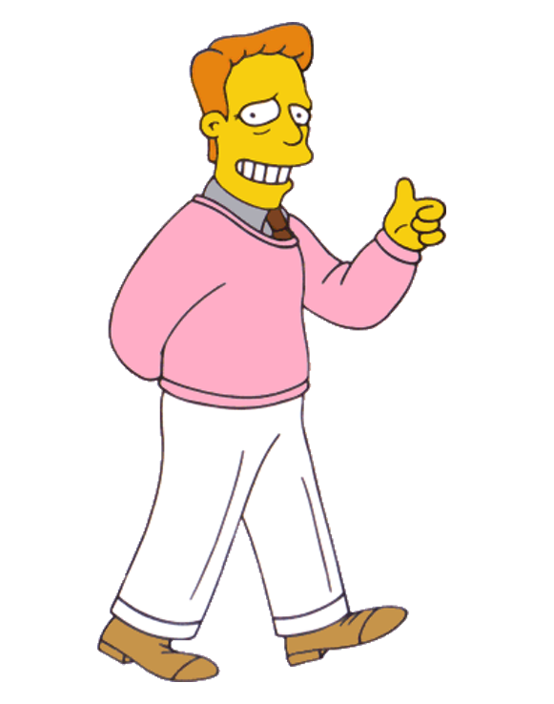
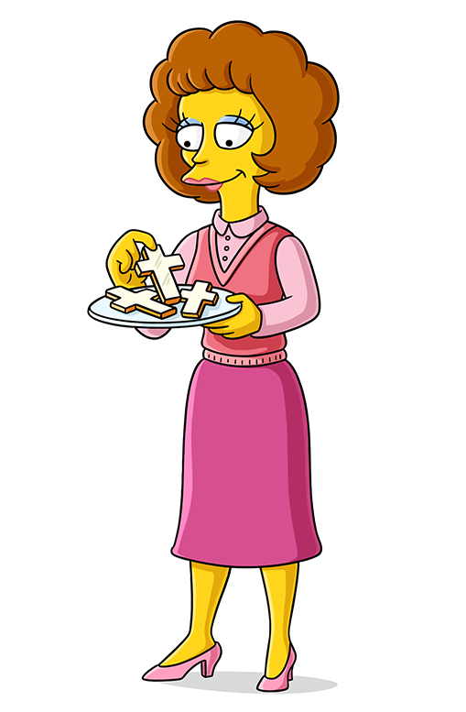
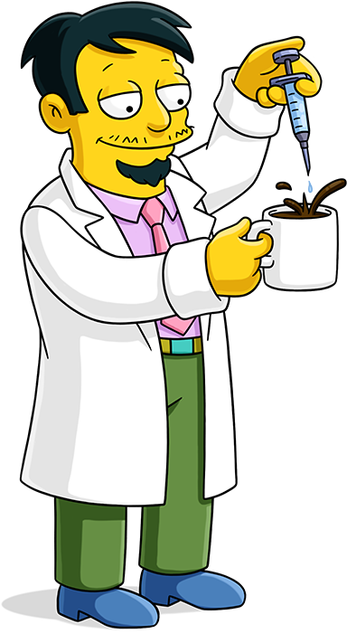
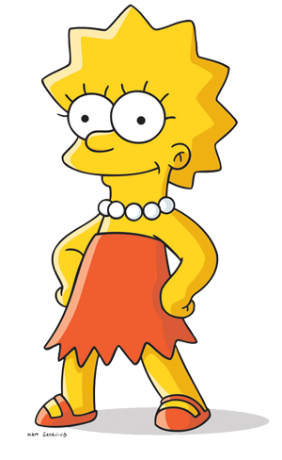

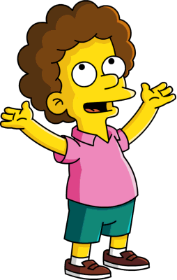
Eneko as
“Snake”
Joni as
“Tony el flaco”, Olivia as “bebé unicejo”
Laura as
“Alaska Nebraska”
Cristian as
“Apu”
Nagore as
“Edna Krabappel”
Oscar as
“Ned Flanders”
Silvia as
“Maude Flanders”,
Hodei as “Rod”, Aimar as “Todd”
Jorge as
“Nick Riviera”
Lorena as
“Lisa Simpson”
Dani as
“Troy Mcclure”

Slide 3
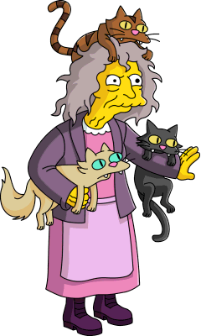
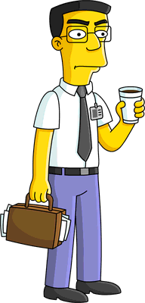
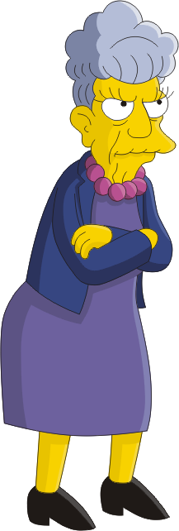
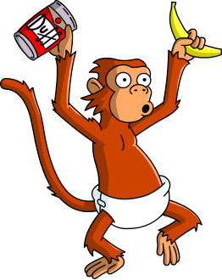
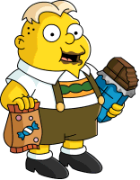
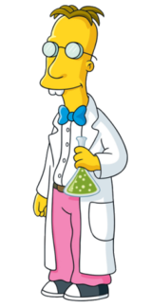
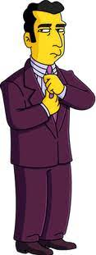
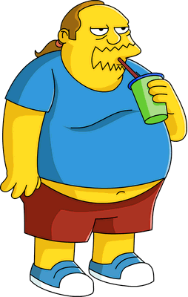
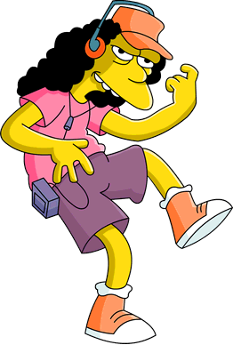
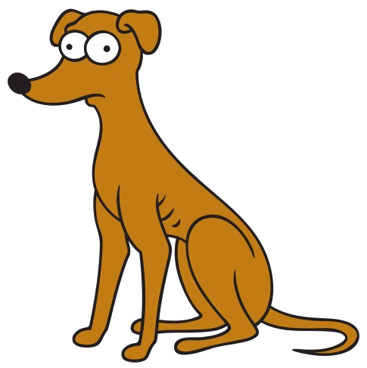
Hector as
“Frank Grimes Jr”
Maite as
“Agnes Skinner”
Martín as
“Mojo”
Imanol as
“Üter”
Esti as
“La loca de los gatos”
Sansón as
“Ayudante de Santa Claus”
David as
“Profesor Frink”
Salas as
“Johnny Labios Sellados”
Mikel as
“Comic Book Guy”
Iker as
“Otto”

