Slide 1
Intelligent Systems: Group 8
Sequence Reinforcement Learning

Slide 2
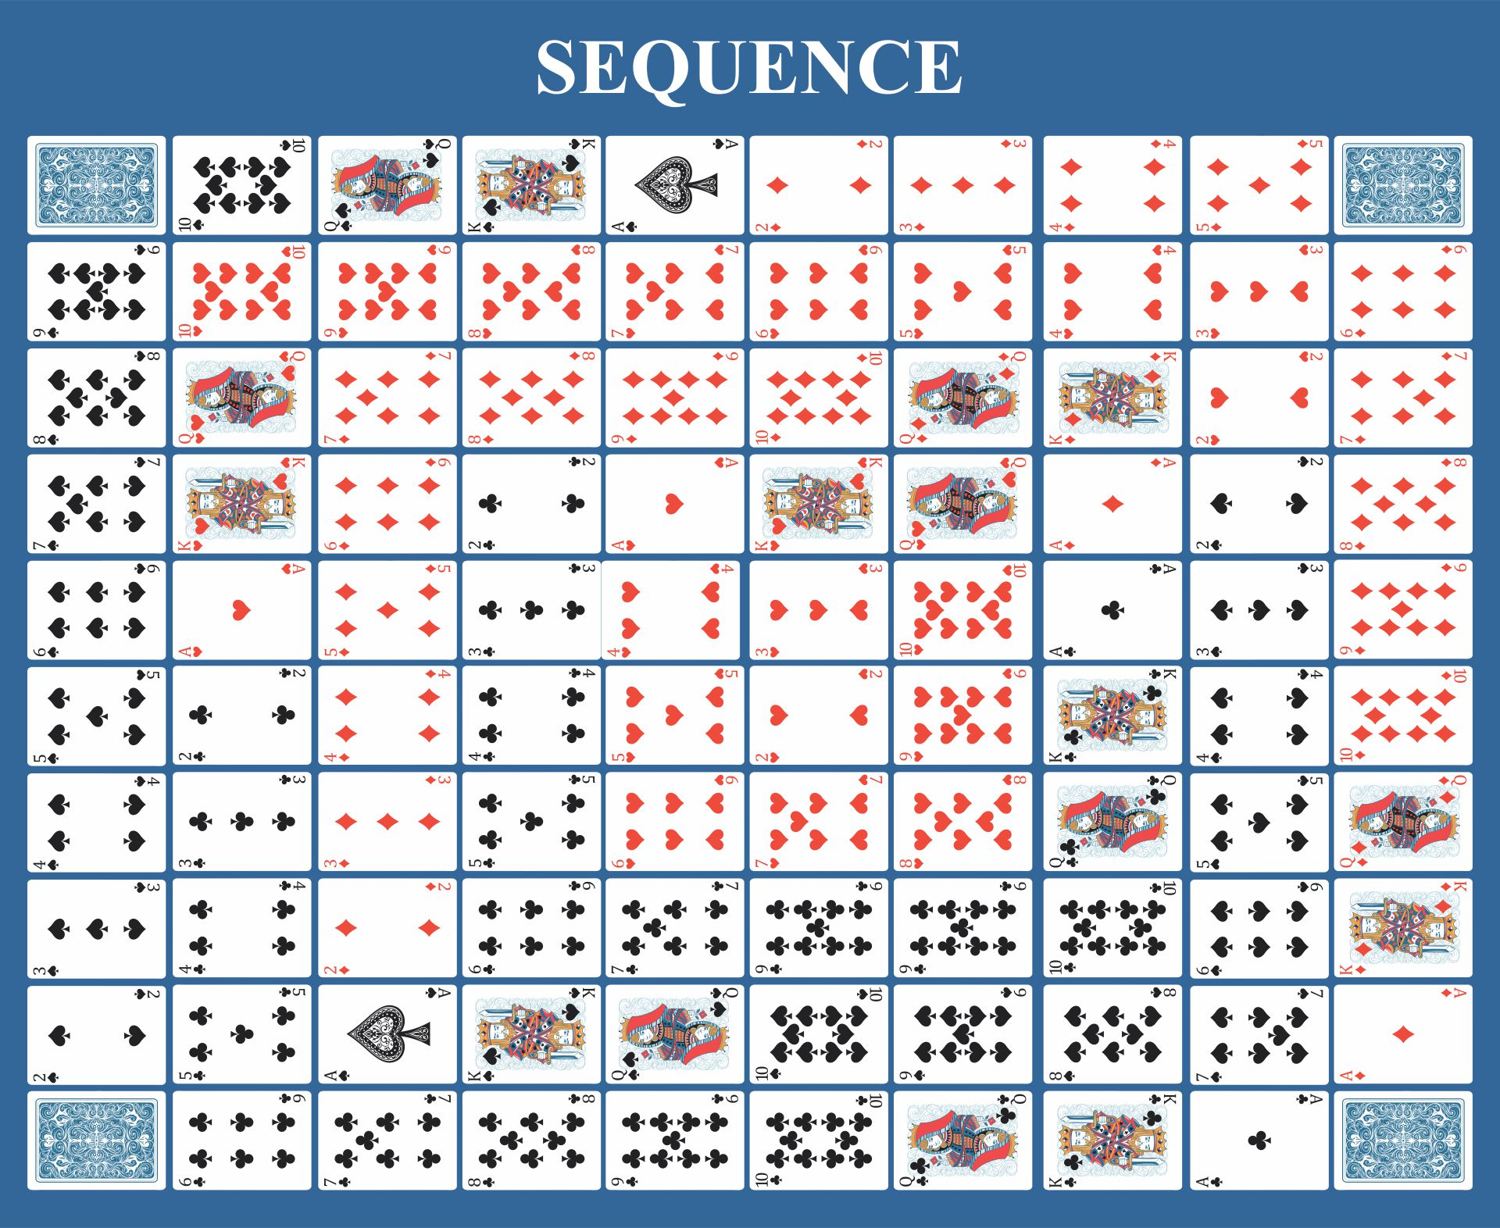
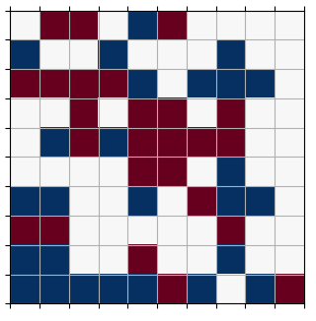
The Game of Sequence
Each player has 5 cards in their hand.
Goals is to get sequence of 5 tokens on the board.
One-eyed Jacks remove opponent's token
Two-eyed Jacks act as wild.
Notes:
Board is 10x10
Slightly simplified model of game.
Very little research on Sequence (None).

Slide 3
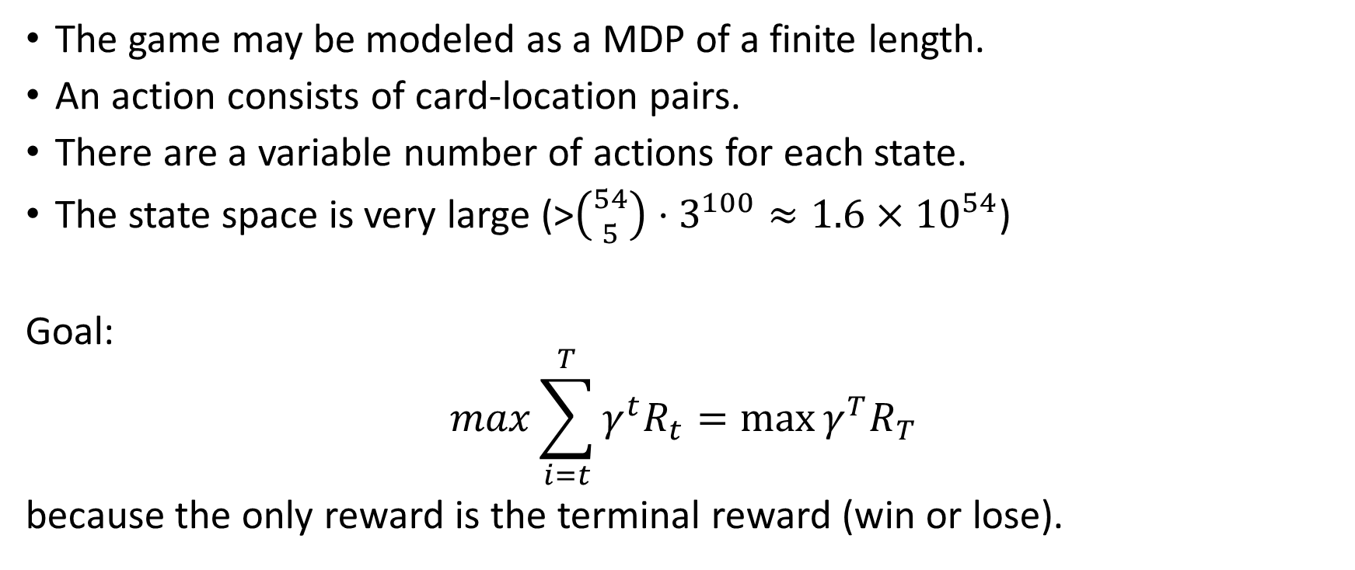
RL Formalism
The game may be modeled as a MDP of a finite length.
An action consists of card-location pairs.
There are a variable number of actions for each state.
The state space is very large (>${\left({54 \atop 5}\right)⋅3}^{100}≈1.6×{10}^{54}$)
Goal:
$$\max{\sum_{i=t}^{T}{γ^{t}R_{t}}}=\max{γ^{T}R_{T}}$$
because the only reward is the terminal reward (win or lose).
Notes:
Not exactly a MDP, but close enough.
Agent must choose one of the actions by scoring each one and picking the best.

Slide 4
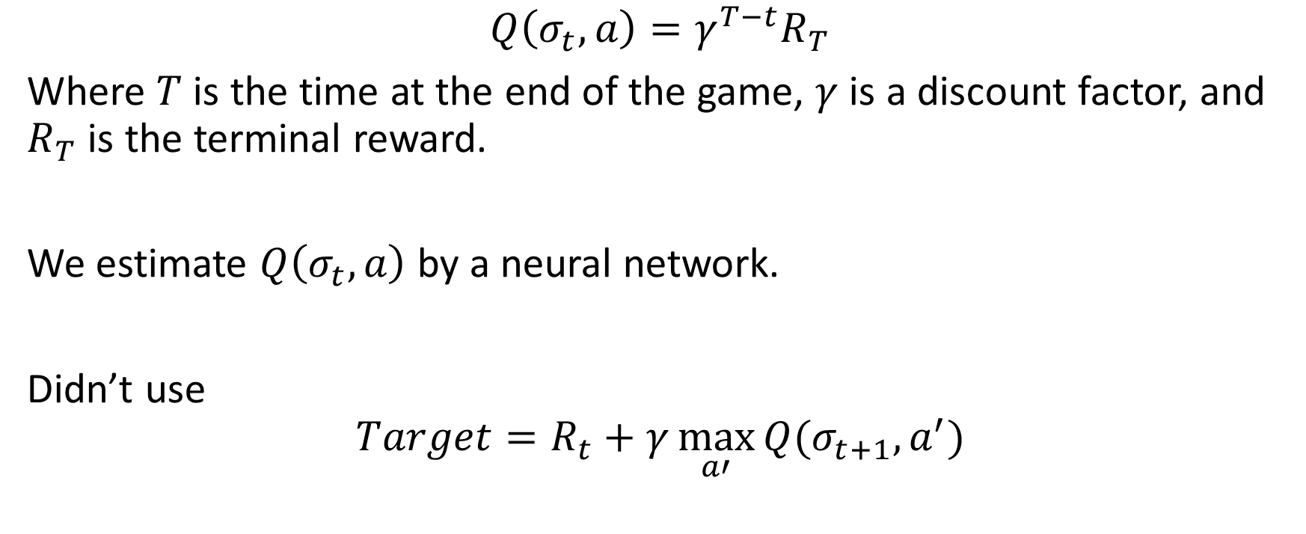
Q-Learning Approach
$$Q\left(σ_{t},a\right)=γ^{T−t}R_{T}$$
Where $T$ is the time at the end of the game, $γ$ is a discount factor, and $R_{T}$ is the terminal reward.
We estimate $Q\left(σ_{t},a\right)$ by a neural network.
Didn’t use
$$Target=R_{t}+γ\max_{a′}{Q(σ_{t+1},a^{′})}$$
Notes:
The difference between this and classical deep Q-learning is that we can calculate $Q\left(σ_{t},a\right)$ exactly since the games are short enough.

Slide 5
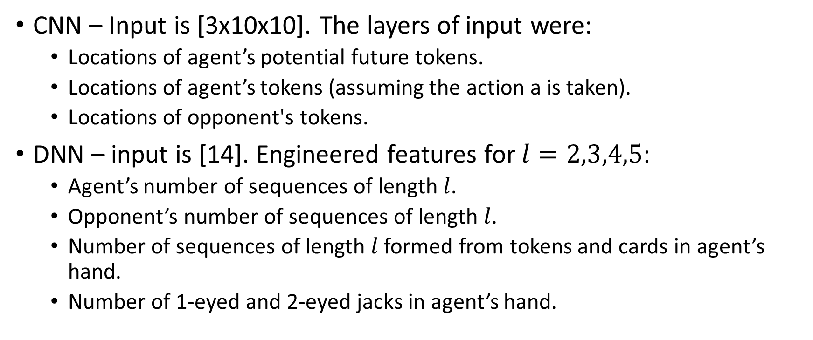
Models
CNN – Input is [3x10x10]. The layers of input were:
Locations of agent’s potential future tokens.
Locations of agent’s tokens (assuming the action a is taken).
Locations of opponent's tokens.
DNN – input is [14]. Engineered features for $l=2,3,4,5$:
Agent’s number of sequences of length $l$.
Opponent’s number of sequences of length $l$.
Number of sequences of length $l$ formed from tokens and cards in agent’s hand.
Number of 1-eyed and 2-eyed jacks in agent’s hand.
Notes:
Conv net had 2 conv layers with max pooling and 2 dense layers with ReLU.
Features were found via convolution. Single layer for DNN.

Slide 6
Experiments
We considered 5 agents:
R: chooses moves randomly.
E: chooses moves according to an engineered heuristic function.
QD: chooses moves according to the Q-learning dense network.
QC: chooses moves according to the Q-learning CNN network.
H: humans choose moves.
Agents play against each other.
Notes:
Performed statistical tests to determine if one agent was better than another.

Slide 7
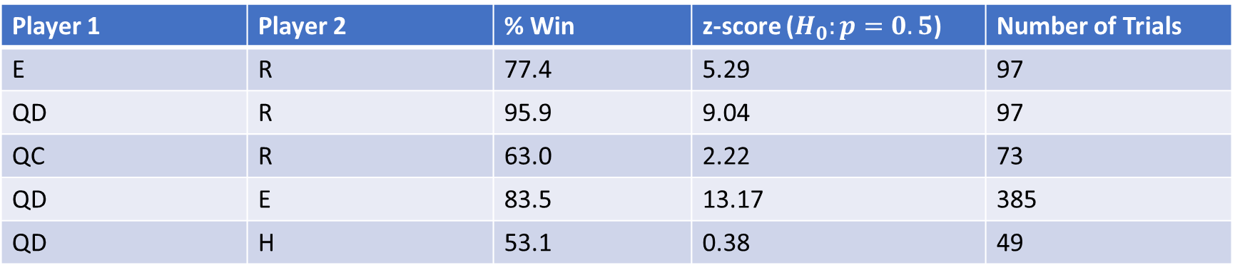
Results
Player 1 | Player 2 | % Win | z-score ($H_{0}:p=0.5$) | Number of Trials
E | R | 77.4 | 5.29 | 97
QD | R | 95.9 | 9.04 | 97
QC | R | 63.0 | 2.22 | 73
QD | E | 83.5 | 13.17 | 385
QD | H | 53.1 | 0.38 | 49
*There is a significant amount of randomness involved in sequence so no player should have a 100% win-rate.

Slide 8
Conclusions
Q-learner DNN worked very well.
CNN requires more training and optimization
Adam optimizer worked much better than SGD
Notes:
The CNN approach may have greater potential but is more complicated. More training and optimization (number of kernels, layers, etc.). Takes longer to run.
In SGD learning rate was not adaptive enough. Adam optimized much better.

