Slide 1
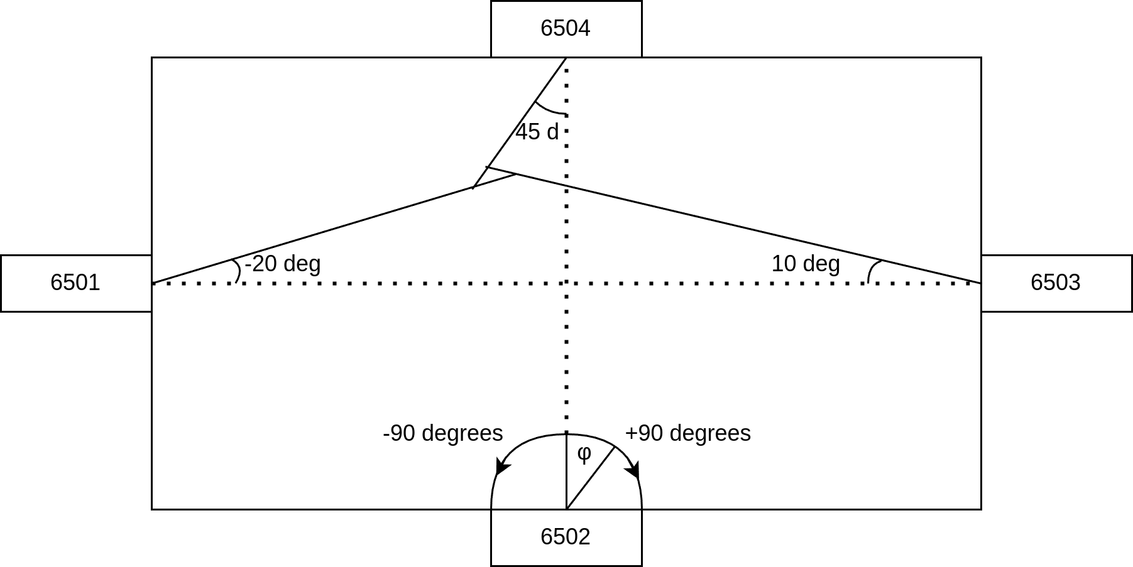
Angle Reading

Slide 2
Intersection between two points
Inputs are p(x0, y0) anchor position and φ, the angle reading
Convert the line representation to y = m*x + b
m = tan(φ), b = y0 - m*x0
Two line point intersection is solved by
x = (b2-b1) / (m1 - m2)
y = m1*x + b1

Slide 3
Finding Average Point
Due to noise, more than two lines never intersect
Find common point of line pairs
p_6501_6502, p_6502_6503, etc…
Find Average point between those to get an estimation

