Slide 1

Autoencoders

Slide 2
Deep Learning
Welcome to the Autoencoders section of the course!
Our use of autoencoders falls under unsupervised learning.
Let’s quickly review what applications we will use autoencoders for and why this is unsupervised learning.

Slide 3
Deep Learning
We will use autoencoders for dimensionality reduction and noise removal.
During the training of certain models, we will sometimes use historical data with correct labels, however during the actual use of the model, we won’t be able to use our previous evaluation metrics.

Slide 4
Deep Learning
Unsupervised learning means we won’t have “correct” labels to compare our results to.
Our use cases for autoencoders in this section are sometimes called semi-supervised.

Slide 5
Deep Learning
Semi-supervised because we have the ability to use correct labels during the training of the autoencoder, but actually using the autoencoder we can’t produce metrics such as accuracy or RMSE.

Slide 6
Deep Learning
To fully understand this, we need to first understand how autoencoders work!
Let’s explore the basics of autoencoders in the next lecture.

Slide 7
Autoencoder Basics

Slide 8
Deep Learning
The autoencoder is actually a very simple neural network and will feel similar to a multi-layer perceptron model.
It is designed to reproduce its input at the output layer.

Slide 9
Deep Learning
The key difference between an autoencoder and a typical MLP network is that the number of input neurons is equal to the number of output neurons.
Let’s explore what this looks like and why we would use it!

Slide 10
Example Autoencoder

Slide 11
Deep Learning
Let’s walk through the layers and explain the basic idea of an autoencoder.

Slide 12
Deep Learning
Let’s simplify this even further with just a single hidden layer.

Slide 13
Deep Learning
In order to produce the same output at the final layer, the internal hidden layers must learn what features are important.

Slide 14
Deep Learning
Here we see a design of 5 dimensions reduced to 2 dimensions, then expanded back to the original 5.

Slide 15
Deep Learning
Outputs
Feed forward network trained to reproduce its input at the output layer.
Hidden
Inputs

Slide 16
Deep Learning
Outputs
Output size is the same as the input layer.
Hidden
Inputs

Slide 17
Deep Learning
Outputs
The hidden representation attempts to maintain the important input information.
Hidden
Inputs

Slide 18
Deep Learning
Outputs
We can then use the hidden layer to extract meaningful insights.
Hidden
Inputs

Slide 19
Deep Learning
Outputs
This idea is extremely similar to PCA - Principal Component Analysis!
Hidden
Inputs

Slide 20
Deep Learning
Outputs
We can then explore stacked autoencoders with more hidden layers.
Hidden 3
Hidden 2
Hidden 1
Inputs

Slide 21
Deep Learning
Important Note!
The hidden layer is NOT simply sub-selecting only certain features.
Its calculating combinations of the original features represent the original data in a reduced dimensional space.

Slide 22
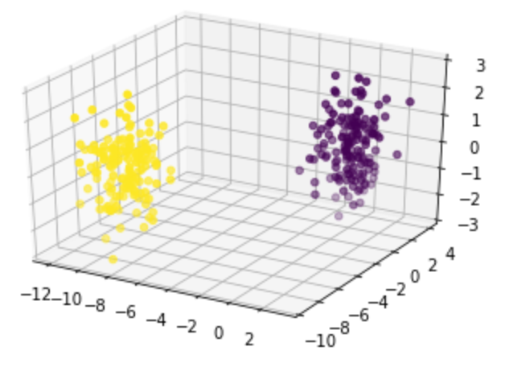
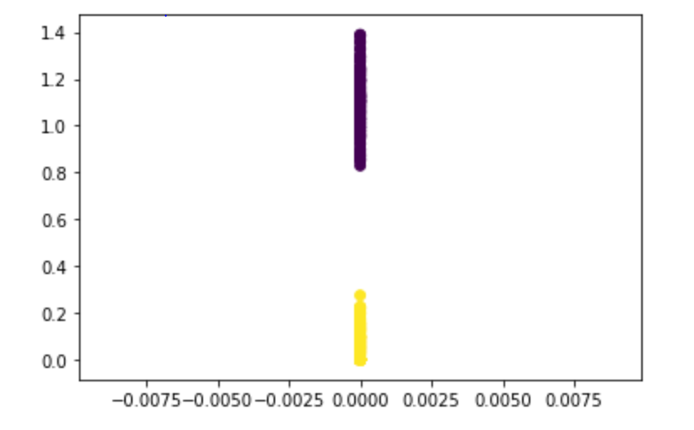
Deep Learning
Dimensionality Reduction

Slide 23
Deep Learning
The main idea behind an autoencoder:
The center hidden layer reduced the dimensionality to learn the most important combinations of original features.

Slide 24
Deep Learning
We’ll explore 2 use cases:
Dimensionality Reduction
Noise Removal

Slide 25
Autoencoders for Dimensionality Reduction

Slide 26
Deep Learning
We can use an autoencoder for dimensionality reduction by separating it out into 2 parts:
Encoder
Decoder

Slide 27
Example Autoencoder

Slide 28
Example Autoencoder
ENCODER
DECODER

Slide 29
Example Autoencoder
ENCODER

Slide 30
Deep Learning
This encoder can now successfully reduce dimensionality of the original data by taking combinations of the original features.
What use cases does this have?

Slide 31
Deep Learning
Dimensionality Reduction
Compress data
Visualize data in lower dimensions
Reveal hidden relationships not clearly seen in higher dimensions

Slide 32
Deep Learning
Dimensionality Reduction

Slide 33
Autoencoders on
Image Data

Slide 34
Deep Learning
We’ve already seen that even simple images are high dimensional data sets.
Recall a simple 28x28 image has 784 features/dimensions.

Slide 35


Deep Learning
Inputs
Outputs
Hidden
Hidden
Hidden

Slide 36
Deep Learning
We now have an autoencoder that understands what features of the 784 are important and which are not.
For example, it likely understands that pixels on the edge don’t matter.

Slide 37
Deep Learning
We can use this same logic to create an autoencoder that removes noise, since the autoencoder knows what features are important.

Slide 38
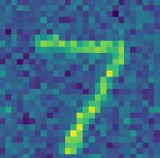
Deep Learning
Inputs
Outputs
Hidden
Hidden
Hidden

Slide 39
Deep Learning
Let’s explore 2 autoencoders
Attempt to recreate input images in the output.
Remove noise from input images to accurately reproduce output.

Slide 40
Autoencoders Exercise

Slide 41
Deep Learning
The purpose of this exercise is to answer the following question:
“Given a data set of average eating habits between countries in the United Kingdom, does any particular country stand out as different?”

Slide 42
Autoencoders Exercise
Solutions

