Slide 1
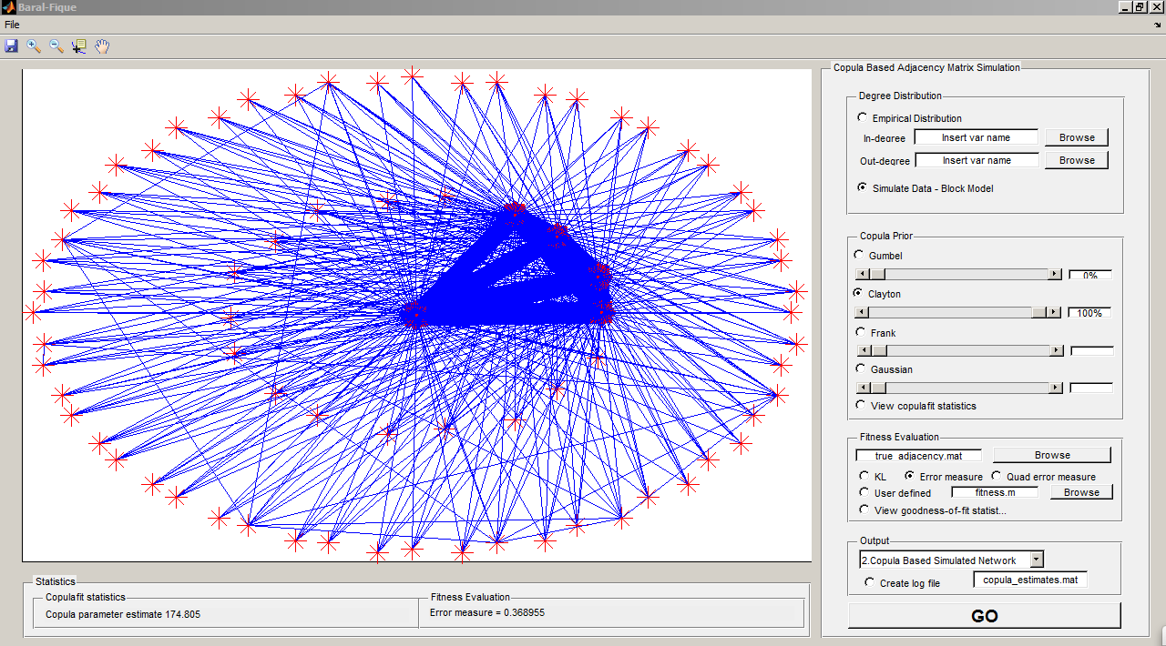
Import marginals as two .mat vectors
As of now, only Gumbel and Clayton copula families fit estimation works. Use 100% of Gumbel or 100% of Clayton
Log file not operational yet
Error measure=sum(abs(^m_{ij}-m_true_{ij}))/sum(sum(m_true_{ij}))
First select all options and then press GO

