Slide 1
Fraud Detection in Credit Card Transactions
Machine Learning Approaches & Implementations
Presenter
Iman Zabett

Slide 2
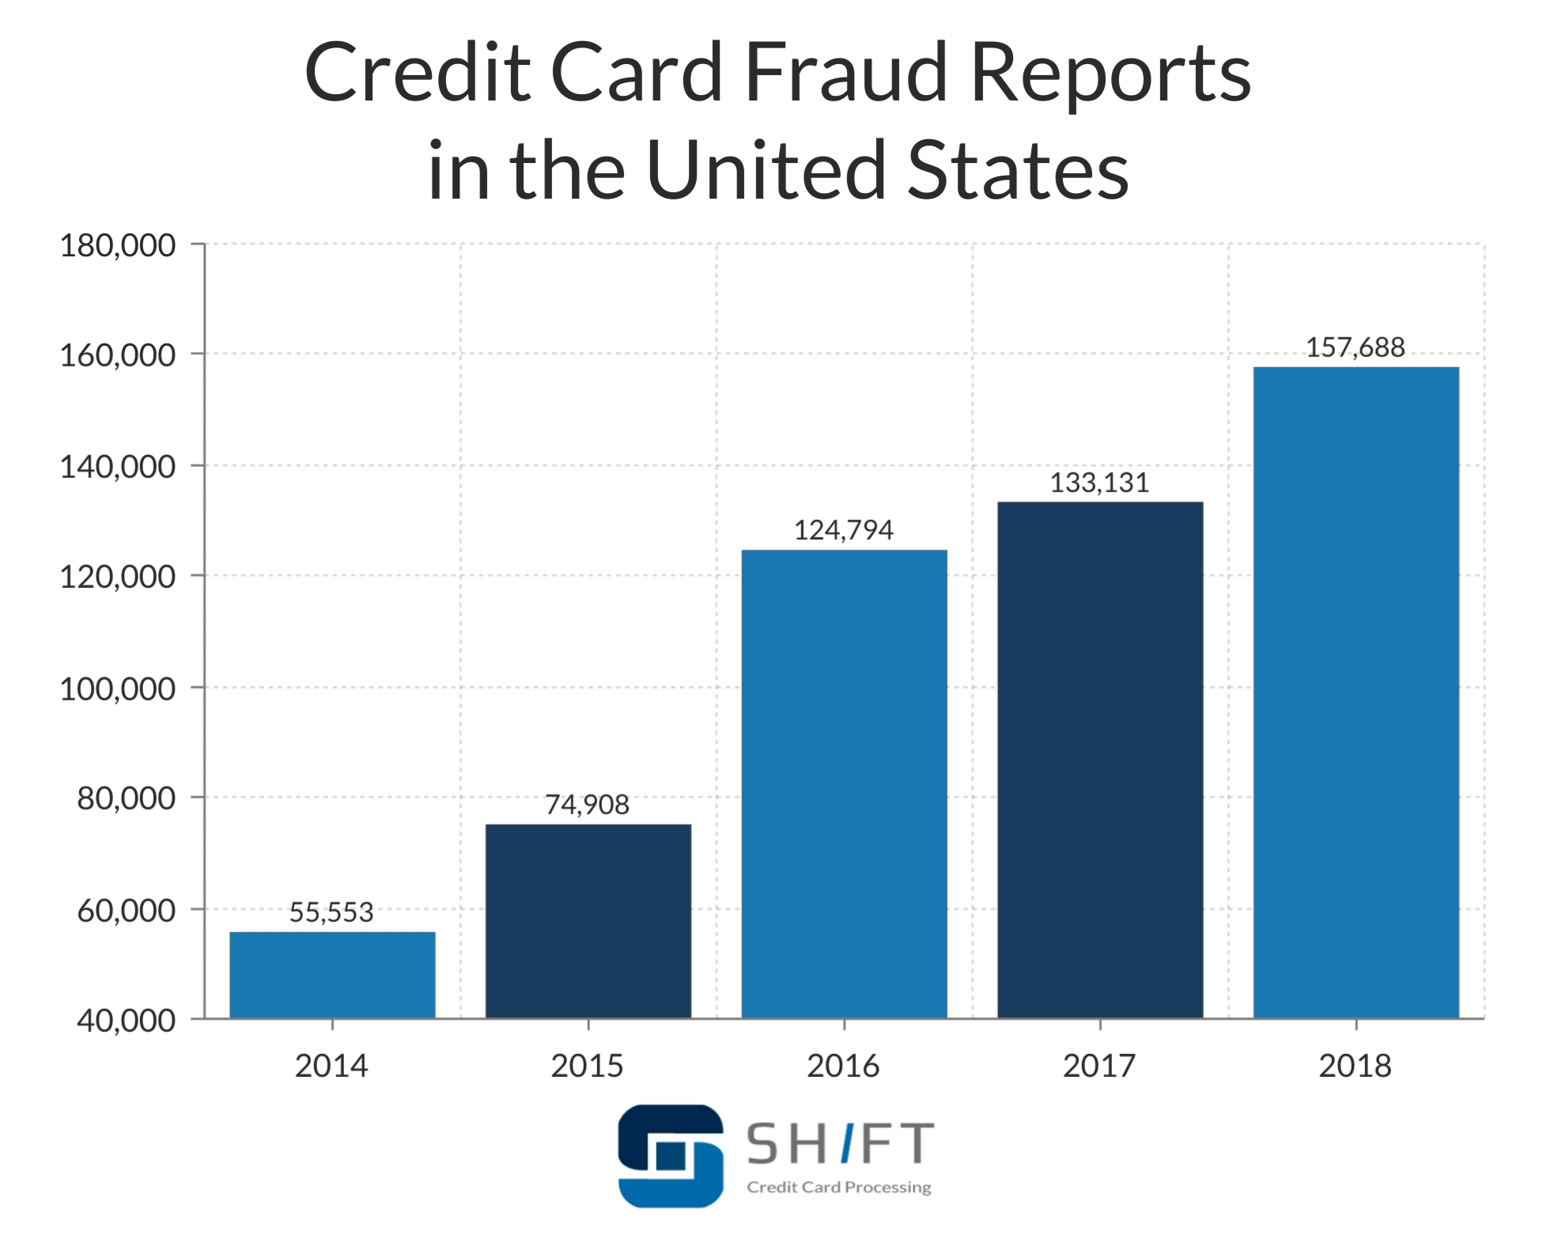
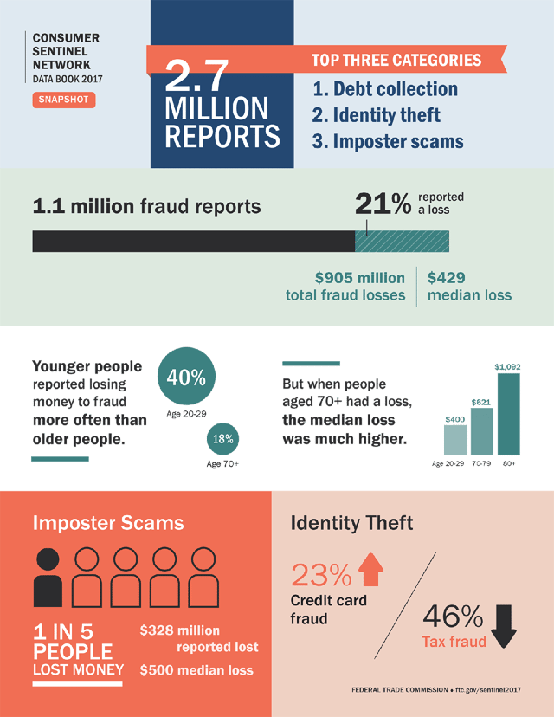
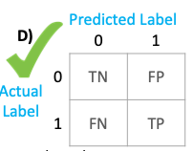
Credit Card Fraud Detection Problem
Why it is a problem?
What is Credit Card Fraud?
Credit Card Fraud Detection Problem
Highly sophisticated and hard to find pattern (nearly random)
Highly imbalance
True Positive: The fraud cases that the model predicted as ‘fraud.’
False Positive: The non-fraud cases that the model predicted as ‘fraud.’
True Negative: The non-fraud cases that the model predicted as ‘non-fraud.’
False Negative: The fraud cases that the model predicted as ‘non-fraud.
Source: https://shiftprocessing.com/credit-card-fraud-statistics/

Slide 3
Fraud detection Approaches
General Approaches Machine Learning Approaches
1. Numerical tests (Forensic analytics)
Benford’s law test, Z-Score test, duplication test, relative size factor test, same-same-same test, same-same-different test
2. Advanced data analytical tests
Trend analysis
Gestalt element link (GEL-1, GEL-2)
3. IF-THEN Rules (Expert Rules)
Purpose is to use facts and rules, taken from the knowledge of many human experts, to help make decisions.”
Example of rules
More than 4 ATM transactions in one hour?
More than 2 transactions in 5 minutes?
Magnetic stripe transaction then internet transaction?
4. Machine Learning approaches
4.1. Supervised
Regression Analysis
Probabilistic Approaches (Bayesian, Hidden Markov)
Tree-based algorithms (Decision Tree)
Ensemble methods (Random Forest, ExtraTrees , Gradient Boost)
4.2. Unsupervised
Isolation Tree, One Class SVM
Clustering (K-Means)
Deep learning (Autoencoder family, GAN family, CNN, RNN, LSTM, …)
4.3 Hybrid / Semi-supervised
Combination of unsupervised and supervised
4.4. Reinforcement Learning
Notes:
Conventional approaches
Tools:
Modern/ ML approaches

Slide 4
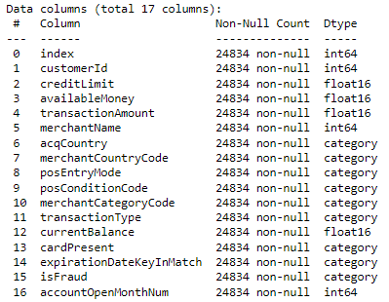
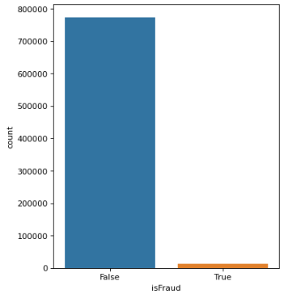
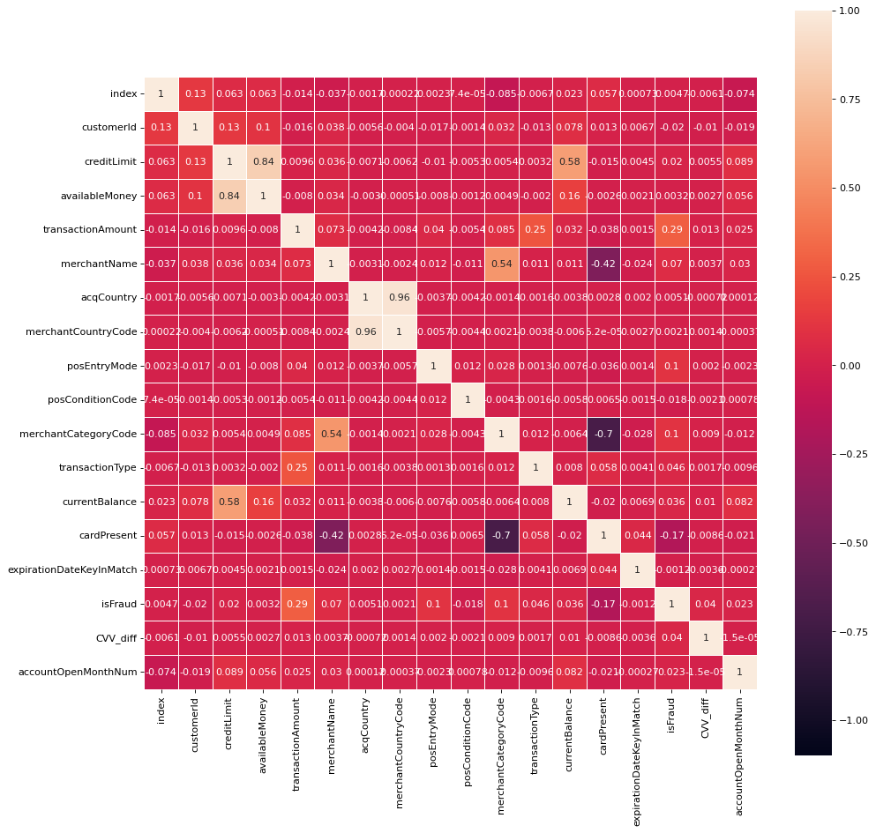
Exploratory Data Analysis (EDA)
EDA
Regression Analysis
Predictive Models
We Need Insight from Dataset
Sampling Methods
Overview of Dataset
Preprocessing
drop unnecessary columns
drop NaN
Data Type conversions
Descriptive Statistics
Defining Unique values for categorical features
Min, Max, Mean, Median, …
Histogram, Correlations and multilinearity
Modality: Unimodal, Multimodal distributions
Boxplot: standard deviation, interquartiles, and outliers
Transformations
Sampling Data (under-/over-sampling, SMOTE)s
Normality: Boxcox transformations
Label encoding
Feature Engineering
Crafting new features
Identifying the most important features
Adding/dropping features to Dataset
Memory Optimization
Selecting and Optimizing Data types
Notes:
The data analysis aims to provide some useful insights from the dataset and relationships among the variables. This is a crucial part of data science project. It provides the necessary insights and understanding on dataset which we will be used for future steps such as feature engineering, model development and evaluation.
Finally after some analysis, the dataset is prepared based on the most important features and necessary transformations to be able to use for machine learning model developments.
Undersampling
Remove a random sample of the majority class events
Oversampling
Duplicate a random sample of the minority class events
SMOTE
Generate events into the minority class

Slide 5
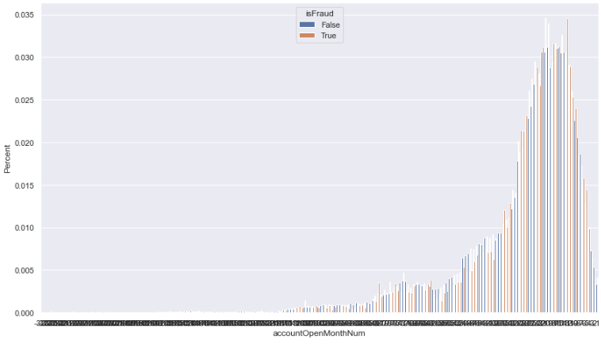
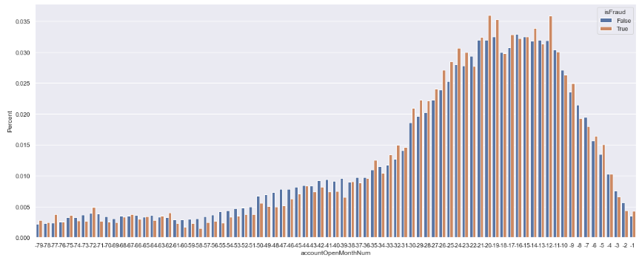
Feature Extraction
EDA
Regression Analysis
Predictive Models
Can we craft useful features?
DateTime Difference Analysis (Adding features)
‘currentExpYear’ (year difference)
‘accountOpenYear’ (year difference)
‘accountOpenMonth’ (month difference, no matter of year difference)
‘accountOpenMonthNum’, (month difference in total, with respect year difference)
dateOfLastAddressChangeYear (year difference)
dateOfLastAddressChangeYear (year difference)

Slide 6


Regression Analysis
EDA
Regression Analysis
Predictive Models
Other way to confirm the significance of predictors?
“isFraud” (output) is binomial distribution. We need Logistic Regression Analysis
Hypothesis testing (H0 and HA)
Statistical Assumptions
Building Model
Model evaluation
Statistical Conclusion Validity
Model
$y=\log\left(\frac{p}{1−p}\right)=β_{0}+β_{1}x_{1}+$ $β_{2}x_{2}+ …+β_{n}x_{n}$
$\hat{y}=y+e=β_{0}+β_{1}x_{1}+$ $β_{2}x_{2}+ …+β_{n}x_{n}$+ $e$
What are the steps?

Slide 7
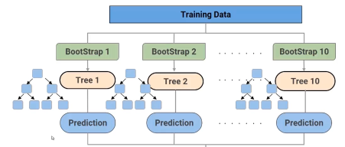
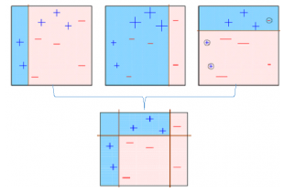

Supervised Methods
EDA
Regression Analysis
Predictive Models
Generalized Linear Model (GLM)
- Link function acts not on the error term and perfect choice for non-normal distributed data
1-GLM without interactions terms
2-GLM with interactions terms
KNN
Decision Tree
Random Forest
Gradient Boosting
$$LF\left(\hat{y}\right)=LF\left(y\right)+e$$
$y=β_{0}+β_{1}x_{1}+$ $β_{2}x_{2}+…$
$y=β_{0}+β_{1}x_{1}+$ $β_{2}x_{2}+β_{12}x_{1}x_{2}+…$
Other methods
Ensemble (Bagging and Boosting)

Slide 8
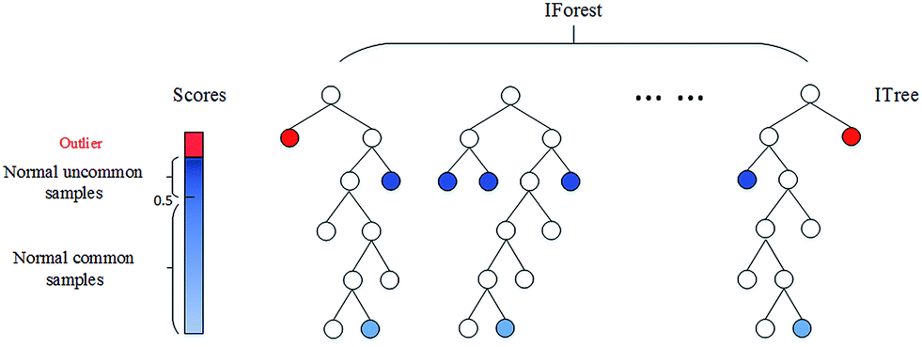
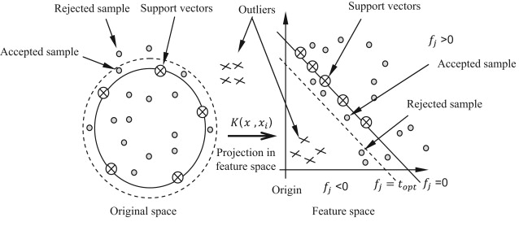
Unsupervised Methods
EDA
Regression Analysis
Predictive Models
Isolation Forest
Calculates scores for observations based on the number of conditions required to separate a given observations.
Normally, the number of conditions for normal observations are much higher than anomalies
Trained only on the “normal” data. In our case negative (legitimate) transactions
It learns boundaries of the normal points and the region can be adjusted
It assumes that outliers (fraud) samples far from the classification boundaries
One Class SVM
Notes:
The Isolation Forest algorithm isolates observations by randomly selecting a feature and then randomly selecting a split value between the maximum and minimum values of the selected feature. The logic argument goes: isolating anomaly observations is easier because only a few conditions are needed to separate those cases from the normal observations. On the other hand, isolating normal observations require more conditions. Therefore, an anomaly score can be calculated as the number of conditions required to separate a given observation.
A One-Class Support Vector Machine is an unsupervised learning algorithm that is trained only on the ‘normal’ data, in our case the negative examples. It learns the boundaries of these points and is therefore able to classify any points that lie outside the boundary as, you guessed it, outliers.

Slide 9
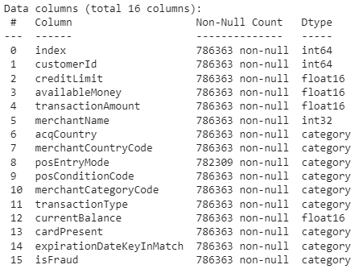
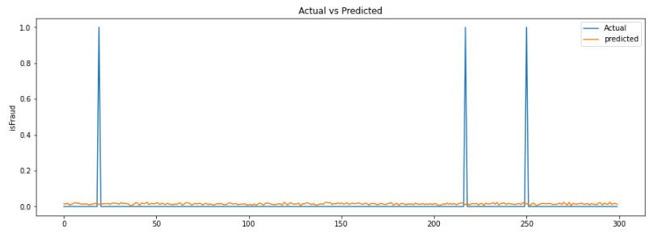
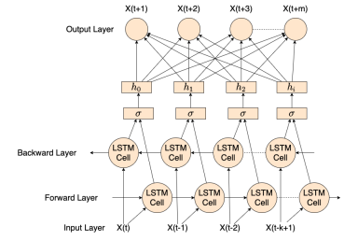
Time Series Analysis using LSTM Network
EDA
Regression Analysis
Predictive Models
Let’s see the data as a Time-Series data
No random sampling
Forming “window” and “horizon”
Bidirectional LSTM Univariate Horizon Style
Notes:
LSTM (Long Short-Term Memory) network is a type of RNN (Recurrent Neural Network) that is widely used for learning sequential data prediction problems. As every other neural network LSTM also has some layers which help it to learn and recognize the pattern for better performance. The basic operation of LSTM can be considered to hold the required information and discard the information which is not required or useful for further prediction.
LSTM is one of the best choice for sequential data and time-series.

Slide 10
Next Steps
Explainable Fraud Detection (Prescriptive Analytics)
Hybrid architectures!
Unsupervised Feature Extraction (DNNs) + Supervised ML
Sample ID | Predicted label | Explanation
****6453 | Legitimate | No abnormal behavior detected
****3294 | Fraud | Type III prototype in August
****2068 | Fraud | Type VI prototype in May and type II prototype in June

Slide 11
Selected References
Fraud Detection Approaches - Review
Shirgave, S., Awati, C., More, R., & Patil, S. (2019). A Review On Credit Card Fraud Detection Using Machine Learning. Int. J. Sci. Technol. Res, 8, 1217-1220
Tiwari, P., Mehta, S., Sakhuja, N., Kumar, J., & Singh, A. K. (2021). Credit Card Fraud Detection using Machine Learning: A Study. arXiv preprint arXiv:2108.10005..
Fraud Detection of Credit Cards using Machine Learning
Awoyemi, J. O., Adetunmbi, A. O., & Oluwadare, S. A. (2017, October). Credit card fraud detection using machine learning techniques: A comparative analysis. In 2017 international conference on computing networking and informatics (ICCNI) (pp. 1-9). IEEE.
Varmedja, D., Karanovic, M., Sladojevic, S., Arsenovic, M., & Anderla, A. (2019, March). Credit card fraud detection-machine learning methods. In 2019 18th International Symposium INFOTEH-JAHORINA (INFOTEH) (pp. 1-5). IEEE
Dornadula, V. N., & Geetha, S. (2019). Credit card fraud detection using machine learning algorithms. Procedia computer science, 165, 631-641.
Maniraj, S. P., Saini, A., Ahmed, S., & Sarkar, S. (2019). Credit card fraud detection using machine learning and data science. International Journal of Engineering Research and, 8(09).
Bidirectional LSTM
Chandra, R., Goyal, S., & Gupta, R. (2021). Evaluation of deep learning models for multi-step ahead time series prediction. IEEE Access, 9, 83105-83123.

Slide 12

Questions / Comments ?

