Slide 1


Equity Market Analysis

Slide 2
Agenda
Market Overview
Top 5 Overview
Market Progression
Share Price Progression
Key Figures & Ratios
Final Overview

Slide 3
Market Overview
Industry Contribution
Company Contribution
Total Capitalization: 1,347,395,441,118.007
Companies Listed: 80
Industries / Market Segments: 11

Slide 4
Top 5 Overview
Alpha Dhabi Holding
Industry – Financial Services / Asset Management
Subsidiaries – ~ 55 (5 Verticals)
TAQA – AD National Energy Co.
Industry – Utilities & Energy
Subsidiaries – 25
Operating in – 11 countries, 4 continents
Intl. Holding Company
Industry – Financial Services / Investment
Subsidiaries – 88 (6 Verticals)
Presence in – 4 continents
First Abu Dhabi Bank
Industry – Financial Institution
Subsidiaries – 27
Presence in – 20 countries, 5 continents
Etisalat Group
Industry – Telecommunications
Subsidiaries – 19
Operating in – 16 countries, 3 continents
Notes:
Key Insights: Low comparability between top 2 and bottom 3
Change market contribution to pie chart
Countries operating in??

Slide 5
ADH
IHC
ETISALAT
FAB
TAQA

Slide 6
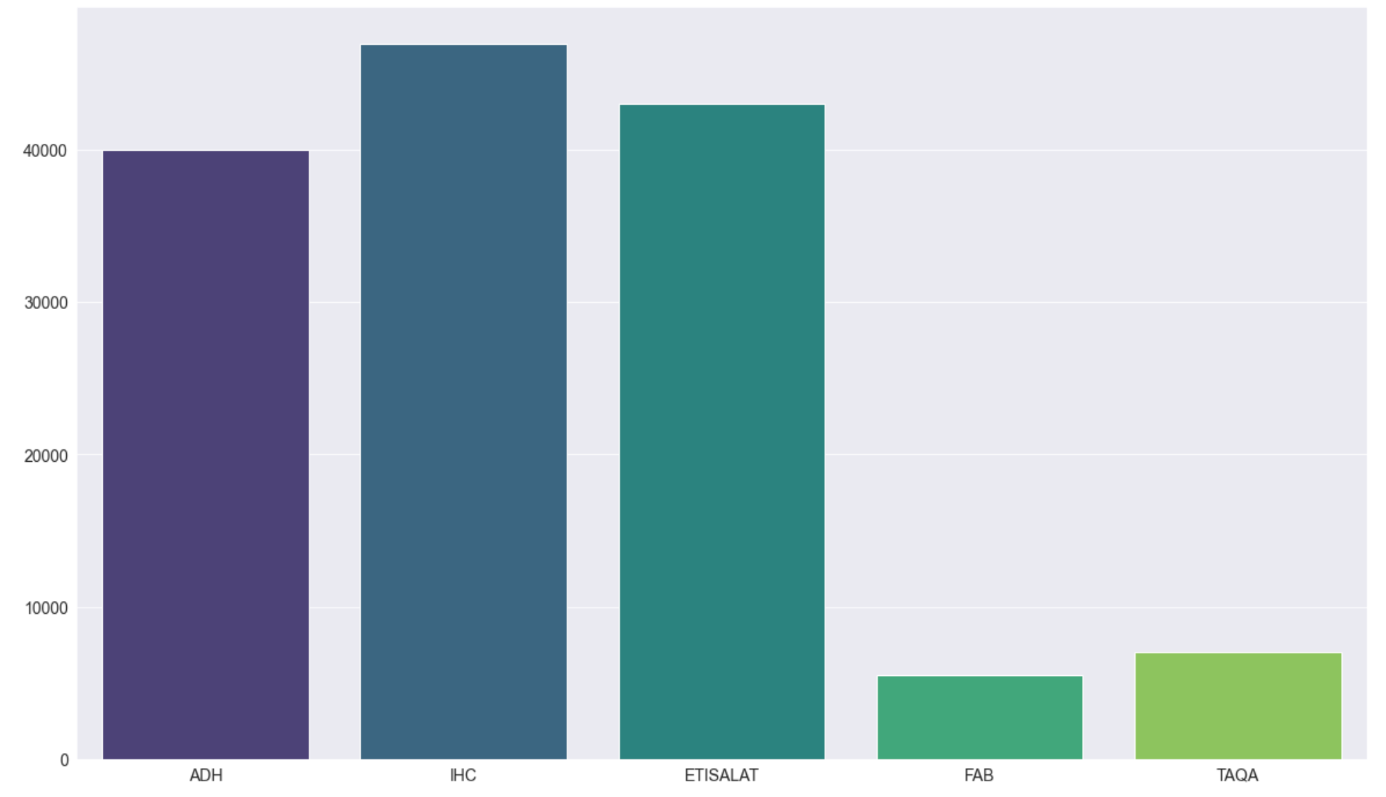
Employee Size (2021)
47,000+
43,000
40,000+
~ 5,500
7,000+
Notes:
Key Insights –
Etisalat operates globally, no. of employees reasonable in context
Alpha likely has similar structure to IHC due to similar industry plus holding influence (40, 000+ Employees; what do companies count in employees? Just group employees? Subsidiary employees?)

Slide 7
Shareholding Information
National (99.4%)
Alpha Dhabi Holding
IHC (44%)
Infinity Wave (44%)
Foreign (0.6%)
National (92.43%)
Intl. Holding Company
PAL Group (66.44%)
Foreign (7.57%)
National (94.51%)
Etisalat Group
Emirates Investment Authority (60%)
Foreign (5.49%)
National (82.92%)
First Abu Dhabi Bank
Mubadala Investment (37%)
Foreign (17.08%)
National (99.96%)
TAQA - AD National Energy Company
ADQ (Holding Company) (98.6%)
Foreign (0.04%)
Notes:
Etisalat – Government owned, will likely remain monopoly / duopoly with du
FAB – state-owned

Slide 8
Trading Information (as of 2 August 2021)
Market Cap:
288.20B
----------
Total Shares:
10B
30-day Avg. Volume: 6.58M
Market Cap:
240.43B
----------
Total Shares:
1.82B
30-day Avg. Volume: 2.98M
Market Cap:
208.37B
----------
Total Shares:
8.70B
30-day Avg. Volume: 1.8M
Free-Float: 12%
Free-Float: 18.4%
Free-Float: 40%
Alpha Dhabi Holding
Intl. Holding Company
Etisalat Group
Market Cap:
182.58B
----------
Total Shares:
10.92B
30-day Avg. Volume: 17.9M
Market Cap:
141.67B
----------
Total Shares:
112.43B
30-day Avg. Volume: 3.2M
Free-Float: 44%
Free-Float: 1.4%
First Abu Dhabi Bank
TAQA – AD National Energy Co.
Notes:
Key Insights:
Alpha, IHC, and TAQA are most risky in the long run (low float)
Alpha original shares = 300k
FAB 15.3% owned by AD ruling family, 30.6% by other GCC and UAE entities / individuals (https://www.bankfab.com/en-ae/about-fab/investor-relations/shareholder-information/share-profile)
Alpha / IHC market share likely different now; effect of pure health acquisition / significant changes in revenue (alpha might have higher share)

Slide 9
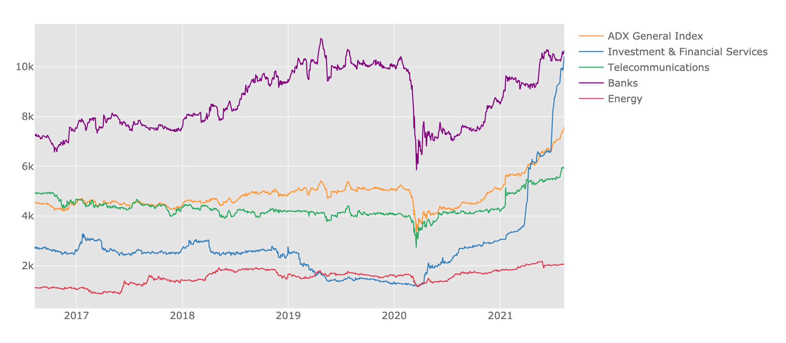
Market Progression (5-year Period)

Slide 10
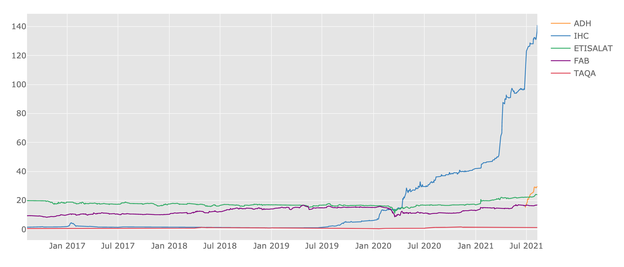
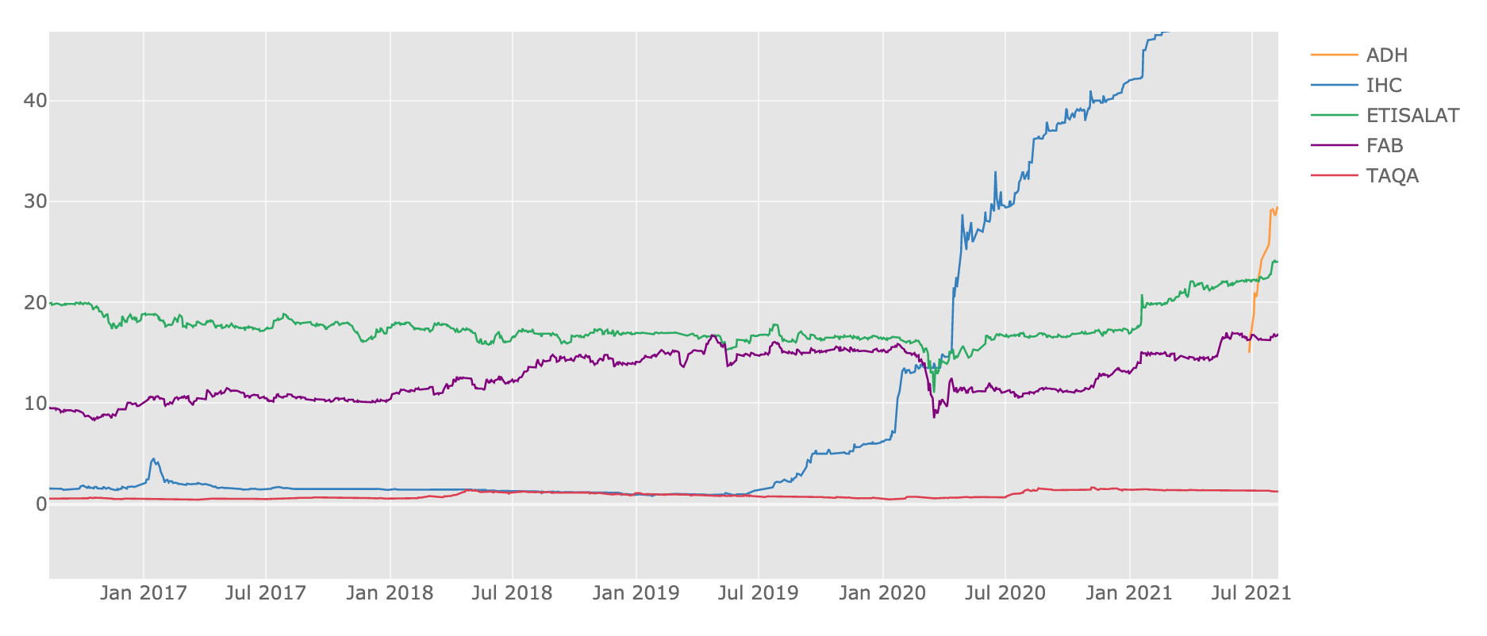
Top 5 Historical Prices (5-year Period)

Slide 11
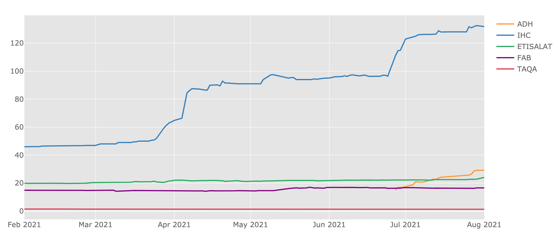
Top 5 Historical Prices (6-month Period)

Slide 12
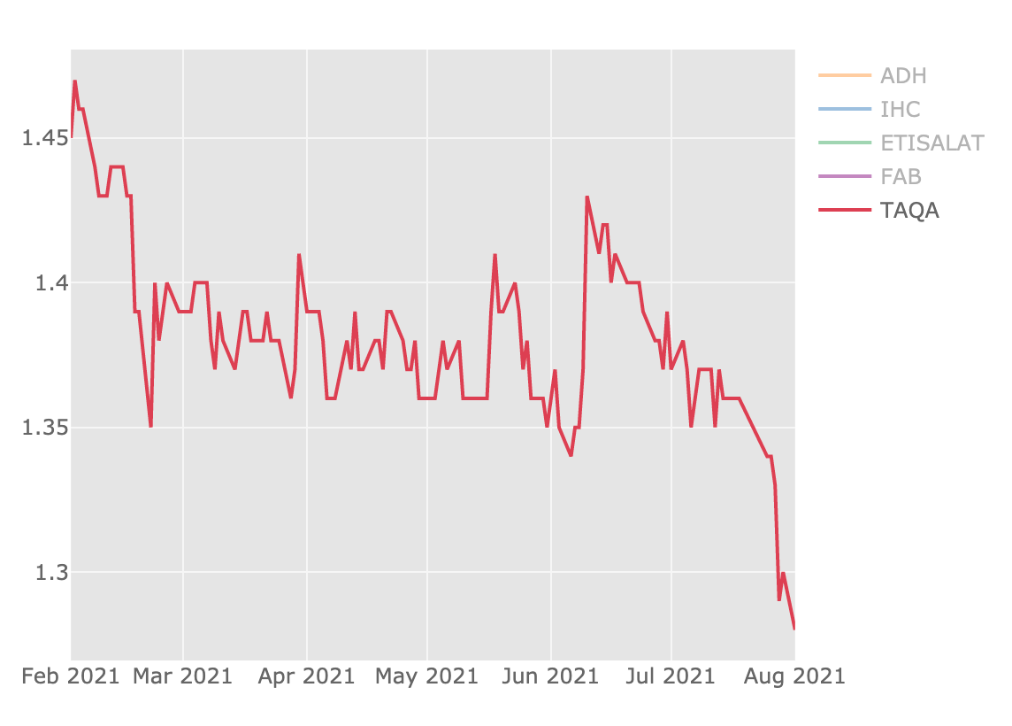
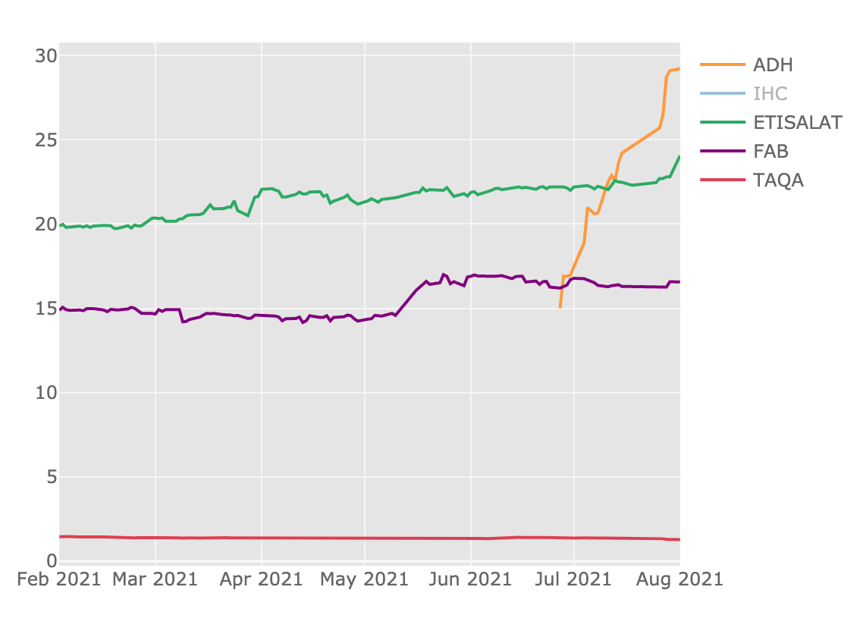
Top 5 Historical Prices (6-month Period)

Slide 13
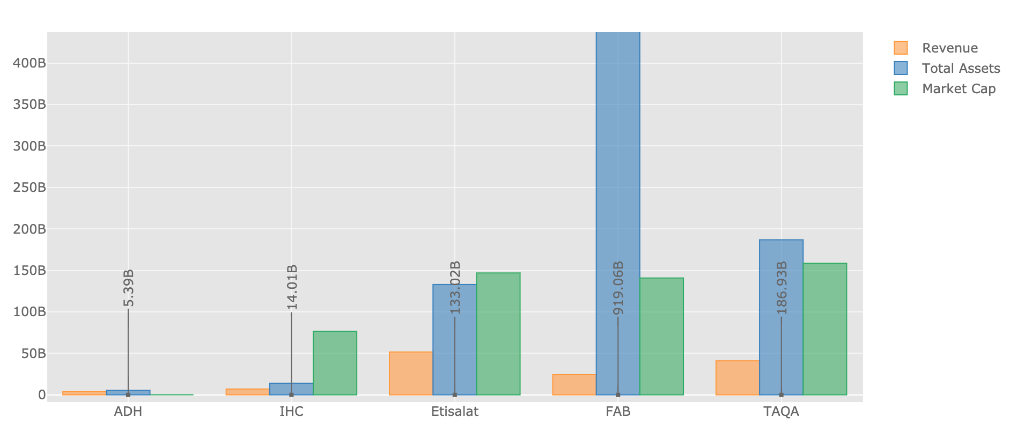

Key Figures (2020)

Slide 14
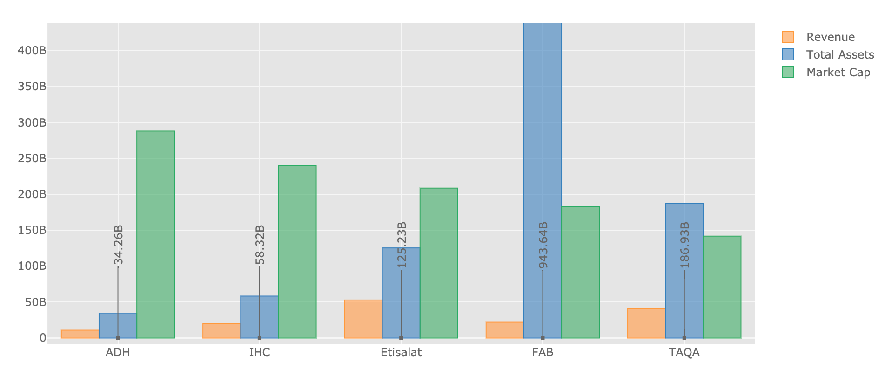
Key Figures (2021*)
*Figures annualized on assumption of recurrence in similar periods throughout the year

Slide 15
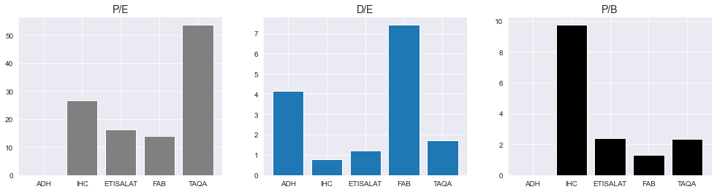
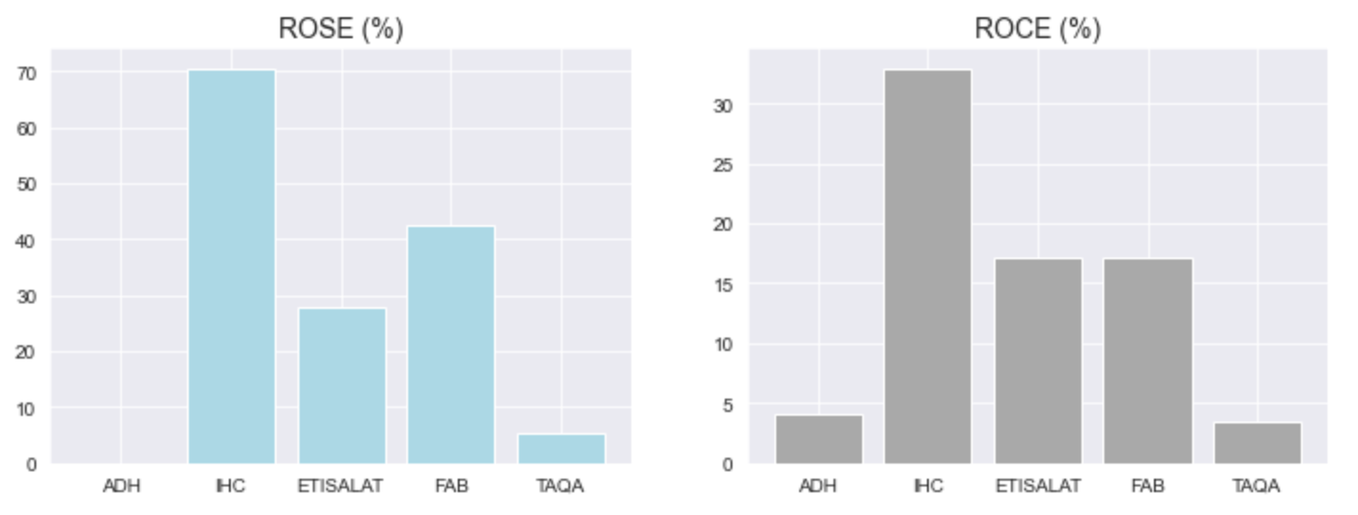
Key Ratios (2020)
Notes:
Key Insights:
TAQA likely overvalued (controlled shares, high P/E, lowest returns, share price falling)
IHC also likely overvalued (high P/B and P/E)

Slide 16
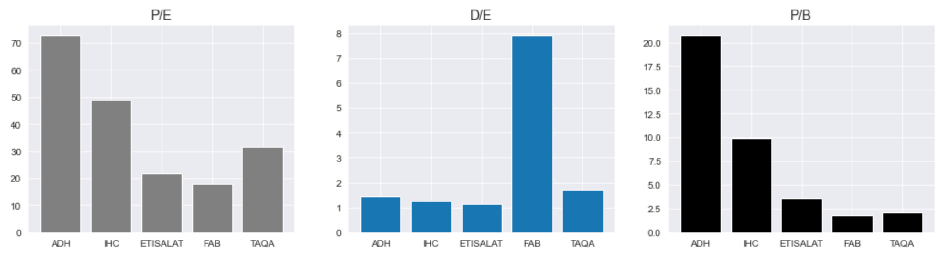
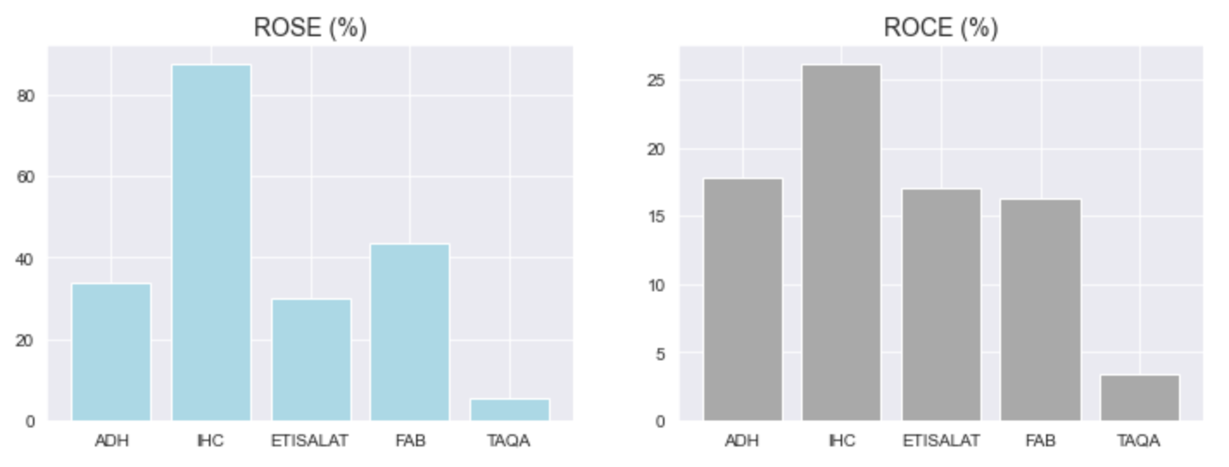
Key Ratios (2021*)
*Figures annualized on assumption of recurrence in similar periods throughout the year, prices obtained at 9 Aug 2021
Notes:
Key Insights:
Alpha likely overvalued (high P/E + P/B) – rising due to speculation
FAB D/E high (financial institution industry norm?)

Slide 17
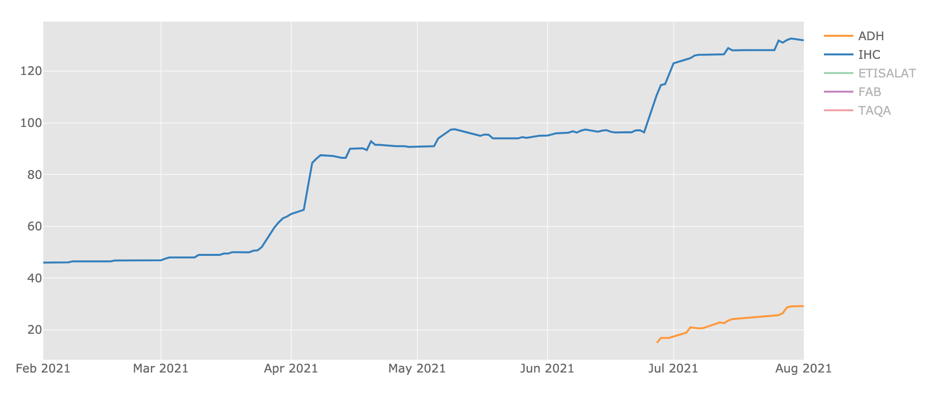
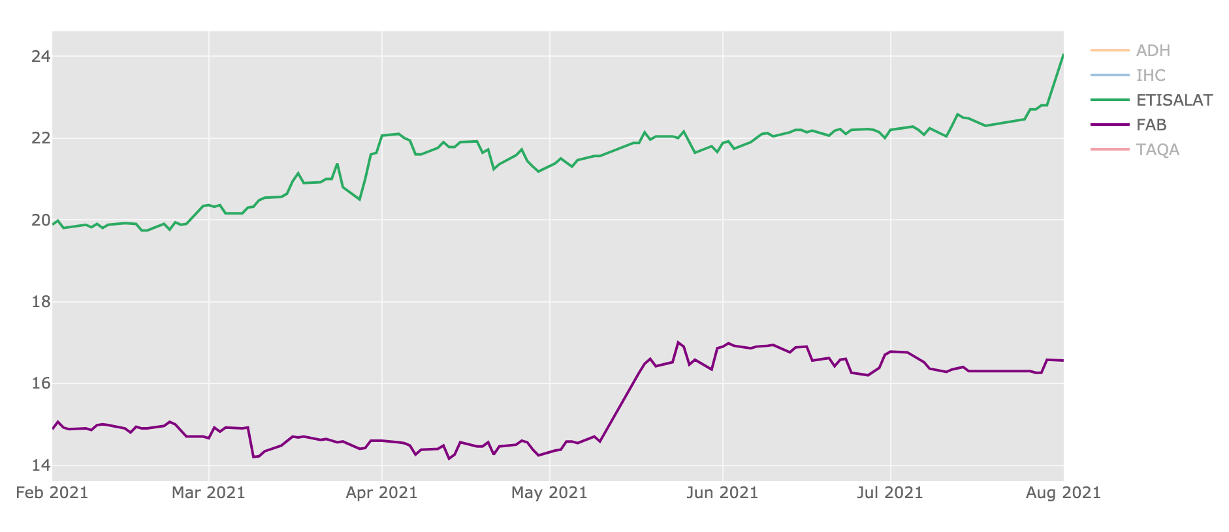
Final Overview
Short-term Outlook:
43,000
40,000+
Long-term Outlook:
7,000+
7,000+
~ 5,500
Notes:
Short-term Outlook: ADH / IHC
Long-term Outlook: ETISALAT
Avoid: TAQA

