Slide 1
Data Center Jeeves
DCJeeves-Spark
DCJeeves-UCS
Cisco UCS Director
DCJeeves-Alexa
DCJeeves-App
DCJeeves-CloudCenter
Cisco Cloud Center
DCJeeves-Tropo
DCJeeves-Openstack
Cisco Meta Cloud
DCJeeves-Web

Slide 2

Data Center Jeeves
DCJeeves-Spark
DCJeeves-UCS
Cisco UCS Director
DCJeeves-Alexa
DCJeeves-App
DCJeeves-CloudCenter
Cisco Cloud Center
DCJeeves-Tropo
DCJeeves-Openstack
Cisco Meta Cloud
DCJeeves-Web

Slide 3
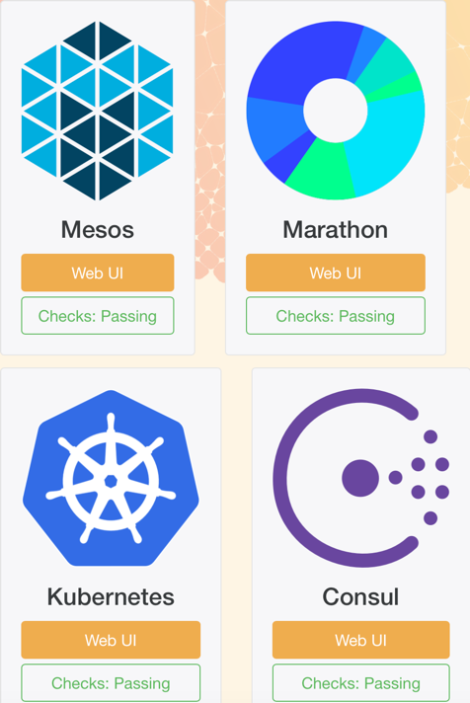
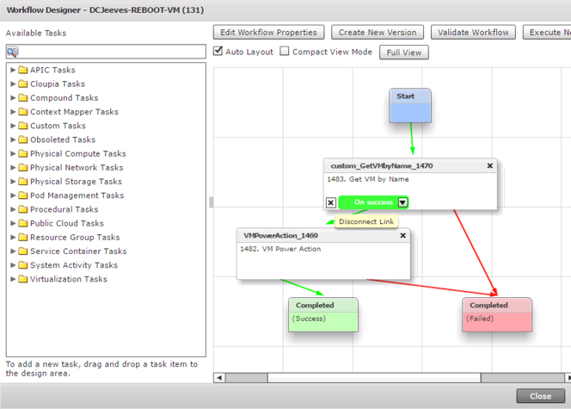
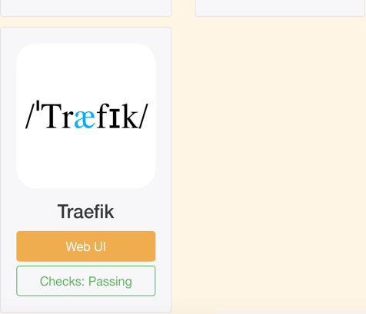
Data Center Jeeves
DCJeeves-UCS
Cisco UCS Director
REST - JSON
REST - JSON
REST - JSON
MANTL.io
DCJeeves-Alexa
Amazon
Alexa
Amazon
AWS Lambda
UCS Director
Data Center
DCJeeves-App
github.com/
imapex/dcjeeves_alexa
github.com/
imapex/dcjeeves_app
github.com/
imapex/dcjeeves_ucsd

Slide 4
Data Center Jeeves
DCJeeves-Alexa
DCJeeves-App
DCJeeves-UCS
Cisco UCS Director
REST - JSON
REST - JSON
REST - JSON
MANTL.io
Amazon
Alexa
Amazon
AWS Lambda
UCS Director
Data Center
github.com/
imapex/dcjeeves_alexa
github.com/
imapex/dcjeeves_app
github.com/
imapex/dcjeeves_ucsd

Slide 5
Data Center Jeeves
DCJeeves-Alexa
DCJeeves-App
DCJeeves-UCS
Cisco UCS Director
REST - JSON
REST - JSON
REST - JSON
MANTL.io
Amazon
Alexa
Amazon
AWS Lambda
UCS Director
Data Center
github.com/
imapex/dcjeeves_alexa
github.com/
imapex/dcjeeves_app
github.com/
imapex/dcjeeves_ucsd

Slide 6
Data Center Jeeves
DCJeeves-Alexa
DCJeeves-App
DCJeeves-UCS
Cisco UCS Director
REST - JSON
REST - JSON
REST - JSON
MANTL.io
Amazon
Alexa
Amazon
AWS Lambda
UCS Director
Data Center
github.com/
imapex/dcjeeves_alexa
github.com/
imapex/dcjeeves_app
github.com/
imapex/dcjeeves_ucsd

Slide 7
Data Center Jeeves
DCJeeves-Alexa
DCJeeves-App
DCJeeves-UCS
Cisco UCS Director
REST - JSON
REST - JSON
REST - JSON
MANTL.io
Amazon
Alexa
Amazon
AWS Lambda
UCS Director
Data Center
github.com/
imapex/dcjeeves_alexa
github.com/
imapex/dcjeeves_app
github.com/
imapex/dcjeeves_ucsd

Slide 8
imapex.io

