Slide 1
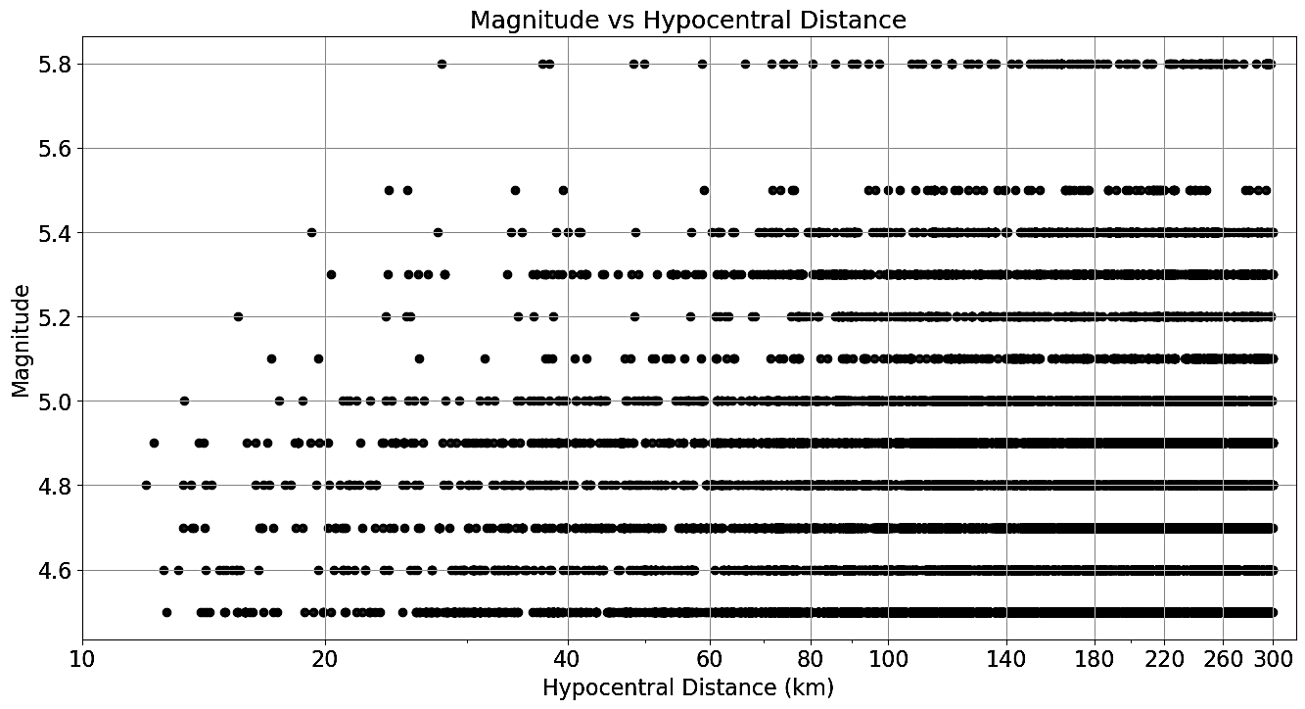
No stations: 151
No of eqs: 372 shallow crustal
No of records: 8428
Groups of data for analyses:
4.5≤M ≤5.0 & 12km<R ≤40km
5.0<M ≤5.8 & 12km<R ≤40km
(c) 4.5<M ≤5.0 & 40km<R ≤100km
(d) 5.0<M ≤5.8 & 40km<R ≤100km
(e) 4.5<M ≤5.0 & 100km<R ≤300km
(f) 5.0≤M ≤5.8 & 100km<R ≤300km
(b)
(d)
(f)
(a)
(c)
(e)
Steps to follow//apply per group of data per horizontal component:
(1) Selection of acceleration time history window from P-wave arrival (as it is picked) till the end of the recording (thus we consider the entire acceleration record length)
(2) Baseline & offset correction and tapering (1sec) before the P-wave arrival and 1sec at the end of the recording
(2) FAS for the freq, range (0.2Hz-30Hz) of the selected time history and K-O smoothing (b=50% ??)
(3) Relative Velocity Response Spectra (for the same freq. range & for critical damping=0%, 2%, 5%, 10%, 20%) of the same time history as in (2) and K-O smoothing (b=50% ??)
(4) Comparison of FAS with RVRS-damping 0% (one by one and per group the average FAS with average RVRS)
(5) Conclusions

