Slide 1
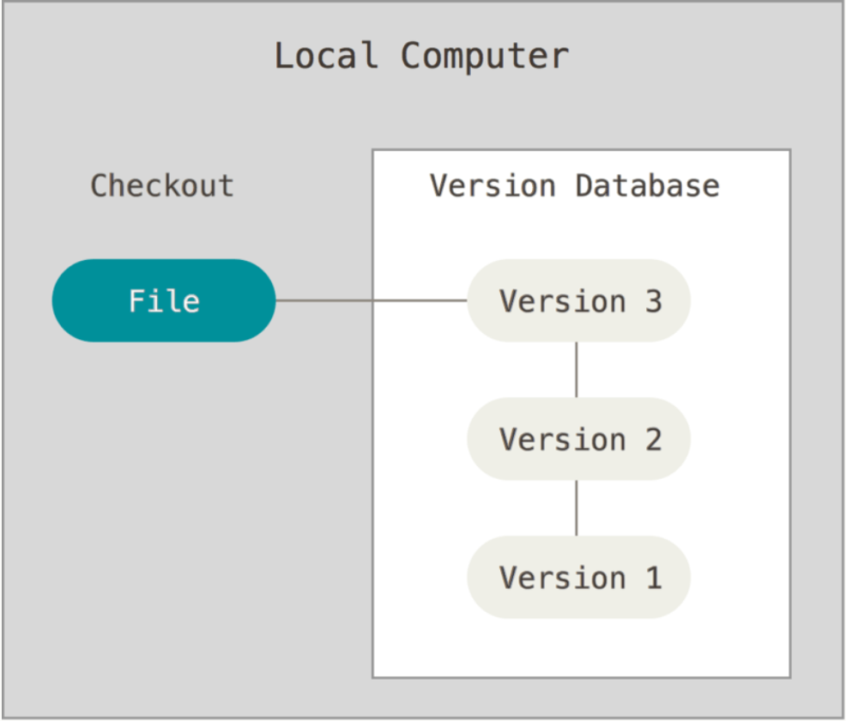
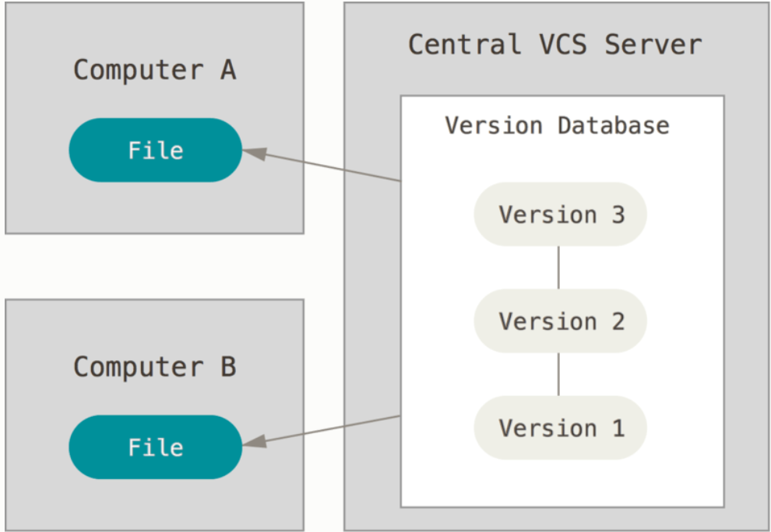
Version control systems
Version control is a system that records changes to a file or set of files over time so that you can recall specific versions later. It allows you to revert selected files back to a previous state, compare changes over time see who last modified something etc.
Old local VCSs used simple database that kept all the changes to files (or versions) under version control (ex. RCS). It keeps the changes (differences between files) in a special format on disk so that you can re-create any file at any point.
In Git terms, a “checkout” is the act of switching between different versions of a file for example.
Because of the need to collaborate with other people, Centralized Version Control Systems (CVCSs) were developed (ex. CVS, Subversion, Perforce). They have a single server that contains all the versioned files and a number of clients that check out files from the central place. However, single point of failure. If that server goes down for an hour, then during that hour nobody can collaborate at all or save versioned changes to anything they’re working on. If the hard disk of the server, becomes corrupted you lose everything
Local version control
Centralized version control

Slide 2
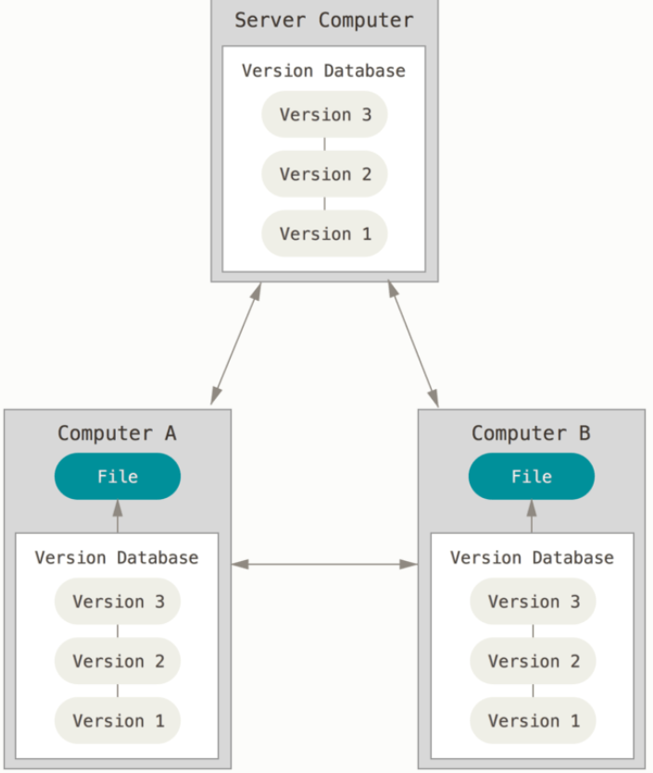
DVCS-GIT
Distributed Version Control Systems (DVCSs), like GIT, Mercurial, Bazzar, Darcs, clients FULLY MIRROR THE REPOSITORY INCLUDING ITS FULL HISTORY. Thus if any server dies, any of the client repos can be copied back up to the server to restore it. Every clone is a full backup of all the data.
The major difference between GIT and other VCS is that the other files store the information as a list of file-based changes (changes made to each file over time – delta based version control).
Instead GIT, thinks of its data more like a series of snapshots. Every time you commit, GIT takes a picture of what all your files look like at that moment and stores a reference to that snapshot. If files haven’t changed, GIT does not store the file again, just a link to the previous identical file it has already stored
This is like a stream of snapshots
If you want to see the project history or the version of a file a month ago, GIT doen’t need to go out to the server to get the response. It simply reads about them directly from your local database.
YOU HAVE THE ENTIRE HISTORY OF THE PROJECT RIGHT THERE ON YOUR LOCAL DISK
You don’t have to ask a remote server for a version of a file. If you want to see the changes between the current version of the file and the file one month ago, Git can look up the file a month ago and do a local difference calculation
Distributed version control systems

Slide 3
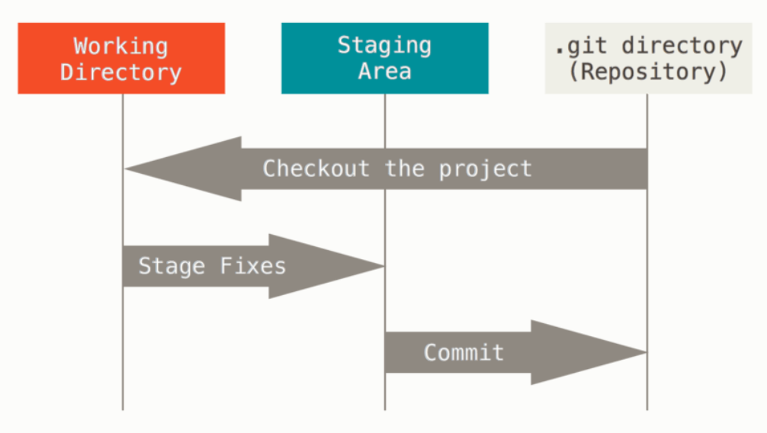
GIT
Everything is Git is checksummed before it is stored and is referred to by that number. It is impossible to change the contents of any file or directory without Git knowing about it. This mechanism is called SHA-1 HASH (40 character string of hexadecimal characters). IN FACT GIT STORES EVERYTHING IN ITS DATABASE NOT BY FILE NAME BUT BY THE HASH VALUE OF ITS CONTENTS.
EXAMPLE: 24b9da6552252987aa493b52f8696cd6d3b00373
Git has three main states that your files can have:
Modified (you have changed the file but have not committed it to your database)
Staged (you have marked modified file in its current version to go into your next commit snapshot)
Committed (data stored in your local database)
Three main sections of GIT:
Working tree (a file in your disk pulled from the git directory or repo)
Staging area (file that stores information about what will go into your next commit)
Git directory ( or repository, is where Git stores the data. It is what is copied when you clone a repository)

Slide 4
GIT
Workflow:
Modify files in your working tree
Stage just those changes you want to be part of your next commit
Commit (take the files in the staging area and store that snapshot to your Git directory)
If a particular version of a file is in the Git directory, it’s considered committed. If it has been modified and was added to the staging area, it is staged. And if it was changed since it was checked out but has not been staged, it is modified.
User git config to set configuration variables
Set your identity:
Git config --global user.name “Ioannis Maragkakis” # set your username
Git config --global user.email Giannis.marar@hotmail.com # set your email
Git config --global core.editor “path of editor exe file” # set your editor
Git config –global init.defaultBranch main # set your default branch main name
Git config --list # see all the configurations
Git help <verb> or git <verb> --help # get help

Slide 5
Get a repository
You can get a GIT repository in one of two ways:
Convert a local directory into Git repository
Clone an existing Git repository
Convert a local directory
Go into your local directory and git init. This creates a new subdirectory named .git that contains all of your necessary repository files — a Git repository skeleton. At this point, nothing in your project is tracked yet
Clone an existing repository
Use git clone <url>. Git receives a full copy of nearly all data that the server has. Every version of every file for the history of the project is pulled down by default.
Example:
git clone https://github.com/libgit2/libgit2 # That creates a directory named libgit2, initializes a .git directory inside it, pulls down all the data for that repository, and checks out a working copy of the latest version
git clone https://github.com/libgit2/libgit2 mylibgit # it does the same as the previous but the folder had a different name

Slide 6
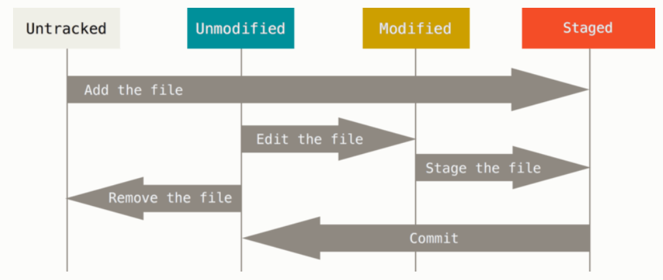
Get a repository
Files can be tracked or untracked
Untracked files are files that Git doesn’t know about them. It does not track them. These files in your current working directory were not in your last snapshot and were not in your staging area . Tracked files are files that were in the last snapshot. Tracked can be unmodified, modified, staged.
When you first clone, all of your files are tracked and unmodified.
When you edit files, Git sees them as modified because you have changed them since your last commit. As you work you stage these modified files and then commit all those staged changes am the cycle repeats
untracked
tracked

Slide 7
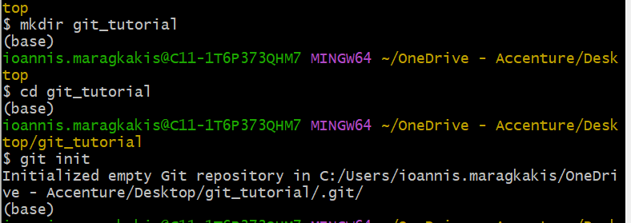
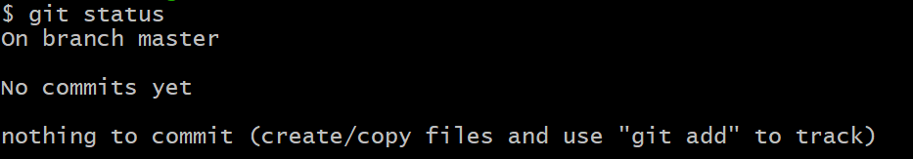
Status
See the status of your files (in which state they are currently):
git status
Start by making a directory, going into that directory and git init
Now run git status and we have a clean directory
Clean working directory
none of your tracked files are modified
no untracked files
on branch master

Slide 8
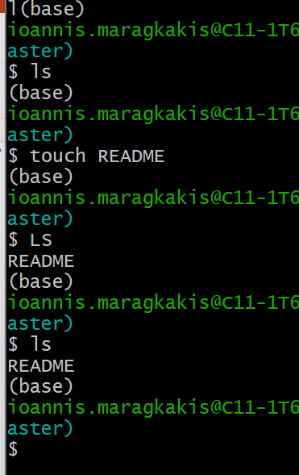
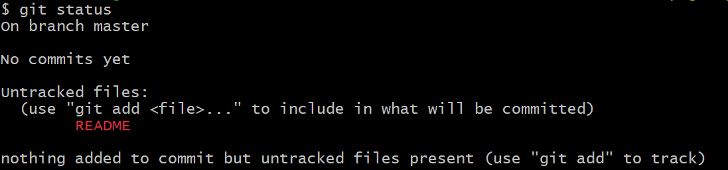
Add README file
Adding README file
Run git status
You can see the file under untracked because git still doesn’t track the file
Untracked means git sees a file you didn’t have in the previous commit
Use git add to track it

Slide 9
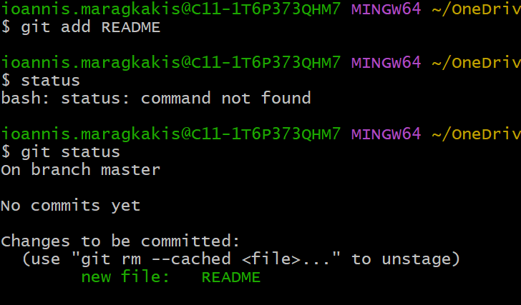
Track README
Use git add README to track it
It is under changes to be committed because it is in the staged area
Now it is also tracked
If you commit now, this version of the file in the staging area is going to be saved in the repo

Slide 10
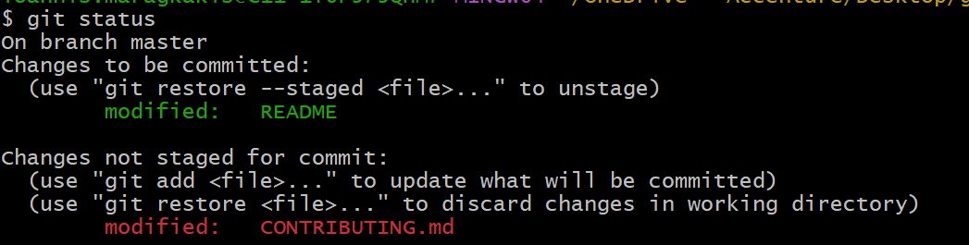
Stage modified files
Let’s create another file (CONTRIBUTING.md), track it using git add, save it in the repo and just change it by adding a line in it
Now we have the staged README file from before
Also we have the tracked and modified CONTRIBUTING.md but it has not been staged (run git add to stage it)
You can see the REAME under changes to be committed because it is staged
You can see the CONTRIBUTING.md under changes not staged for commit because it is modified but not staged

Slide 11
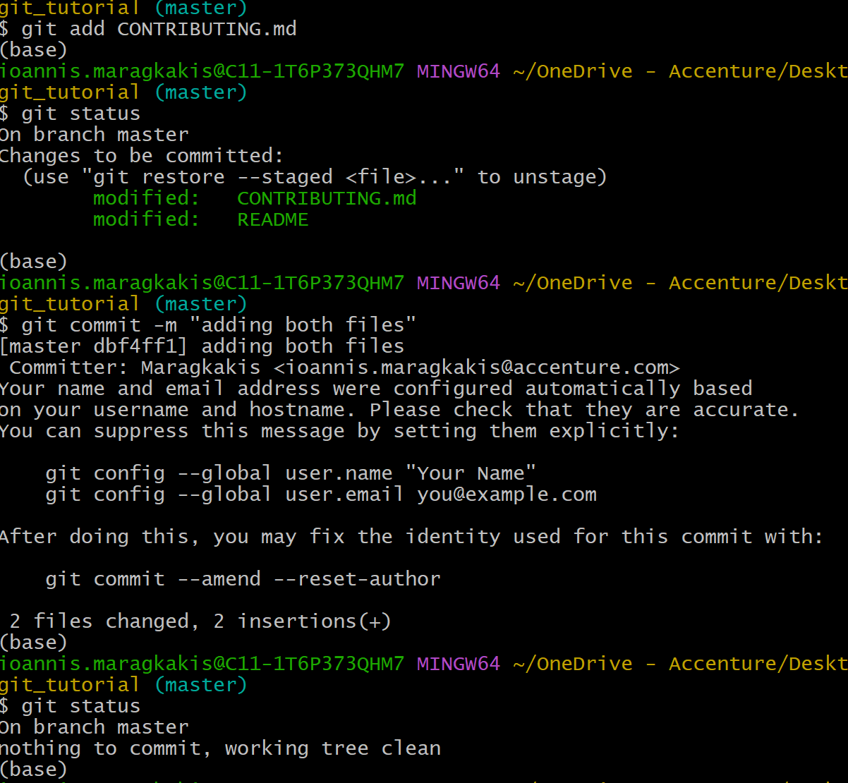
Stage modified files
Use git add to stage the CONTRIBUTING.md and then commit to save the version of both files in the repo
Now we have a clean working directory

Slide 12
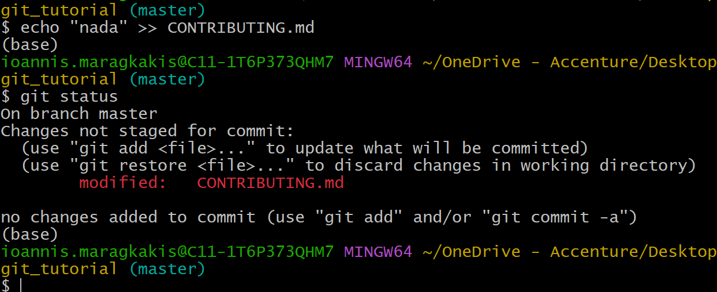
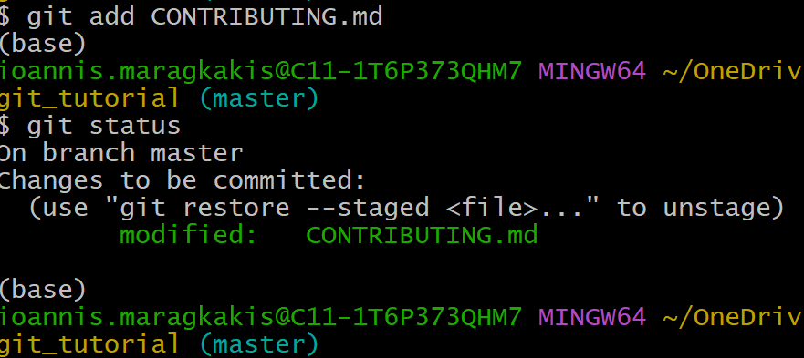
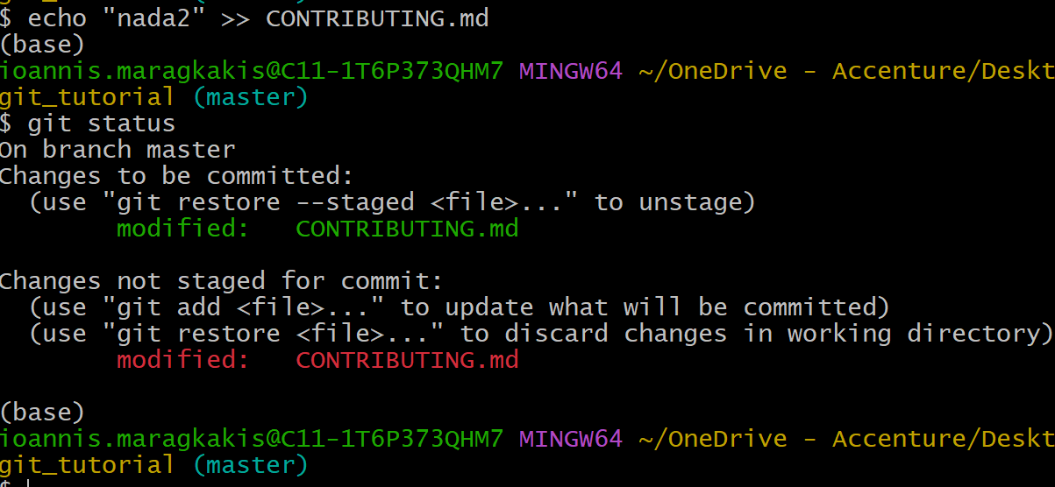
Let’s say you want to modify the CONTRIBUTING.md again and add a line
It is in modified state. Now stage it using git add
Now let’s say you forgot to add a line and you add it now

Slide 13
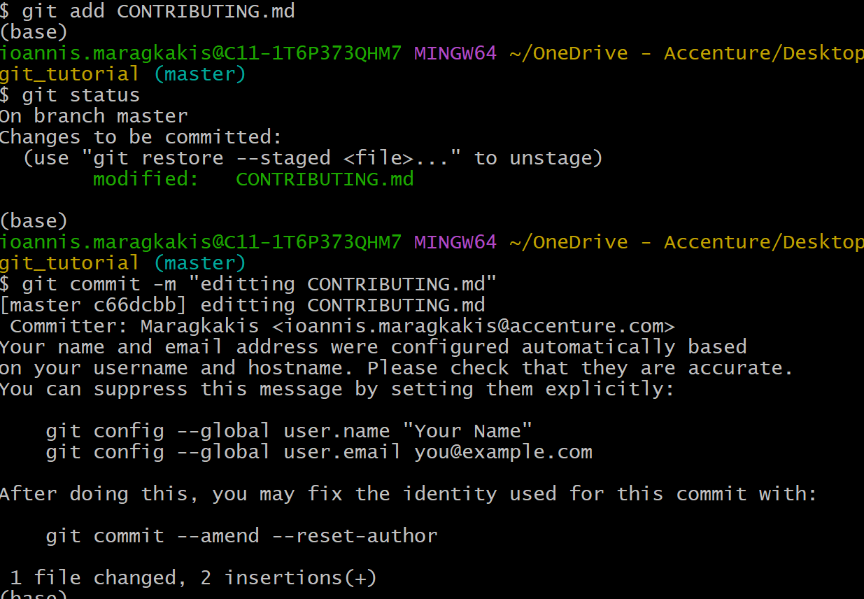
Two versions of a file in different modes
Now as you can see from before you have two versions of the same file one in the staging area (this is the version that will be saved when git commit) and another in the modified state. You need to use git add to stage the new changes

Slide 14
Git ignore
To ignore files that you don’t want Git to automatically track use the .gitignore file
The patterns you create in it, target files to ignore tracking
The rules are:
Blank lines or lines starting with # are ignored
Standard glob patterns work and will be applied recursively throughout the entire working tree
Start patterns with forward slash (/) to avoid recursivity
End patterns with forward shash (/) to specify a directory
Negate pattern by starting it with an exclamation point (!)
Examples:
*.a ignore all files ending in .a
!lib.a don’t ignore lib.a (although we said ignore all .a files before)
/TODO only ignore the TODO file in the current directory not subdir/TODO
Build/ ignore all files in ANY directory named build
Doc/*.txt ignore doc/notes.txt
Doc/**/*.pdf ignore all .pdf files in the doc/ directory and any of its subdirectories

Slide 15
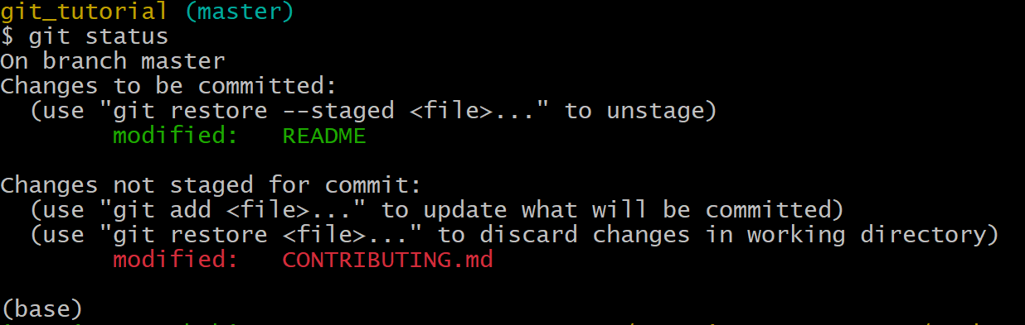
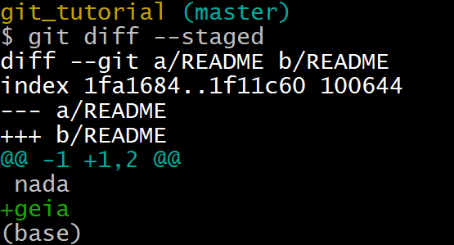
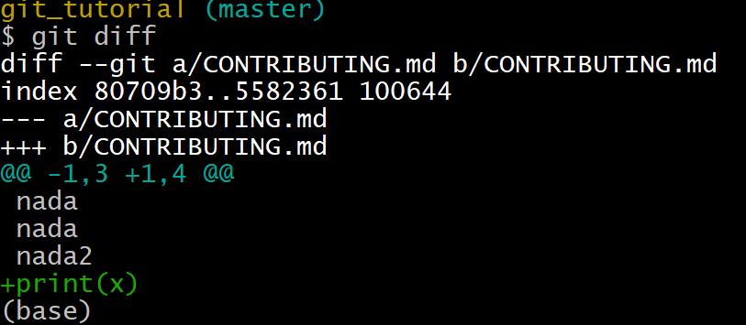
Git diff
Use git diff to find out more details about what have you modified but you have not staged.
Use git diff --staged to find out what have you staged that you are about to commit
Let’s say we modify and stage the README file and we just modify the CONTRIBUTING.md file WITHOUT staging it. The status is:
git diff --staged
git diff

Slide 16
Git commit
We will see the git diff later. Now stage all the files by using git add and commit using:
git commit –m “a short message” to commit inserting a short message of what you are about to commit
If you provide commit without the short message and do git commit , it will open the default editor to write a bigger message of what you are about to commit
The commit records the snapshot you set up in your staging area. Anything you didn’t stage is still sitting there modified.
Every time you perform a commit, you are recording a snapshot of your project that you can revert to later
You can also skip the staging area and commit right away using:
git commit -a -m “commit a message”
This will make Git automatically stage every file that is already tracked before doing the commit so you just skip the git add part

Slide 17
Git remove and move
To remove a file from Git you have to remove it from your tracked files (remove it from the staging area) and then commit. The following command does that and also removes the file from your working directory so you don’t see it as an untracked file:
git rm CONTRIBUTING.md
The next time you commit the file will be gone and no longer tracked
If you modified the file or had already added it to the staging area, you must force the removal with –f
If you want to keep the file in your hard drive but not have git track it anymore, use:
Git rm –cached CONTRIBUTING.md
To move or rename a file use:
git mv CONTRIBUTING.md CONTRIBUTING2.md

Slide 18
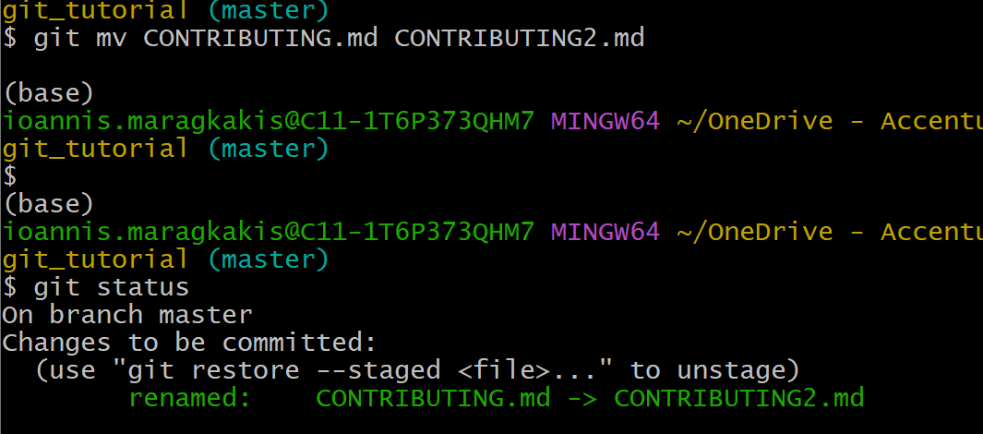
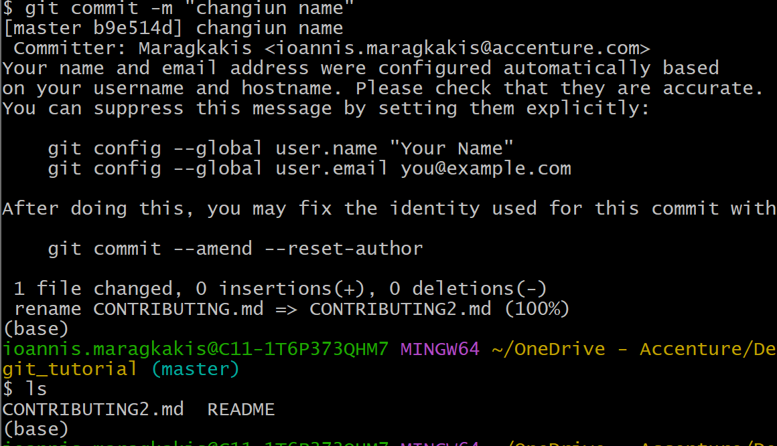
Git remove and move
Here we move (RENAME) the CONTRIBUTING.md to CONTRIBUTING2.md. If you see git understands about it and have it in the changes to be committed in the renamed:
Now we commit and check the files that we have in out current directory

Slide 19
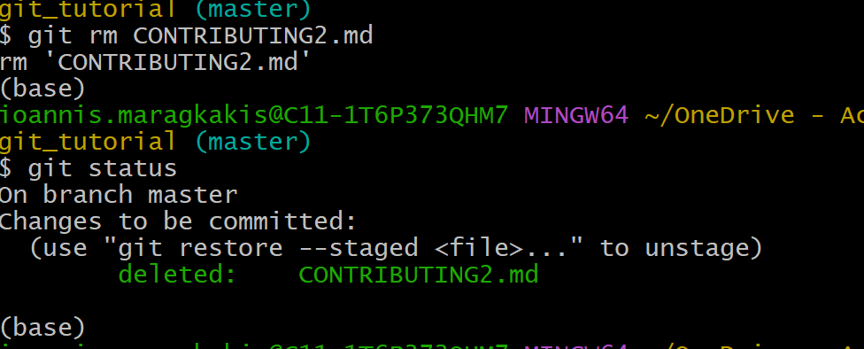
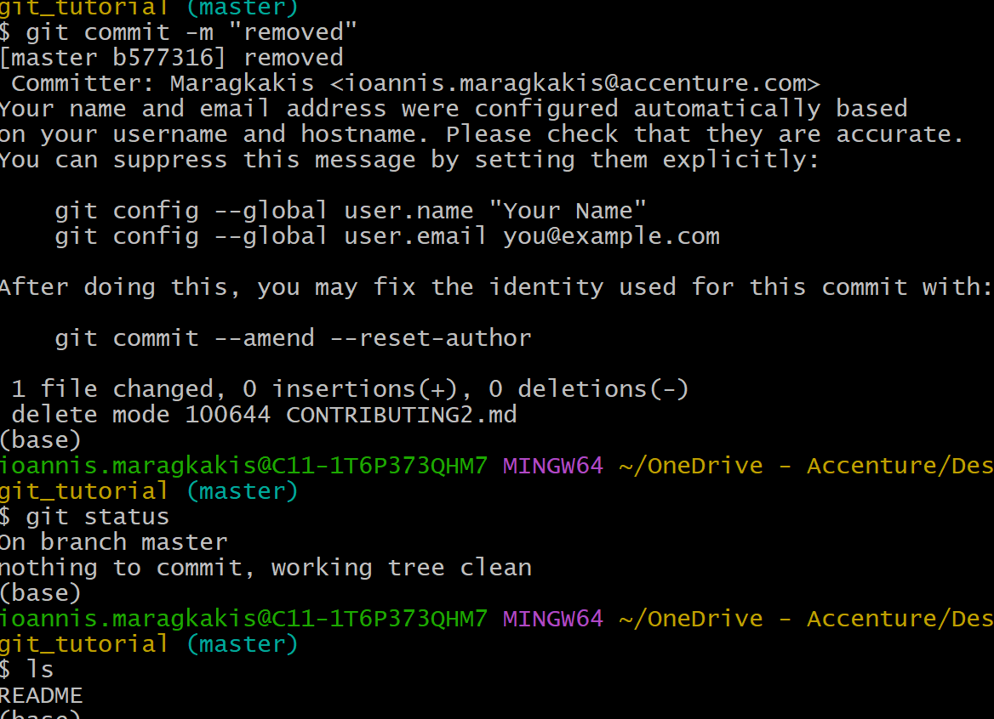
Git remove and move
Now let’s remove it using git rm
An we again commit and see that the file is removed

Slide 20
Undo things
Git will use git restore to undo operations
Unstaging a staged file: git restore –staged <file>
Unmodifying a modified file: git restore <file
Redo a commit, make additional changes you forgot, stage them and commit again: git commit --amend

Slide 21

Working with remotes
Remote repositories are versions of your git project that are hosted on the internet somewhere. Collaborating with others involves managing these remote repos and pushing and pulling data to and from them when you need to share work
It is entirely possible that you can be working with a remote repo that is , in fact on the same host you are
To see which remote servers you have configures, use git remote
If you cloned your repo, you should at least see origin (default name Git gives to the server you cloned from)
You can also use the git remote -v to get the URLs that Git has stored for the shortname to be used when reading and writing to that remote

Slide 22
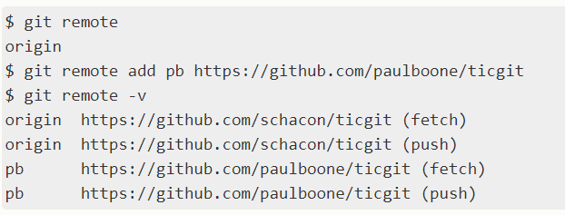
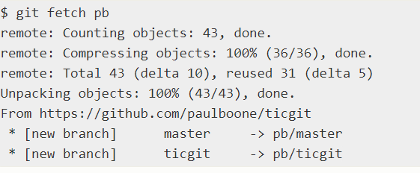
Working with remotes (2)
Add remote repositories using:
Git remote add <shortname> <url>
When you add a remote you can use the short name instead of the whole URL

Slide 23
Working with remotes (2)
To get data from your remote project:
Git fetch <remote>
The command goes out to that remote project and pulls down all the data from that remote project that you don’t have yet. After you do this, you should have references to all the branches from that remote, which you can merge in or inspect at any time.
If you clone a repo, the command automatically adds that remote repo under the name “origin”, so git fetch origin fetches any new work that has been pushed to that server since you cloned or last fetched from.
Git fetch command only downloads the data to your local repo, it does not automatically merge it with any of your work. You have to merge it manually
If your current branch is set up to track a remote branch, you can use the git pull command to automatically fetch and then merge that remote branch into your current branch
By default git clone command automatically sets up your local master branch to track the remote master branch on the server you cloned from
Running git pull generally fetches data from the server you originally cloned from and automatically tries to merge it into the code you are currently working on

Slide 24
Working with remotes (2)
To share your project, you can push it:
git push <remote> <branch>

Slide 25
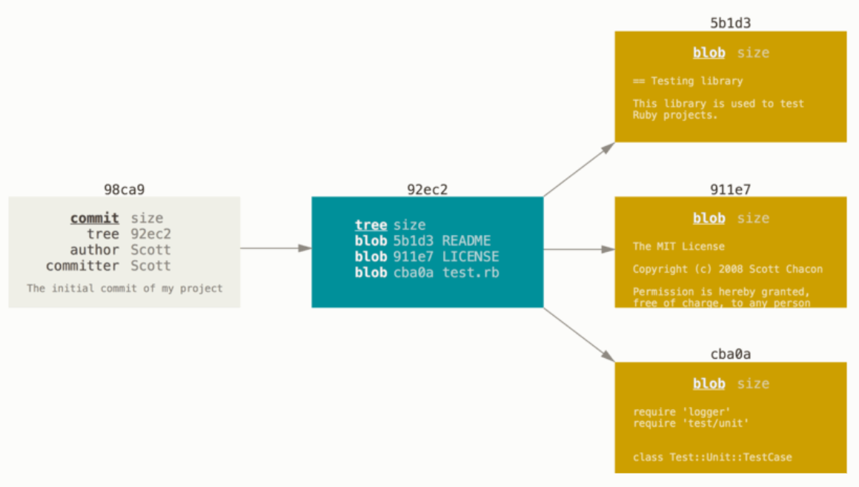
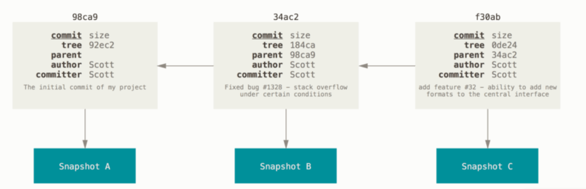
Branching
Branching means to diverge from the main line of development and continue to work without messing with that main line.
It is a simple movable pointer between the commits
When committing git stores a commit object that contains:
Name of the author
Email of the author
Message that you typed
Pointers to the commit or commits directly before this commit (parent or parents)
Pointer to a tree object that contains the snapshots of the contents you staged

Slide 26
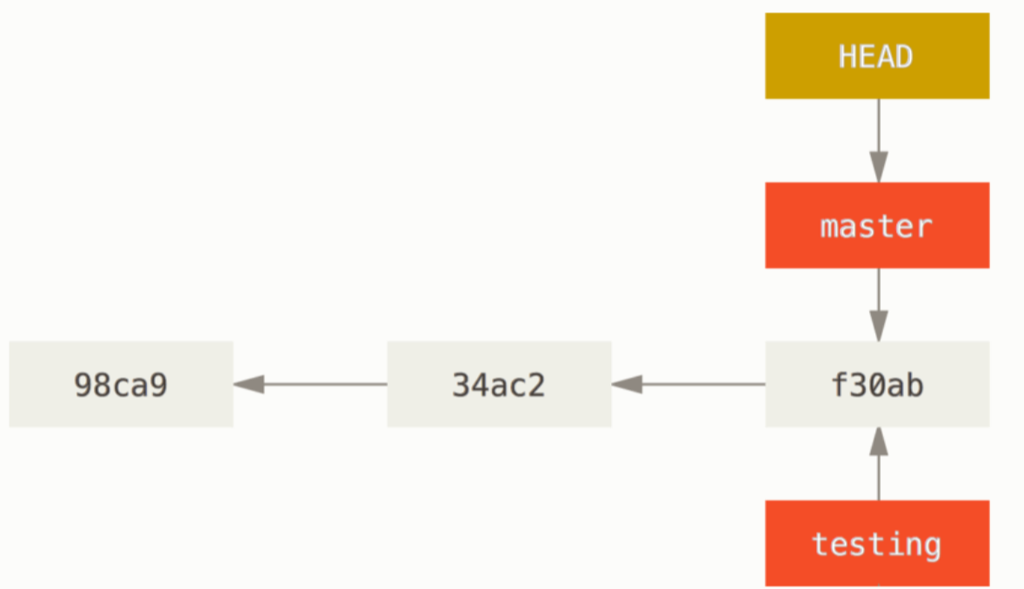
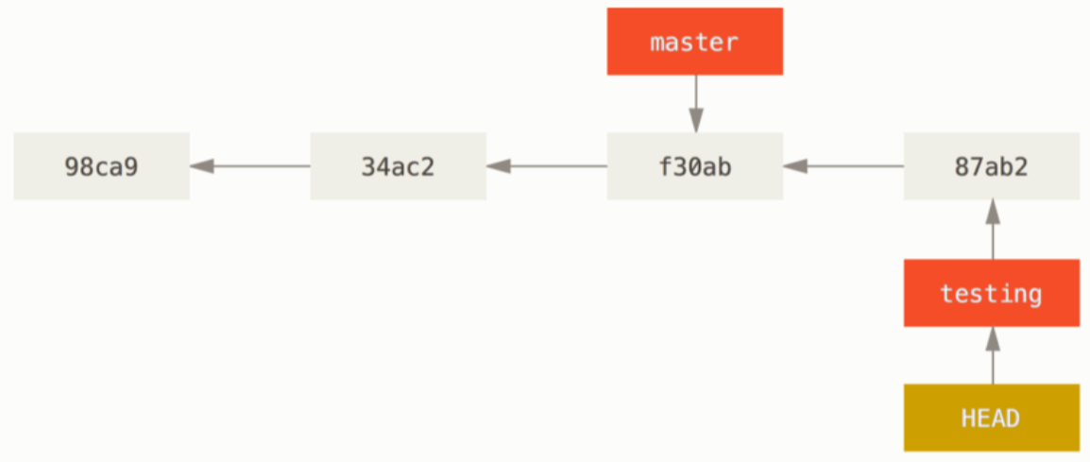
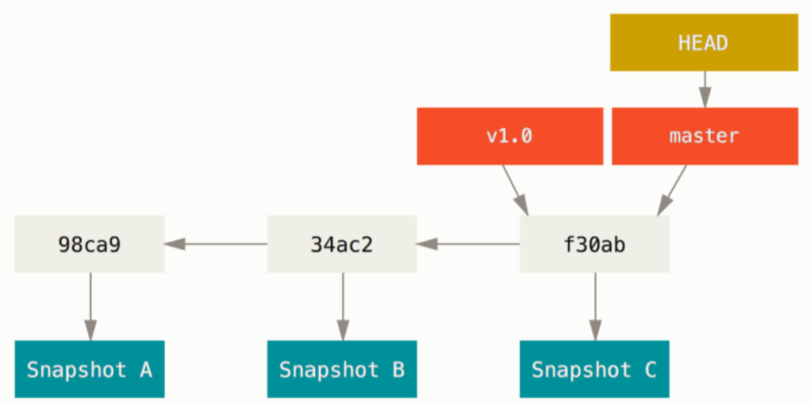
Branching
As you make commits, you are given a master or main branch that points to the last commit you made. Every time you commit, the master branch pointer moves forward
When you make a new branch, you create a pointer that points to the same commit you are currently on
Because a branch in Git is actually a simple file that contains the 40 character SHA-1 checksum of the commit it points to, branches are cheap to create and destroy
To find out what branch you are currently on, Git keeps a special pointer called HEAD
To switch to an existing branch use the git checkout <branch> command. This changes the position of the HEAD pointer to the branch you switched to
Every time you make a commit when you are on the new branch (ex. testing), the pointer moves forward and your master stays at the same place.

Slide 27
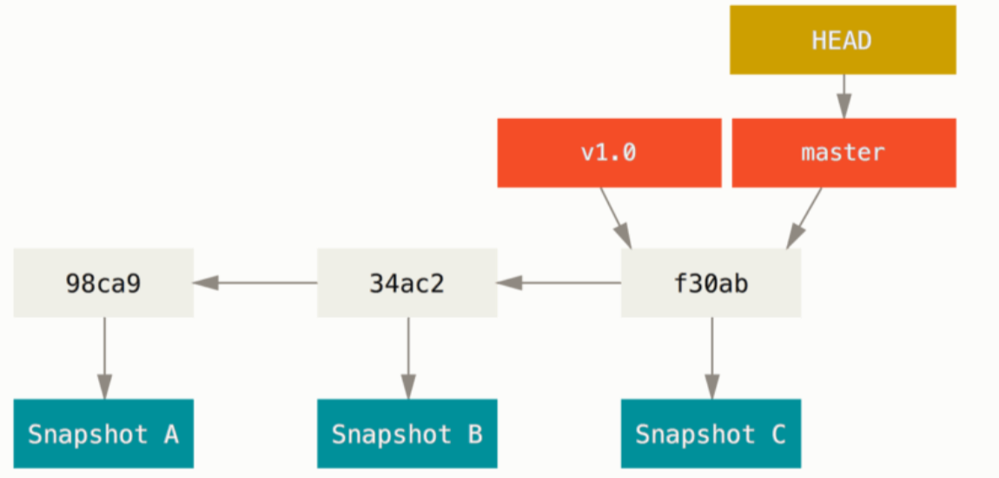
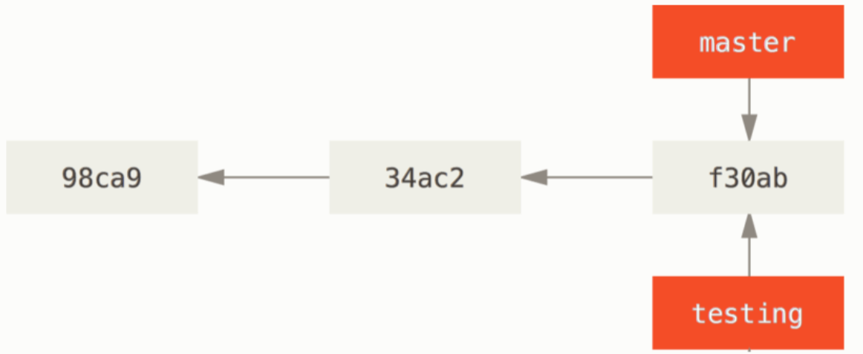
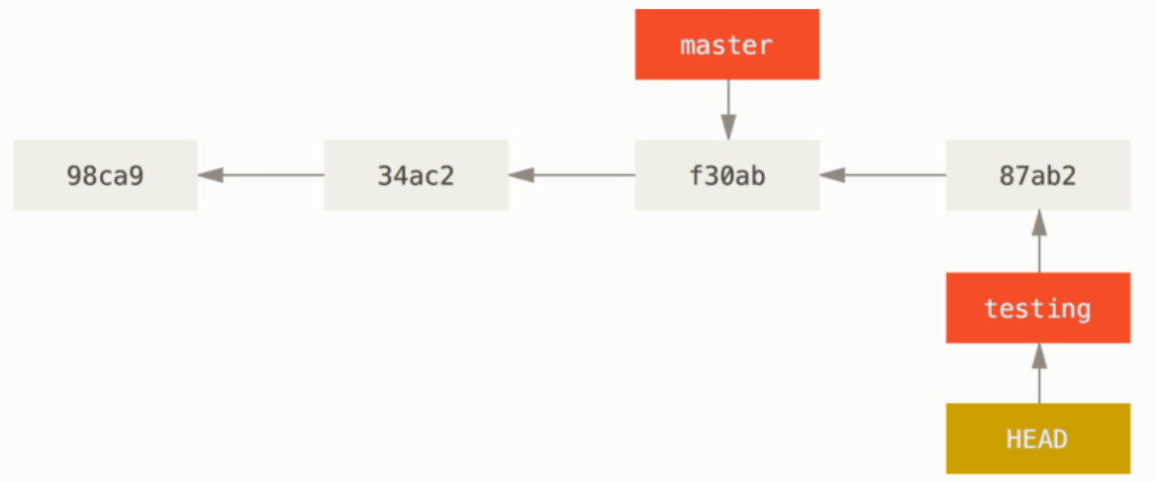
Branching
Use git branch to see your branches and where is the HEAD (the one with the asterisc)
For example let’s say we have our master in f30ab
We add a new branch called testing.
We change the HEAD to point to the testing branch and commit

Slide 28
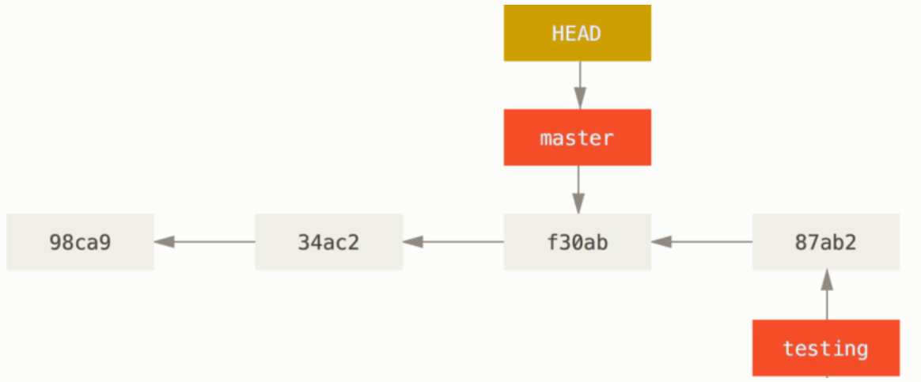
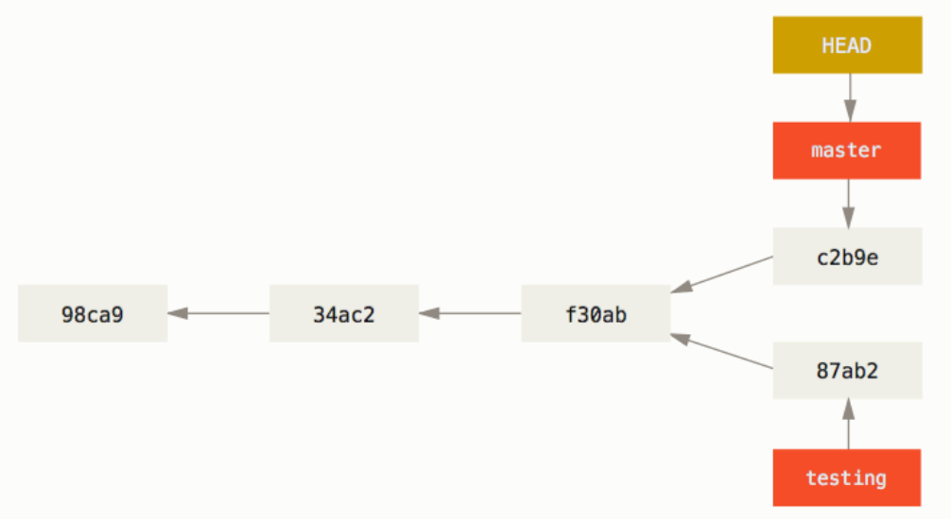
Branching
Let’s switch back to the master branch
Now make a commit

Slide 29
What makes a repo popular
This question can be answered with 3 metrics:
Star, when a user likes your repo or they want to show some appreciation, they star it
Watch, when a user wants to be notified of all the activities in a repo, they watch it
Fork, when a user wants a copy of the repo or they inted to make contributions, they fork it

Slide 30
What is code of conduct
The code of conduct, defines standards for how to engage in a community. It signals an inclusive environment that respects all contributions. It also outlines procedures for addressing problems between members of your project's community.

