Slide 1
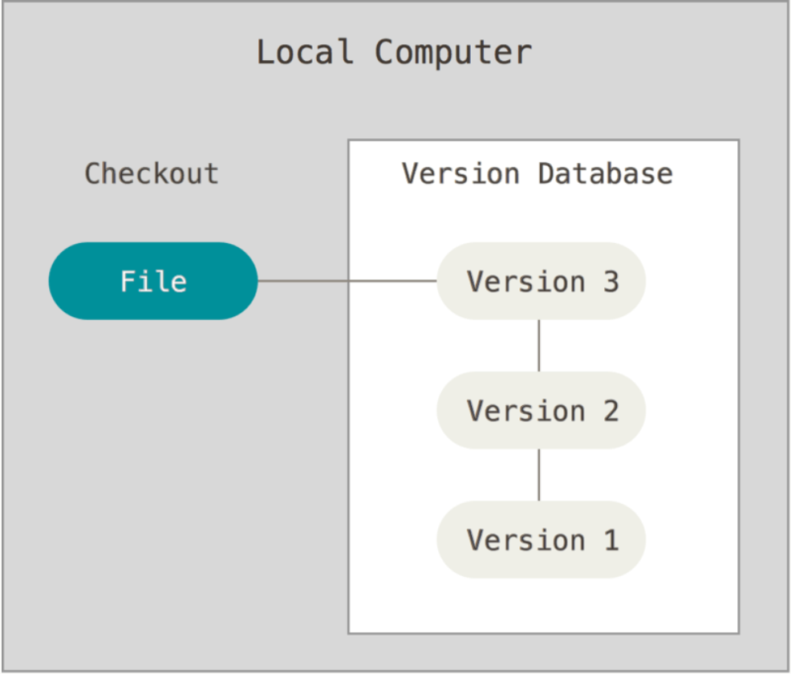
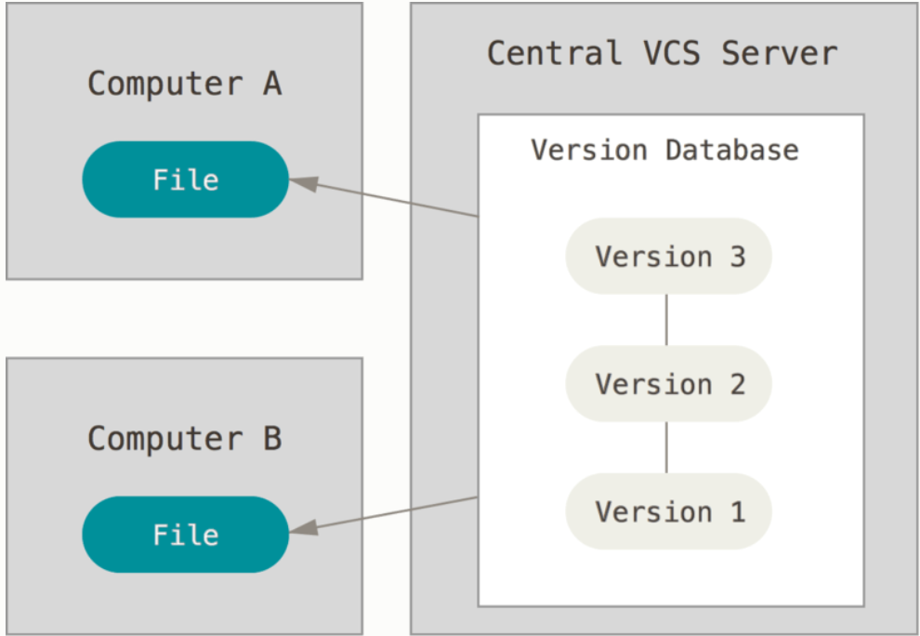
Version control systems
Version control is a system that records changes to a file or set of files over time so that you can recall specific versions later. It allows you to revert selected files back to a previous state, compare changes over time see who last modified something etc.
Many users save different versions of their files, by just copying them into other directories. However, this technique is error prone. That is why programmers created the local version control systems (VCSs). Local VCSs used simple database that kept all the changes to files (or versions) under version control (ex. RCS). It keeps the changes (differences between files) in a special format on disk so that you can re-create any file at any point.
In Git terms, a “checkout” is the act of switching between different versions of a file
Because of the need to collaborate with other people, Centralized Version Control Systems (CVCSs) were developed (ex. CVS, Subversion, Perforce). They have a single server that contains all the versioned files and a number of clients or computers that check out files from the central place. However, single point of failure. If that server goes down for an hour, then during that hour nobody can collaborate at all or save versioned changes to anything they’re working on. If the hard disk of the server, becomes corrupted you lose everything
Local version control
Centralized version control

Slide 2
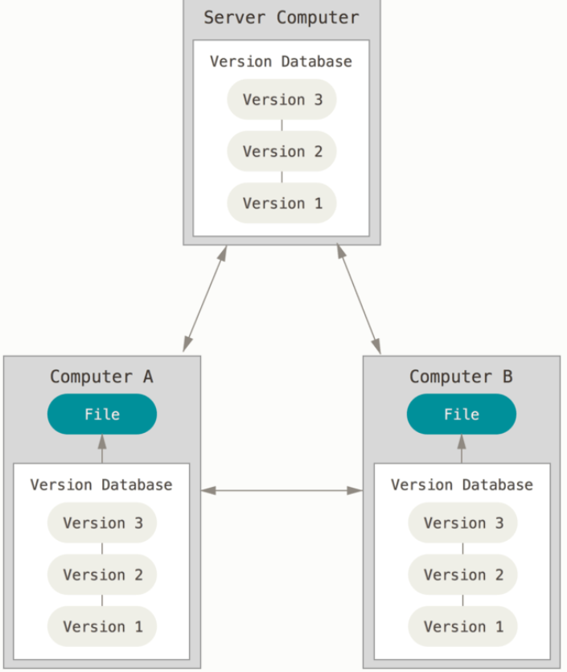
Distributed version control systems
Distributed Version Control Systems (DVCSs), like GIT, Mercurial, Bazzar, Darcs, clients FULLY MIRROR THE REPOSITORY INCLUDING ITS FULL HISTORY. Thus if any server dies, any of the client repositories (or repos) can be copied back up to the server to restore it. Every clone is a full backup of all the data.
I am gonna refer to a repository as repo
The major difference between GIT and other VCSs is that the other VCSs store the information as a list of file-based changes (changes made to each file over time – delta based version control).
Instead GIT, thinks of its data more like a series of snapshots. Every time you commit (save), GIT takes a picture of what all your files look like at that moment and stores a reference to that snapshot. If files haven’t changed, GIT does not store the file again, just a link to the previous identical file it has already stored
This is like a stream of snapshots
If you want to see the project history or the version of a file a month ago, GIT doen’t need to go out to the server to get the response. It simply reads about them directly from your local database.
YOU HAVE THE ENTIRE HISTORY OF THE PROJECT RIGHT THERE ON YOUR LOCAL DISK
You don’t have to ask a remote server for a version of a file. If you want to see the changes between the current version of the file and the file one month ago, Git can look up the file a month ago and do a local difference calculation
Distributed version control systems

Slide 3
By having the entire history of the project in your local disk, every operation seem almost instantaneous. This aspect of Git will make you think that the gods of speed have blessed Git with unworldly powers.
according to the documentation (pro-git book)

Slide 4
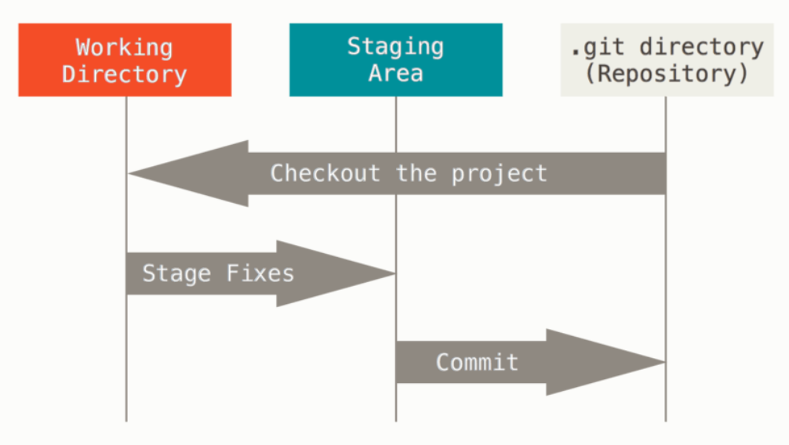
GIT
Everything in Git is checksummed (everything is asiigned a number that is the result of a hash function) before it is stored and is referred to by that number. It is impossible to change the contents of any file or directory without Git knowing about it. This mechanism is called SHA-1 HASH (40 character string of hexadecimal characters). In fact git stores everything in its database not by file name but by the hash value of its contents.
HASH example: 24b9da6552252987aa493b52f8696cd6d3b00373
Git has three main states that your files can have:
Modified (you have changed the file but you have not marked its current modified version to go into the next commit snapshot)
Staged (you have marked a modified file in its current version to go into your next commit snapshot)
Committed (data stored in your local database)
Three main sections of GIT:
Working tree (a file in your disk pulled from the git directory or repo or in other words a single checkout of your project)
Staging area (a file generally contained in your git directory that stores information about what will go into your next commit). The staging area is also called the index.
Git directory ( or repository, is where Git stores the data. It is what is copied when you clone a repository)

Slide 5
GIT
Workflow:
Modify files in your working tree/directory
Stage just those changes you want to be part of your next commit
Commit (take the files in the staging area and store that snapshot to your Git directory)
If a particular version of a file is in the Git directory, it’s considered committed. If it has been modified and was added to the staging area, it is staged. And if it was changed (modified) since it was checked out (a copy of it from your repo into your working directory) but has not been staged, it is modified.
User git config to set configuration variables
git config --global user.name “Ioannis Maragkakis” # set your username
git config --global user.email Giannis.marar@hotmail.com # set your email
git config --global core.editor “path of editor exe file” # set your default editor
git config –global init.defaultBranch main # set your default branch main name
git config --list # see all the configurations
git help <verb> or git <verb> --help # get help

Slide 6
Get a repository
You can get a GIT repository in one of two ways:
Convert a local directory into Git repository
Clone an existing Git repository
Convert a local directory
Go into your local directory and git init. This creates a new subdirectory named .git (the dot in front of it makes it a hidden file, see all hidden files using ls –la in your terminal) that contains all of your necessary repository files — a git repository skeleton. At this point, nothing in your project is tracked yet
Clone an existing repository
Use git clone <url>. Git receives a full copy of nearly all data that the server has. Every version of every file for the history of the project is pulled down by default.
Example:
git clone https://github.com/libgit2/libgit2 # That creates a directory named libgit2, initializes a .git directory inside it, pulls down all the data for that repository, and checks out a working copy of the latest version
git clone https://github.com/libgit2/libgit2 mylibgit # it does the same as the previous but the folder has a different name

Slide 7
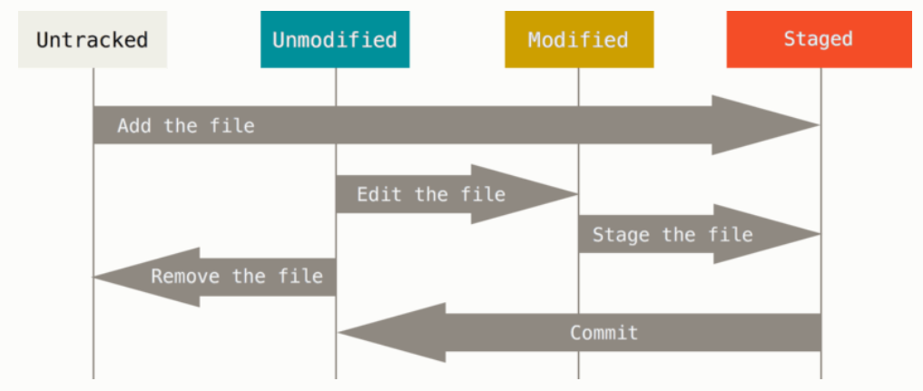
Get a repository
Files can be tracked or untracked
Untracked files are files that Git doesn’t know about them. It does not track them. These files in your current working directory were not in your last snapshot and were not in your staging area . Tracked files are files that were in the last snapshot. Tracked can be unmodified, modified, staged.
When you first clone, all of your files are tracked and unmodified.
When you edit files, Git sees them as modified because you have changed them since your last commit. As you work you stage these modified files and then commit all those staged changes and the cycle repeats
untracked
tracked

Slide 8
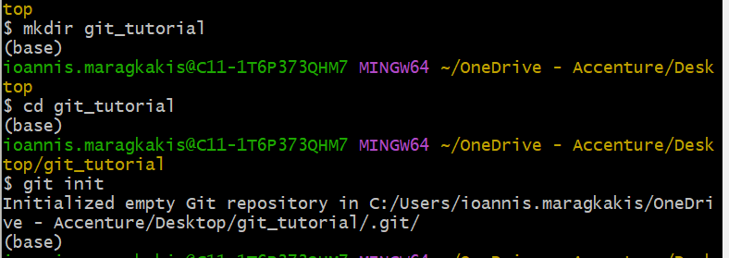
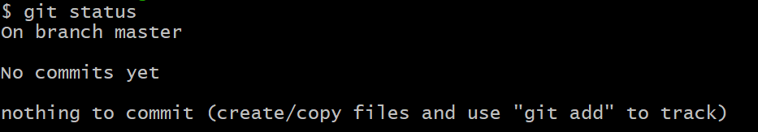
Status
See the status of your files (in which state they are currently):
git status
Start by making a directory (mkdir), going into that directory (cd) and git init. It will create a new subdirectory named .git that contains all of your necessary repository files. At this point nothing in your project is tracked yet.
Now run git status and we have a clean directory
Clean working directory
none of your tracked files are modified
no untracked files
on branch master

Slide 9
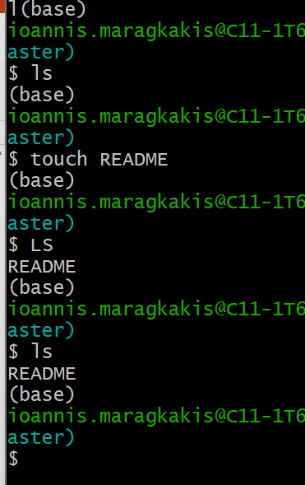
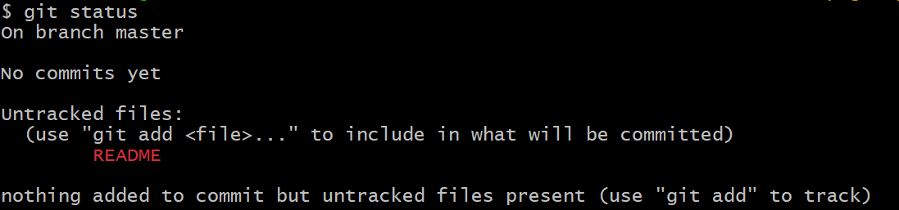
Adding a file
Now add a file named README (use the touch command)
Run git status
You can see the file under untracked files because git still doesn’t track the file
Untracked means git sees a file you didn’t have in the previous commit
Use git add to tell git to track it

Slide 10
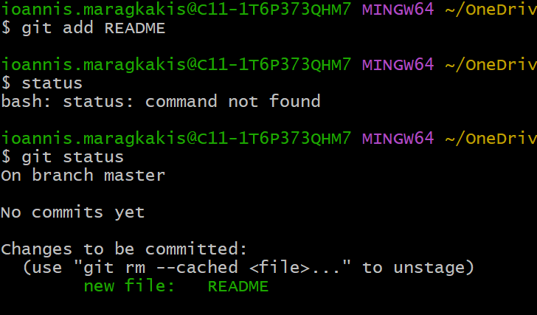
Tracking file
Use git add <file> to tell git to track it
Then run git status again. The README file is under changes to be committed because it is in the staged area
Now it is also tracked
If you commit now, this version of the file in the staging area is going to be saved in the repo

Slide 11
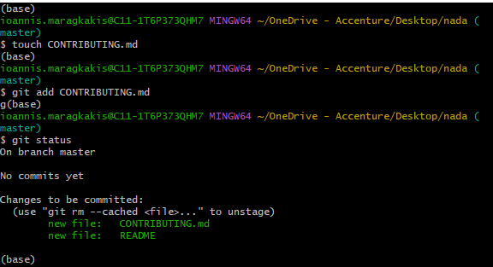
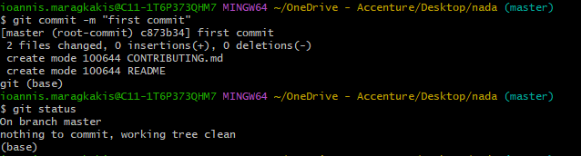
First commit
Let’s create another file called CONTRIBUTING.md, track it using git add
Now we have two files in the staging area the README and the CONTRIBUTING.md files
Now save the current version of the two files in your repo using the commit –m “message” command. In the message type a short description of what changes you did. Then get the status again.

Slide 12
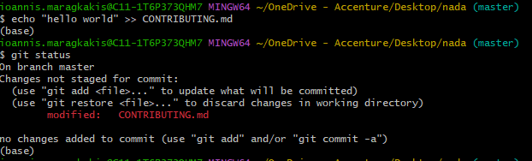
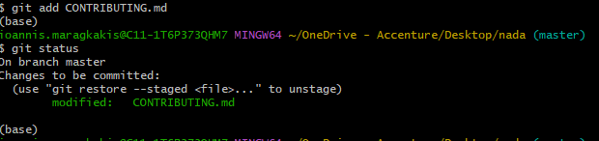
Modifying files
Modifying files
Now let’s modify the CONTRIBUTING.md file and add a line into it using the echo command. Then get the status again. You can see the file under Changes not staged for commit because we have modified the file but we have not staged it.
Run git add <file> to tell git to stage it and check the status. Now it is under Changes to be committed because we staged it and this version of the file is going to be stored in the git directory when we commit

Slide 13
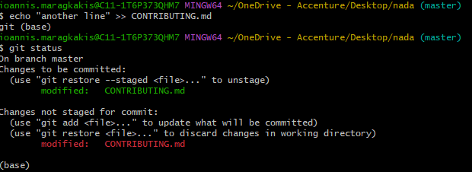
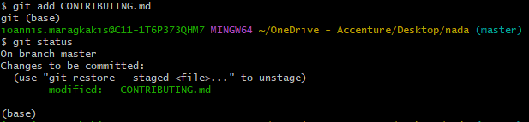
Two versions of a file in different modes
Let’s say now that you forgot something and you modify the CONTRIBUTING.md again and add a line (use the echo command again to append the line in the file using >>). Check the status now.
You can see that we have two versions of the CONTRIBUTING.md file. One is staged in the stage area as we had before, and the other one is modified but not staged. If we commit now, the version of the file in the staging area is going to be saved. To merge your changes, use the git add <file> command to stage the modified file
Now we have just one file in the stage area

Slide 14
Git ignore
To ignore files that you don’t want Git to automatically track use the .gitignore file
The patterns you create in it target files to ignore tracking
The rules are:
Blank lines or lines starting with # are ignored
Standard glob patterns work and will be applied recursively throughout the entire working tree
Start patterns with forward slash (/) to avoid recursivity
End patterns with forward shash (/) to specify a directory
Negate pattern by starting it with an exclamation point (!)
Examples:
*.a ignore all files ending in .a
!lib.a don’t ignore lib.a (although we said ignore all .a files before)
/TODO only ignore the TODO file in the current directory not subdir/TODO
Build/ ignore all files in ANY directory named build
Doc/*.txt ignore doc/notes.txt
Doc/**/*.pdf ignore all .pdf files in the doc/ directory and any of its subdirectories
Check some examples here

Slide 15
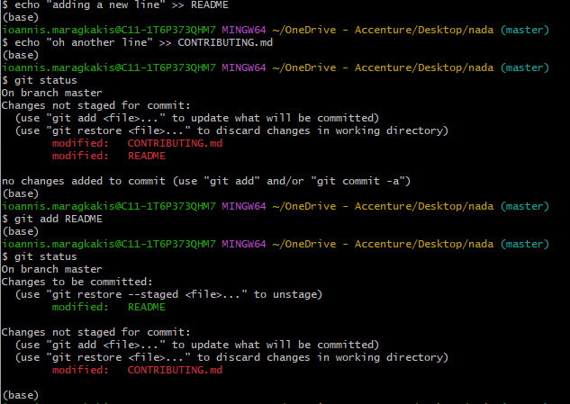
Git diff
Use git diff to find out more details about what have you modified but you have not staged.
Use git diff --staged to find out what have you staged that you are about to commit
Although git status, answers these questions, git diff shows you the exact lines added and removed
Let’s say you edit and stage the README file (append “adding a new line” in the file) and just edit the CONTRIBUTING.md file (append “oh another line”) without staging it. Let’s run the git status command. Now we have a modified but staged README file under Changes to be committed and a modified CONTRIBUTING.md file under Changes not staged for commit.

Slide 16
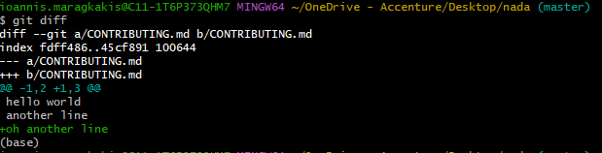
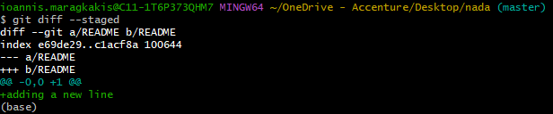
Git diff
Let’s see the two commands. Remember we added oh another line in the CONTRIBUTING.md and adding a new line in the README file. Git diff shows you what you have modified but not staged that is the CONTRIBUTING.md file (check the green text with the plus sign on the lower left image below). Git diff –staged show you what you have staged that you are about to commit that is the README file (check the green text again on the lower right)
git diff
git diff --staged

Slide 17
Git commit
We will see the git diff later. Now stage all the files by using git add and commit using: git commit –m “a short message” to commit inserting a short message of what you are about to commit
If you provide commit without the short message and do git commit , it will open the default editor to write a bigger message of what you are about to commit
The commit records the snapshot you set up in your staging area. Anything you didn’t stage is still sitting there modified.
Every time you perform a commit, you are recording a snapshot of your project that you can revert to later
You can also skip the staging area and commit right away using: git commit -a -m “commit a message”
This will make Git automatically stage every file that is already tracked before doing the commit so you just skip the git add part

Slide 18
Git remove and move
To remove a file from Git you have to remove it from your tracked files (remove it from the staging area) and then commit. The following command does that and also removes the file from your working directory so you don’t see it as an untracked file: git rm <file>
The next time you commit the file will be gone and no longer tracked
If you modified the file or had already added it to the staging area, you must force the removal with -f
If you want to keep the file in your hard drive but not have git track it anymore, use: git rm --cached <file>
To move or rename a file use: git mv <oldfile> <newfile>

Slide 19
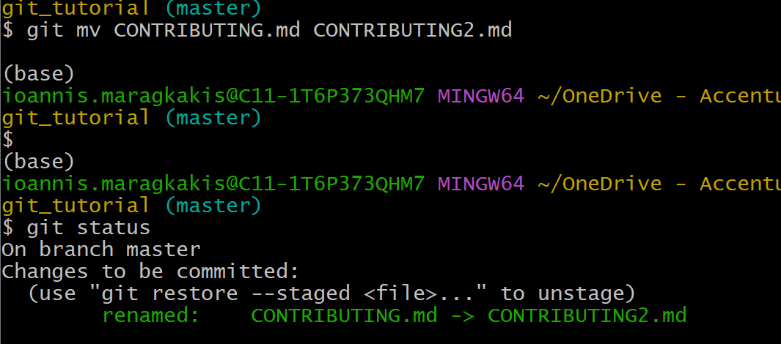
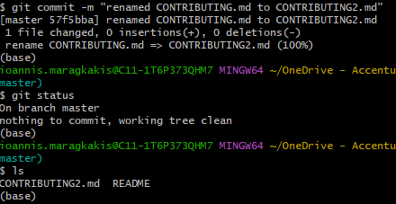
Git move
Here we move (or more specifically, rename) the CONTRIBUTING.md to CONTRIBUTING2.md. If you check, git understands about it and have it in the changes to be committed
Now we commit and check the files that we have in out current directory

Slide 20
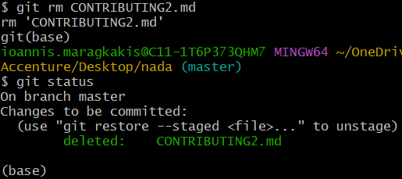
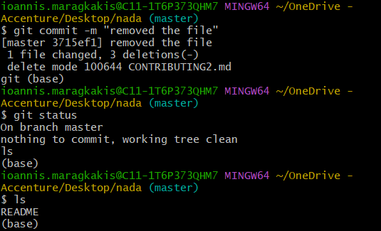
Git remove
Now let’s remove it using git rm <file>
An we again commit and see that the file is removed

Slide 21
Other general information
If you want to see the commits that you have done in the past use the git log command. It will list all the commits made in that repository, with its SHA-1 checksum, the author name, email, date written and the message passed into commit command.
Some flags that you can use in the git log command is:
git log -p -n (where the n is the number of entries displayed ex. Show me just the first two entries using -2)
git --stat (it prints below each commit entry some information about how many files were changed, how many lines in those files were added and removed etc. and a summary at the end
git --pretty=oneline (prints the entries in one line in a more compact form)
Check other options here
Git will use git restore to undo operations
Unstaging a staged file: git restore --staged <file>
Unmodifying a modified file: git restore <file>
Redo a commit, make additional changes you forgot, stage them and commit again: git commit --amend

Slide 22

Working with remotes
Remote repositories are versions of your git project that are hosted on the internet somewhere. Collaborating with others involves managing these remote repos and pushing and pulling data to and from them when you need to share work
Remote repositories can be on your local machine. It is entirely possible that you can be working with a remote repo that is , in fact on the same host you are
To see which remote servers you have configures, use git remote
If you cloned your repo, you should at least see origin (default name git gives to the server you cloned from)
You can also use the git remote -v to get the URLs that git has stored for the shortname to be used when reading and writing to that remote

Slide 23
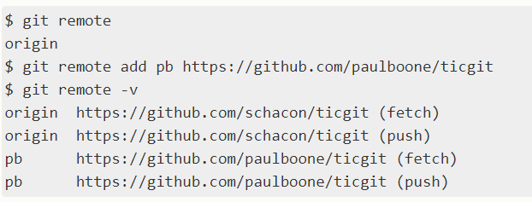
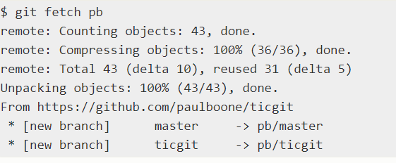
Working with remotes (2)
Add remote repositories using: git remote add <shortname> <url>
When you add a remote you can use the short name instead of the whole URL when performing any operation on the remote repo
Below you can see, we have just the origin when running the git remote, and then we add another repo (ticgit) give it a short name called pb. When we do that, we can use the word pb to do some operations, for example the fetch operation (check the right image) instead of the whole URL.

Slide 24
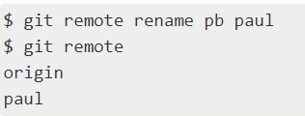

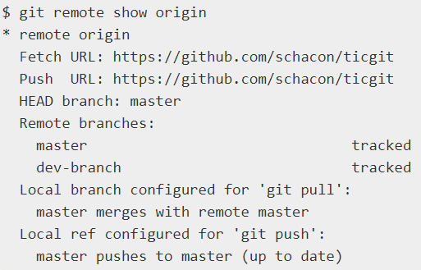
Working with remotes (2)
Use git remote rename <old name> <new name> to rename the remote’s shortname
Use git remote remove <name> to delete the remote reference to a remote
If you want to inspect a remote use git remote show <remote>

Slide 25
Git fetch pull push
The git remote command that we saw is used in conjunction with the git fetch, git push and git pull commands.
The git fetch command downloads commits, files and refs from a remote repo to your local repo. Fetching is what you do when you want to see what everybody else has been working on. It doesn’t force you to merge the changes into your repository. Git isolates fetched content from existing local content. It has no effect on your local repo. Fetched content has to be checked out using git checkout command. This helps review commits before integrating them with your local repo.
There is another command called git pull that is more aggressive than git fetch. It will download the remote content for the active local branch and immediately execute git merge command. So git pull consists of git fetch and then git merge
The git push command is used to upload local repository content to a remote repository. It is the counterpart of the git fetch but whereas fetching imports commits to local branches, pushing exports commits to remote branches. To push a specific branch use git push <remote> <branch>

Slide 26
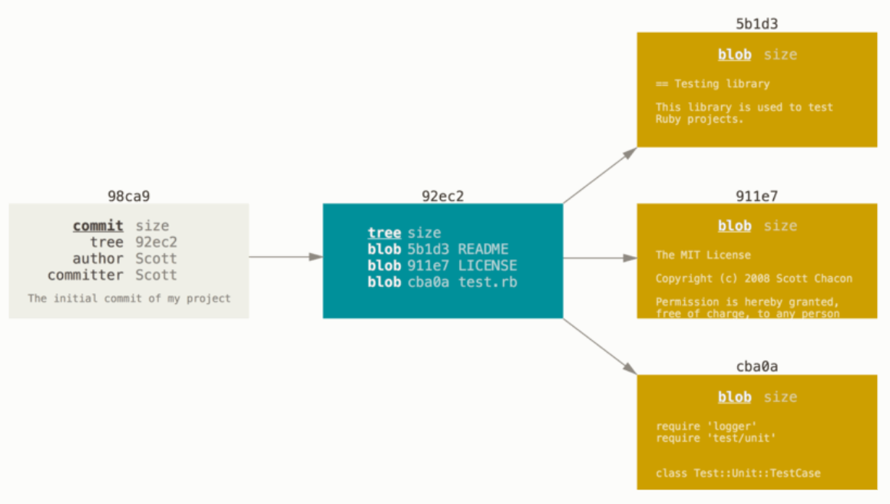
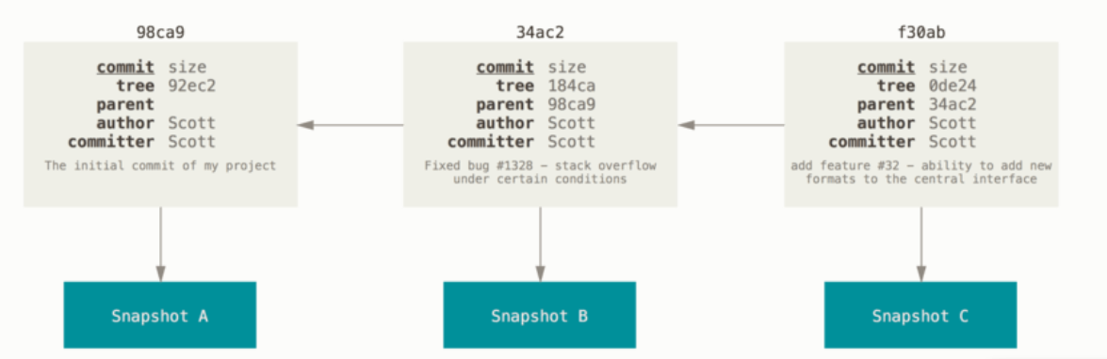
Branching
Branching means to diverge from the main line of development and continue to work without messing with that main line.
It is a simple movable pointer between the commits
The default branch name in Git is master
When committing git stores a commit object that contains: 1) Name of the author, 2) Email of the author, 3) Message that you typed, 4) Pointers to the commit or commits directly before this commit (parent or parents), 5) Pointer to the snapshot of the content you staged. This staged content is saved as a tree object that in generally represents the contents of a directory or subdirectory
For example, if we have a directory with 3 files and you stage them and commit, we get five objects (three blobs or file contents, one tree object and one commit object)

Slide 27
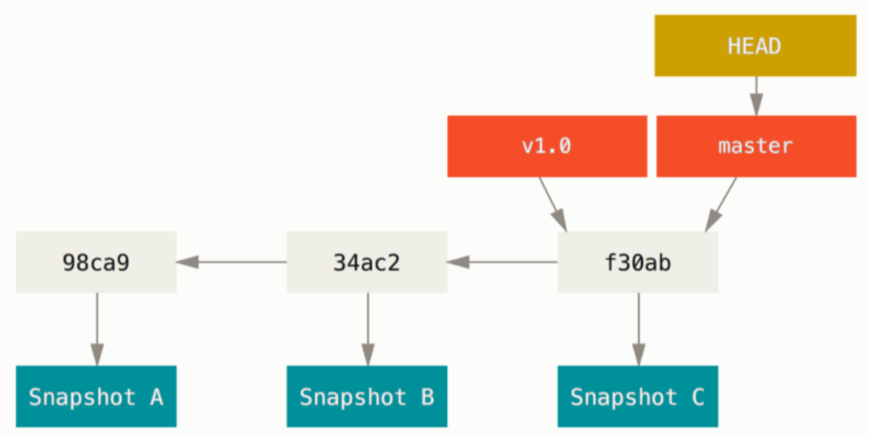
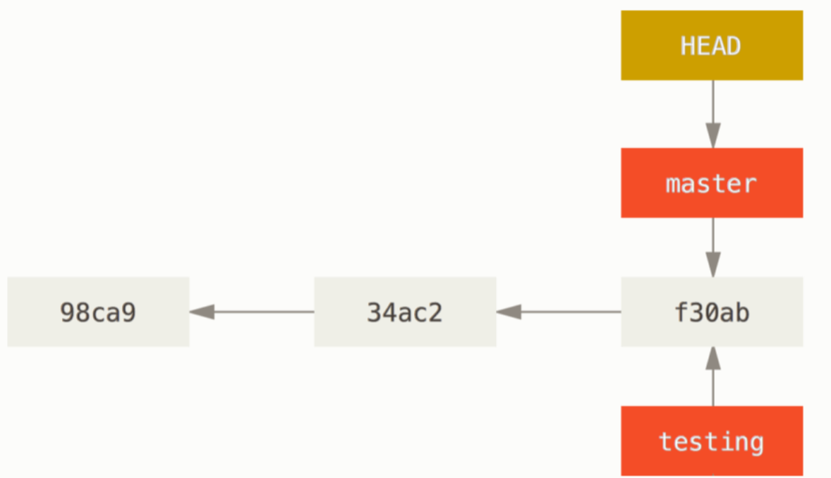
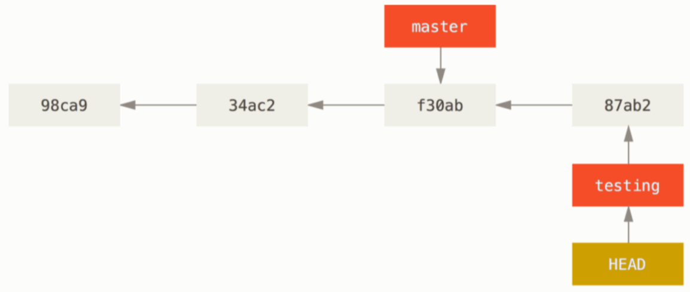
Branching
As you make commits, you are given a default master or main branch that points to the last commit you made. Every time you commit, the master branch pointer moves forward
When you make a new branch, you create a pointer that points to the same commit you are currently on
Because a branch in Git is a simple file that contains the 40-character SHA-1 checksum of the commit it points to, branches are cheap to create and destroy
To find out what branch you are currently on, Git keeps a special pointer called HEAD that always points to the current branch (use git log --oneline --decorate to see where is the HEAD at that time)
Default master branch
New branch pointing where master points
Change to testing and commit

Slide 28
Branching
To create a new branch use the git branch <branch> command (NOTE THAT WE JUST CREATED THE BRANCH, WE DIDN’T SWITCH TO THAT BRANCH)
To switch to an existing branch use the git checkout <branch> command. This changes the position of the HEAD pointer to the branch you switched to
To create a new branch and at the same time switch to that branch use git branch –b <branch>
Every time you make a commit when you are on the new branch (ex. testing), the pointer moves forward and your master stays at the same place.

Slide 29
Branching
To check where the HEAD points right now use git log –-oneline --decorate or git branch (the star in the result of git branch shows where is the current branch)
When you use the git checkout <branch> command, it moves that HEAD to the branch you want to switch to
By default git log will only show you the commit history below the branch you have checked out. To show commit history for the desired branch you have to explicitly specify it: git log <branch>. To show all of the branches use git log --all
It is important to note that when you switch branches in Git, files in your working directory will change to look like it did the last time you committed on that branch
Instead of the git checkout <branch> command you can also use git switch <branch>
Instead of the git checkout –b <branch> you can use git switch –c <branch>

Slide 30
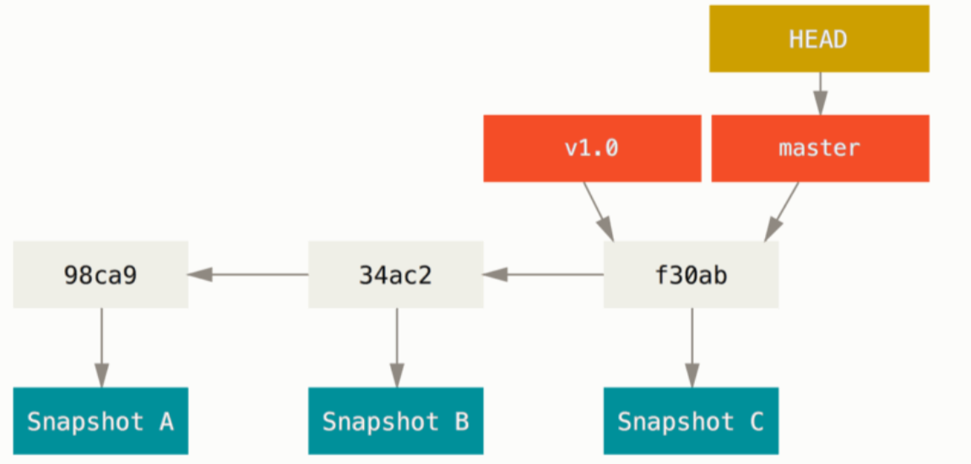
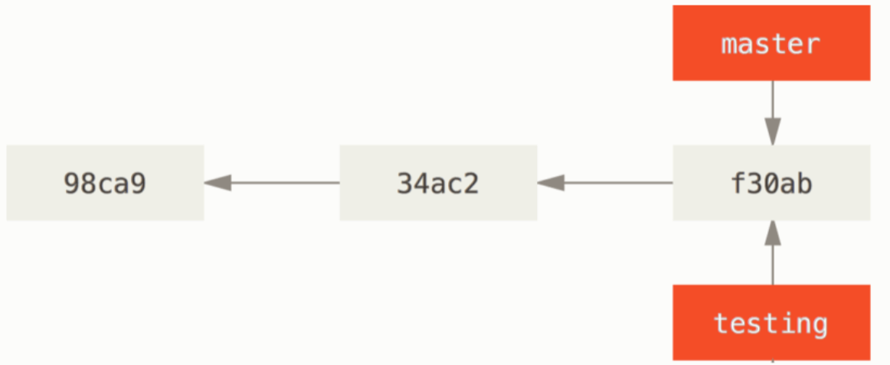
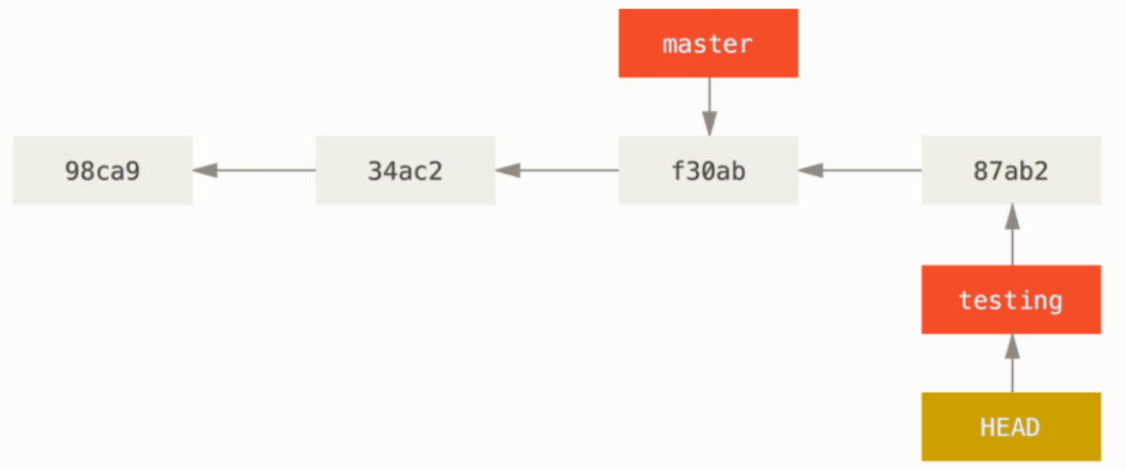
Branching example
Use git branch to see your branches and where is the HEAD (the one with the asterisk)
For example let’s say we have our master in f30ab (the HEAD points to the master branch)
We add a new branch called testing that points where master points
We switch branch to the testing (HEAD points to the testing branch) and then we commit some changes. As you can see, after we commit the changes, the master branch points to an earlier commit.

Slide 31
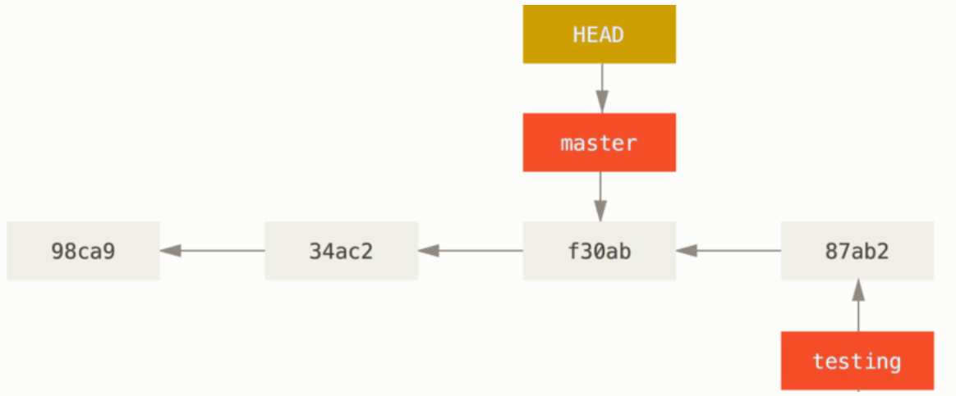
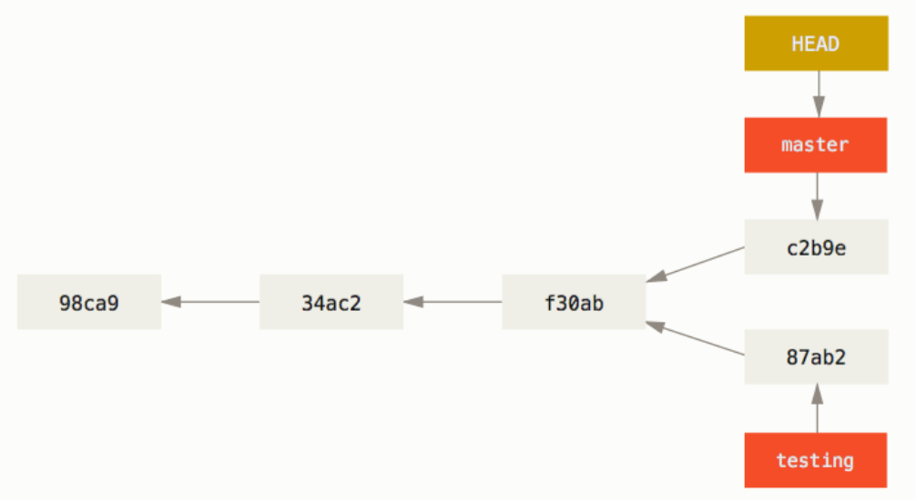
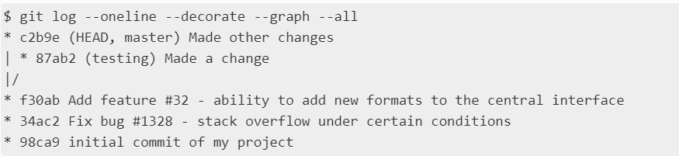
Branching
The testing branch has moved in comparison to the master branch. Let’s switch back to the master (the HEAD goes to the master branch)
Now make a commit when we are on the master branch. Now the master branch and the testing branch have moved to different directions or commits. To see all of the changes or history of the commits, use: git log --oneline --decorate --graph --all
We were on f30ab when we created the testing branch. Then we did different changes or commits to the testing branch and to the master branch. And they diverge from each other

Slide 32
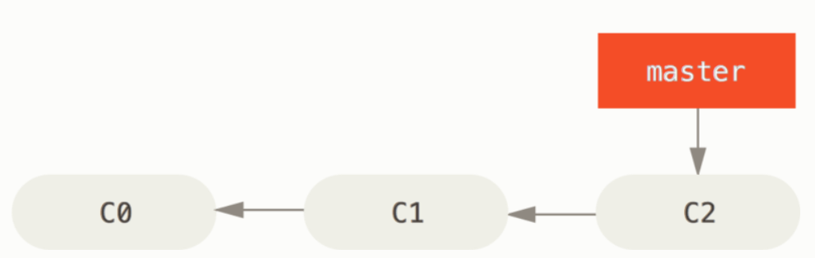
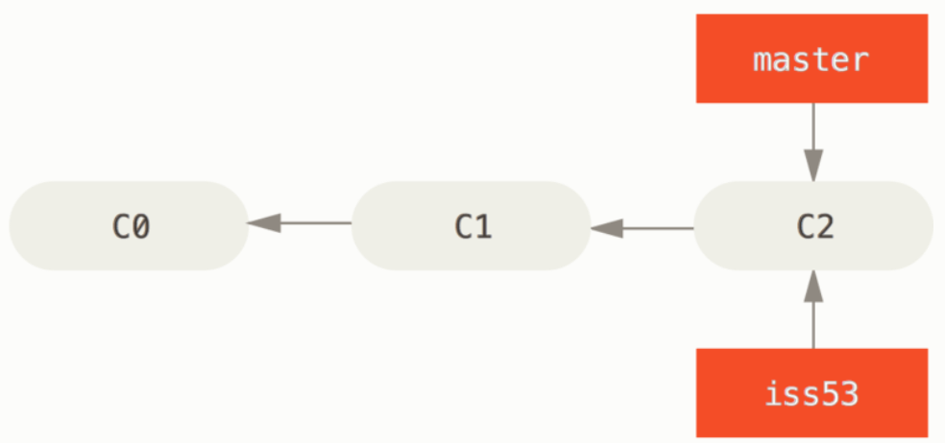
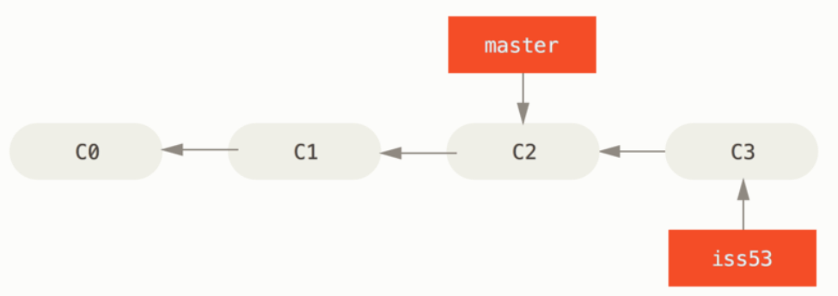
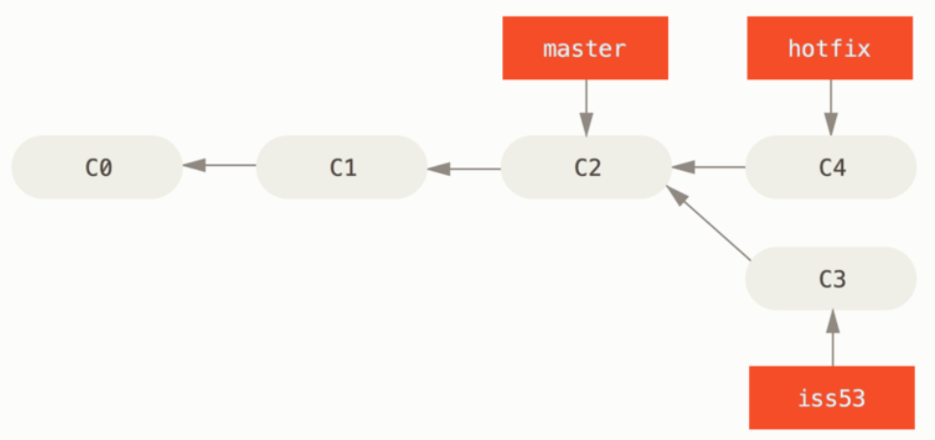
Basic branching example (2)
We are working on a project and we have some commits on master branch (C0-C2)
Now we decided that we want to work on issue #53. So we create that branch. That branch has the same commits as master: git checkout –b iss53
Now we do some commits on iss53 and the branch moves forward in comparison to the master branch: git commit ...
Now they tell us that there is another issue called hotfix. Switch to master branch, create the hotfix branch, switch to that branch and lastly do some commits: git switch master git switch –c hotfix git commit ...

Slide 33
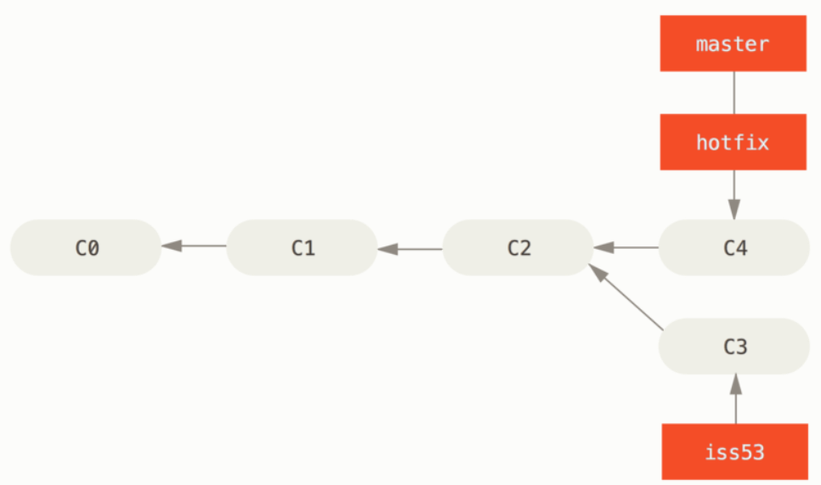
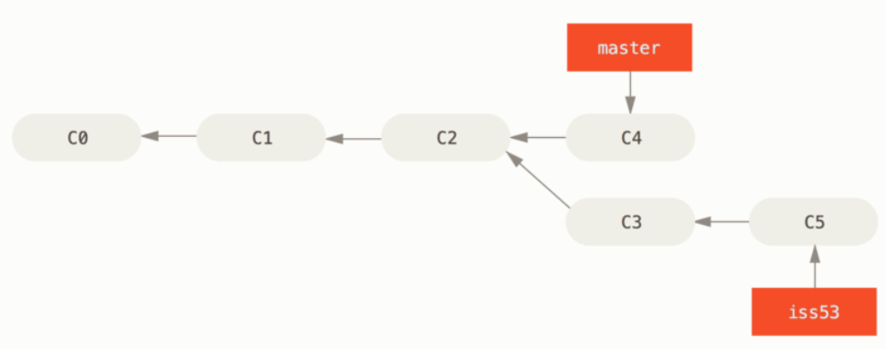
Basic branching example (2)
When we are ok with hotfix we merge it back into master branch. Switch back to master and merge: git checkout master git merge hotfix
Now delete the hotfix since you merged and you don’t need it and switch to the old iss53 issue and continue working (do some changes and commit) git branch –d hotfix git checkout iss53
Before
After
Here we have a fast-forward merge when you try to merge one commit with a commit that can be reached by following the first commit’s history, Git simplifies things by moving the pointer forward because there is no divergent work to merge together
It’s worth noting here that the work you did in your hotfix branch is not contained in the files in your iss53 branch. If you need to pull it in, you can merge your master branch into your iss53 branch by running git merge master (while you are on iss53 branch), or you can wait to integrate those changes until you decide to pull the iss53 branch back into master later.

Slide 34
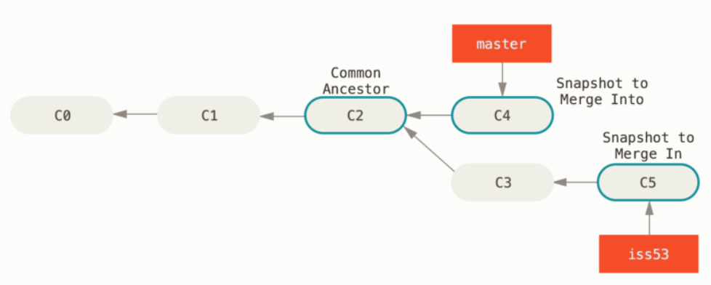
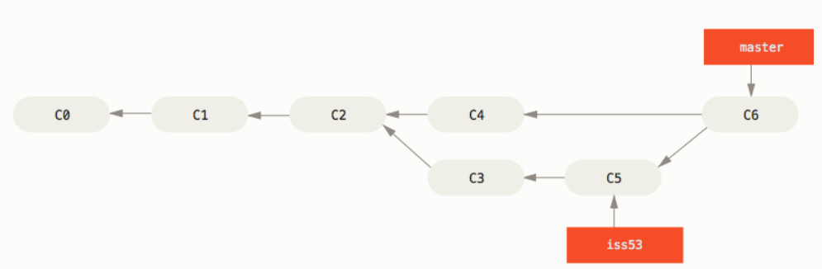
Basic branching example (2)
Suppose now that we want to merge the iss53 issue to your master branch. Go to the master branch and then merge iss53: git switch master git merge iss53
Here when we merge we see a different result from before. Because the commit on the branch you are on (master), isn’t a direct ancestor of the branch you are merging in (iss53), Git does a simple three-way merge using the two snapshots pointed to by the branch tips and the common ancestor of the two. Git creates a new snapshot that results from this three-way merge and automatically creates a new commit that points to it. This is referred to as a merge commit, and is special in that it has more than one parent. Now we can delete the iss53 branch: git branch –d iss53

Slide 35
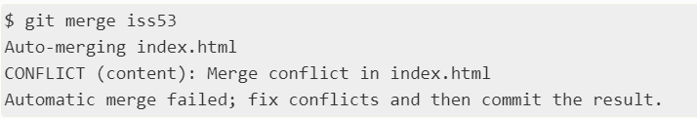
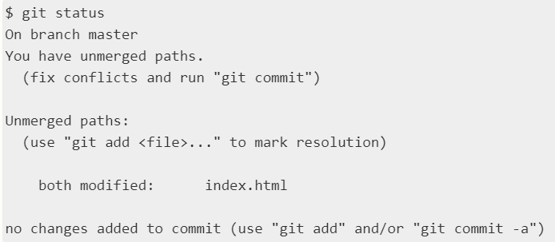
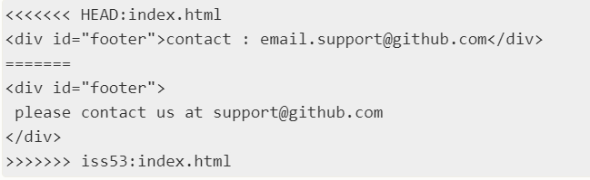
conflicts
If you have changed the same part of the same file differently in the two branches you are merging, you will get a merge conflict. An example of it, would be if you changed the same part of a file in issue #53 and hotfix.
Run git status to see which files are unmerged after a merge conflict
Git adds some conflict resolution markers to the files that have conflicts so you can open them manually and resolve those conflicts. To solve this you have to either choose one side or the other and you are done commit the changes.

Slide 36
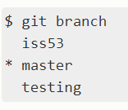




Branch management
You use git branch to check your branches and where the HEAD is located at that time (check the star)
To see the last commit in each branch use git branch –v
To see which branches are already merged into the branch you are on, use git branch –-merged
To see all the branches that contain work you haven’t yet merged in, run git branch --no-merge. Because testing contains work that isn’t merged in yet, trying to delete it with git branch –d testing will fail. If you really want to delete the branch and lose that work, force it: git branch –D <branch>
The above commands (--merged, --no-merged) show you what is, respectively, merged or not merged into your current branch. You can always provide an additional argument to ask about the merge state with respect to some other branch without checking that other branch out first

Slide 37

Branch management
To change the branch name you also need to change the name of it on the remote server (ex. GitHub). Rename it using: git branch --move <old_branch_name> <new_branch_name>
However, this change is only local. To let others see the corrected branch on the remote, push it git push --set-upstream origin <new_branch_name>
However, the old branch name is still on the remote server, so you need to delete it git push origin --delete <old_branch_name>
To rename the master branch into main use: git branch --move master main
Then push it: git push --set-upstream origin main

Slide 38
Types of branches
Two kinds of branches:
Long running branches
Topic branches
A topic branch is a short-lived branch that you create and use for a single feature or related work. In git it is common to create, work on, merge and delete branches several times a day (ex. Iss53, hotfix). You can keep the changes there for minutes, days, or months, and merge them in when they’re ready, regardless of the order in which they were created or worked on.
Long running branches are branches that are always open and that you use for different stages of your development cycle. Many Git developers have a workflow that embraces this approach, such as having only code that is entirely stable in their master branch — possibly only code that has been or will be released. They have another parallel branch named develop or next that they work from or use to test stability — it isn’t necessarily always stable, but whenever it gets to a stable state, it can be merged into master

Slide 39
Remote branches
Remote references are references or pointers to your remote repositories including branches, tags etc. To get a full list of remote references use git ls-remote <remote> or git remote show <remote>
Remote tracking branches are references to the state of remote branches. They are local references that you can’t move. Git moves them for you whenever you do any network communication (ex. they remind you where the branches in your remote repositories were the last time you connected to them)
Remote tracking branches take the form <remote>/<branch>. For example if you wanted to see what the master branch on your origin remote looked like last time you connected with it, you would check the origin/master branch. If you were working on an issue with a partner and they pushed up an iss53 branch, you might have your own local iss53 branch, but the branch on the server would be represented by the remote-tracking branch origin/iss53.
While master is the default name for a starting branch when you run git init which is the only reason it’s widely used, origin is the default name for a remote when you run git clone

Slide 40


Remote branches
Let’s say you have a Git server on your network at git.ourcompany.com. If you clone from this, Git’s clone command automatically names it origin for you, pulls down all its data, creates a pointer to where its master branch is, and names it origin/master locally. Git also gives you your own local master branch starting at the same place as origin’s master branch, so you have something to work from.
you do some work on your local master branch, and, in the meantime, someone else pushes to git.ourcompany.com and updates its master branch, then your histories move forward differently. Also, as long as you stay out of contact with your origin server, your origin/master pointer doesn’t move. Notice that the updated master branch on the server, is on the commit 190a3 and the local origin/master reference is on the commit f4265 (still not updated)

Slide 41

Remote branches
To synchronize your work with a given remote, you run a git fetch <remote> command (in our case, git fetch origin). This command looks up which server origin is (in this case, it’s git.ourcompany.com), fetches any data from it that you don’t yet have, and updates your local database, moving your origin/master reference pointer to its new, more up-to-date position. Now both the server master branch and the local origin/master reference points to the same commit.
Before
After
fetch

Slide 42

Tracking branches
Tracking branch is a local branch that represents a remote branch. These local tracking branches have the format <remote>/<branch>
After you git clone a repo, a local tracking branch is created (ex. origin/master) which represents the remote branch (ex. master)
Origin is the alias for the remote URL
The tracking branch is updated only with network operations like clone, fetch, pull, push

Slide 43


Tracking branches
Before when we cloned the repo, the C commit was the same for both the remote repo and the local repo. Now, suppose you have made a commit in the local repo (commit D), and also someone made a commit to the remote repo (commit E). Now we can see that your local master branch points to the latest commit (D), the remote repo master branch points to the commit E, and local tracking branch (reference) points to the commit C (it is still not updated).
If you type git status you will see that your local master branch is ahead of the origin/mater tracking branch by 1 commit:

Slide 44
Tracking branches
Note that if you clone from a remote repo, git will automatically create a tracking branch for the remote master branch. However, if you have a local repo and set the remote using git remote add <name> <url> then you will have to explicitly set the remote tracking branch on your own
You need the tracking branches because otherwise git wouldn’t know from which remote repo to sync with especially when using commands like fetch, pull, push etc.
To explicitly set remote tracking branches use git branch --set-upstream-to=<remote>/<branch> master command
If you just use git branch command it will only show you the local branches. If you also want to see the tracking branches then you can use git branch –a and it will list all the branches including remote tracking branches. Also you can use git branch -r command to see just the remote tracking branches.
The default tracking branch is set in the remotes/origin/HEAD path. This allows you to use just <remote> instead of <remote>/<branch> in Git commands. To change the default tracking branch use git remote set-head <remote> <branch> command
You can check whether default tracking branch is set or not by checking the .git/refs/remotes/origin/ location and if you have a file called HEAD then it means that default remote tracking branch is set

Slide 45
Remote branches
When you want to share a branch with the world, you need to push it up to a remote server to which you have write access. Your local branches aren’t automatically synchronized to the remotes you write to. You have to do it manually (push the branches you want to share). For example if you have a branch named serverfix that you want to work on with others, you can push it using git push <remote> <branch>. In our case git push origin serverfix.
If you didn’t want to call it serverfix on the remote, you could use git push origin serverfix:awesomebranch to push your local serverfix branch to the awesomebranch branch on the remote project.
SOS!!
It’s important to note that when you do a fetch that brings down new remote-tracking branches, you don’t automatically have local, editable copies of them. In other words, in this case, you don’t have a new serverfix branch — you have ONLY an origin/serverfix pointer that you can’t modify. To merge this work into your current working branch, you can run git merge origin/serverfix. If you want your own serverfix branch that you can work on, you can base it off your remote-tracking branch
https://stackoverflow.com/questions/4693588/what-is-a-tracking-branch

Slide 46


Slide 47
Remote branches
To delete a remote branch use the --delete option to git push. For example if you are done with the serverfix branch on the remote project, use git push origin --delete serverfix to delete it
When using git fetch it will fetch all changes on the server that you don’t have yet, but it will not modify your working directory. It will simply get the data for you and let you merge it yourself. There is a command called git pull which is a git fetch immediately followed by a git merge.
If you have a tracking branch set up either by explicitly setting it or by having it created for you by the clone or checkout commands, git pull will look up what server and branch your current branch is tracking, fetch from that server and then try to merge in that remote branch

Slide 48
What makes a repo popular
This question can be answered with 3 metrics:
Star, when a user likes your repo or they want to show some appreciation, they star it
Watch, when a user wants to be notified of all the activities in a repo, they watch it
Fork, when a user wants a copy of the repo or they inted to make contributions, they fork it

Slide 49

What is code of conduct
The code of conduct, defines standards for how to engage in a community. It signals an inclusive environment that respects all contributions. It also outlines procedures for addressing problems between members of your project's community.

