Slide 1
Introduction
Learning problems fall into the following categories:
Supervised learning, where the available data consists of features and an associated label. The goal is to learn the function that maps feature vectors (inputs) to labels (output). Each example is a pair of an input vector and a desired output value. Some examples are:
Classification: samples belong to two or more classes, and we want to learn from already labeled data , how to predict the class of unlabeled data (ex. Handwritten digit recognition)
Regression: The desired output consists of one or more continuous variables (numeric). Example the prediction of the length of a salmon as a function of its age and weight
Unsupervised learning, in which training data consists of a set of input vectors x without any corresponding target values. The goal is to discover groups of similar examples within the data (clustering), determine the distribution of data within the input space (density estimation).

Slide 2
Introduction 2
A common practice in machine learning is to evaluate an algorithm by splitting a data set into two: a) a training set on which we learn some properties, b) testing set on which we test the learned properties
Scikit-learn deals with learning information from one or more datasets that are represented as 2D arrays. They can be understood as a list of multi-dimensional observations. We say that the first axis of these arrays is the samples axis, while the second is the features axis.
Sklearn also provides, many built-in machine learning algorithms and models, called estimators. Each estimator can be fitted to some data using its fit method that accepts 2 inputs: a) the samples matrix (X) in the form (n_samples, n_features) and b) the target values (y) which are real numbers for regression tasks, or integers for classification tasks. The target values are usually 1d array.
Once an estimator is fitted, it can be used for predicting target values of new data

Slide 3
Transformers and pre-processors
A typical pipeline in machine learning consists of a pre-processing step that transform or imputes the data (pre-processors, transformers) for example StandardScaler and a final predictor that predicts target values
The transformer objects don’t have a predict method but a transform method that outputs a newly transformed sample matrix X.
Sometimes, you want to apply different transformations to different features: the ColumnTransformer is designed for these use-cases.

Slide 4
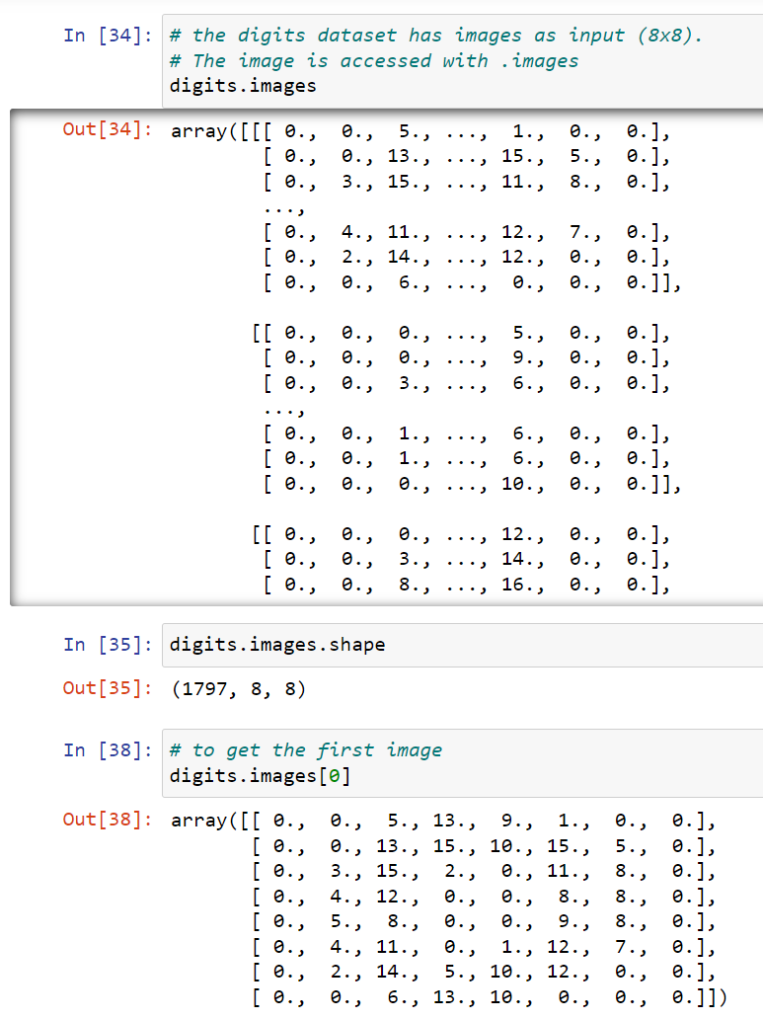
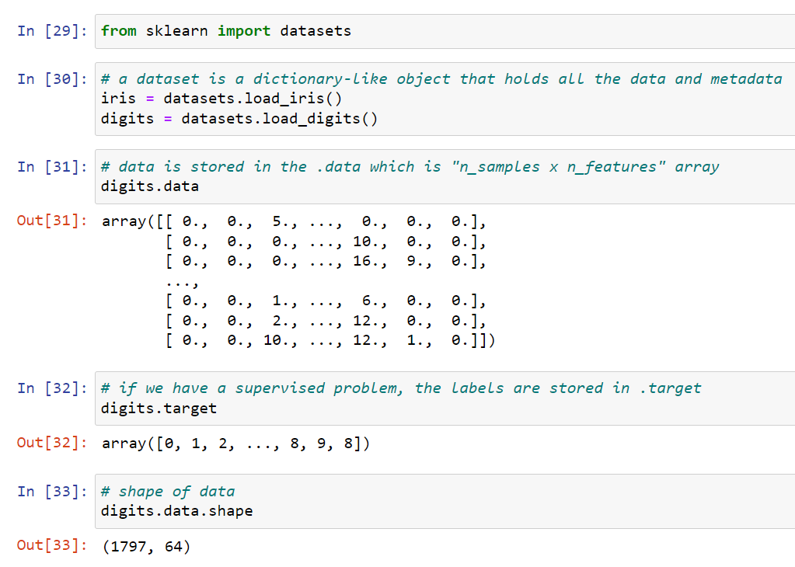
Sk-learn datasets
SK-learn has the iris and the digits dataset for classification and the diabetes dataset for regression
Other useful keys in dataset dictionary is the DESCR that describes the dataset, the feature_names that contains the names of the features and the target_names that contain the names of the target or labeled values. These can be extracted using:
<dataset>.DESCR
<dataset>.feature_names
<dataset>.target_names

Slide 5
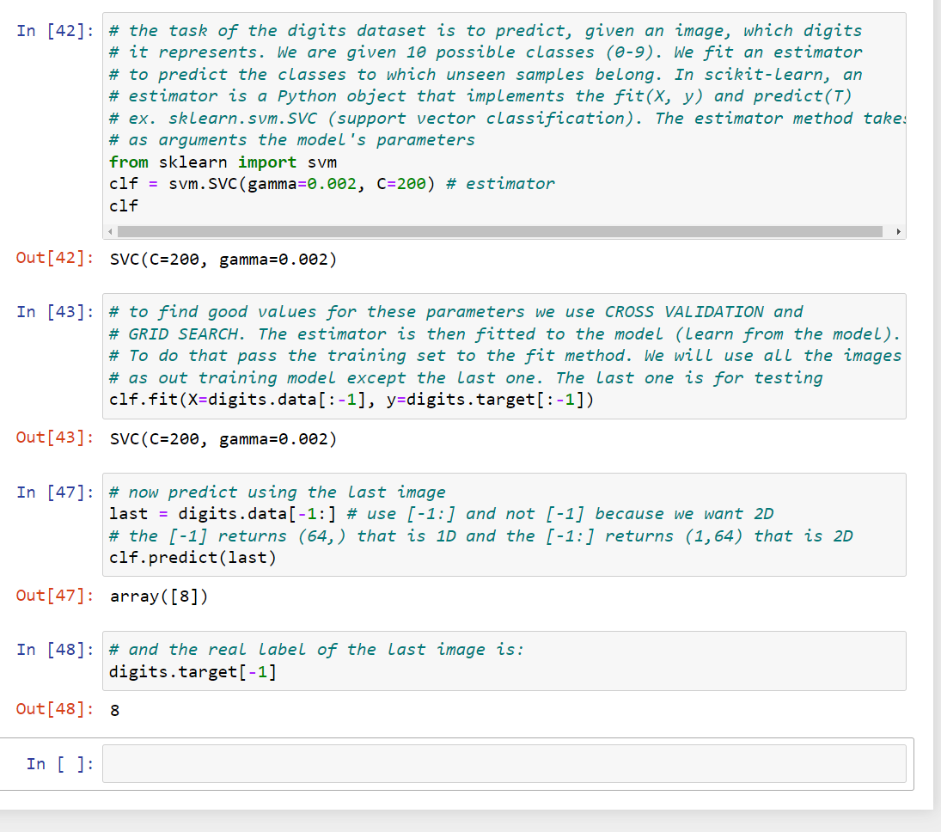
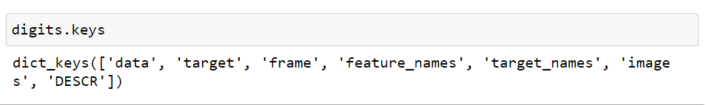
Digits dataset
The keys of the dictionary of the digits dataset is:

Slide 6
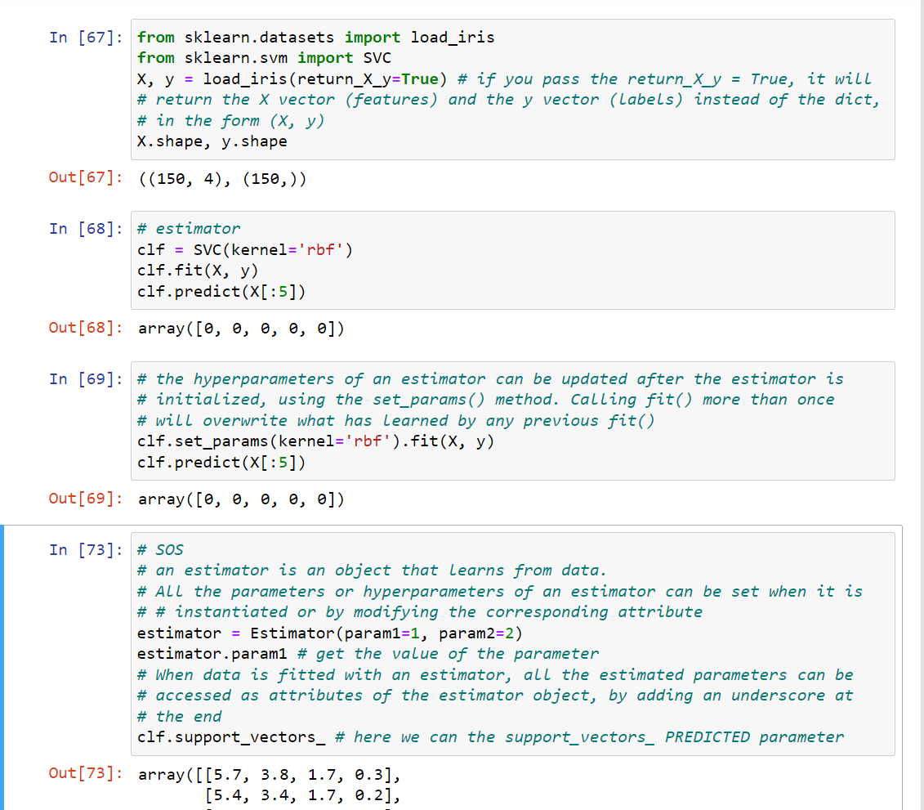
Updating parameters

