Slide 1
Application of Extreme Value Theory to Tennis Serve Record Estimation
Blue Yonder Meetup
Ivan Marevic, 26.10.2023

Slide 2
Agenda
Introduction
What is Extreme Value Theory (EVT)?
EVT Basics
Applications of EVT and Tennis Serve Record Estimation
Summary & Next Steps

Slide 3
Introduction

Slide 4
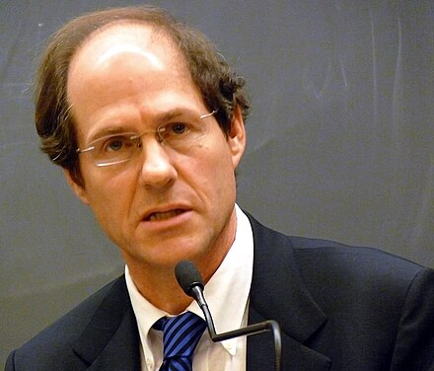




Introduction
How did I get interested in Extreme Value Theory (EVT)?
1. During COVID-19 → plenty of time
2. Downplay of COVID-19 by “experts”
Cass Sunstein
Richard Thaler
(Nobel Price in Economics)
Dr. Phil
“More people drown in a swimming pool than are killed by Covid”
“Most people in North America and Europe do not need to worry much about the risk of contracting the disease. That's true even for people who are traveling to nations such as Italy that have seen outbreaks of the disease.”

Slide 5
What is Extreme Value Theory?

Slide 6


What is Extreme Value Theory?
Outliers
Extremes
Data point out of the natural range of variation
Might be caused by measurement error → removed from data
Data point within natural range of variation
Characterized by unusual magnitude or temporal scarcity
4.20 m
→ gain in stock option of 40%
→ gain in stock option of 800%
2.30 m
1.40 m

Slide 7
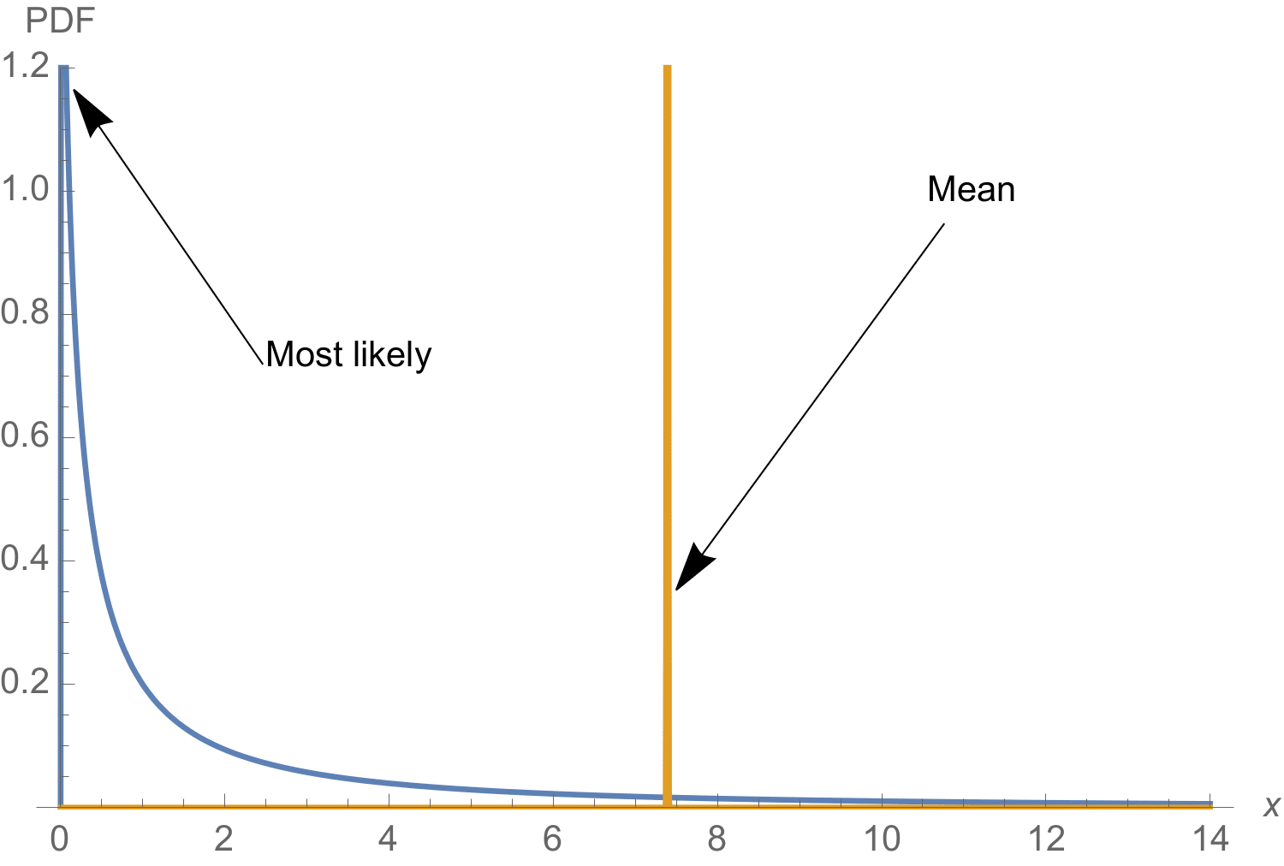
What is Extreme Value Theory?
What are we trying to do with EVT?
Check if the phenomenon we are investigating is fat tailed or not?
Find the endpoint of a distribution (if it exists)
endpoint x* =
?

Slide 8
EVT Basics

Slide 9
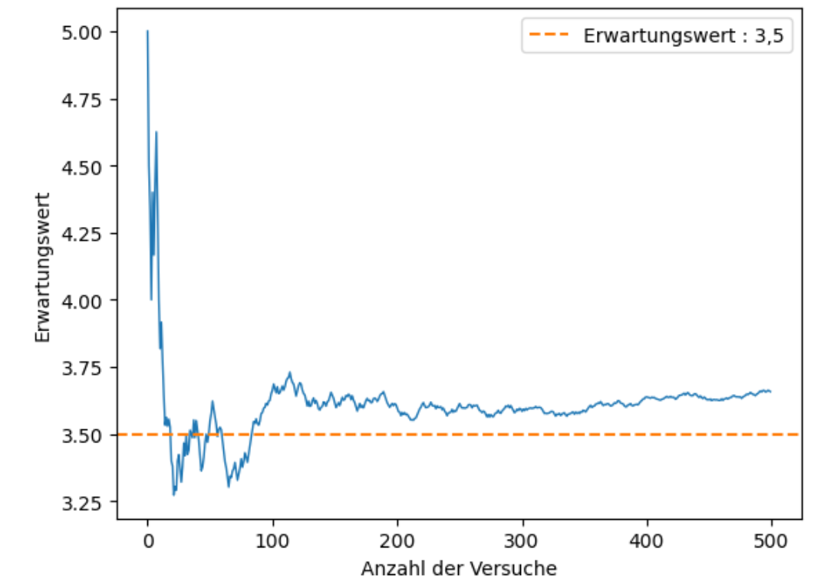
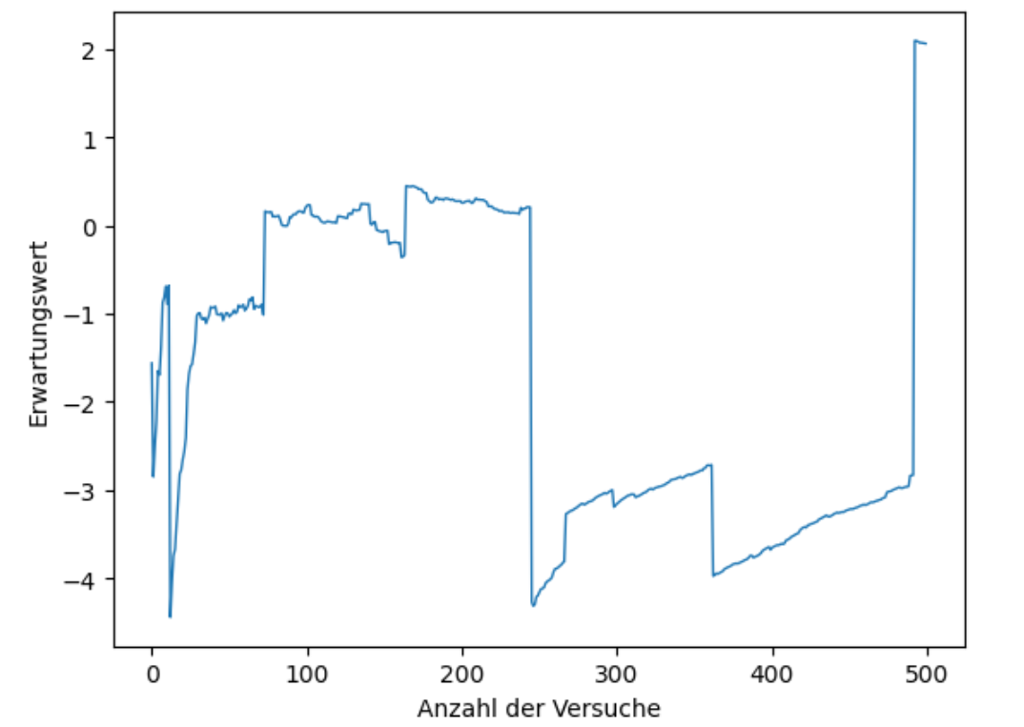
EVT Basics
Die roll E(X):
Why do we need EVT?
Assumption of normality does not hold in many cases
Future extremes are not in the current data
Many statistical concepts/operations fail to work on fat-tailed distributions
Cauchy E(X):

Slide 10
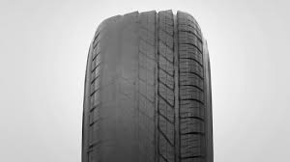
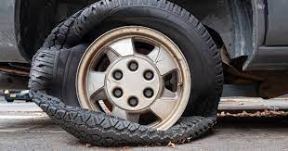
EVT Basics
Given X1, X2, …, Xn iid random variables, the central limit theorem is concerned with with the limit behavior of partial sums X1 + X2 +… + Xn as n → ∞
EVT is concerned with max(X1, X2, …, Xn) or min(X1, X2, …, Xn) as n → ∞
Example scenarios:
  Tires of a car wear out over time and over a long time the accumulated decay results in failure → partial sum exceeds a threshold (CLT)
  Tire blows up when hitting the sidewalk → partial maxima exceed threshold (EVT)

Slide 11
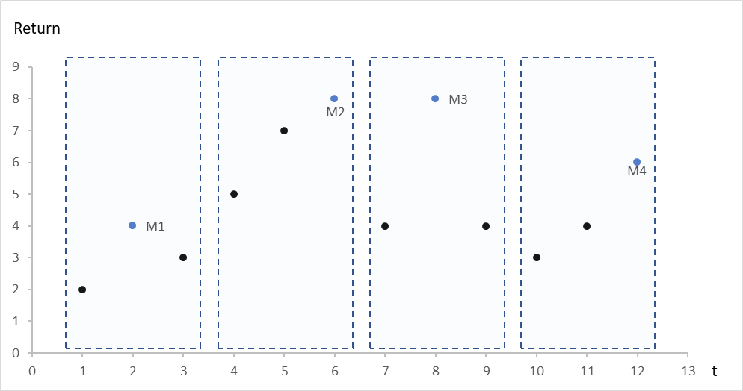
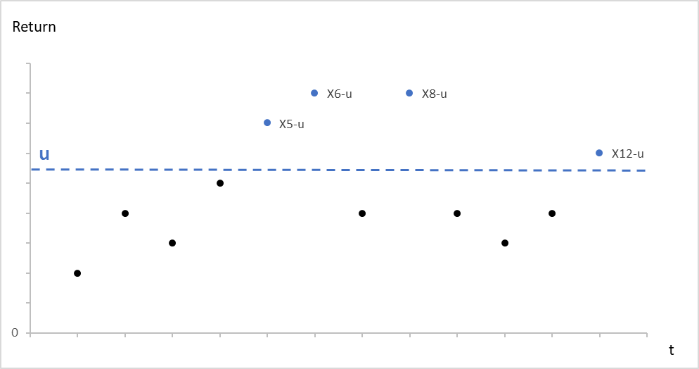
EVT Basics
How do we get the maxima?
For non time series data define maximum per unit of interest
  Max. age per person
  Max. tennis serve speed per player in a dataset
For time series data we can either use the block maxima (BM) or peaks over threshold (POT) methods
BM
POT

Slide 12
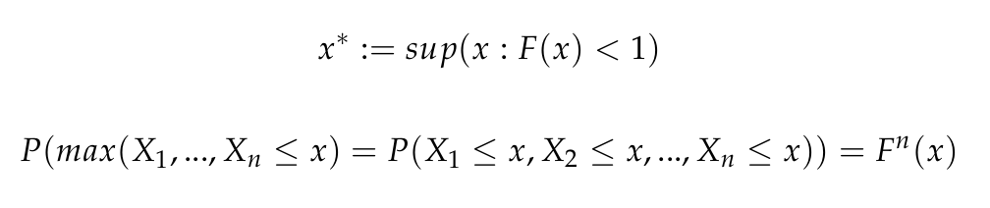


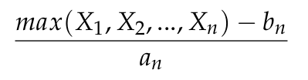

EVT Basics
Extreme Value Distribution
Let F be the underlying distribution function and x* its right endpoint.
Thus, some normalization is necessary:

Slide 13

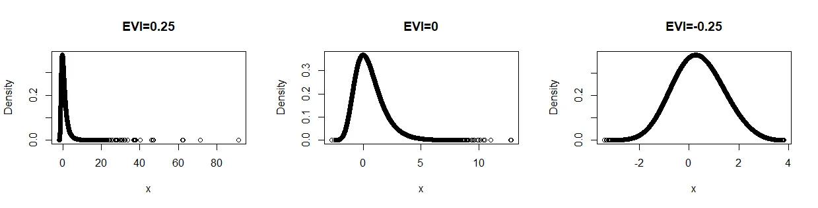
EVT Basics
Subclasses of the Extreme Value Distribution (G)
Parametrized general form by introducing the extreme value index ξ:
ξ case | consequence | distribution class
ξ > 0 | the right endpoint of the distribution is infinity → heavy right tail (major moments do not exist) | Frechet
ξ = 0 | the right endpoint of the distribution equals infinity → light tailed (moments exist) | Gumbel
ξ < 0 | The right endpoint of the distribution exists → short tail | Reverse-Weibull

Slide 14

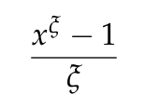
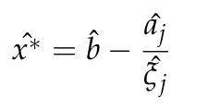
EVT Basics
Estimating the endpoint x*
As a reminder we need to estimate
It can be shown that
≡
with x > 0
For ξ < 0 this yields the following estimator for j = 1, 2:

Slide 15
Applications of EVT & Tennis Serve Record Estimation

Slide 16





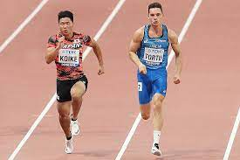
Applications of EVT
Overview of application areas of EVT
Wars
Dike height
Pandemics
Skyscraper height
Life span
Athletic records

Slide 17
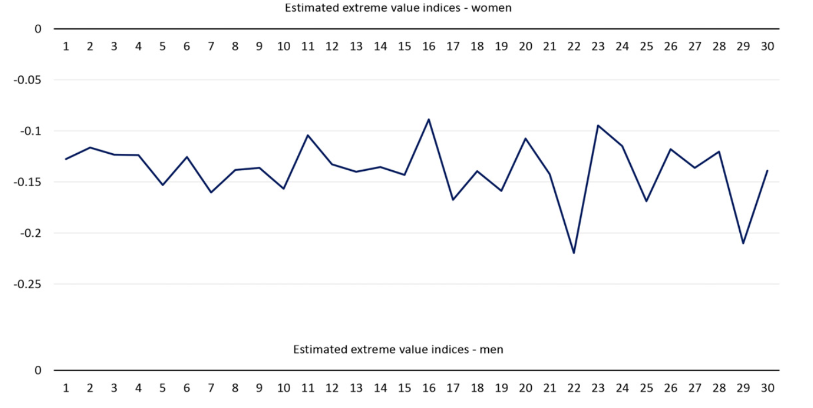
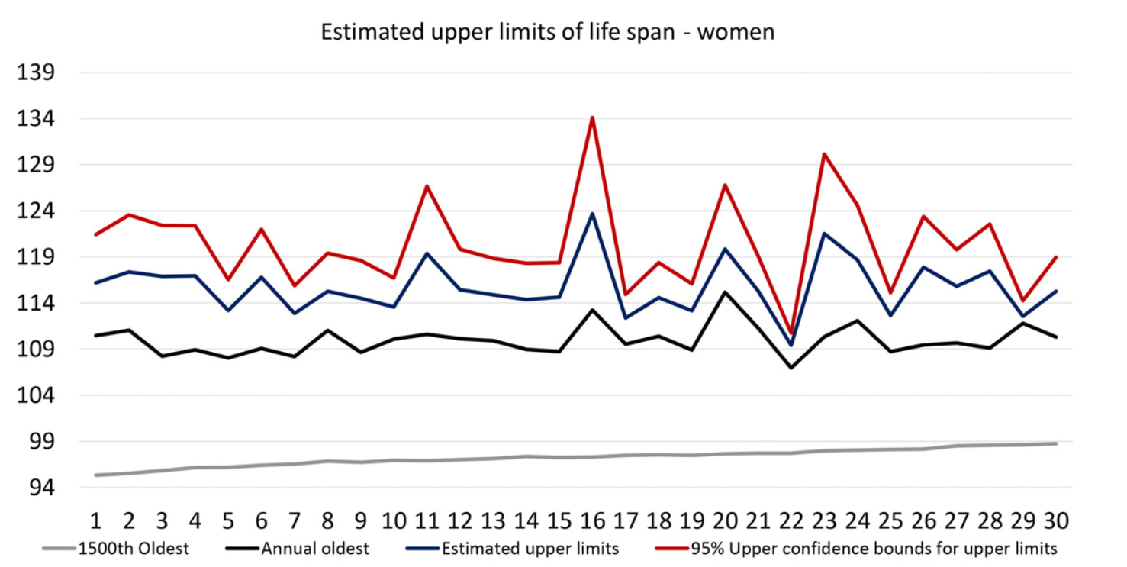
Applications of EVT
Human Lifespan Endpoint Estimation (Einmahl et al. 2019)
All analyses done for each year in a 30 year span
Estimate EVI to check if endpoint is finite
Estimate the endpoint and derive 95% CI for the upper bound

Slide 18
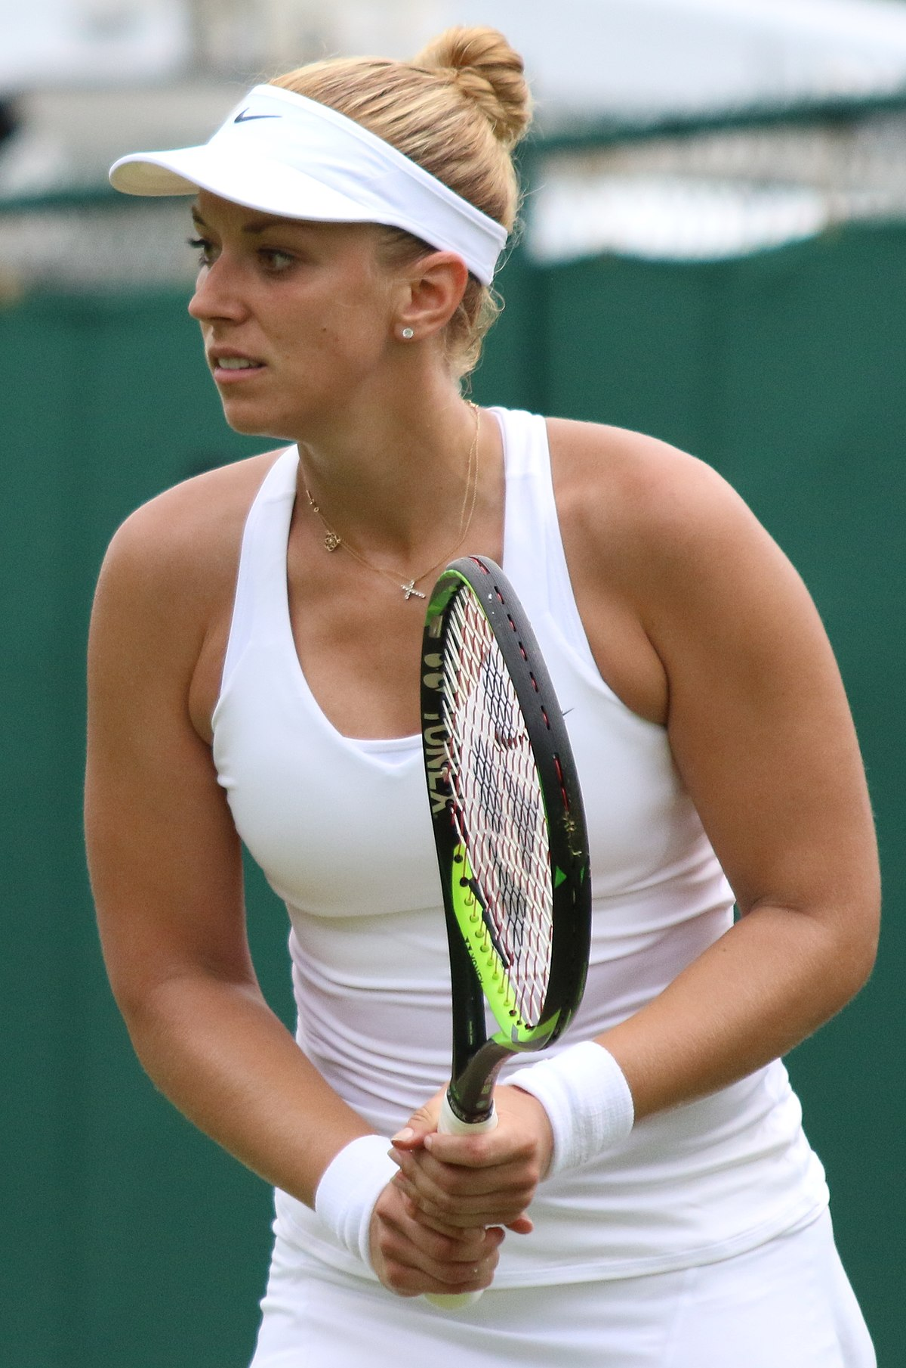
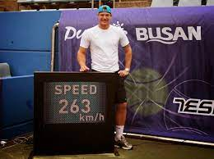
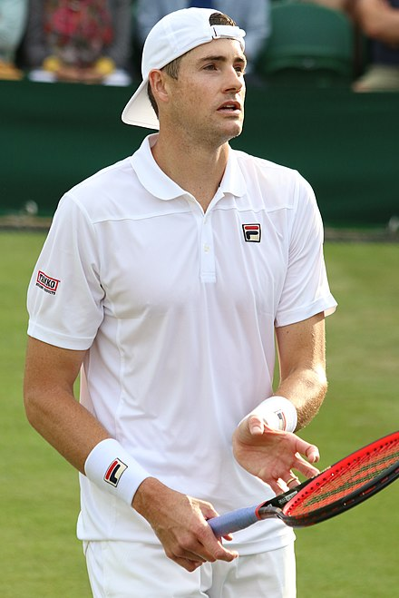
Tennis Serve Record Estimation
Background
the current officially recorded tennis serve records:
  Women: 210.8 km/h (Sabine Lisicki)
  Men: 253 km/h (John Isner)
These records were recorded at events on the official major circuits (WTA and ATP)
Unofficial records
  Women: 220 km/h (Georgina Garcia Perez)
  Men: 263 km/h (Sam Groth)
?

Slide 19
Tennis Serve Record Estimation
Research Questions
What is the fastest tennis serve possible for women and men given today's technology and equipment?
What is the quality of the estimated record (e.g. estimate of expected number of exceedances of the estimated record)?
How plausible are the unofficial serve records given the endpoint estimates?

Slide 20
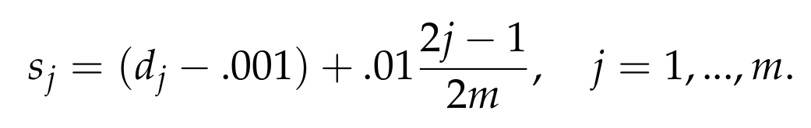
Tennis Serve Record Estimation
Examples of misspellings:
DiMitrov vs. Dimitrov
Ramos-Vinolas vs. Ramos Vinolas
The Data
point-by-point data from the 4 major tournaments since 2011¹.
inclusion of official recordings of serve speeds that were not in this dataset (incl. world record)
extraction of serve speed maximum for each player and correction of misspellings
  every player occurred once in the final dataset
  Multiple identical entries where smoothed as the estimation procedure is sensitive to clusters:
190.10 km/h
190.20 km/h
190.30 km/h
d=serve speed
m=number of players in cluster
190.10 km/h
190.20 km/h
190.30 km/h
¹https://github.com/JeffSackmann/tennis\_slam\_pointbypoint

Slide 21
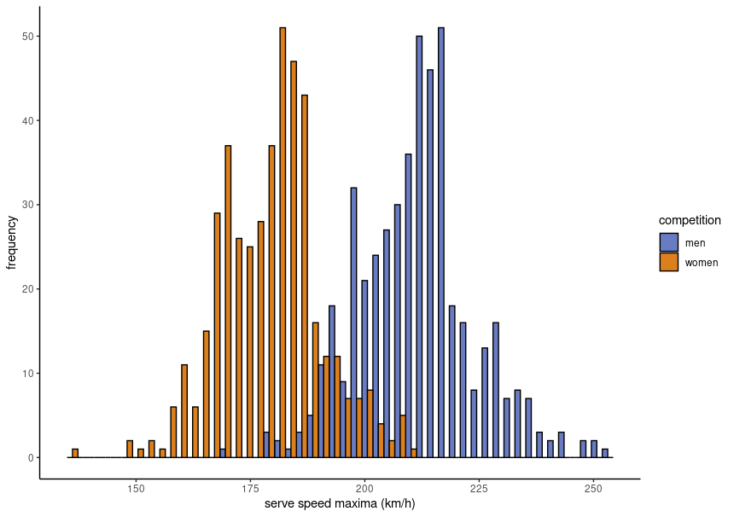
Tennis Serve Record Estimation
Serve speed distributions for men and women

Slide 22
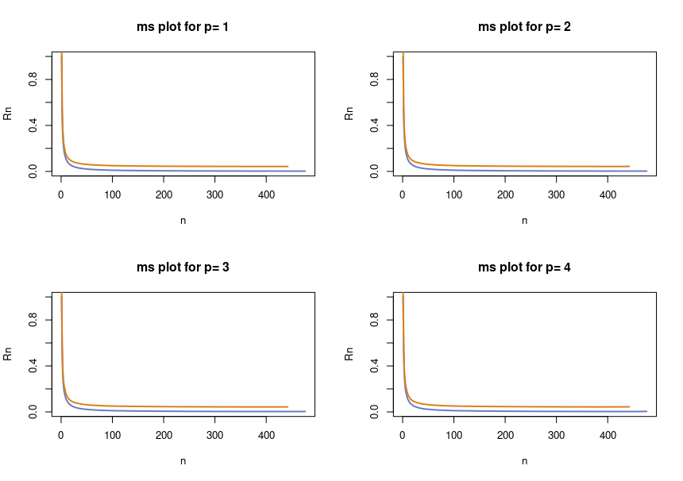
Tennis Serve Record Estimation
Test for normality: MS Plot

Slide 23
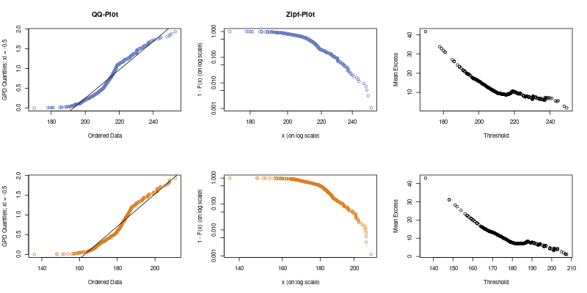
Tennis Serve Record Estimation
Fat tails inspection: QQ, Zipf & ME Plot

Slide 24
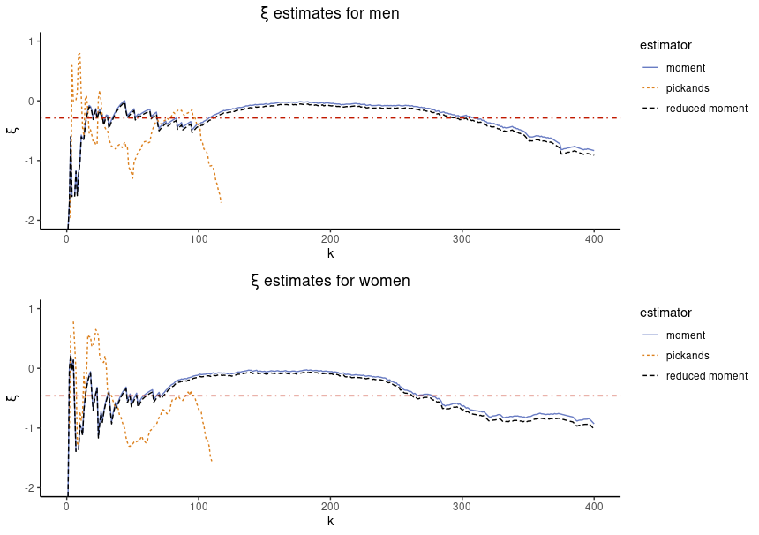
Tennis Serve Record Estimation
Extreme Value Index Estimation (ξ)
EVI estimators:
  Pickand’s
  moment
  reduced moment
first stable region of at least 50 data points
take mean over stable region
ξ < 0 for both women and men
endpoint exists

Slide 25
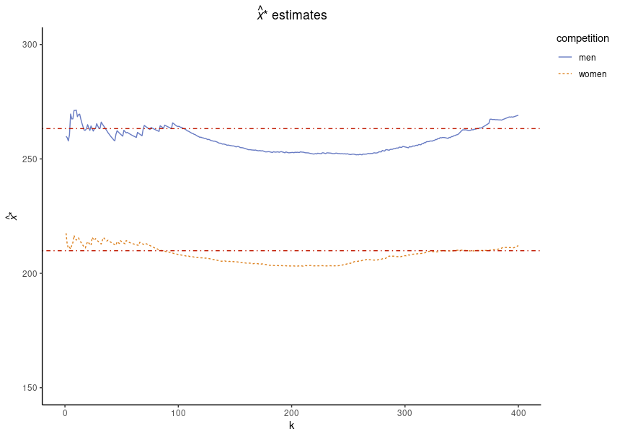
Tennis Serve Record Estimation
Endpoint Estimation (x*)
Endpoint estimation:
first stable region of at least 50 data points
take mean over stable region
x* women: 211.43 km/h
x* men: 262.65 km/h

Slide 26
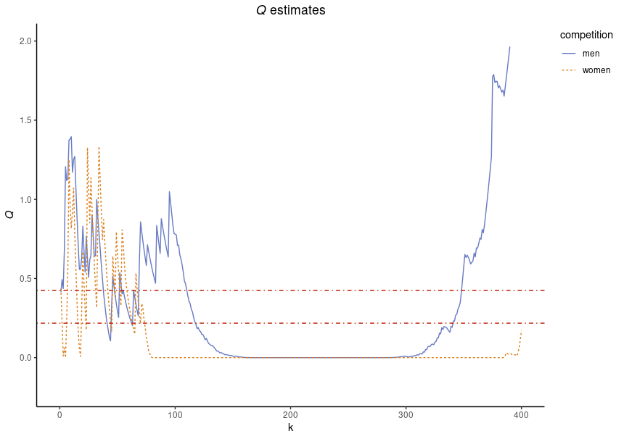
Tennis Serve Record Estimation
Quality of Estimated Endpoint (Q)
Number of exceedances of estimated endpoint given current record Xn,n
Q women: 0.42
Q men: 0.21
Q < 0.5 which indicates a good quality → record is unlikely to be exceeded in general
record is more likely to be broken for women compared to men

Slide 27
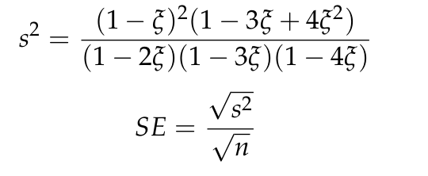
Tennis Serve Record Estimation
Plausibility of Unofficial Serve Records
Construction of confidence interval (CI) around the estimated endpoint given ξ:
Check if upper bound includes the unoffical records:
    Women UB: 211.75 km/h
    Men UB: 263.47 km/h
Unofficial records:
Women:
  214 km/h (A. Sabalenka)
  220 km/h (G. Garcia Perez)
Men:
  257.5 km/h (A. Olivetti)
  263 km/h (S. Groth)
CIupper = Xmean + (SE * 1.96)

Slide 28
Summary & Next Steps

Slide 29

Summary & Next Steps
Summary:
tennis serve record endpoints can be estimated for women and men competitions
Quality of estimated endpoints is good
Unofficial records seem plausible for men but not for women
Next Steps:
Tennis serve record estimation on year by year basis → technology effects
Investigate how EVT applicable to ML methods

Slide 30



Thanks for your attention!
Code: https://github.com/imarevic/evt_ts
Contact:
Ivan Marevic imarevic89@gmail.com https://www.linkedin.com/in/ivan-marevic-9776a8243/

