Slide 1
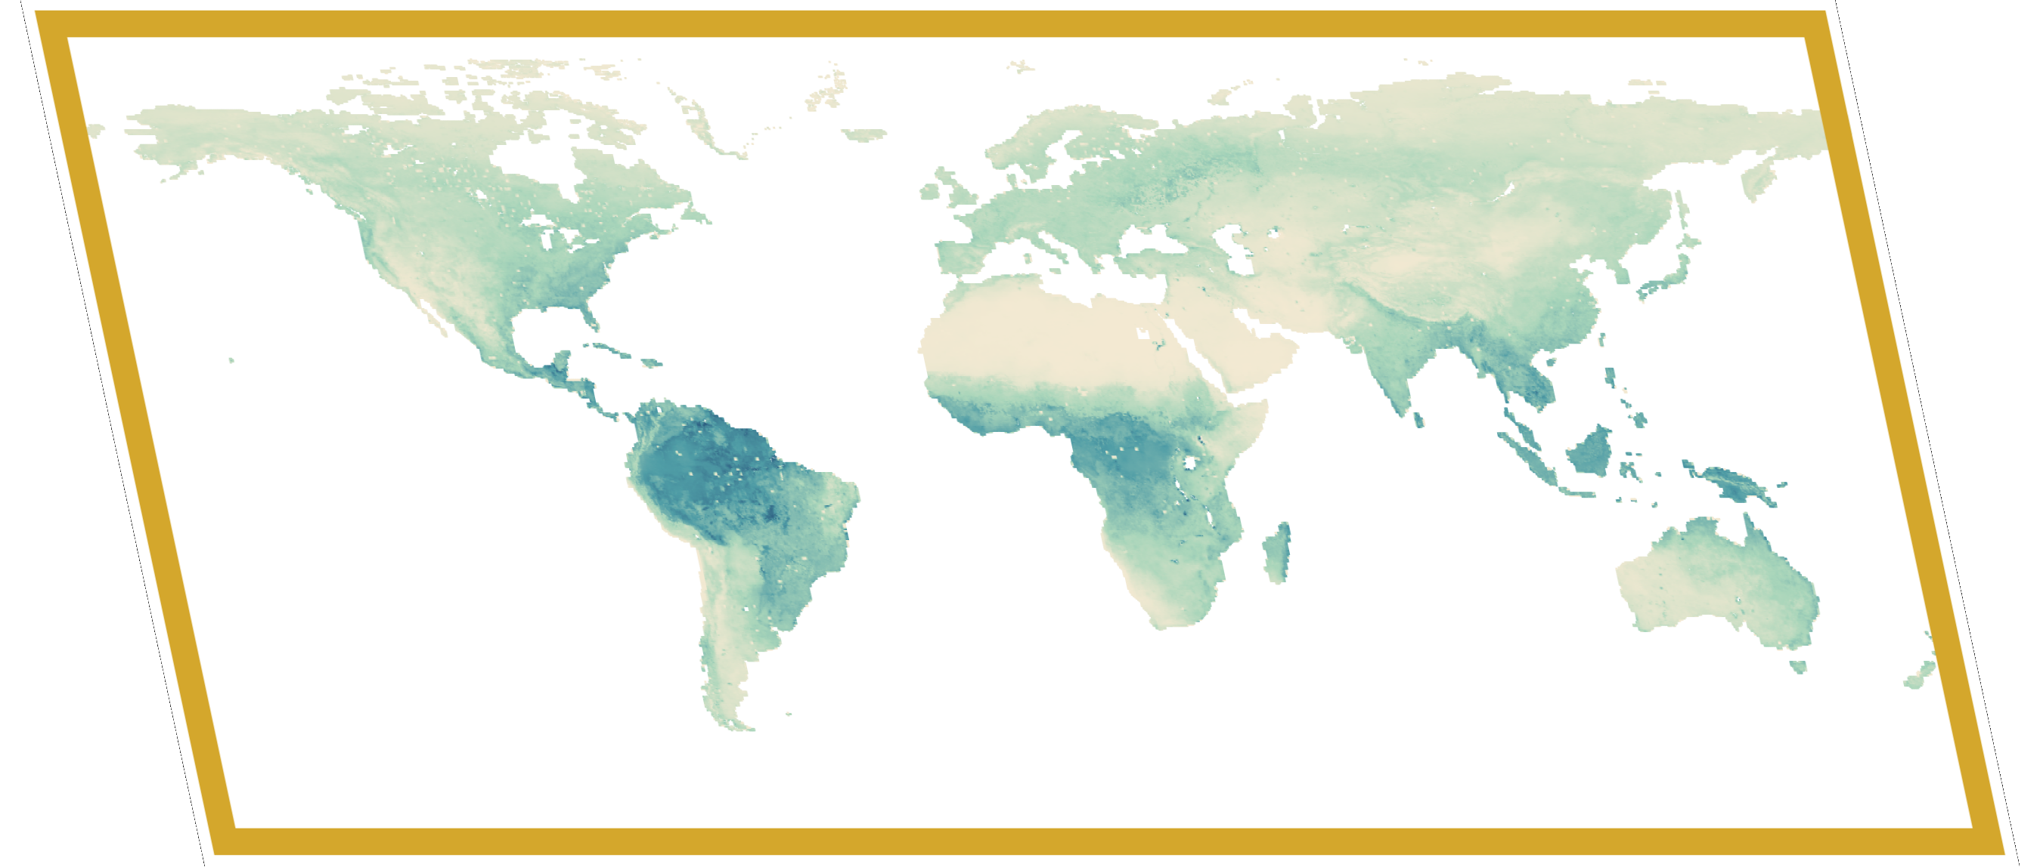
Inputs
Candidate-specific evaluation
Sampling probabilities
Monte Carlo sampling
Global land · 0.25°
annual 1982–2021
Per grid cell for P and E
Use 4 error metrics to calculate performance scores and ranks
For all 235 units
biome x IPCC region
Calculate statistics
Coherent precipitation (P) and
evaporation (E) candidate pairs
Grid-cell weights
For 100 members, sample a uniform random number in [0,1]
Mean
Standard deviation (sd)
Sen-slope
Trend significance
10 scenarios Table X
2 product scenarios:
Base and Change
8 sensitivity scenarios
1 | ERA5-Land | ERA5-Land
2 | FLDAS | FLDAS
3 | MERRA-2 | MERRA-2
4 | TerraClimate | TerraClimate
5 | MSWEP | GLEAM
Reuse that number across all 10 scenarios
Leave-candidate-out
Select candidate P–E pair using unit’s cumulative scenario sampling probabilities
Physics gate
For candidate pairs, is P/E ≥ 0.9?
AND
For at least 7 of 12 PET estimates, is E < PET?
No ➔ Pair’s grid-cell weight = 0
Candidate
Use the selected pair’s original P and E values for all cells and years within the unit
Median of means
Median of sd
Median of Sen-slope
Majority significance
Reference ensembles
➔ For the same member, differences in P and E values come from scenario weights
8 P
8 E
Sampling probabilities
For evaluation only
Calculate 4 error metrics
For each scenario and candidate pair, calculate area-weighted sampling probabilities for
235 Biome x IPCC region sampling units
Relative absolute bias:
mean
sd
Sen-slope
Significance agreement
Aggregation
Potential evaporation (PET)
10x100 area-weighted annual P and E time series for each IPCC region and globally
12 PET estimates
For plausibility screening only
Variables Scale Records
Two probabilistic P–E ensemble products of plausible terrestrial water-cycle worlds.
Base: balanced weighting
Change: greater weight on trends
ITHACA products
P and E
Grid
Biome x IPCC region
IPCC region
global
Monte Carlo members
Scenario weights
Candidate pair provenance
Uncertainty estimates

