Slide 1


On the Role of Constraints in
System Identification
Arie Yeredor
Dept. of Electrical Engineering - Systems
School of Electrical Engineering
Tel-Aviv University

Slide 2

Outline
System identification – problem models
Estimation and approximation approaches
The role(s) of constraints:
  Incorporating prior knowledge
  Avoiding trivial solutions
  Mitigating bias
  Imposing stability
  Imposing structures
Conclusion

Slide 3




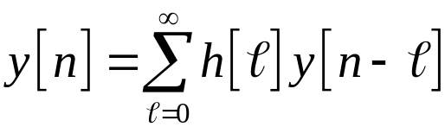






System Identification
The single-input single-output (SISO)
linear, time-invariant, causal, stable model
(with output-noise only):
It is desired to estimate from observations of the noisy output and possibly the input .

Slide 4


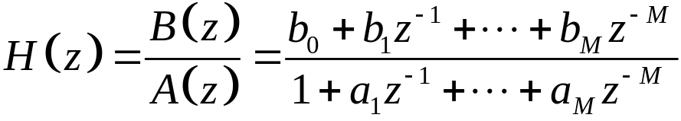
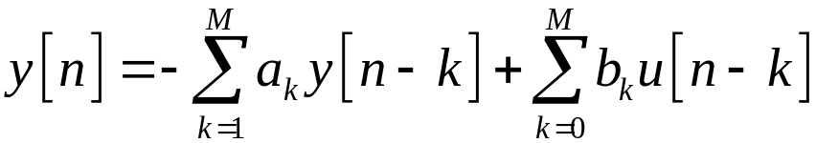
System Identification (contd.)
In the general case, this involves estimation of an infinite number of parameters .
Often the system is parameterized as a rational system of general order :
thereby giving rise to the following causal difference equation:

Slide 5

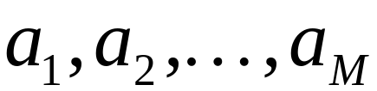
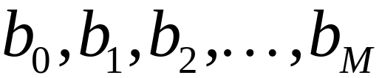
System Identification (contd.)
With this parameterized representation it is desired to estimate the parameters

Slide 6


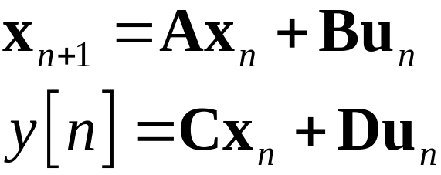
System Identification (contd.)
The same difference equation also admits a state-space representation as follows: Defining a state-vector and a “driving vector” , we can express the same relation using
note that this representation is not unique.

Slide 7
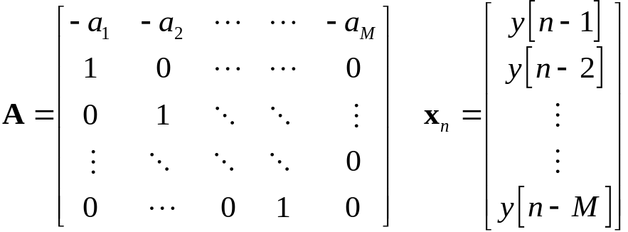
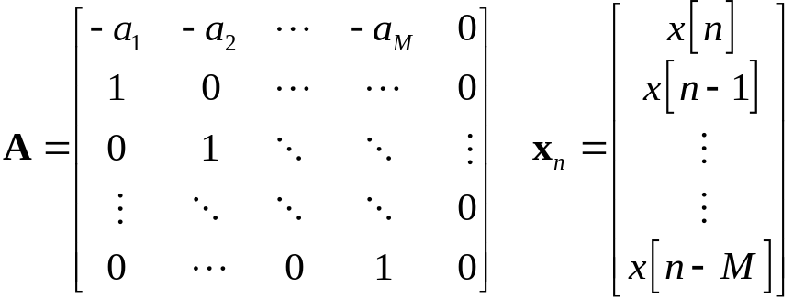
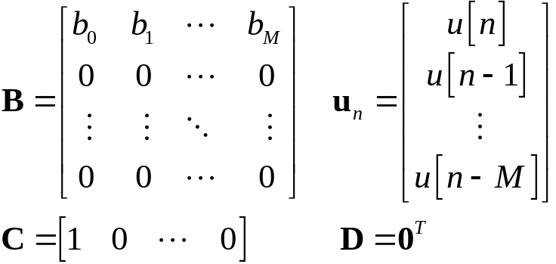
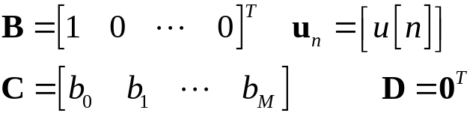
System Identification (contd.)

Slide 8
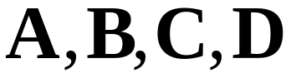
System Identification (contd.)
With this parameterized representation it is desired to estimate the matrices
(with tolerable ambiguities, as long as the implied input-output relation is maintained).

Slide 9
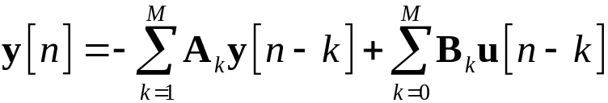
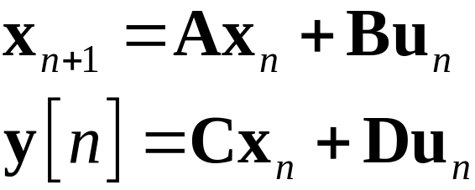
System Identification (contd.)
For Multiple-Inputs Multiple Outputs (MIMO) systems, similar difference equations or state-space equations can be obtained:
or:

Slide 10
Estimation approaches
The Maximum Likelihood (ML) approach is often guaranteed to provide consistent estimates of the parameters, and, moreover, is asymptotically optimal (in the sense of minimum mean square error, among all (asymptotically) unbiased estimates).
ML estimation involves maximization of the Likelihood function with respect to the parameters, and no “artificial” constraints are required (except for the purpose of incorporating prior knowledge, if available).
However, in the rational model with noisy output measurements ML estimation can become computationally unattractive.

Slide 11
Estimation approaches (contd)
It is therefore often tempting to resort to “heuristic” Least-Squares (LS)-driven approaches, such as Errors-In-Variables or subspace-based approaches.
In these contexts, the free parameters often have to be constrained, and mis-constraining may result in inconsistent estimates.

Slide 12
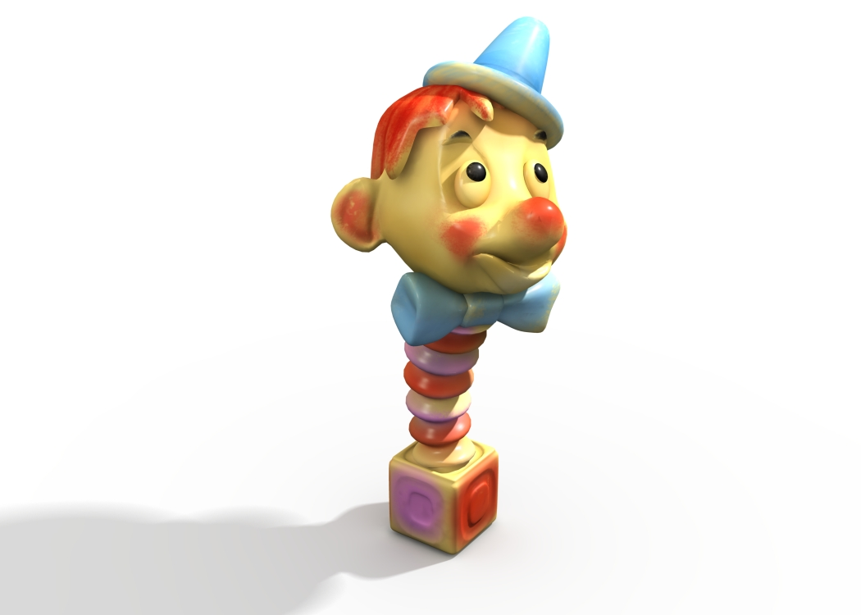

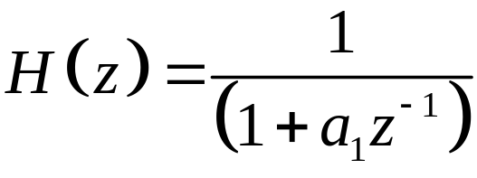
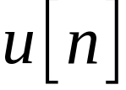

A “Toy-Example”
Consider the first-order autoregressive (AR(1)) process
is the (noiseless) output of the system
whose input is the (unobserved) process
, known to be zero-mean, white with variance .

Slide 13

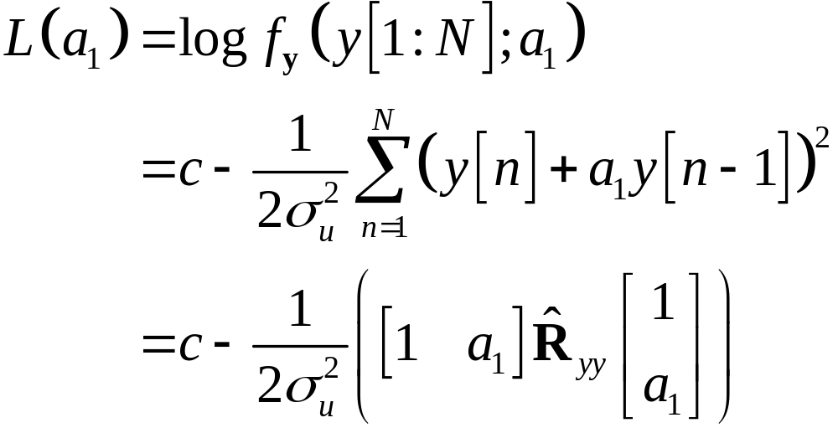
“Toy-example” (contd.)
Assuming that is Gaussian, the ML estimate seeks so as to maximize the likelihood, given by

Slide 14
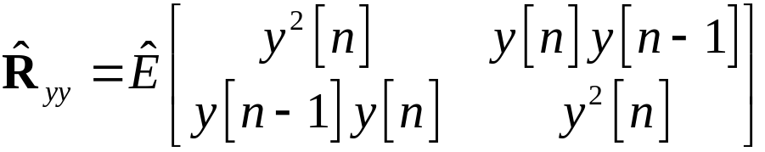
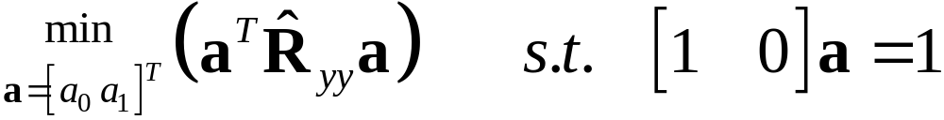
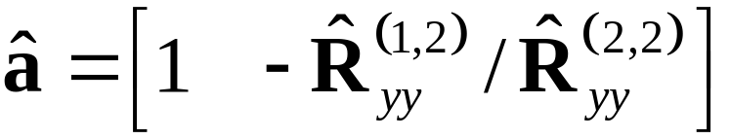

“Toy-example” (contd.)
Where .
An equivalent constrained minimization problem is
whose solution is
,
which is a consistent estimate of .

Slide 15

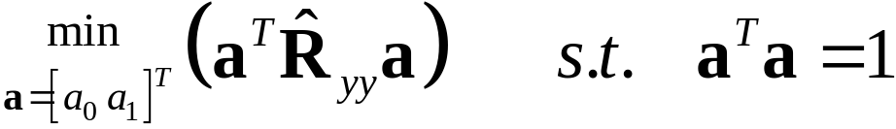





“Toy-example” (contd.)
What if we wanted to minimize the same LS criterion, subject to a different, quadratic constraint (and then “impose” by scaling)?
The solution is the eigenvector of corresponding to the smallest eigenvalue.
This is either or
(depending on the sign of ).
Therefore, following normalization we would always get , which is always inconsistent.

Slide 16




“Toy-example” (contd.)
Of course, it can now be argued that the quadratic constraint is inappropriate for the problem. But what if it were?
Consider the slightly different model equation
where it is now known that
(e.g., if it is known that
for some unknown ).

Slide 17


“Toy-example” (contd.)
The quadratic constraint in
is now “appropriate” for the problem, but the minimization would still yield the useless, inconsistent estimate !
However, if we were to use the “inappropriate” linear constraint (and then normalize), we would get a consistent estimate again!

Slide 18
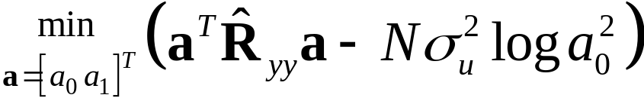

“Toy-example” (contd.)
This is because in the second problem (with the quadratic constraint), the “heuristic” LS criterion is no longer ML, and therefore its consistency is not guaranteed, but rather depends on the constraint. The consistent ML criterion for this problem is
.
Note that no constraints are necessary here for avoiding the “trivial” solution . However, any relevant constraints may be incorporated.
Note that with the linear (monic) constraint, the ML criterion is reduced to the LS criterion.

Slide 19
“Toy-example”: conclusion
When a “heuristic” LS criterion is used, using the “wrong” constraints (even if they are consistent with the problem at hand) may result in inconsistent, or even useless estimates.

Slide 20





General formulation
Any cost-function-based estimation scheme (e.g., ML, LS-based) would generally be cast as a constrained minimization problem,
where are the observations, are the parameters of interest and are possible auxiliary “nuisance parameters”.
The constraints (vector-)function may effectively constrain , or both.

Slide 21
The role of constraints
Constraints on either the parameters of interest or the nuisance parameters (mainly required for LS-driven, non-ML criteria) can emerge from various perspectives or requirements.
Some possible motivations are:
  Avoiding trivial solutions
  Mitigating bias
  Incorporating prior knowledge
  Imposing stability
  Imposing structures

Slide 22
LS-based criteria
A popular LS criterion, associated with the difference equation model, is the following. Recall the SISO model equation,

Slide 23
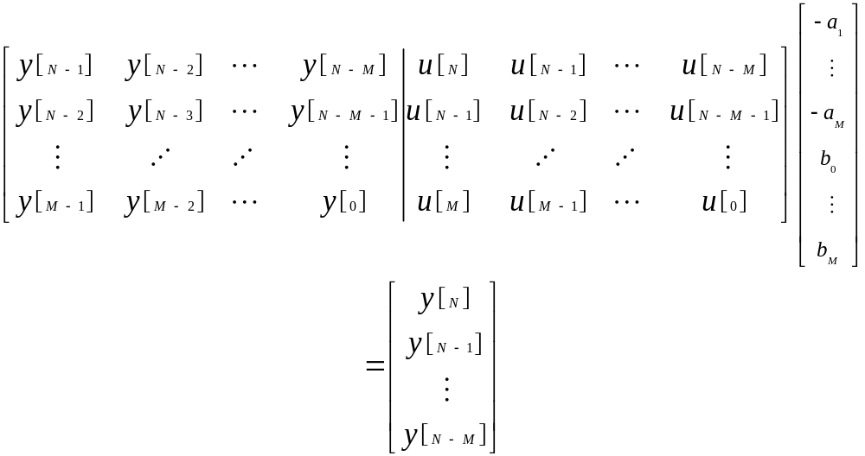
LS-based criteria (contd.)
which can also be written in matrix form as

Slide 24

LS-based criteria (contd.)
In the case of an exact model and noiseless observations, equations are sufficient for exact identification of the system parameters.
In the presence of model inaccuracies, more equations can be used in order to obtain an ordinary LS solution.
However, in the presence of output (and / or input) noise, different approaches can be taken.

Slide 25


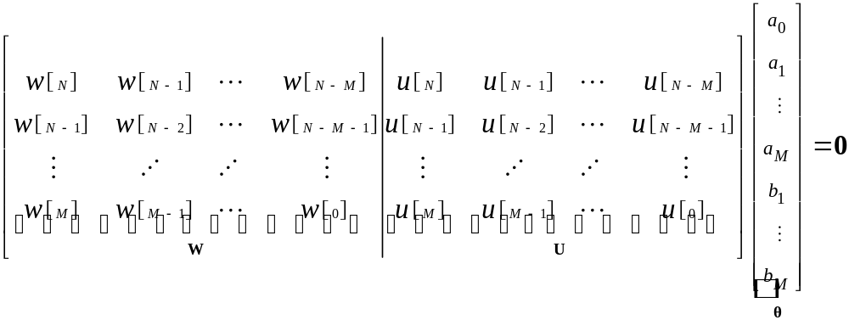
The TLS approach
When the true output is replaced by the noisy output , the matrix equation can be reformulated as follows:

Slide 26





The TLS approach (contd.)
The (weighted) TLS approach then seeks a minimal perturbation of the “output section” of the data matrix, such that the equation is satisfied with some .
A “natural” (linear) constraint on for avoiding the trivial solution is .
Note that the formulation here involves another set of “nuisance parameters” , which are the required perturbation matrix’ elements. Note that in this framework, the nuisance parameters are unconstrained.

Slide 27




The TLS approach (contd.)
The TLS constrained minimization can therefore be formulated as
(where denotes the first column of the identity matrix).
The linear constraint on can be replaced with a quadratic constraint, such as (with almost any nonzero ) with no effect on the resulting solution in this case.

Slide 28
The Equation Error approach
Although the TLS approach attempts to account for the output measurements noise by trying to retrieve some “underlying data”, the resulting estimate is usually inconsistent.
A possible remedy, which regains consistency by essentially applying the ML estimate (for Gaussian output noise), is the Structured TLS (STLS, De Moor ’94, Markovsky et al., ’05), to which we shall return later.
Somewhat surprisingly, however, it is possible to obtain consistent estimates without accounting for the output noise (as long as it is white), by slightly reformulating the criterion and changing the constraint on (Regalia, ’95).

Slide 29
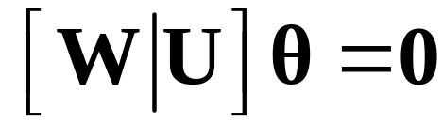

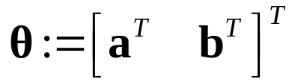

Equation Error approach (contd.)
Recall the model equation with the true output replaced by the noisy output:
Now, rather than modify so as to obtain exact equality, find that minimizes the norm of the left-hand side.
To avoid the trivial solution, has to be constrained.

Slide 30
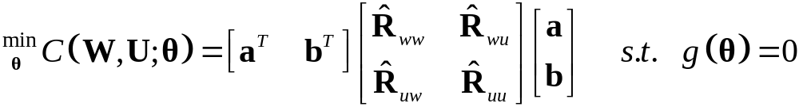
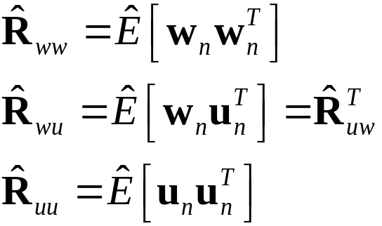


Equation Error approach (contd.)
The resulting criterion becomes
where
where are columns of (resp.)

Slide 31


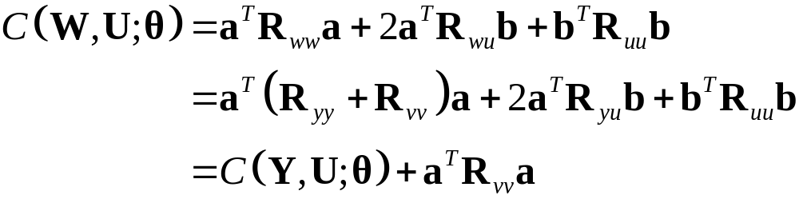

Equation Error approach (contd.)
Under weak ergodicity conditions on and , the empirical correlations tend asymptotically to the true correlations.
Thus, to study the estimator’s consistency, we substitute the true correlations into the criterion,
where the first transition is due to the assumption that the observation noise is uncorrelated with the input, and is the same LS criterion, evaluated with the true (noiseless) output data.

Slide 32




Equation Error approach (contd.)
It is therefore evident, that the noisy output criterion only differs (asymptotically) from the noiseless output criterion by the term .
Under the assumption of white output noise
(with ), a quadratic constraint on of the form would render the noisy criterion identical to the noiseless criterion up to an additive constant.
Since the noiseless criterion is minimized by the true , that value would also minimize the noisy criterion (properly constrained), regaining consistency and eliminating the bias.
This will not happen if the linear constraint is used – which would result in severe bias.

Slide 33
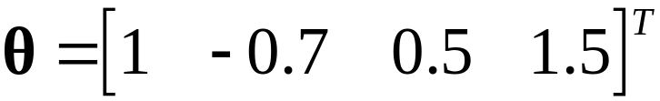

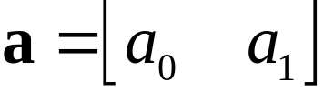
Equation Error approach (contd.)
We demonstrate this concept in the identification of a first-order system, so as to be able to use a two-dimensional plot. We used .
We plot the residual asymptotic cost function following minimization with respect to , vs. all values of .
Values estimated with the linear and quadratic constraints are demonstrated for different noise levels.

Slide 34
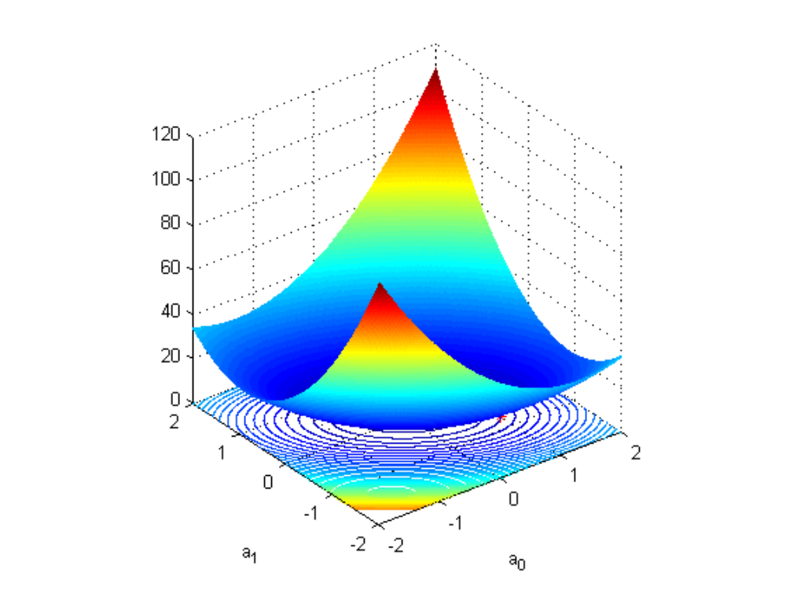
General mesh

Slide 35
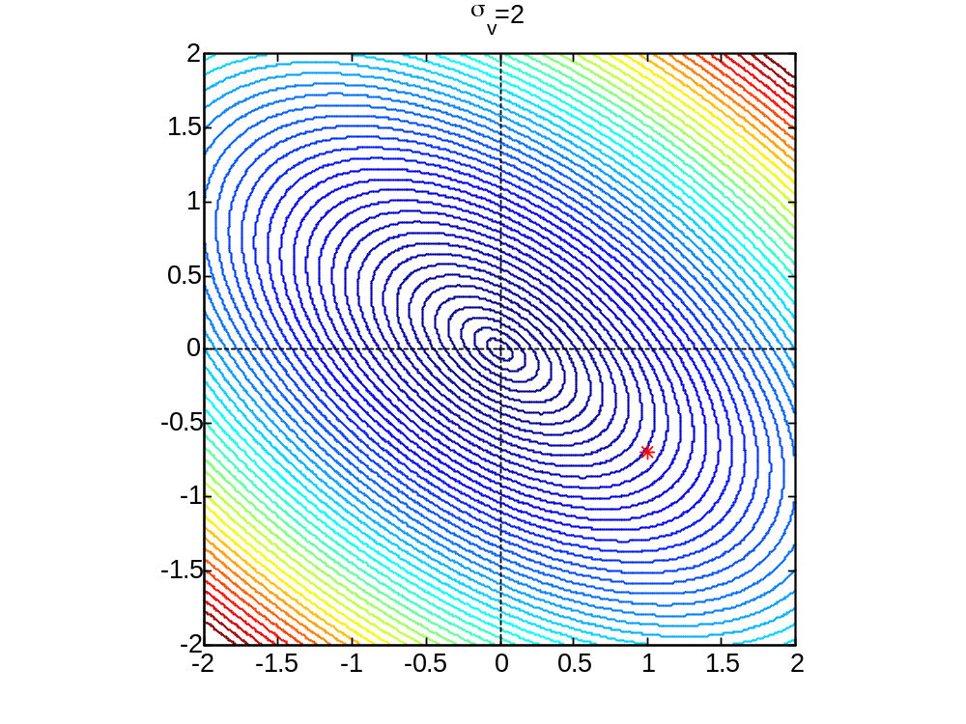
General contour

Slide 36
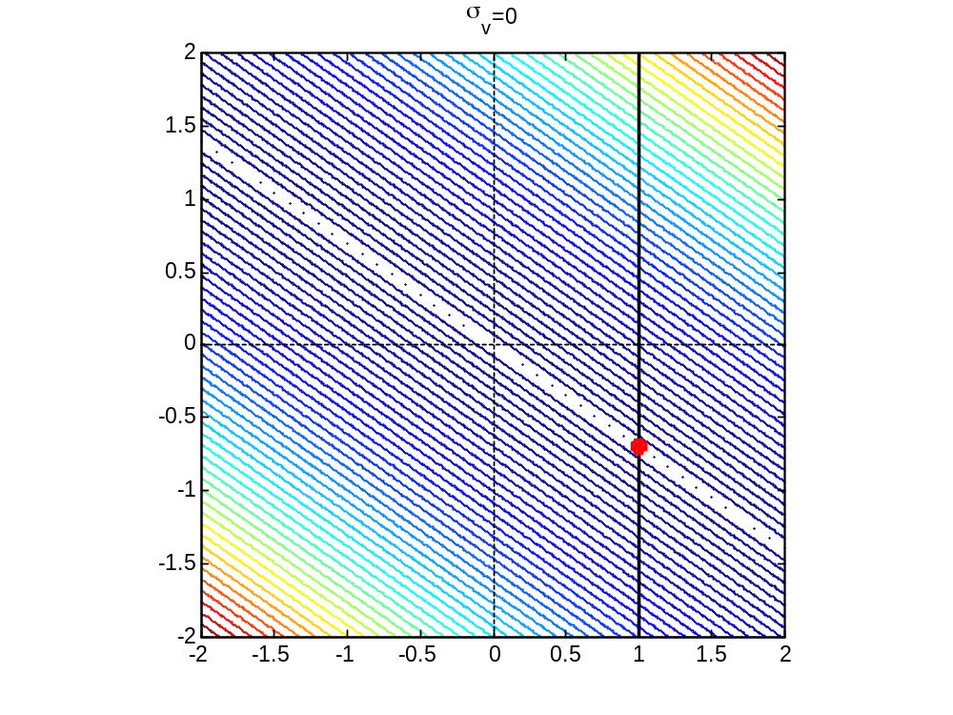
Linearly constrained, noise level 0

Slide 37
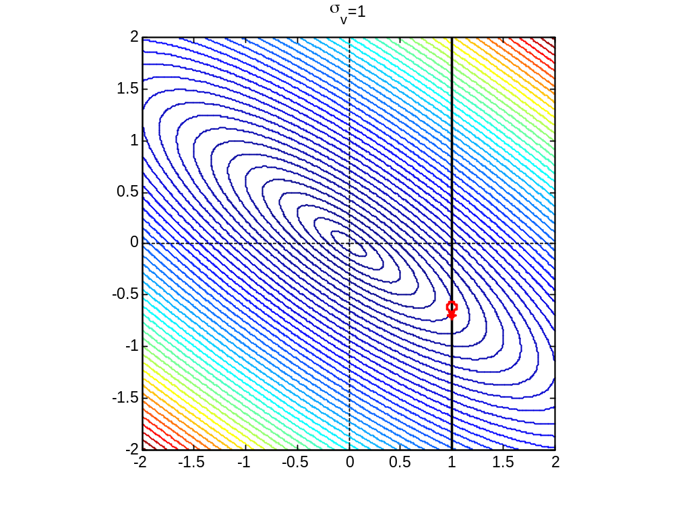
Linearly constrained, noise level 1

Slide 38
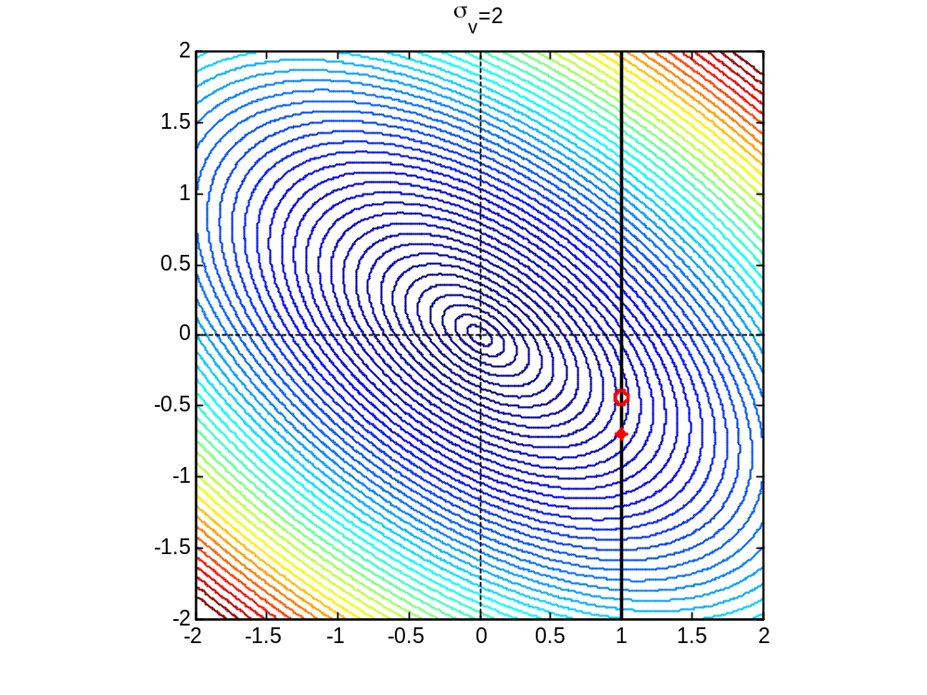
Linearly constrained, noise level 2

Slide 39
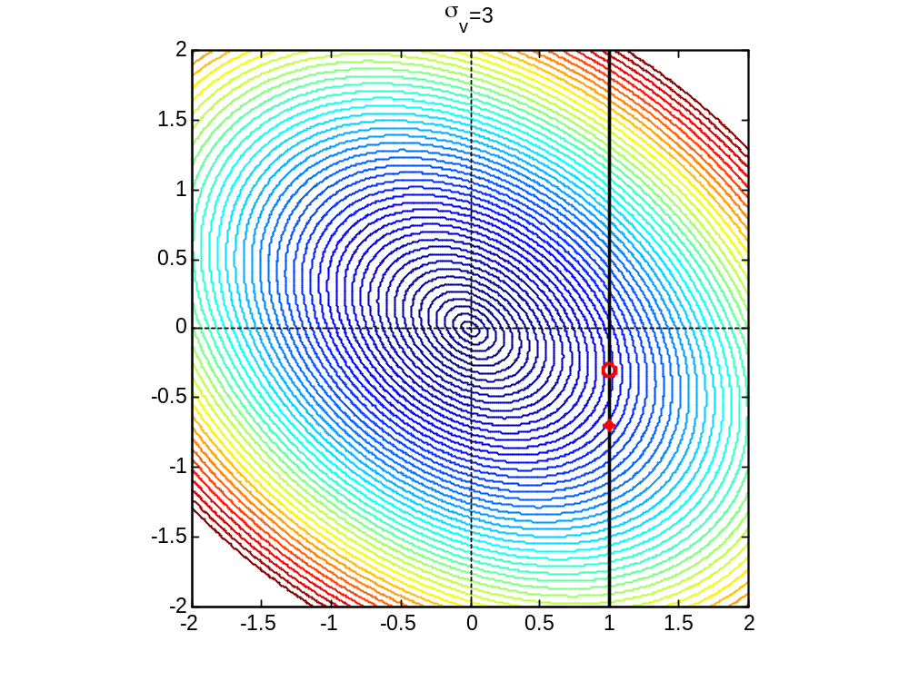
Linearly constrained, noise level 3

Slide 40
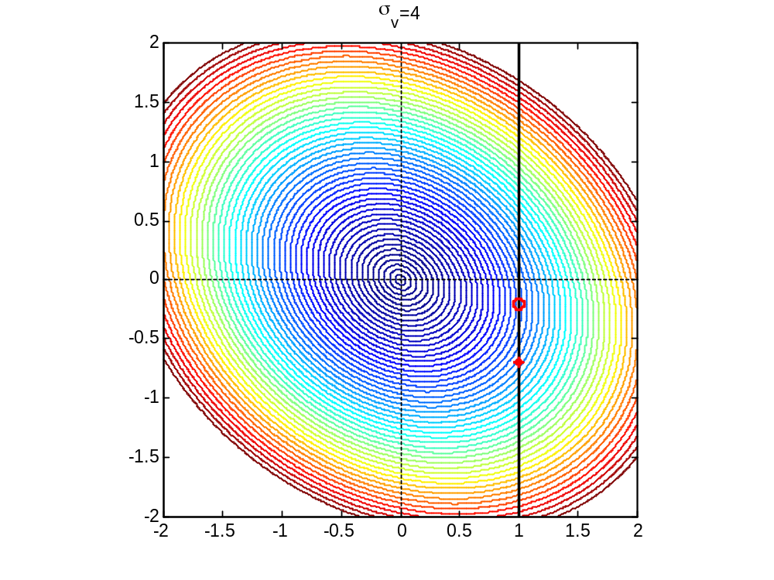
Linearly constrained, noise level 4

Slide 41
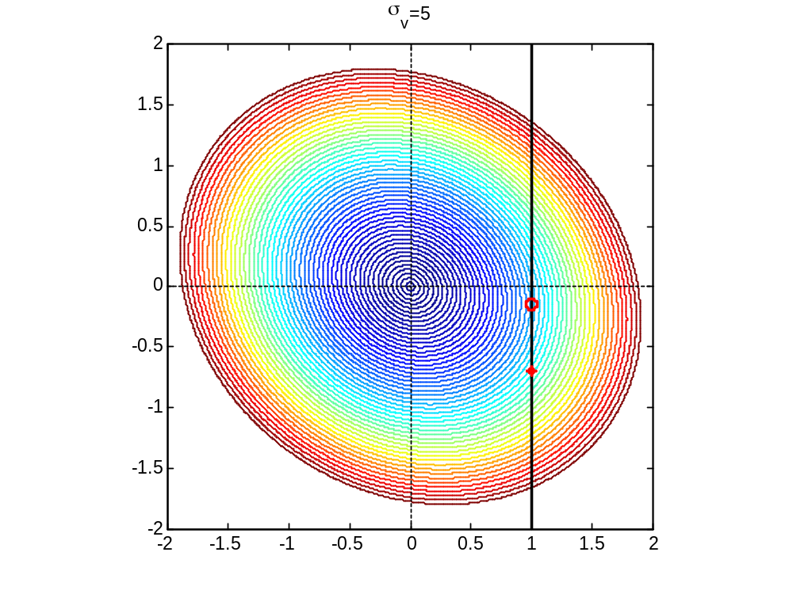
Linearly constrained, noise level 5

Slide 42
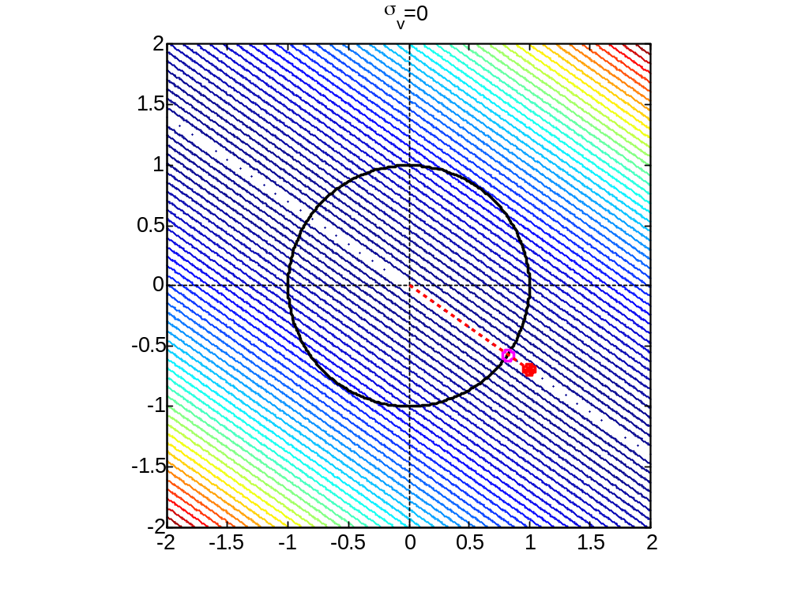
Quadratically constrained, noise level 0

Slide 43
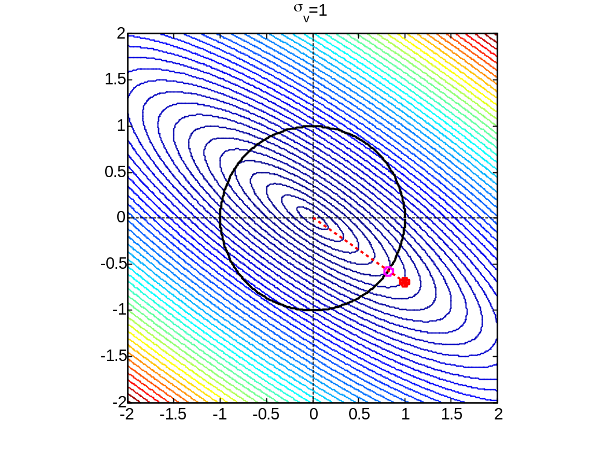
Quadratically constrained, noise level 1

Slide 44
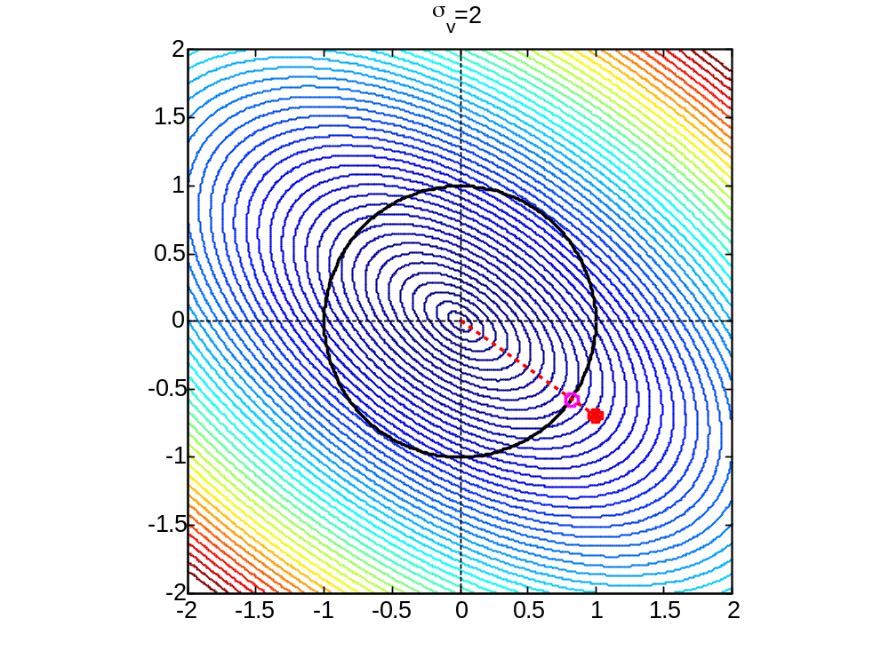
Quadratically constrained, noise level 2

Slide 45
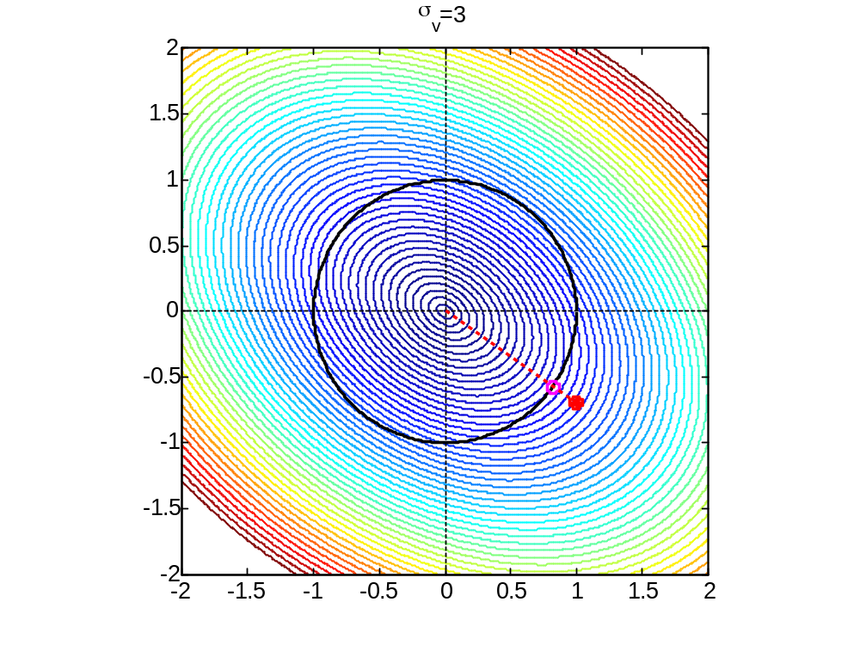
Quadratically constrained, noise level 3

Slide 46
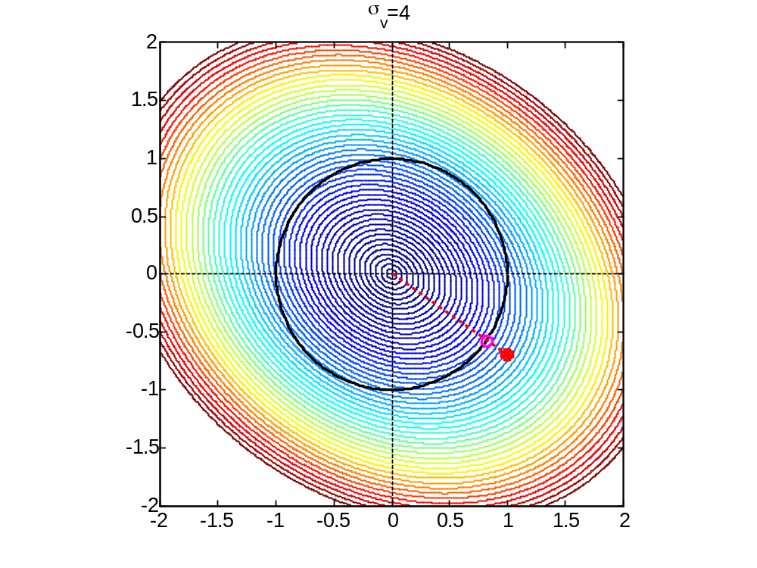
Quadratically constrained, noise level 4

Slide 47
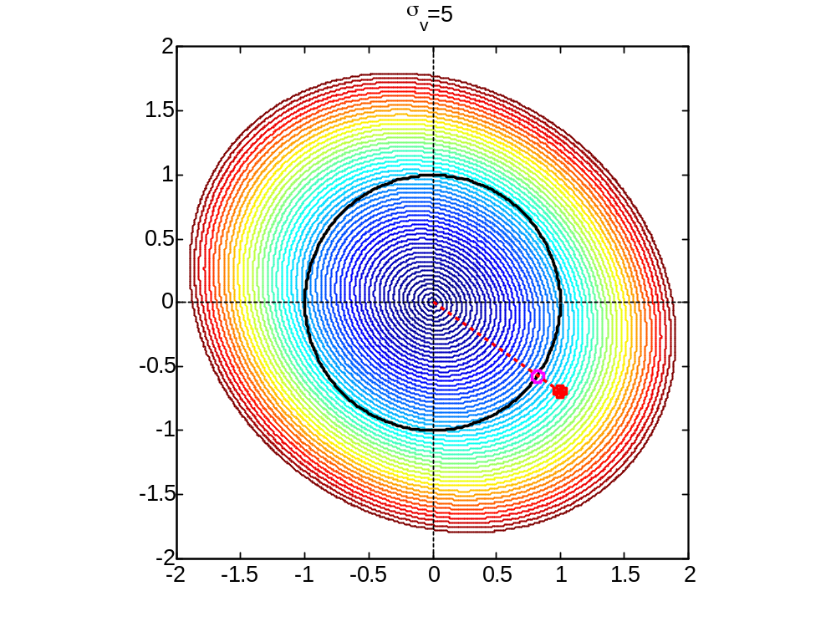
Quadratically constrained, noise level 5

Slide 48

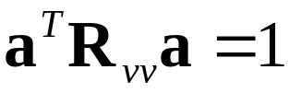
Equation Error approach (conclusion)
Therefore, the same criterion with a different constraint, although not a “natural” constraint, turns an inconsistent estimate into a consistent one.
Note that if the noise is not white, but has a known covariance , then the quadratic constraint may be adjusted accordingly, , to maintain consistency.

Slide 49

Incorporating prior knowledge
Quite often, some prior knowledge is available regarding characteristics of the estimated system.
Such information can be incorporated in a Bayesian (or some heuristic approach) when subject to uncertainty.
Otherwise, however, it is desirable to incorporate the prior knowledge in the form of constraints on the estimated parameter, thereby effectively reducing dimensionality and improving accuracy.

Slide 50

Prior knowledge (contd.)
Assume that the system is known to have specific gains at certain frequencies.
At each such frequency:
  Either the exact complex-valued gain
  is known;
  Or the magnitude-square gain is known (often more common).

Slide 51



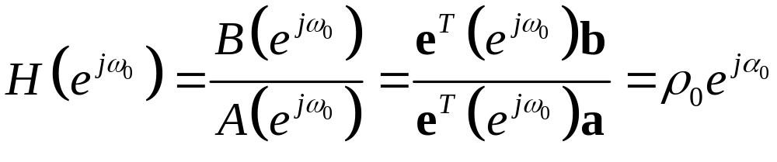
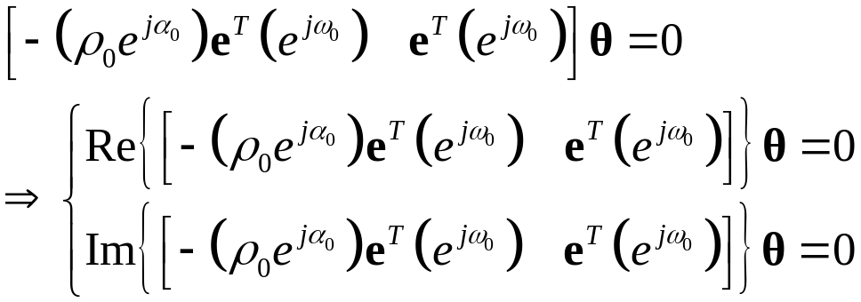
Prior knowledge (contd.)
Define the vector
Then a prescribed complex gain at some prescribed frequency can be specified as
giving rise to the linear real-valued constraints:

Slide 52

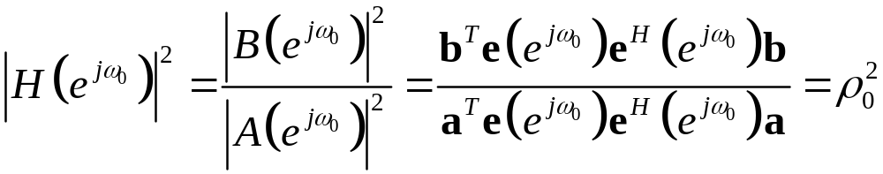

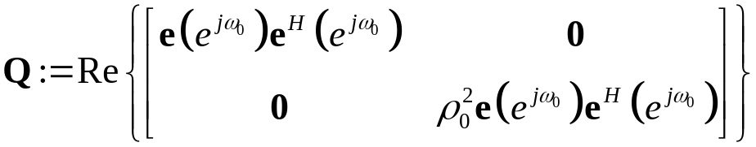

Prior knowledge (contd.)
Likewise, a prescribed squared magnitude at can be specified as
giving rise to the quadratic real-valued constraint , where
Note, however, that this is not a convex constraint, since is sign-indefinite; This may cause problems in the minimization.

Slide 53


Prior knowledge (contd.)
Alternatively, the locations of some zeros or poles of may be known (e.g., DeGroat et al. ’92, Chen et al., ’97). Assume that is some known pole. Then the following linear constraint follows directly:
Known zeros can be similarly incorporated. Note that known zeros on the unit-circle can also be expressed as known (zero) gains at the respective frequencies, as discussed earlier.

Slide 54


Imposing stability
Stability is one of the desired properties of the estimated system, but it is generally not guaranteed, even if the underlying system is known to be stable.
Recall the (possibly MIMO) state-space system equations
within this framework, stability is solely determined by the matrix .

Slide 55





Imposing stability (contd.)
Assuming that the driving process and the state (at the same time-instant) are uncorrelated, the evolution of the state’s covariance is given by
where is the covariance of .
In steady state (if reached), we would have

Slide 56





Imposing stability (contd.)
It can be shown that a condition for the existence of such for any positive-definite input covariance (implying stability) is the existence of some positive-definite matrix , such that
.
This condition is also known as Lyapunov’s condition, and is equivalent to requiring that all the eigenvalues of have a magnitude smaller than one.

Slide 57


Imposing stability (contd.)
Such a constraint is generally impossible to impose, since the feasibility set is an open set.
Common approaches: solve an unconstrained minimization, and then reflect any eigenvalues of with magnitude larger that one into the unit-circle. This may result in severe estimation errors.
Lacy and Bernstein (’03) propose a different approach, which enables to formulate a constrained minimization scheme, whereby the constraints guarantee stability of .

Slide 58



Imposing stability (contd.)
The proposed approach is applied in the framework of subspace identification, in which the underlying states are estimated first from the observed data (without explicit knowledge of the model matrices).
Given the states estimate, (weighted) LS identification of (and ) can be obtained from the state equation.
After eliminating from the weighted LS criterion, the stabilization constraint on is introduced as follows.

Slide 59



Imposing stability (contd.)
The “open” constraint
is substituted with a “closed” constraint
(where is some selected “small” parameter), which can also be expressed as

Slide 60

Imposing stability (contd.)
Following some changes of variables and other minor manipulations, the LS criterion can be combined with the “closed” constraint in the form of a quadratic-programming problem with positive-semidefinite constraints.
The problem is formed as the minimization of a linear function over symmetric cones, for which standard optimization packages can be used.

Slide 61


Structural constraints
Recall the TLS framework
The main intuitive purpose in finding is to “uncover” the output noise, thereby unveiling the clean output, which can yield the exact parameters through the implied linear equations.

Slide 62




Structural constraints (contd.)
However, both the noisy and the underlying share a Hankel structure, which is not imposed on the perturbation matrix .
As a result, the matrix generally does not have a Hankel structure, and thus cannot serve as a consistent estimate of , as intuitively intended.
This implies general inconsistency of the TLS approach.

Slide 63








Structural constraints (contd.)
Thus, it is necessary to impose a structural constraint on the “nuisance parameters” as well.
Such a structural constraints (Hankel in this case) is essentially a linear constraint, which can be easily expressed as , where is a sparse matrix with one and one in each row.
However, a more convenient constraining scheme is to re-parameterize the matrix in terms of the parameters required to define the respective Hankel structure.

Slide 64
Structural constraints (contd.)
This formulation, involving constraints on the “nuisance parameters” results in the well-known STLS problem (De Moor ’94, Markovsky et al. ’05).
Since the obtained constrained minimization problem coincides with the ML criterion (for Gaussian output noise), the obtained estimate is consistent (Kukush et al., ’05).

Slide 65
Conclusion
We have discussed and demonstrated the important role of incorporating relevant constraints in minimization criteria related to system identification.
When the ML criterion is used, usually no constraints are necessary (except for reflecting prior information on the parameters space).
However, when alternative “heuristic” criteria are involved, proper constraints may potentially make the difference between “good” and “useless” estimates.

