Slide 1


Blood Cell Image Classification Using Neural Networks
Brian Martinez
Ian Marquez

Slide 2

Outline
Introduction
Understanding the Problem
Data and Data Processing
Machine Learning Approach
Results and Analysis
Discussion and Future Work

Slide 3
Introduction

Slide 4
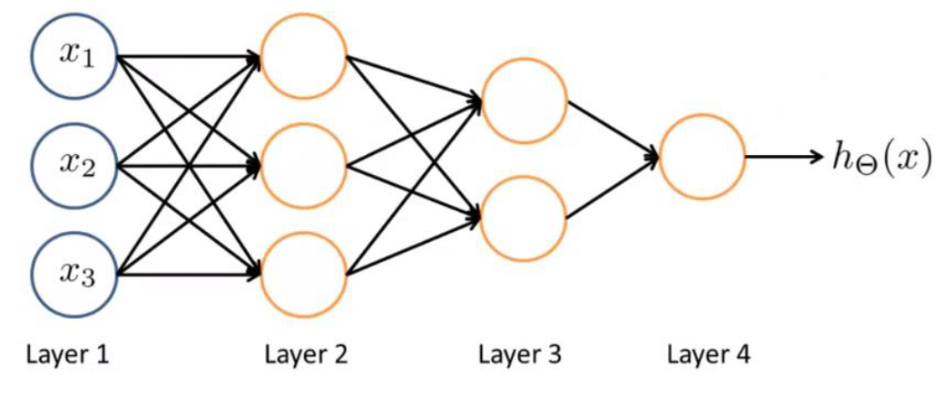
Introduction
A Neural Network(NN) is a machine learning technique reminiscent of biological neural networks
NNs are comprised of nodes called neurons, each with the ability to transmit signals to one another
Each NN has layers of neurons
Neural Network Example

Slide 5
Understanding the Problem

Slide 6
Understanding the Problem
Over 250,000 clinical labs in the US
13 billion lab tests annually
7 billion clinical test annually
Estimated 251,000 deaths annually due to medical error (2016)
Third leading cause of death after heart disease and cancer
Many processes are still manual in heathcare
Machine Learning can be used to help mitigate errors, improve workflow, and patient care

Slide 7
Data and Data Processing

Slide 8
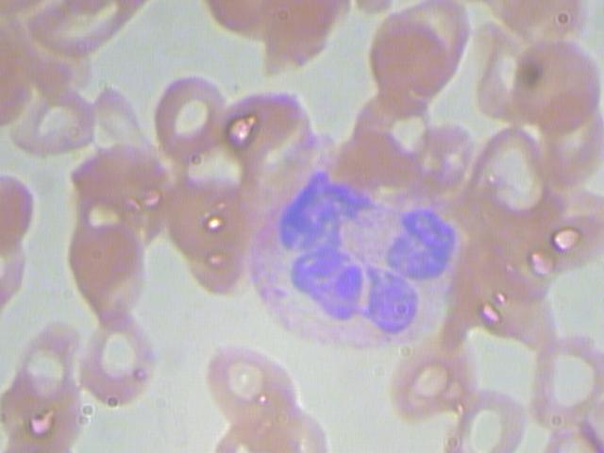
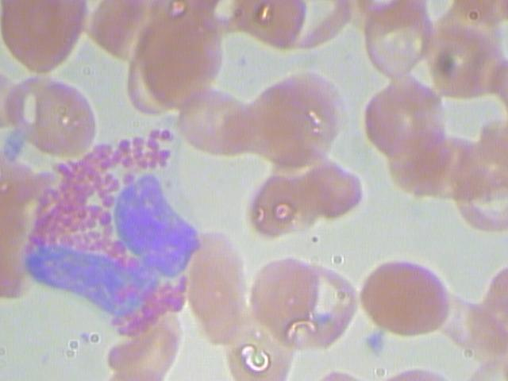
Data and Data Processing
Data Consists of 12,910 blood images
410 original and 12,500 augmented
First need to process images to identify the red blood cells method?
Neutrophil
Eosinophil

Slide 9
Machine Learning Approach

Slide 10
Machine Learning Approach
Use Neural Network to accurately determine blood cell types

Slide 11
Results and Analysis

Slide 12
Results and Analysis
Five models used: Base, Alpha, Beta, Epsilon, and Gamma
Images used for each model were manipulated in one or more ways:
Random Horizontal Flip
Random vertical Flip
Random degree of rotation from 0º to 180º
Random height shift
Random width shift

Slide 13
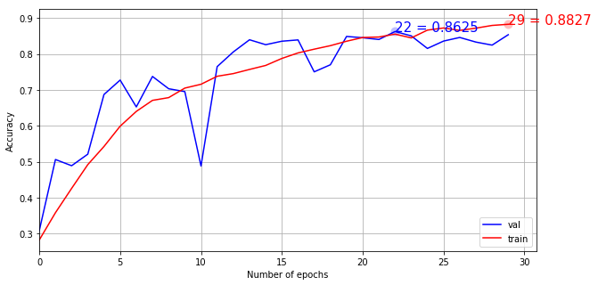
Results and Analysis-Base
Mods used: Random horizontal flip, 10º rotation, 0.1 width and height shift range
Large dip in model accuracy before midpoint

Slide 14
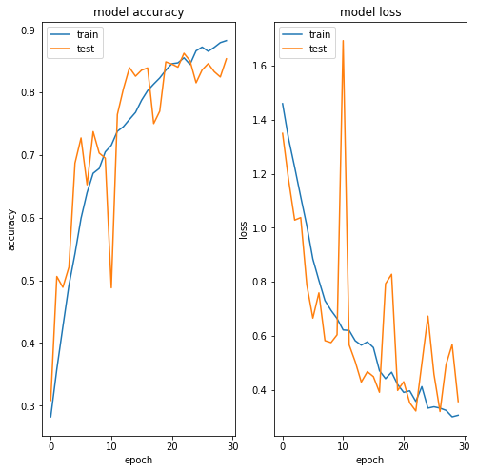
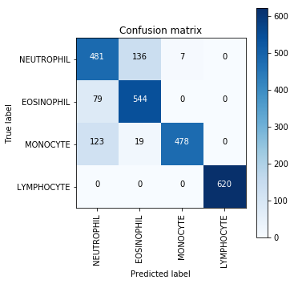
Results and Analysis-Base
364 errors or 85.36% accuracy
Highest accuracy with Lymphocyte detection, lowest with momocyte

Slide 15
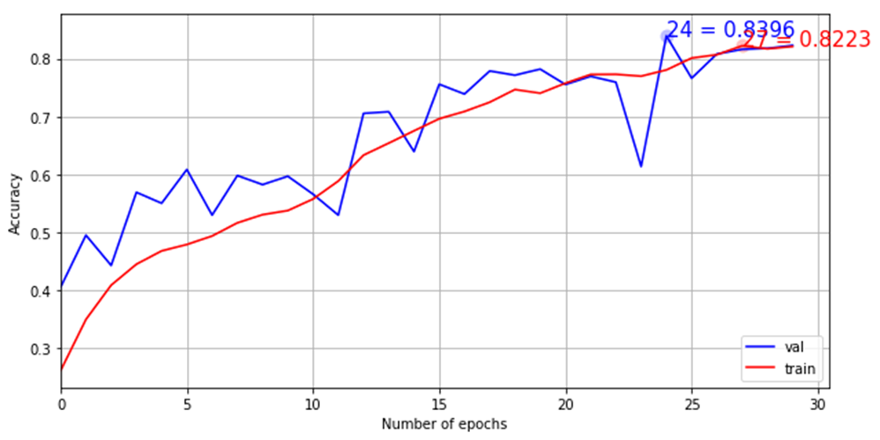
Results and Analysis-Alpha
Mods used: Random horizontal flip, random vertical flip, 70º rotation, 0.1 width and height shift range
Steady climb in accuracy, training and test data have similar results

Slide 16
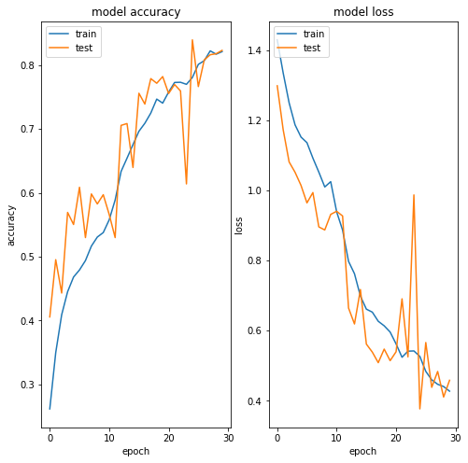
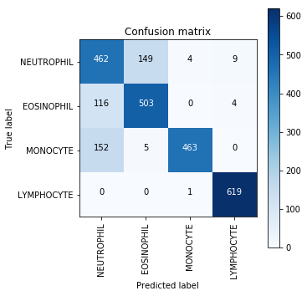
Results and Analysis-Alpha
83.96% testing accuracy
Lymphocyte has highest detection accuracy, while neutrophil and monocyte
detection are similarly low

Slide 17
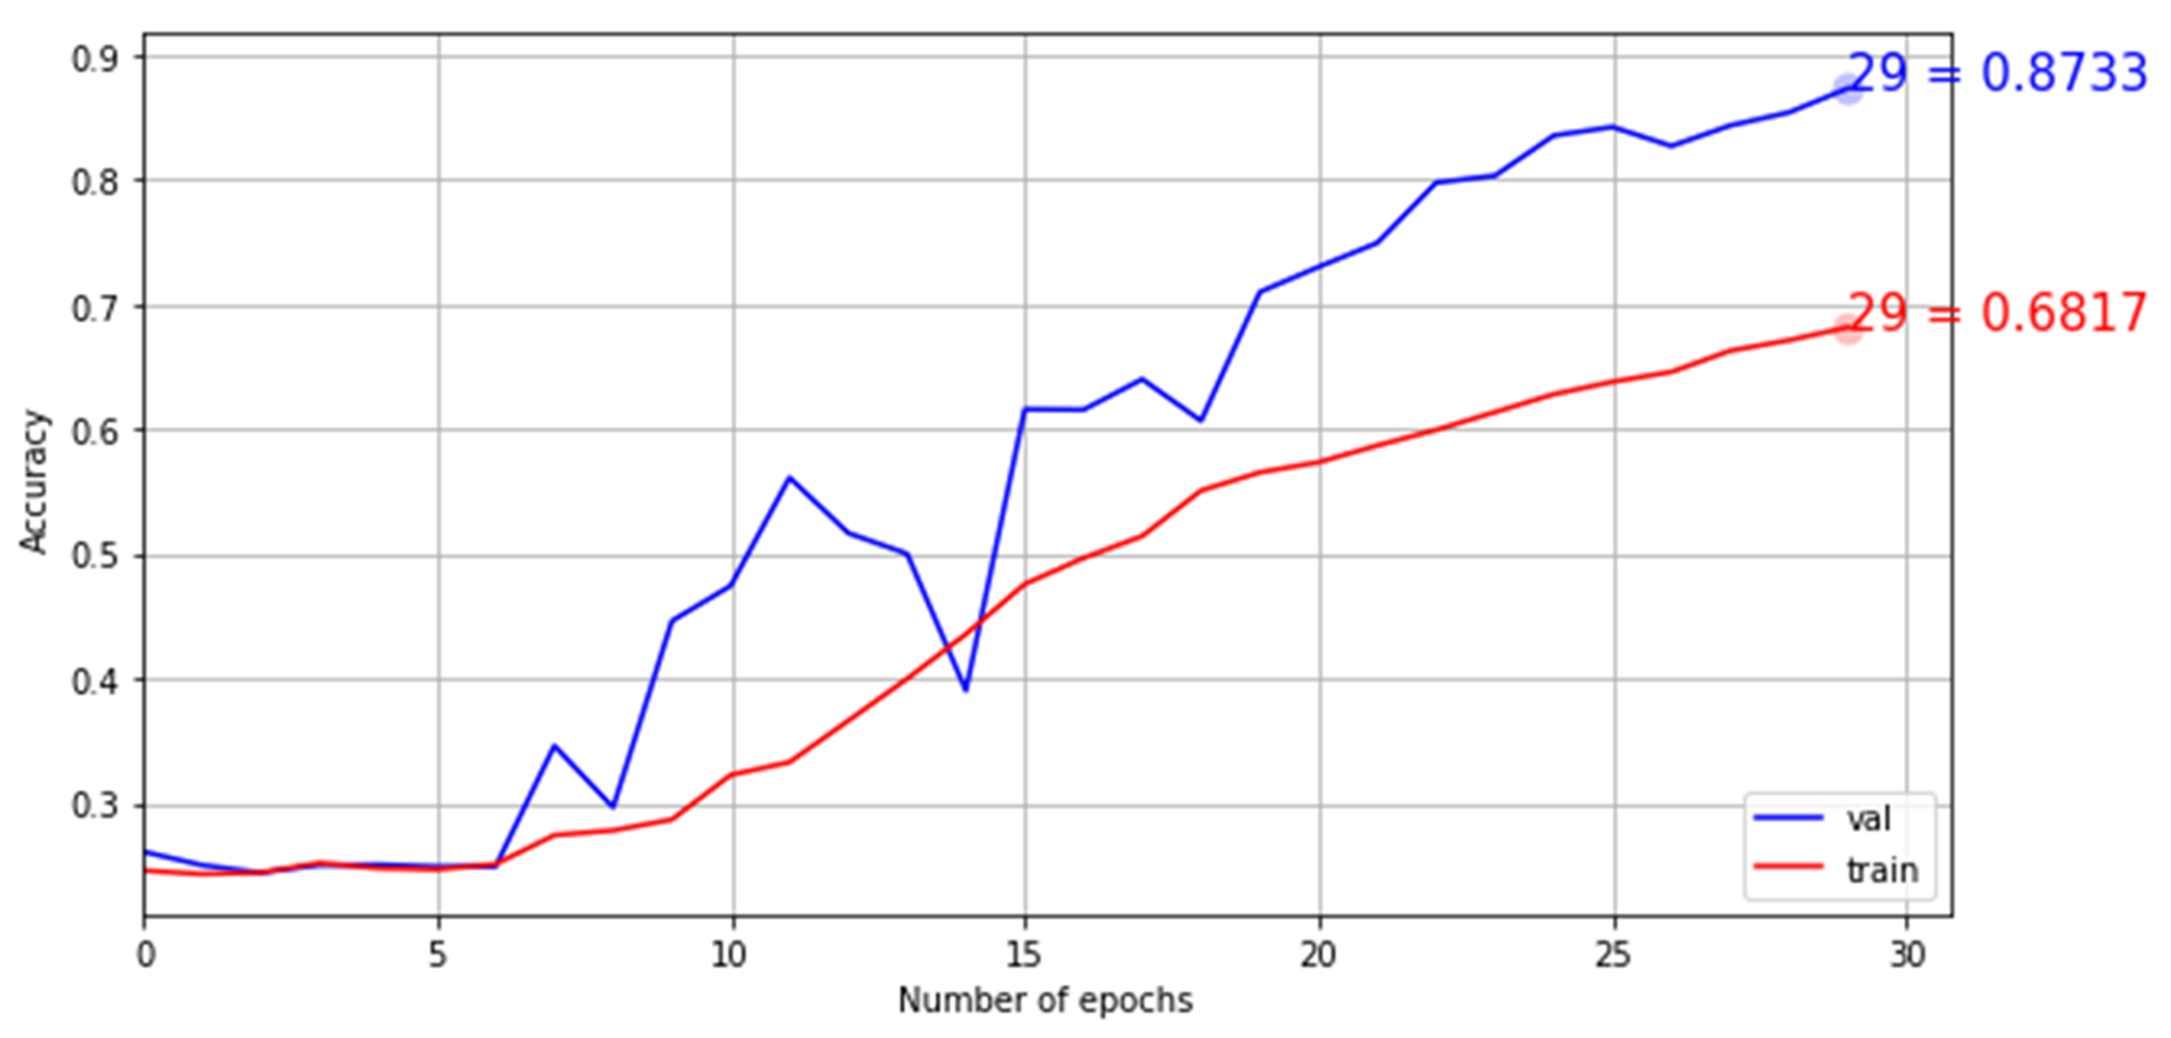
Results and Analysis-Beta
Mods used: Random horizontal flip, random vertical flip, 70º rotation, 0.5 width and height shift range
Low trial accuracy but high test accuracy

Slide 18
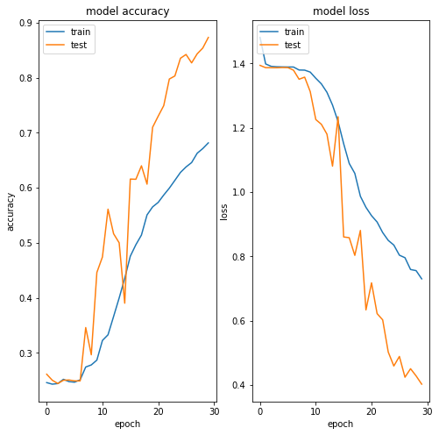
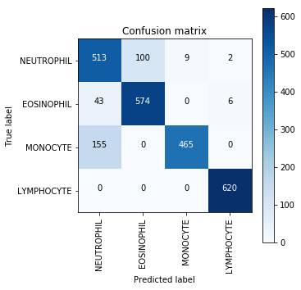
Results and Analysis-Beta
87.33% overall accuracy, all but monocyte detections reasonably accurate

Slide 19
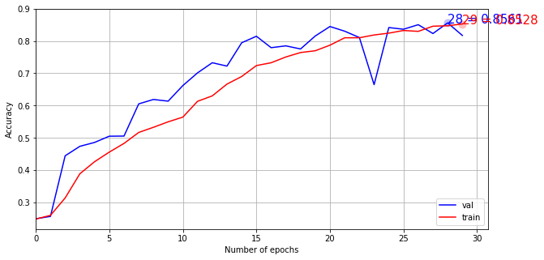
Results and Analysis-Gamma
Mods used: Random horizontal flip, random vertical flip, 180º rotation, 0.1 width and height shift range
Both trial and testing have similar accuracies

Slide 20
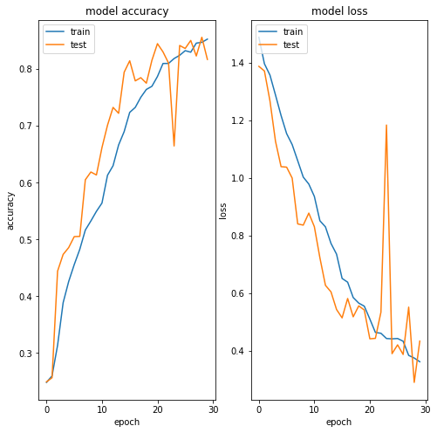
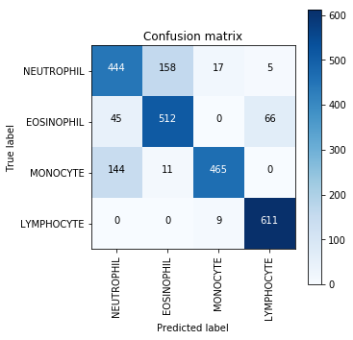
Results and Analysis-Gamma
85.61% accuracy overall neutrophil and monocyte detection lowest

Slide 21
Results and Analysis-Epsilon
Mods used: Random horizontal flip,180º rotation, 0.1 width and height shift range

Slide 22
Results and Analysis-Epsilon

Slide 23
Discussion and Future Work

Slide 24
Discussion and Future Work
Determine why lymphocyte accuracy is reliably high while others are not
Apply same methodology to help identify blood diseases etc…

