Slide 1
Application of Spherical Mirror
by
Arshbir Singh
Xth B (Rollno.9)
DAV Public School Sector 8-c, Chandigarh

Slide 2
refrerences
Class X , NCERT book
Website : Google.com, slideshare.com, teachoo.com

Slide 3
Optical Device
A lens is an optical device that is used to bend light in a specific way.
A converging lens bends light so that the light rays come together to a point.
A diverging lens bends light so it spreads light apart instead of coming together.
Mirrors reflect light and allow us to see ourselves.
A prism is another optical device that can cause light to change directions.
A prism is a solid piece of glass with flat polished surfaces.

Slide 4
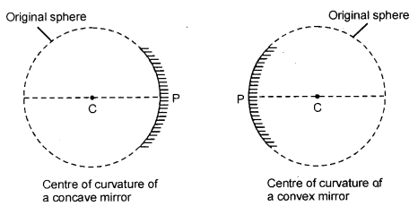
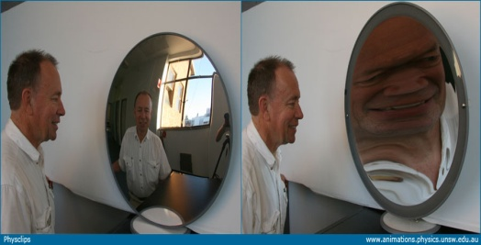
Spherical Mirrors
Spherical Mirror : A curved mirror formed by a part of a hollow glass sphere with a reflecting surface. Two types of spherical mirrors:
Concave mirror: A concave mirror is a curved mirror with the reflecting surface on the hollow side.
Convex Mirror : A convex mirror is a curved mirror with the reflecting surface on the outer side

Slide 5
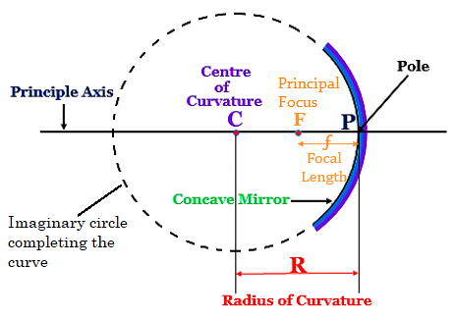
Spherical Mirrors...
Centre of Curvature : The centre of curvature of a curved mirror is defined as the center of the hollow glass sphere of which the curved mirror was (previously) a part.
Radius of curvature: The radius of the hollow glass sphere of which the spherical mirror was a part.

Slide 6
Spherical Mirrors...
Principal Axis : The imaginary line passing through its pole P and center of curvature C.
Pole : The pole is defined as the geometric centre of the curved mirror.
Focus(F) :The principal focus is defined as the point on The principal axis where the light rays travelling parallel to the principal axis after reflection actually meet.

Slide 7
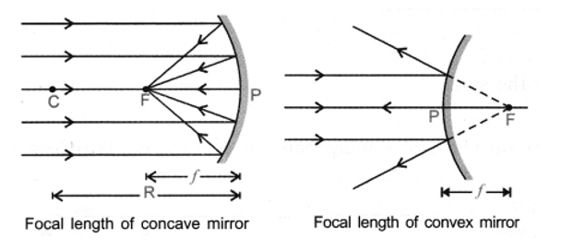
Focal Length
The focal length is the distance between the pole P and the Principal focus F of a curved mirror.
The focal length is half the radius of curvature. Focal Length = Radius of Curvature/2 Focal length

Slide 8
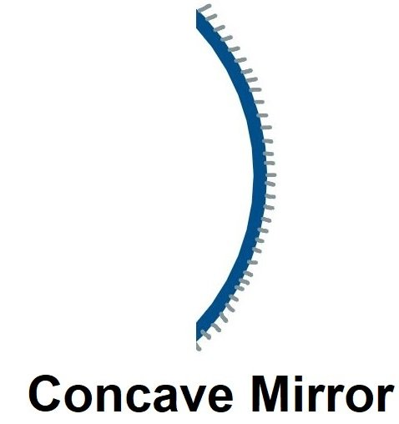
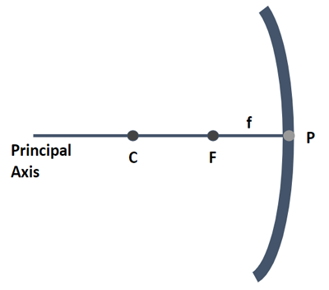
Concave Mirror
A mirror is a curved mirror with the reflecting surface on the hollow side.
Also known as ‘converging mirror’.

Slide 9
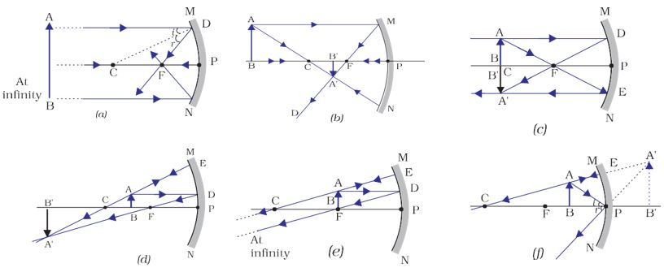
Ray diagrams of concave mirror
If the object is at infinity
Image will be formed at
Focus
Highly diminished (dot like)
Real image
2. If the object is beyond centre of curvature Image will be formed
Between centre of curvature and focus
Diminished
Real image
Inverted

Slide 10
ray diagrams of concave mirror...
3. If the object at centre of curvature
Image will be formed
At centre of curvature and focus
Same size
Real image
Inverted
4. If the object is beweent centre of curvature and focus
Image will be formed
Beyond centre of curvature(c)
Enlarged
Real image
Inverted

Slide 11
Ray diagrams of concave mirror...
5. If the object at focus
Image will be formed
At infinity
Highly enlarged
Real image
Inverted
6. If the object between ‘f’ and pole
Image will be formed
Beyond the mirror
Enlarged
Real image
Erect

Slide 12
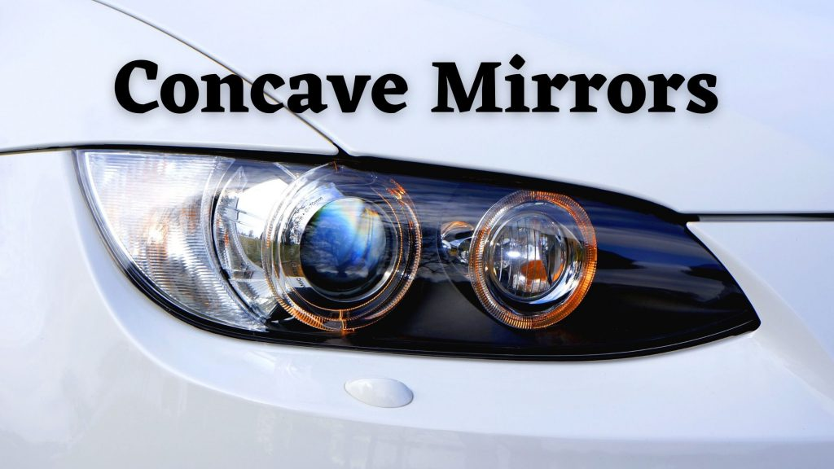

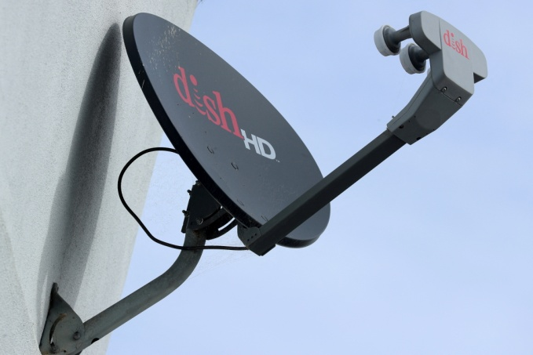

Uses of concave mirror
Headlights of car
Make-up mirror
Antennas /satellites
Dentist mirror

Slide 13
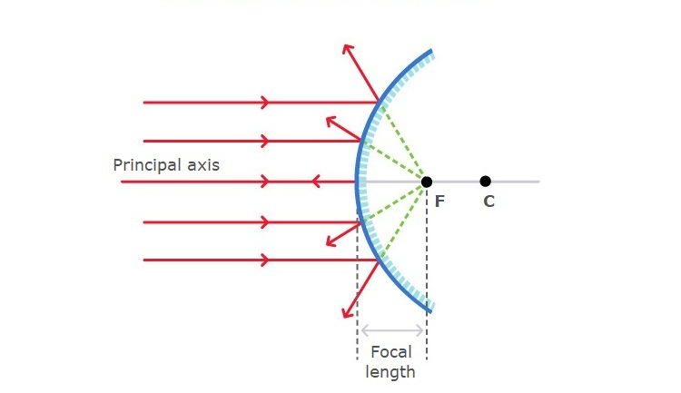
Convex mirror
A convex mirror is a diverging mirror in which the reflective surface bulges towards the light source. They are not used to focus light as they reflect light outwards. The image formed by convex mirrors are smaller than the object but gets larger as they approach the mirror.

Slide 14
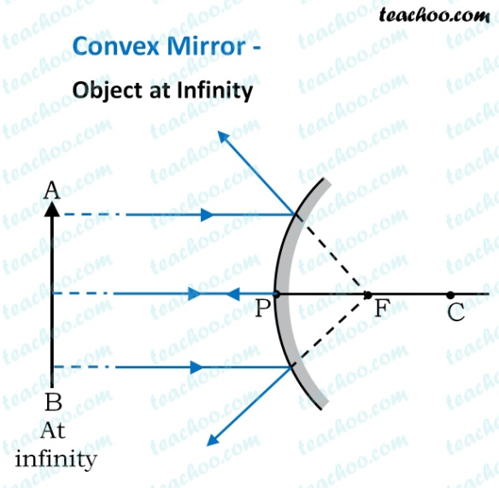
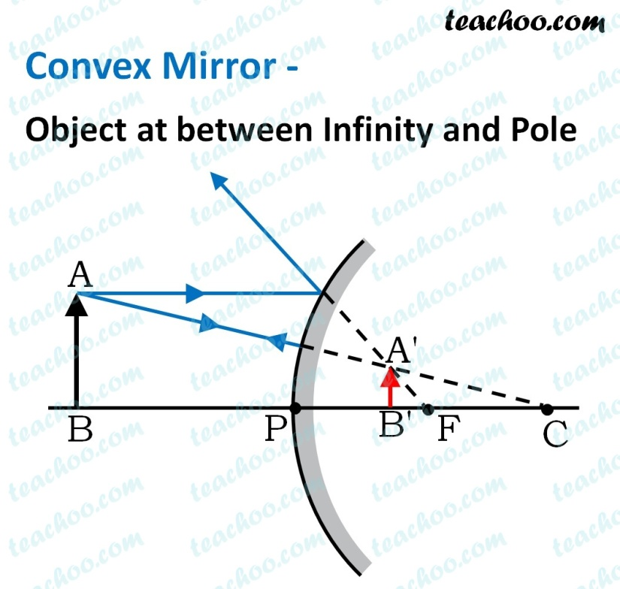
Ray diagram of convex mirror
If the object is at infinity
Image will be formed at focus, on the opposite side of mirror.
2. If the object is between infinity and pole
Image will be formed between focus and pole, on the opposite side of mirror.

Slide 15

Uses of convex mirror

Slide 16
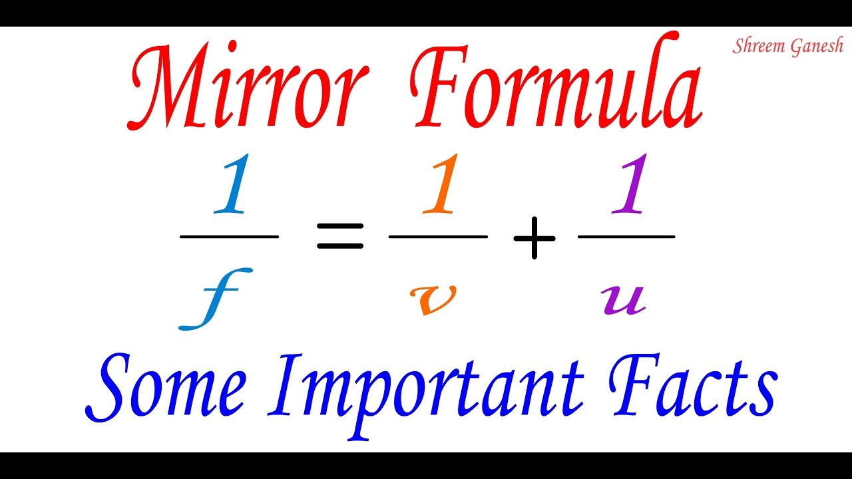
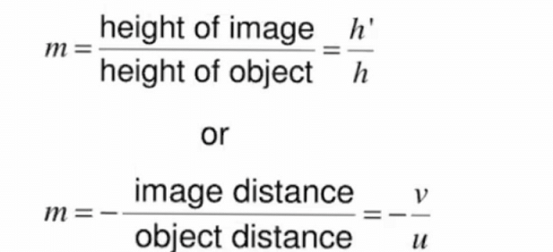
Mirror formula
f: The focal length
v :Distance of image away from mirror
u:The object distance from mirror
h’: Height of image
h: Height of object

Slide 17
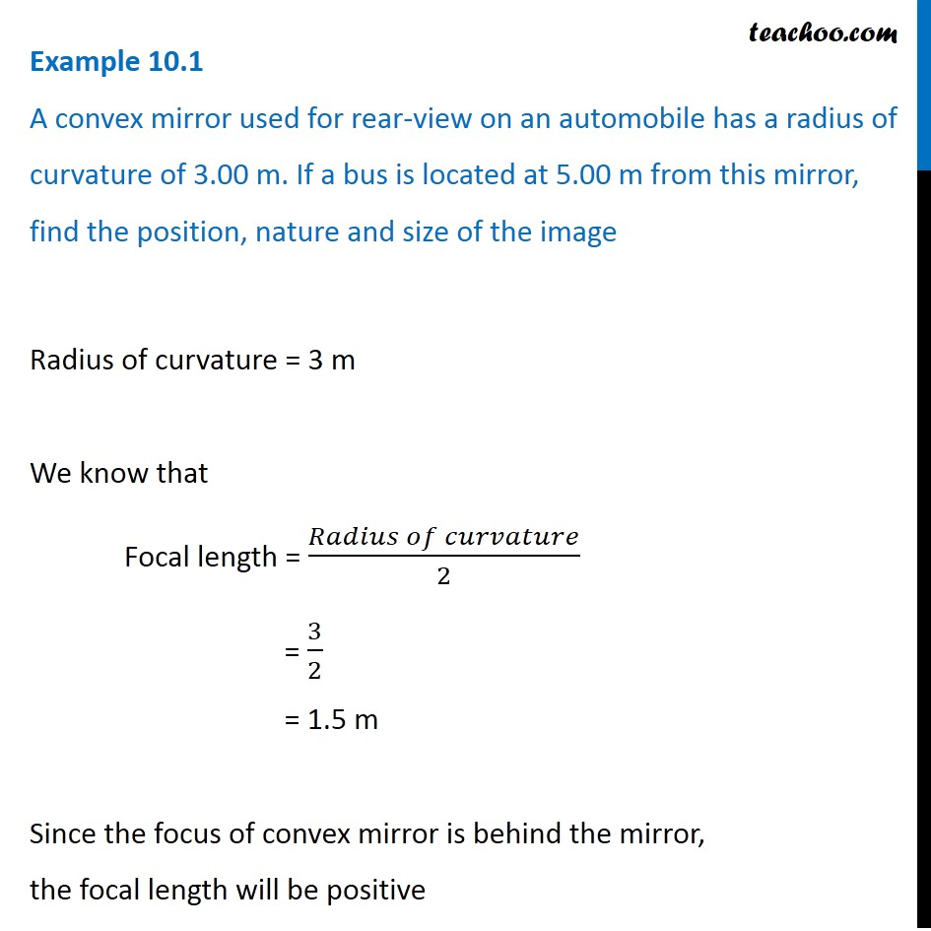
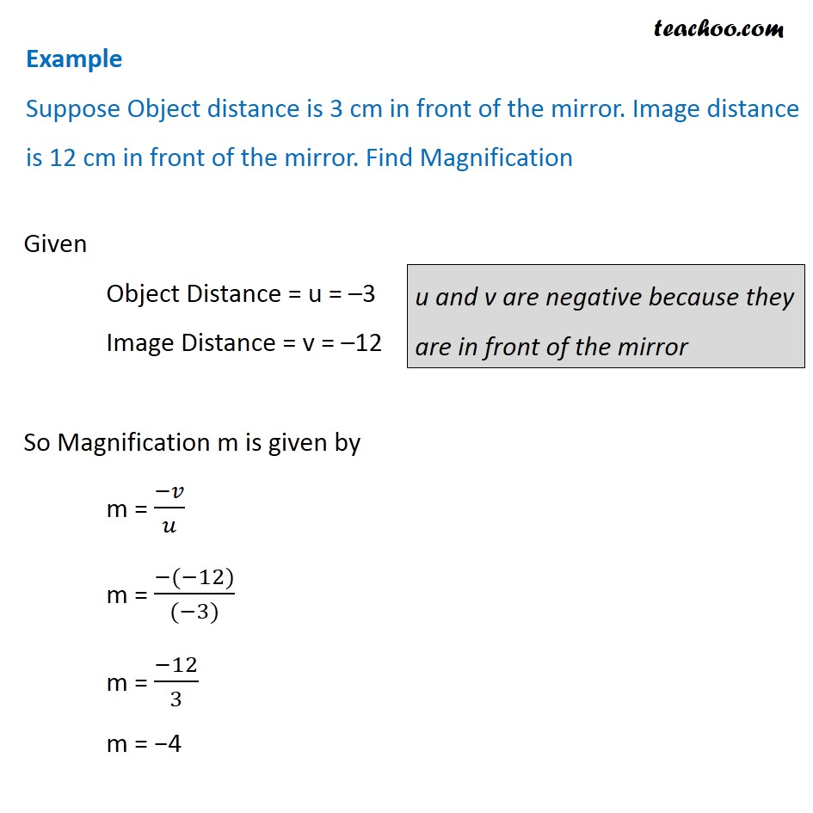
numerical
1.
2.

Slide 18
solutions
1.

Slide 19
Solutions...
2.

Slide 20

Any query refer to:- imarshbir@gmail.com

