Slide 1
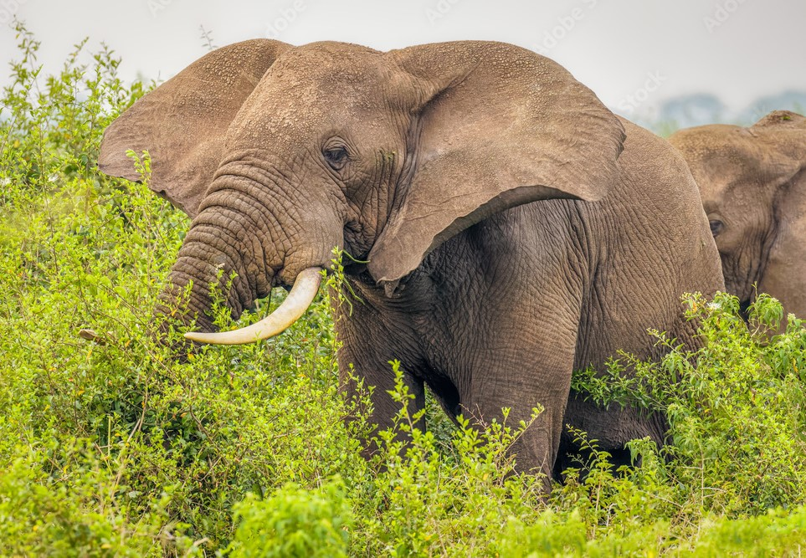
Queen Elizabeth National Park
Uganda’s most popular and diverse conservation area, Queen Elizabeth National Park enjoys a fabulous setting on the western rift valley floor, surrounded by lakes, escarpments and snow-capped Rwenzori mountain. A variety of habitats, including grassland, acacia woodland, forest, wetland and open water, sustains a wide range of mammals while the park’s 604 bird species is a quite remarkable tally for protected area covering less than 2000km².

Slide 2
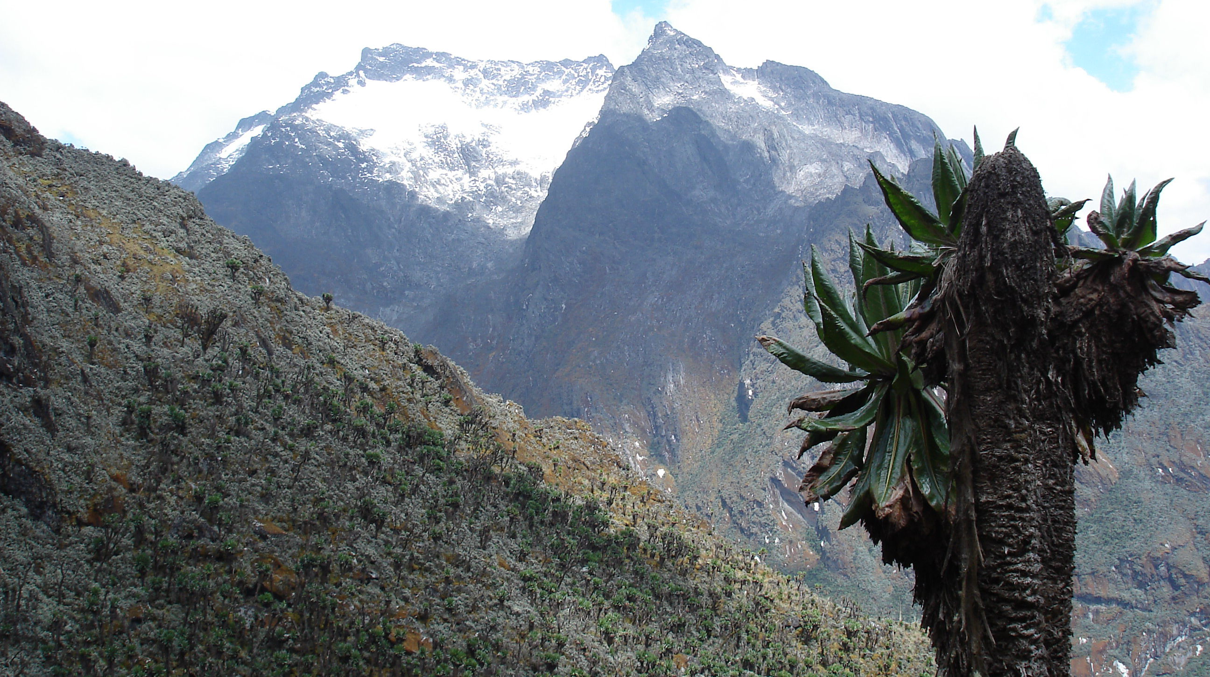
Rwenzori Mountains National Park.
Africa’s highest mountain range, the 5,109m Rwenzori - Mountains of the moon is a montane wonderland. The trails to the snow peaks following glacier – carved valleys filled with fantastically colored mosses and rare Afro-alpine plants that include giant forms of lobelias, heathers and groundsels. Expeditions use a chain of basic huts and campsites to ascend the mountain from trailheads at Kilembe, Mihunga and Katebwa. Though the peaks can be climbed, the main attraction is the opportunity to spend days exploring a stunning montane wilderness inhabited by the rare Afromontane botany peculiar to East Africa’s highest mountains. Visitors can also take shorter, day walks to look for birds and primates in the forests on the lower contours of the national park.

Slide 3
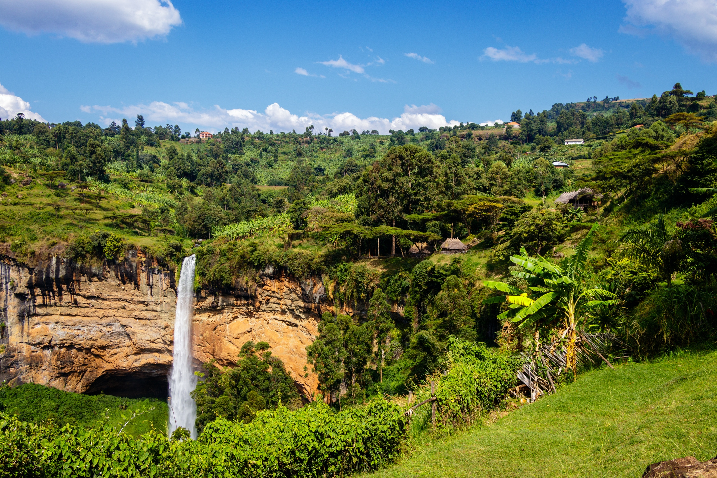
Mt. Elgon National Park
The 1,145km² Mount Elgon National Park protects the higher slopes of Mount Elgon, an extinct volcano, on the Uganda-Kenya border. The Mountain, which measures 80km in diameter, once towered above Kilimanjaro’s current 5900m. Though now reduced to 4321m, still rises 3000m above the hot, dusty plains of Karamoja to provide a cool respite for humans and a refuge for flora and fauna. Tourist activities on the mountain cater for various levels of ambition. Visitors can extend hikes, requiring a minimum of 3 days, to reach the summits which lie along the jagged rim on a giant caldera, 8km across. Less demandingly, visitors can take day/half day walks through forest on the lower edge of the park or simply relax in resorts overlooking a chain of delightful waterfalls just outside the park at Sipi.

Slide 4
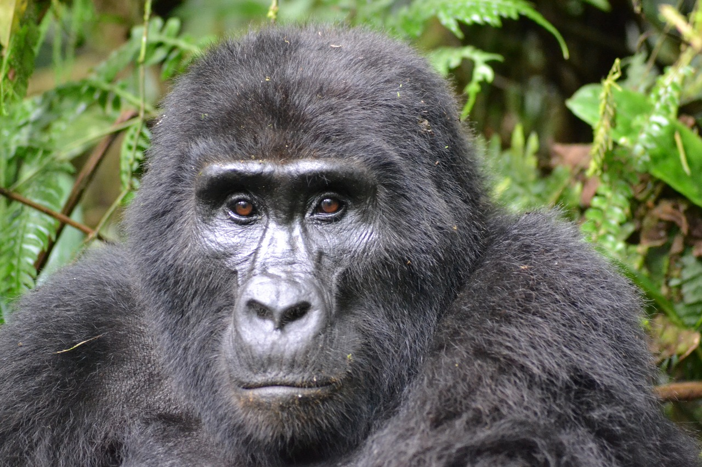
Bwindi Impenetrable National Park
One of the Africa’s oldest forests – being one of the few that predate the arid conditions of the last ice age – the 325km² Bwindi impenetrable has carpeted the margin of the Albertine Rift Valley for some 25,000 years. During this time, it has accumulated a remarkable biodiversity. Species counts include 350 birds, 310 butterflies, 200 trees, 51 reptiles, 88 moths and 120 mammals. The latter includes several primates, among them chimpanzees, L’Hoest monkey, and the star of the Impenetrable show: the mountain Gorilla. The global population of this endangered ape numbers just 800, half of which leave in Bwindui and the remainder on the nearby Virunga

Slide 5
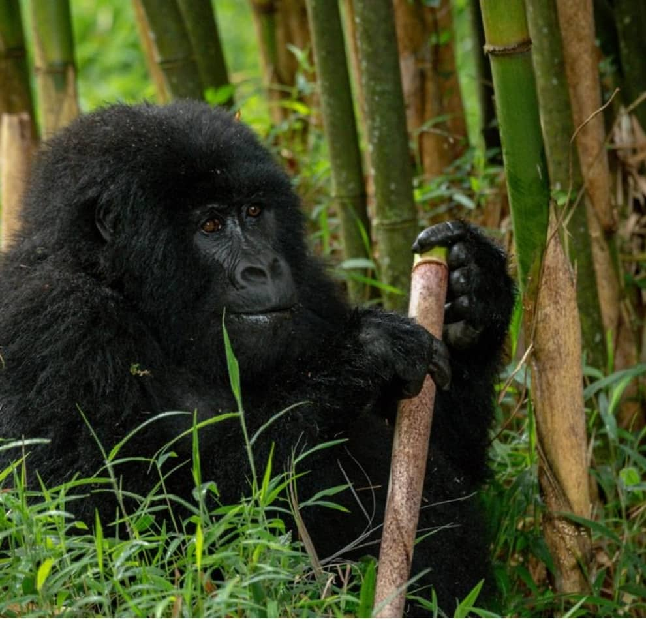
Mgahinga Gorilla National Park
Though uganda’s smallest park covers just 38km², it forms part of a far larger, transboundary protected area that protects wildlife and habitats on the Virunga volcanoes in Uganda, Rwanda and DRC. Mgahinga gorilla enjoys a magnificient setting on the northern slopes of the three of the Virunga’s six extinct cones; Mts.Muhuvura, Gahinga and Sabinyo. The park is home to the two rare primates, mountain gorillas and golden monkeys, both of which can be tracked through their forest habitat. The volcanic peaks can be climbed; the 4127m Muhuvura provides a stunning 360⁰ regional panorama while Sabinyo’s highest peak offers the rare privilege of standing over 3600m high whilst in the three countries at once. A range of habitats, including forest, bamboo and moorland, support a wealth of birdlife including the beautiful Rwenzori turaco. On the lower comtours, visitors can follow the Batwa Trail with Batwa (pigmy) guides to learn about traditional forest life before descending into the Garama Cave, historically the home of the Batwa King, for an unforgattable perfomance of Music and dance.

