Slide 1
Road To Recovery

Slide 2
Introduction
We are focusing on Pneumonia
Highly Contagious Disease
3 Million Cases Reported Annually
Why is this topic interesting/relatable?
We are using an SIR Model to explain possible correlation.
Project Statement
How does adding more money to a hospitals spending affect the rate at which patients recover.
Secondary Question
Is there a direct correlation between hospital spending and recovery rate?
Target Audience
Politicians, Public Health Awareness, Policy Makers, Voting Demographics, Doctors/ Nurses.

Slide 3
Methodology
We retrieved and implemented our data for Hospital-data.com
Beta: Contact Rate Gamma: Rate of Recovery
We are trying to see how money is possibly going to change gamma.
To make model more realistic:
Used actual contact rate for our beta.
Assumptions: Contact rate doesn’t change, Susceptible people don’t increase, Once recovered you don’t get disease again.

Slide 4

Methodology
Step 1: Update function calls add_hospital function, this will update our model
Step 2: add_hospital takes in our system and changes our gamma based on the algorithms we made.
Recovery rate increases more if spending is less than 10,000
Recovery rate increases slower if spending is more than 10,000

Slide 5
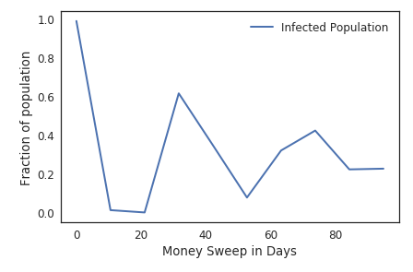
Results
Sweep Parameter shows that while varying the max budget a hospital can use, it is directly affecting the maximum amount of infected people per 100 Days.
Each Day has a different random percentage of money being spent.

Slide 6
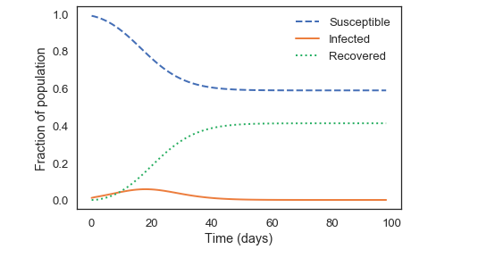
Results
Our results show that as days go on our susceptible population starts to decrease.
Infected population temporarily goes up
Recovery rate starts increasing
After 30 days have past, function starts to flat line.

Slide 7
Analysis
Limitations of Model
Ways to improve
Only studying one disease
Healthcare isn’t involved
Immune system not taken into consideration
Small population
Not enough data
Making it more accurate
Adding more variables to our model
Changing monetary values not just percentages of the money that can be used.

Slide 8
Conclusion
Real-life Applications
To reduce bill paid by insurers, providers’ often appropriate their costs to procedures on how much they are compensated rather than the assets administered for patient care
Politicians with policy making on decrease or increase in financial aid for hospitals and health care
Doctors, nurses, physician’s assistant, affect which hospital they prefer to work at based on salary, patient care, schedule.
Take-Away
Need of an increase in assistance of doctor's/nurses/P.A.’s
Politicians/pharmaceutical & insurance companies take advantage of the system by overpricing costs for healthcare services rather increasing further financial aid for hospitals and patient care.
To accommodate more patients without increasing beds, policy makers are required to make these changes or provide incentives for hospitals to do so
Future Research
Hospitals would benefit from:
-reduced overcrowding
-reduced patient waiting time for services
-reduced of assistance shortages -improved quality and lower cost through optimal patient placement
Patients would recover at a faster rate with pneumonia with proper care and assistance

