Slide 1
Database administration ABD Lecture 1
Paweł Lenkiewicz

Slide 2
Course organization
First part: Microsoft SQL Server
Second part: PostgreSQL

Slide 3
Course organization
Lecture
Power Point presentation
Presentation
Exercises
Virtual computers (VMWare)

Slide 4
Credit
Exercises – colloquium after each part (MS SQL and PostgreSQL) + practical exercises (3 failed / absences allowed).
Exam (test)

Slide 5
Topics (MS SQL)
Installation, architecture, system databases, physical data storage
Database performance tuning, indexes
Transactions, locks, concurrency
Permissions, user accounts, security
Backup, restore
Scheduled tasks, monitoring, other features

Slide 6
Lecture 1
Installation of Microsoft SQL Server
System architecture
System databases
Creating a database
Files
RAID arrays
Database options
Server configuration

Slide 7
Editions of MS SQL
Selected features
Feature | Express | Standard | Enterprise | Developer
Paid | no | yes | yes | no
Processors | 1 socket / 4 cores | 4 sockets / 24 cores | OS max. | OS max.
RAM (Buffer Pool) | 1410 MB | 128 GB | OS max. | OS max.
Max. database size | 10 GB | 524 PB | 524 PB | 524 PB
Resource Governor |  |  | + | +
Transparent Database Encryption |  | + | + | +
Full-Text Search |  | + | + | +
Database Mail |  | + | + | +
Log shipping |  | + | + | +
Profiler |  | + | + | +
Database Tuning Advisor |  | + | + | +
SQL Server Agent Job Scheduling |  | + | + | +
Source: www.microsoft.com

Slide 8
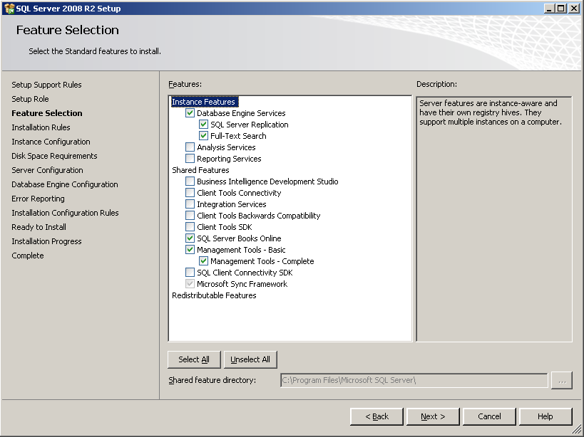
Installation – features selection

Slide 9
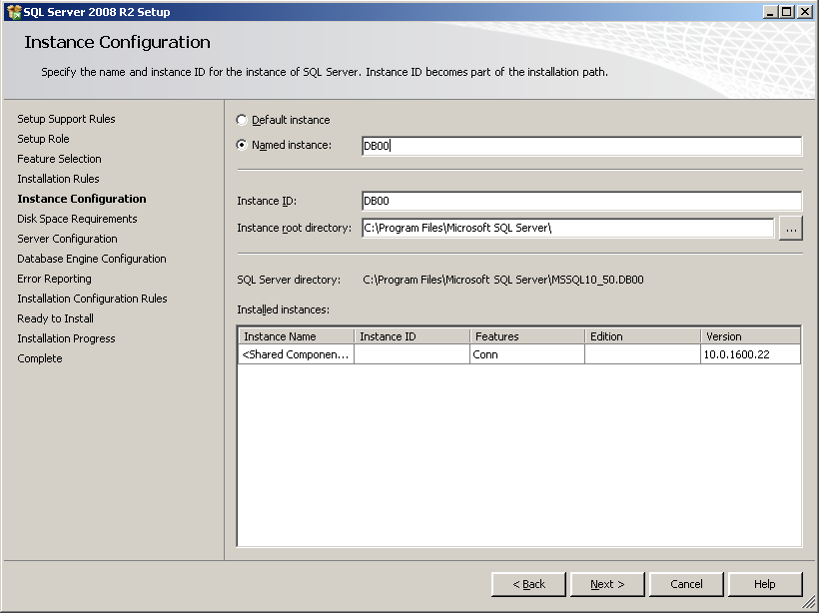
Installation – instances
Default instance
One default instance on a one computer. Name: the same as Windows computer name.
Named instance Many instances on a one computer. Each instance has separated files, services, databases, name. Name: computer_name\instance_name.

Slide 10
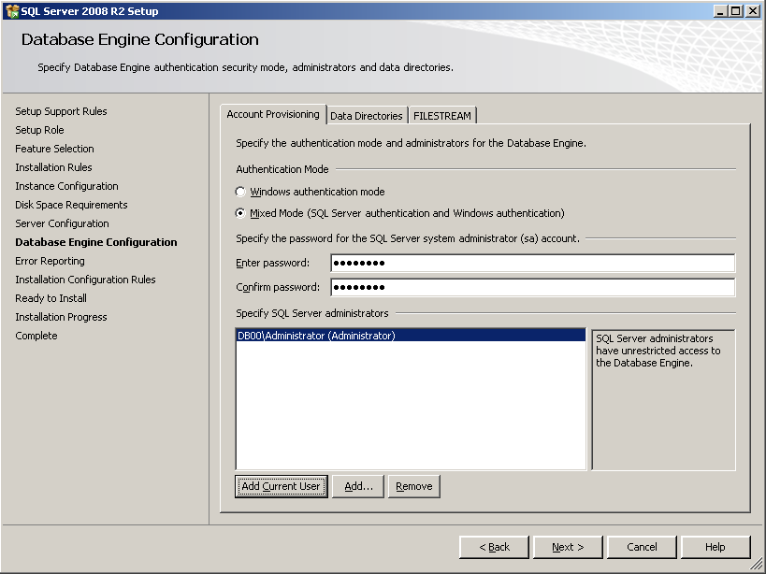
Installation – authentication mode
Windows authentication We use Windows and/or Active Directory accounts to access the database server.
Mixed mode Windows / Active Directory accounts or accounts created on the database server.

Slide 11
Services
MSSQLServer Main database server service
SQLServer Agent Required to start scheduled tasks
Microsoft Distributed Transaction Coordinator Manages the distributed transactions
Microsoft Search Required for “full text search”
Analysis Services Required for OLAP services
Report Server Required for reporting services

Slide 12
Tools
Management Studio
Main tool used for database administration (GUI and command line).
Configuration Manager
Managing the services and network protocols.
Database Engine Tuning Advisor
Generates tuning recommendations.
Profiler
Server monitoring.
Books OnLine
User manual.

Slide 13
Databases
Master
Metadata, e.g. information about user databases, account and all objects on the server level.
Model
Database template. Every new database is a copy of model.
Tempdb
Used for storage of temporary data (e.g. temporary tables).
Msdb
Contains information about scheduled tasks, jobs, etc.
User databases

Slide 14
System stored procedures sp_
Located in Master and user databases. Used for performing administrative tasks and for retrieving information from system databases.
Examples:
Sp_help object
Information about the object (e.g. table)
Sp_helptext object
Displays the text contained in the object (e.g. code of stored procedure)
Sp_helpindex object
Displays information about indexes on the object
Sp_tables
Displays all tables in the database

Slide 15
Object names
Full object name:
server.database.schema.object
Usually we use shorter names, e.g.:
object
database..object
database.schema.object

Slide 16
Server options
memory settings
processor settings
user authentication
connections
database settings
…

Slide 17
Database files
Every database is stored in disk files:
Primary data file (*.mdf)‏
Secondary data files (*.ndf)‏
Transaction log file (*.ldf)
Transactions are saved in the transaction log first. Later, periodically their results are saved in data files (WAL principle). Transaction log is required for rolling back transactions (ROLLBACK), to keep consistency after failure. Using the transaction log, we can restore the database to any point in time.

Slide 18
Database files
Data files (one or more), first .mdf remaining .ndf
…
Database
Transaction log file .ldf

Slide 19
Data file structure
Page 8 KB 8060 bytes – row size limit
Data file .mdf or .ndf
Extent 8 pages

Slide 20
Data file structure
Row must fit one page.
Page may contain many rows.
Each page contains rows from one table only.

Slide 21
Files strategy
Data file and transaction log file on separate disks.
Operating system on separate disk.
Tables joined / used together on separate disks.
Tables updated rarely (archive data, dictionary tables) on separate file.
Tables and indexes on separate disks.

Slide 22
Examples of strategies
Disk 1 - data file
Disk 2 - transaction log
Disk 3 - operating system
Disk 1 - data file 1
Disk 2 - data file 2
Disk 3 - transaction log
Disk 4 - operating system
Disk 1 - data file 1 (data)‏
Disk 2 - data file 2 (indexes)‏
Disk 3 - transaction log
Disk 4 - operating system

Slide 23
RAID arrays
RAID0 - performance, striping, 2 disks
RAID1 - security, mirroring, 2 disks
RAID0+1 - performance and security, 4 disks
RAID5 - performance and security, min. 3 disks
and many more…

Slide 24
Creating a database
Define number, names and localization of data files.
Define name and localization of transaction log.
Set starting size of the files.
Set autogrowth or manual growth of the files.
Set the database options.

Slide 25
Creating a database (SQL)
Example:
CREATE DATABASE Sales ON
(NAME = Sales_dat,
FILENAME = 'c:\program files\microsoft sql server\mssql\data\saledat.mdf',
SIZE = 1MB, MAXSIZE = UNLIMITED, FILEGROWTH = 5MB)‏
LOG ON
(NAME = 'Sales_log',
FILENAME = 'c:\program files\microsoft sql server\mssql\data\salelog.ldf',
SIZE = 1MB, MAXSIZE = UNLIMITED, FILEGROWTH = 5MB)‏
GO

Slide 26
Database options
Recovery model
full
bulk logged (server will not write to the log results of some statements, like: SELECT … INTO …, BULK INSERT)
simple (after commit, transactions are deleted from the log. Recovering the database to a point in time is not possible in this model)
Other settings

Slide 27
Information about database
Sp_helpdb baza
Sp_spaceused
Sp_spaceused obiekt

Slide 28
Filegroups
Database may be stored in many files on many hard drives.
One or many files may belong to a filegroup.
During creation of an object (table or index) we can define a filegroup in which the data will be stored, but we can’t define particular file.
One filegroup must be a default filegroup. All new objects will be stored in the default filegroup if we’ll not specify the other one.

Slide 29
Shrinking files
Management Studio
DBCC SHRINKDATABASE (name)‏
DBCC SHRINKFILE (file)‏

Slide 30
Dropping databases
DROP DATABASE name

