Slide 1
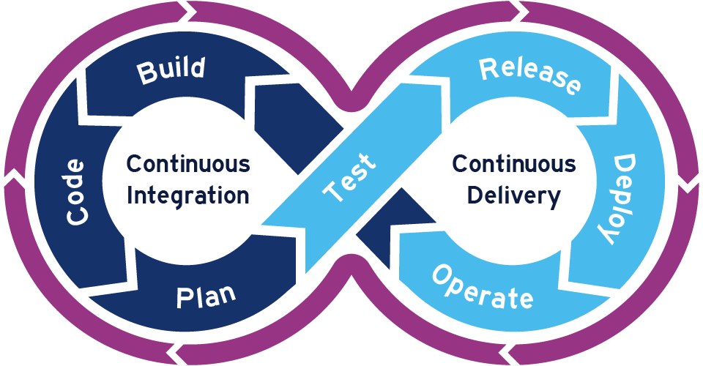

Prepared Mashnov Illia
Specially for EpamDevOpsSpring2021
2021

Slide 2











IaaS + Automatic Configuration Managements
AWS EC2 CentOS 8
S3 Bucket
jenkins-server
Installed docker and Jenkins with image on project server
AWS EC2 ubuntu 20.04
RDS
project-server
Installed docker on project server
Generated hosts file for ansible
My workstation
Fedora 34

Slide 3





Application structure
HTTPS
Port: 5432
Port: 8000
Port: 80

Slide 4




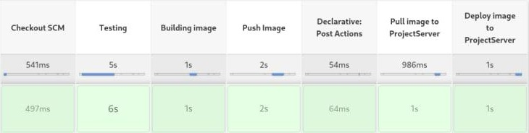

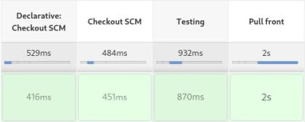
CI/CD pipelines
Unit-tests
image
Backend repository
auto-job pipeline
image
AWS EC2 ubuntu 20.04
Frontend repository
auto-job pipeline

Slide 5








Evolution
Unit-tests
image
Backend repository
auto-job pipeline
AWS EC2 ubuntu 20.04
Slack notification
image
AWS EC2 ubuntu 20.04
quality gateway
Frontend repository
auto-job pipeline
S3 Bucket

Slide 6
Thank you for your attention!
CICD project: https://github.com/imashnyov/EpamFinalProject.git
Web-project frontend: https://github.com/yarik2215/beer-site-backend.git
Web-project frontend: https://github.com/yarik2215/beer-site-front.git

