Slide 1

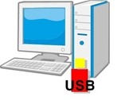
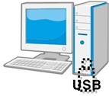
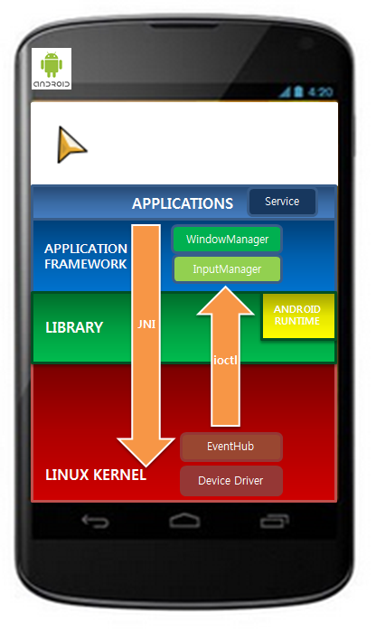
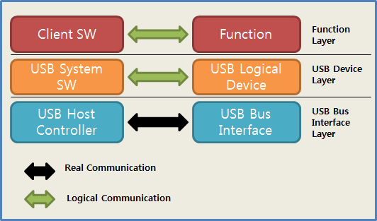
PassU System Architecture
UDP/IP
Virtual USB share &
Input Device control
UDP/IP
Windows USB Stack
Virtual Input Device

