Slide 1
LLVM Passes
Marija Skoric 63/2018
Ana Vucinic 200/2018
Mateja Ivancevic 184/2018

Slide 2
Dead Store Elimination
Delete useless assignments of variables
Assign instructions in C are store instructions in LLVM IR
Eliminate store instructions in IR
A store instructions is considered dead if the variable that the value was stored into is never used before the value of that same variable is changed

Slide 3


Implementation
Look at pointer operands for Store instructions which are unique for every variable
Pointers always start from %2
Ignore first occurrences for pointers, check if 2nd or later occurrence
In this example we delete the 2nd store instruction that assigns value 15 to variable x

Slide 4
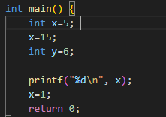
Where it doesn't work
Previous code will delete the first assignment
It will also delete the second one
Printf function prints garbage, only assignment is x=1

Slide 5


Load consideration
Whenever a value currently stored inside a variable is about to be used it is loaded into the variable via the load instruction in LLVM IR
Mark recent pointer operands in load instructions unsafe

Slide 6
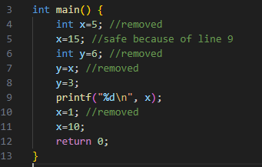

Slide 7
Map and set
Ptr2inst map – pointer operand is key, instruction is the value
Used to know which instruction to delete based on the pointer operand
Unsafeptr – set that contains pointer operands that were recently used in load instructions, checked upon reaching next store instruction

Slide 8
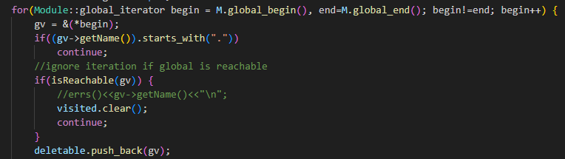
Dead Global Elimination
Delete global variables that have no usage in the code
A global variable is considered dead if it can't be reached
Iterate through global variables via global pointers in module M
Ignore those that start with "." , they are generated by LLVM (i.e. .str global generated when using printf in LLVM IR)

Slide 9
Reachability function
Iterate through all users for a global variable
Consider only users that are instructions
Iterate through instruction operands
Try to cast operand to global variable
Call reachability function recursively if cast succeeds
Uses a set to mark visited variables

Slide 10
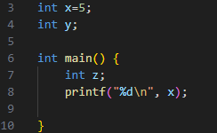
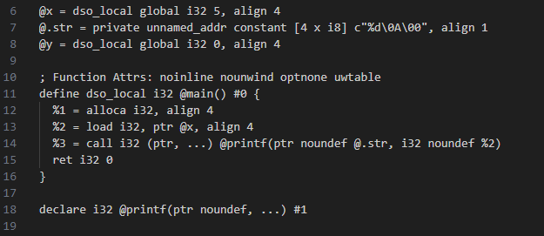

Slide 11
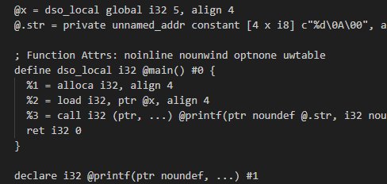

Slide 12
Post Dominator Tree Construction
Used for analysis purposes to represent control flow relationships among program statements
In a control flow graph (CFG), a node A dominates another node B if every path from the entry node of the CFG to node B must go through node A. In other words, node A controls the execution of node B. A dominator tree represents the dominator relationships among the nodes in the CFG.

Slide 13
Immediate dominators
In the post-dominator tree, an immediate dominator of a node N is the node that post-dominates N but does not post-dominate any other node that also post-dominates N. In simpler terms, the immediate dominator of a node is the nearest node in the post-dominator tree that has control over the execution flow of the given node.

