Slide 1
LLVM Passes
Marija Skoric 63/2018
Ana Vucinic 200/2018
Mateja Ivancevic 184/2018

Slide 2
Dead Store Elimination
Delete useless assignments of variables
Assign instructions in C are store instructions in LLVM IR
Eliminate store instructions in IR
A store instructions is considered dead if the variable that the value was stored into is never used before the value of that same variable is changed

Slide 3


Implementation
Look at pointer operands for Store instructions which are unique for every variable
Pointers always start from %2
Ignore first occurrences for pointers, check if 2nd or later occurrence
In this example we delete the 1st store instruction that assigns value 5 to variable x

Slide 4
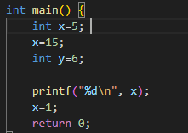
Where it doesn't work
Previous code will delete the first assignment
It will also delete the second one
Printf function prints garbage, only assignment is x=1

Slide 5


Load consideration
Whenever a value currently stored inside a variable is about to be used it is loaded into the variable via the load instruction in LLVM IR
Mark recent pointer operands in load instructions unsafe

Slide 6
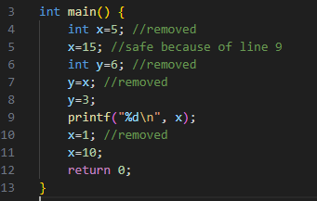

Slide 7
Map and set
Ptr2inst map – pointer operand is key, instruction is the value
Used to know which instruction to delete based on the pointer operand
Unsafeptr – set that contains pointer operands that were recently used in load instructions, checked upon reaching next store instruction

Slide 8
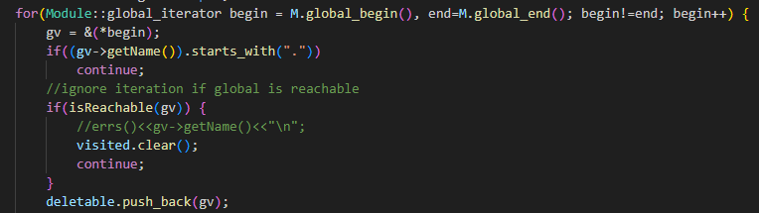
Dead Global Elimination
Delete global variables that have no usage in the code
A global variable is considered dead if it can't be reached
Iterate through global variables via global pointers in module M
Ignore those that start with "." , they are generated by LLVM (i.e. .str global generated when using printf in LLVM IR)

Slide 9
Reachability function
Iterate through all users for a global variable
Consider only users that are instructions
Iterate through instruction operands
Try to cast operand to global variable
Call reachability function recursively if cast succeeds
Uses a set to mark visited variables

Slide 10
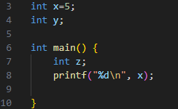
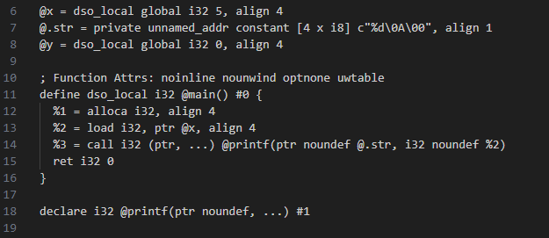

Slide 11
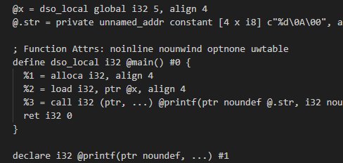

Slide 12
Post Dominator Tree Construction
Used for analysis purposes to represent control flow relationships among program statements
In a control flow graph (CFG), a node A dominates another node B if every path from the entry node of the CFG to node B must go through node A. In other words, node A controls the execution of node B.
In a CFG, a node A post-dominates another node B if every path from node B to the exit node of the CFG must go through node A.

Slide 13
Immediate and Semi dominators
Immediate dominators represent the closest dominator for each node in forward control flow
Semi dominator of node A is the smallest node B such that a path from B to A exists and no vertices on that path except B are no smaller than A

Slide 14
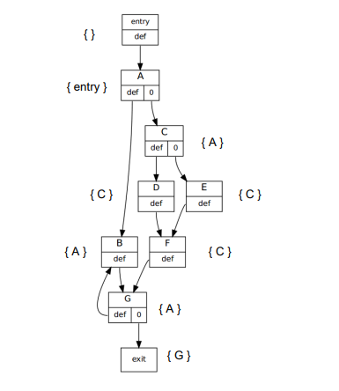

Slide 15
Lengauer-Tarjan algorithm
DFS search to set up initial values
Compute semi dominators for each node
Use semi dominators to compute immediate dominators

Slide 16
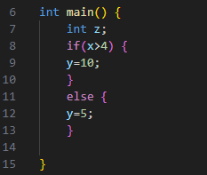
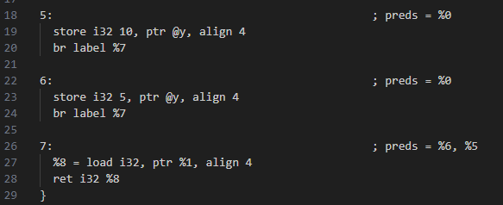
Main difference to regular dominator trees
DFS traversal is started from exit basic block instead of the start
When linking nodes iterate through predecessors instead of successors

Slide 17
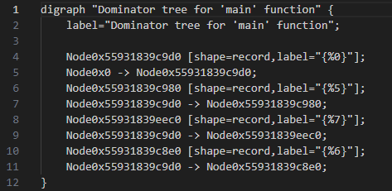
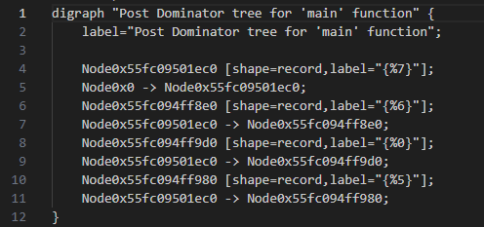

Slide 18
