Slide 1
Guide
Oculus task
Extracted the world landmarks of the videos:
Rgb_front:
/mnt/gpid08/datasets/How2Sign/EgoSign/egoSign/raw_data/PC2/features/rgb_front
Rgb_side
/mnt/gpid08/datasets/How2Sign/EgoSign/egoSign/raw_data/PC2/features/rgb_side
Rgb_head:
/mnt/gpid08/datasets/How2Sign/EgoSign/egoSign/raw_data/PC2/features/rgb_head

Slide 2
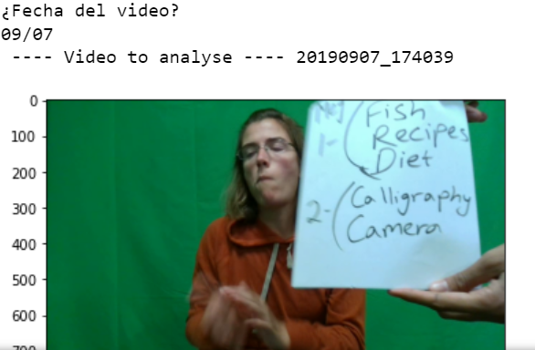
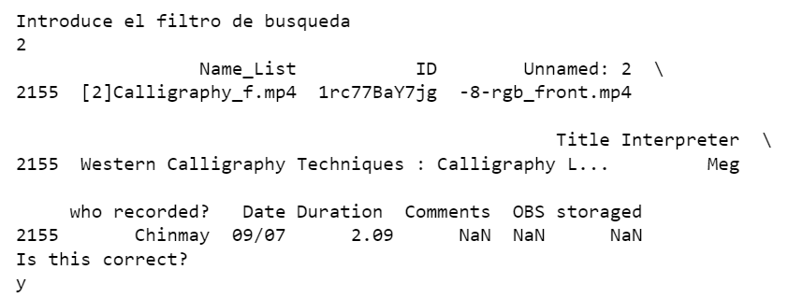
Guide
Alignment task
Created a supervised script to get the relation between video and recording:
Had some problems: some video did not exist, some had not the same name, some of them started before showing the sheet, etc

Slide 3
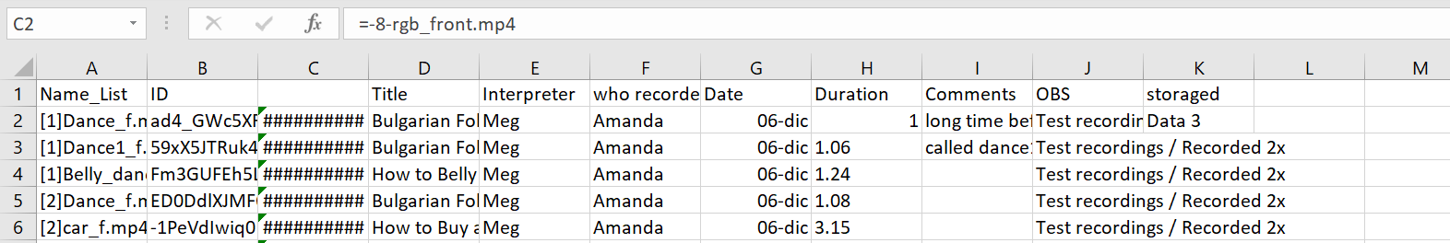
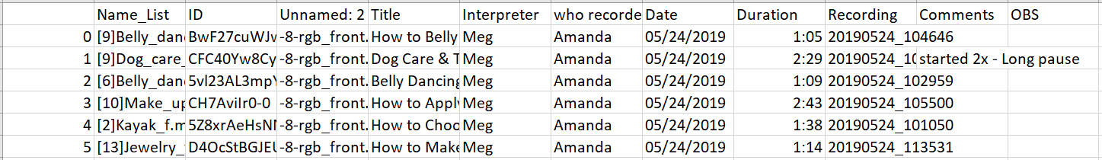
Guide
Alignment task
Created a document with the relation between video and recording:
1. Preprocessed the existing files:
2. Created the files with the mentioned relation:

Slide 4
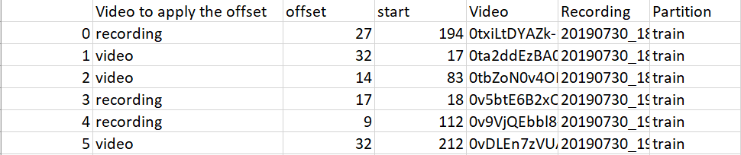
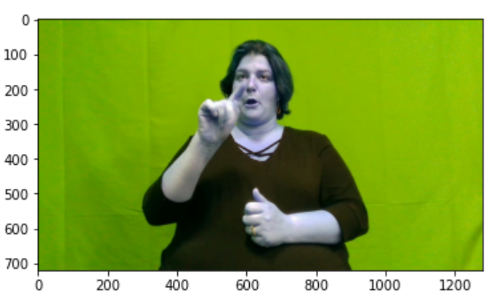
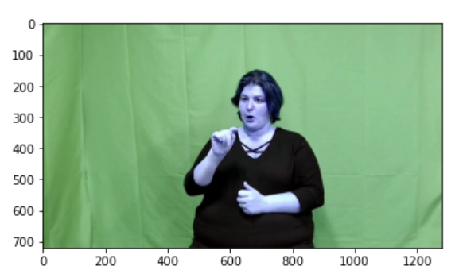
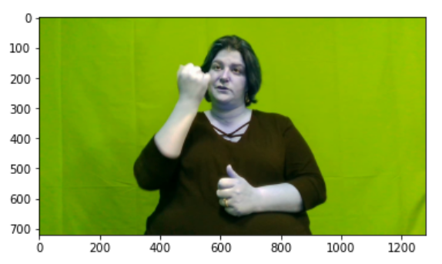
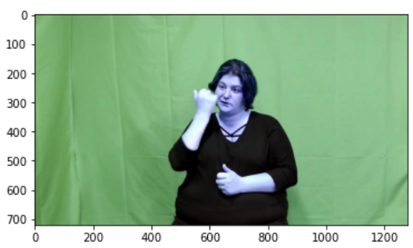
Guide
Alignment task
Adapted the alignment script ang executed that for each pair video-recording:
Tested if alignments were correct:

Slide 5
Guide
Alignment task
For testing if alignments were correct:
1. Transformed videos from 25 frames to 50 frames:
/mnt/gpid08/datasets/How2Sign/How2Sign/video_level/test/video_50frames
2. Extracted and grouped every recording available:
/mnt/gpid08/datasets/How2Sign/How2Sign_RGB-D/videos/train
Videos in its folder
Videos grouped in one folder to facilitate the extraction of keypoints
Both types of keypoints extracted: landmarks and world landmarks

