Slide 1
Fitbrick
Matias Lopez • Raiyan Sobhan

Slide 2
Connections + Code Diagram

Slide 3
Special Features
Memory Saving
Stored most LCD prints to flash rather than RAM using Arduino F command
Saved all variables as unsigned integers
Nothing stored on device
1 SD per user
1 SD per pers
Battery
8+ hours battery life on 1.2V rechargeable batteries

Slide 4
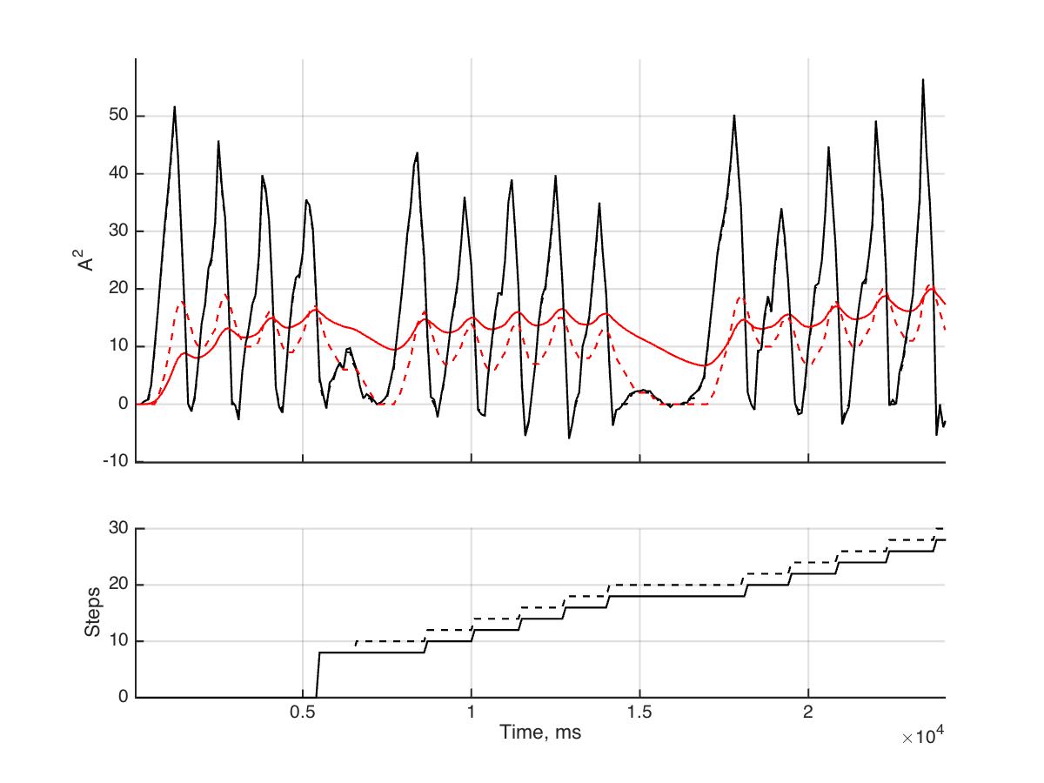


Special Features
Dynamic Threshold
A rounded to integer
Counts on Deceleration
6 Step Count Minimum
Invalid Step Resetting
1g Normalizing

Slide 5
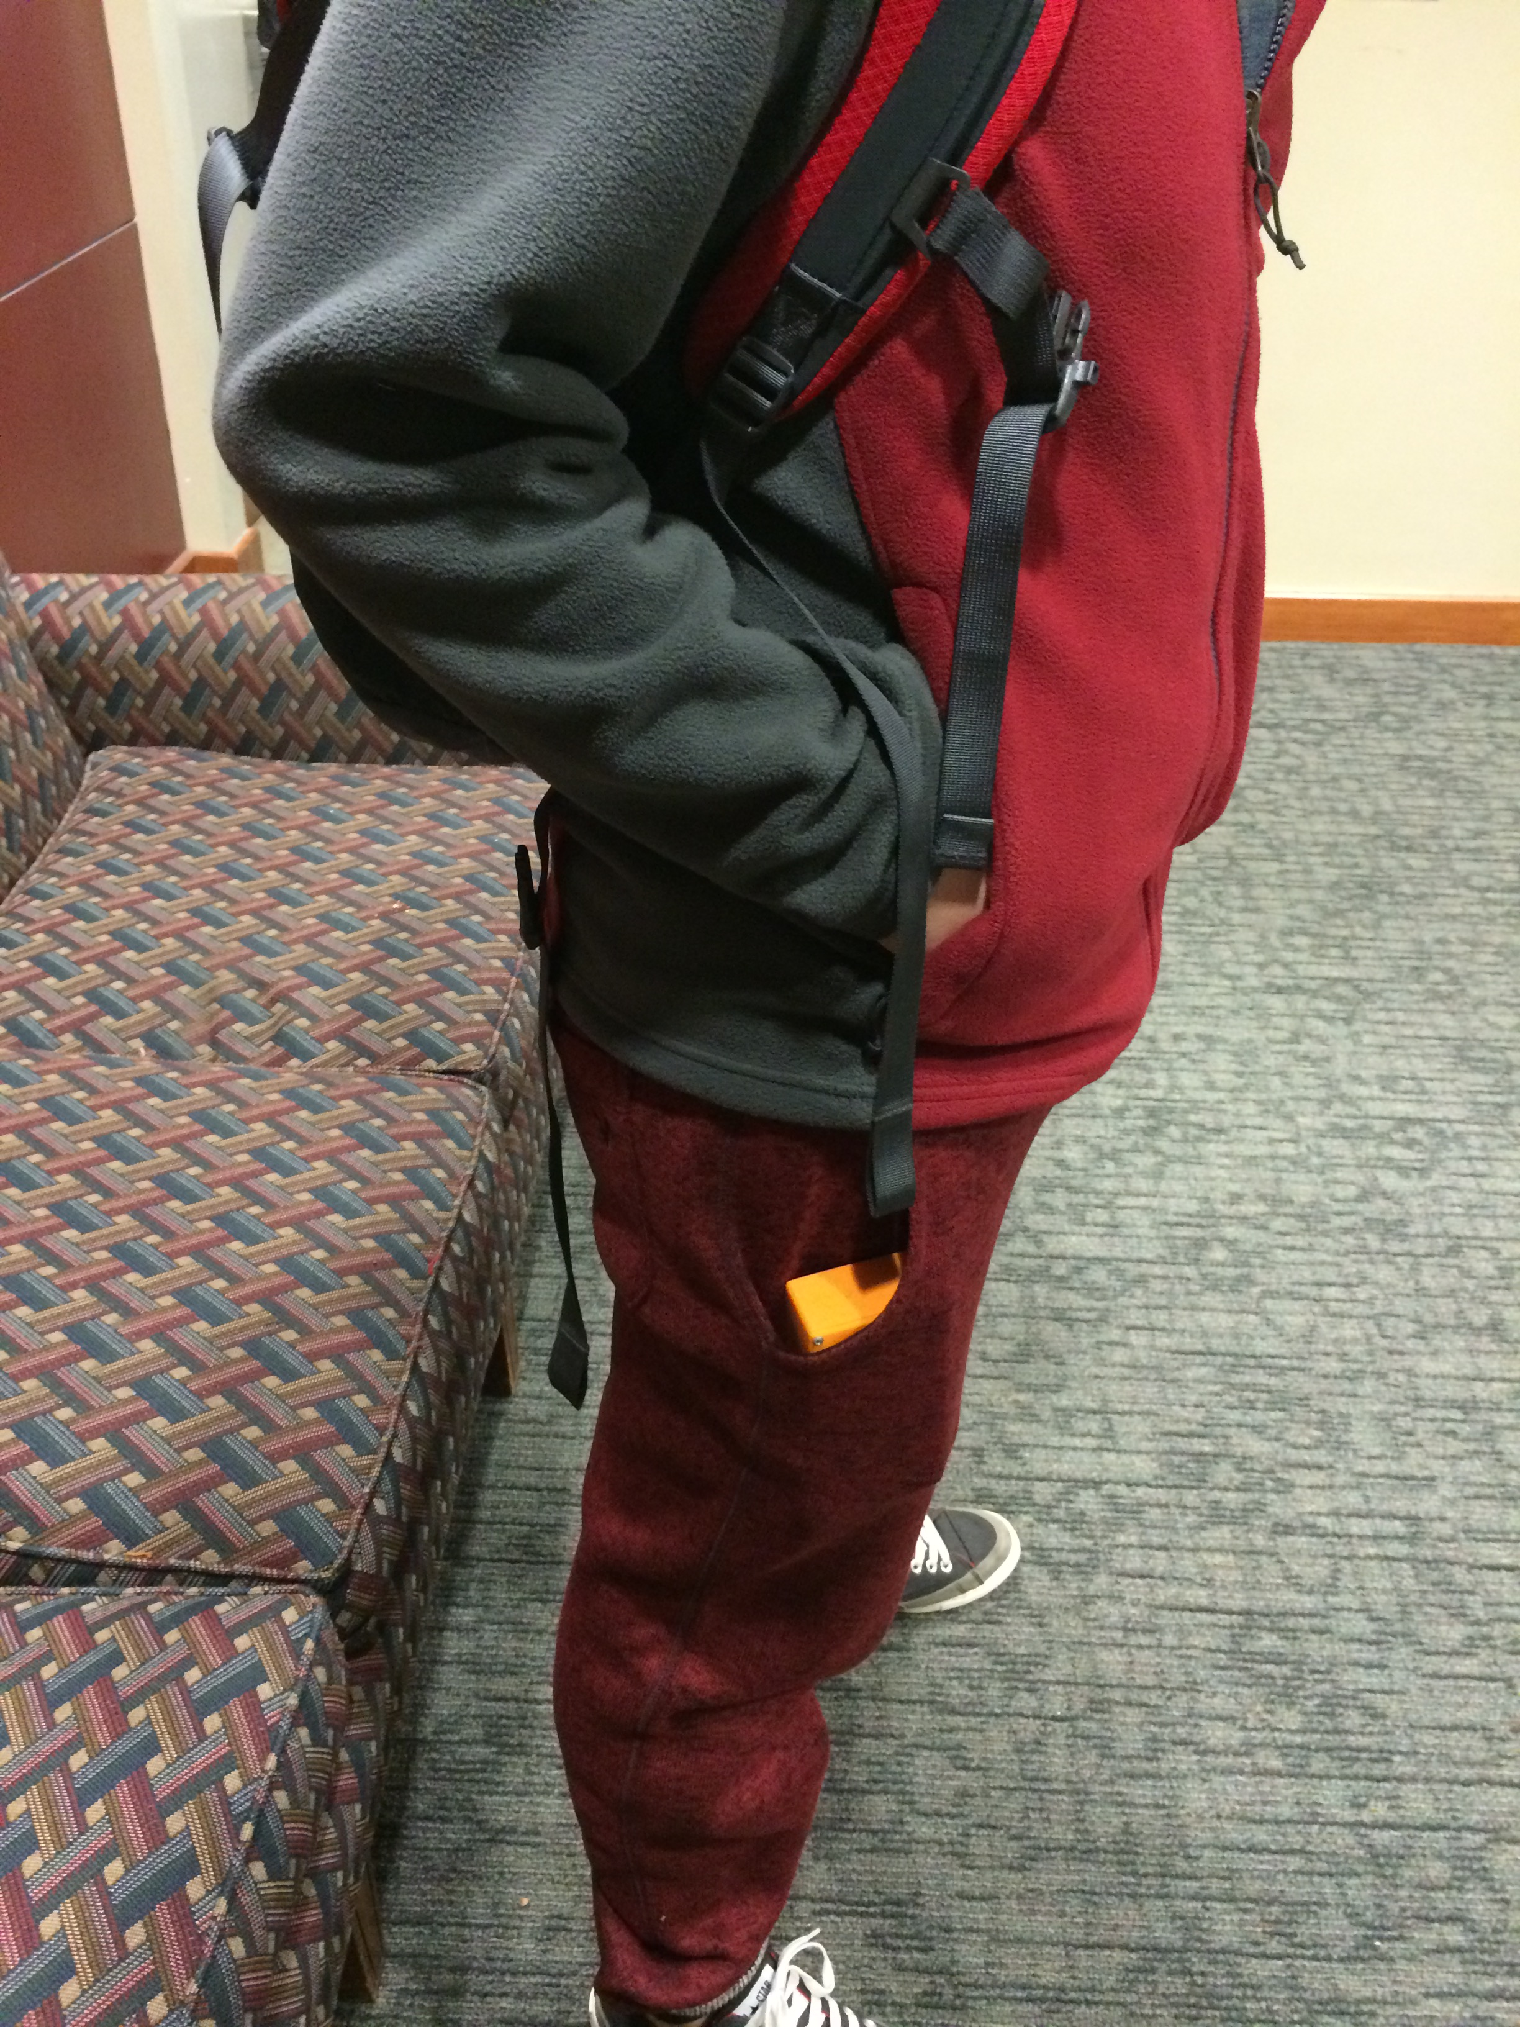
Special Features
Sleep
LCD Screen sleeps after 10 seconds to save battery
Step counting continues
Activity Level¹
Level 1: <120 steps per minute
Level 2: <160 steps per minute
Level 3: >160 steps per minute
¹United States Army, Fort Benning. <http://www.benning.army.mil/mcoe/CommunityHealth/content/pdf/Step%20Conversion%20Chart.pdf>

Slide 6

Special Features
Trainer Mode
User sets desired activity level
Pedometer will beep if the user falls below this activity level
Timer
Timer will begin once user reaches activity level 3
http://images.contentful.com/7h71s48744nc/ttbuWX4JtsGcpN25BIz41u/d6eb57c5801370b80e356e06f297f1af/Forrest-Gump-large.jpg
http://kathynightingalelab.pratt.duke.edu/members/ningrui-li

