Slide 1

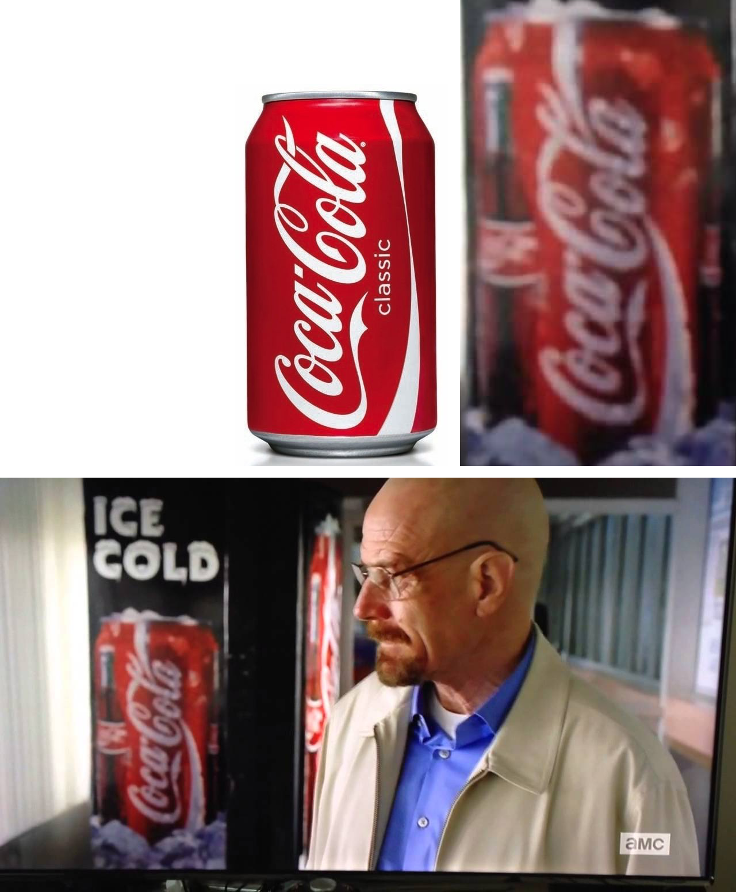
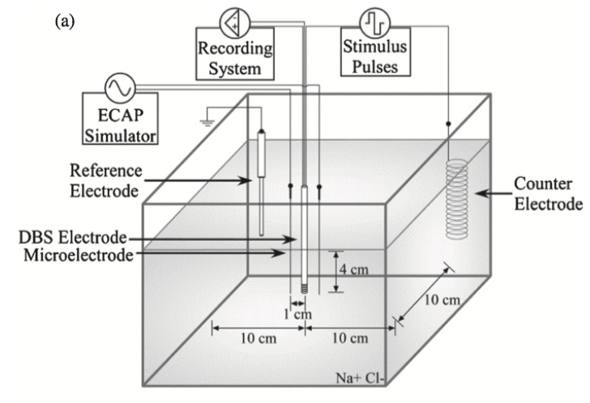
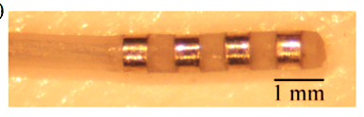
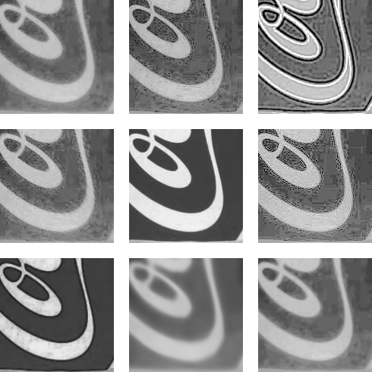
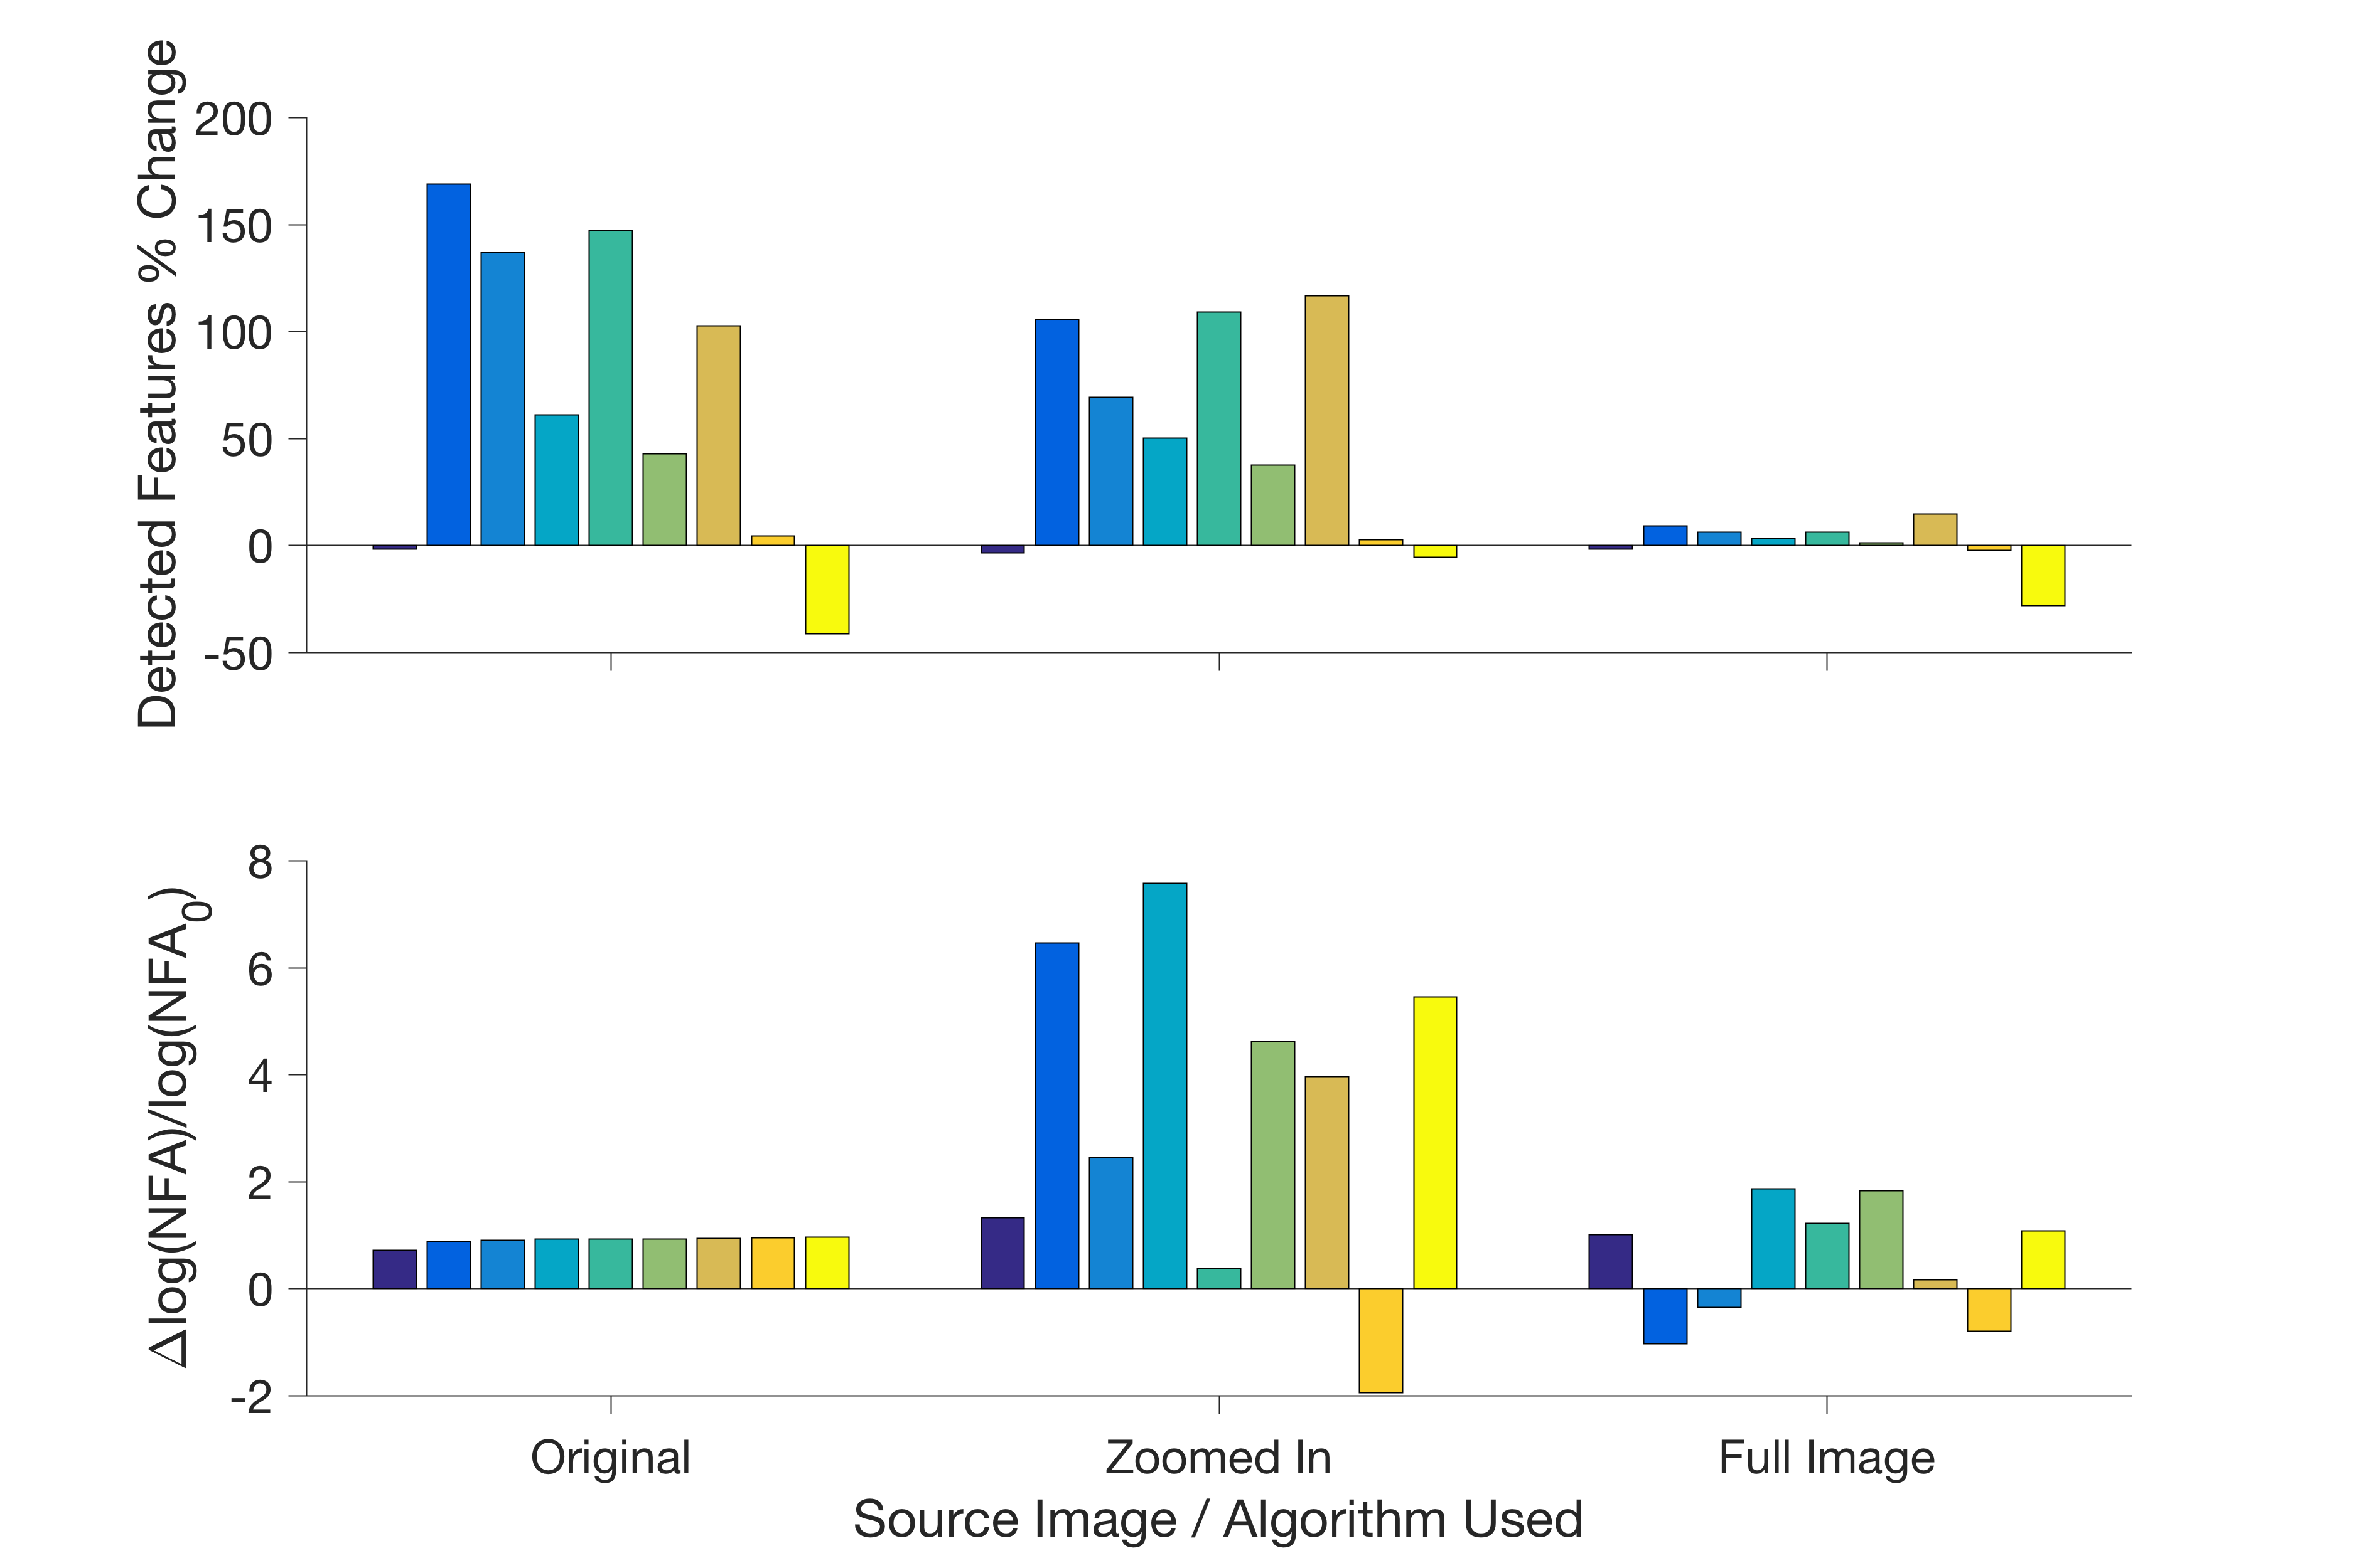
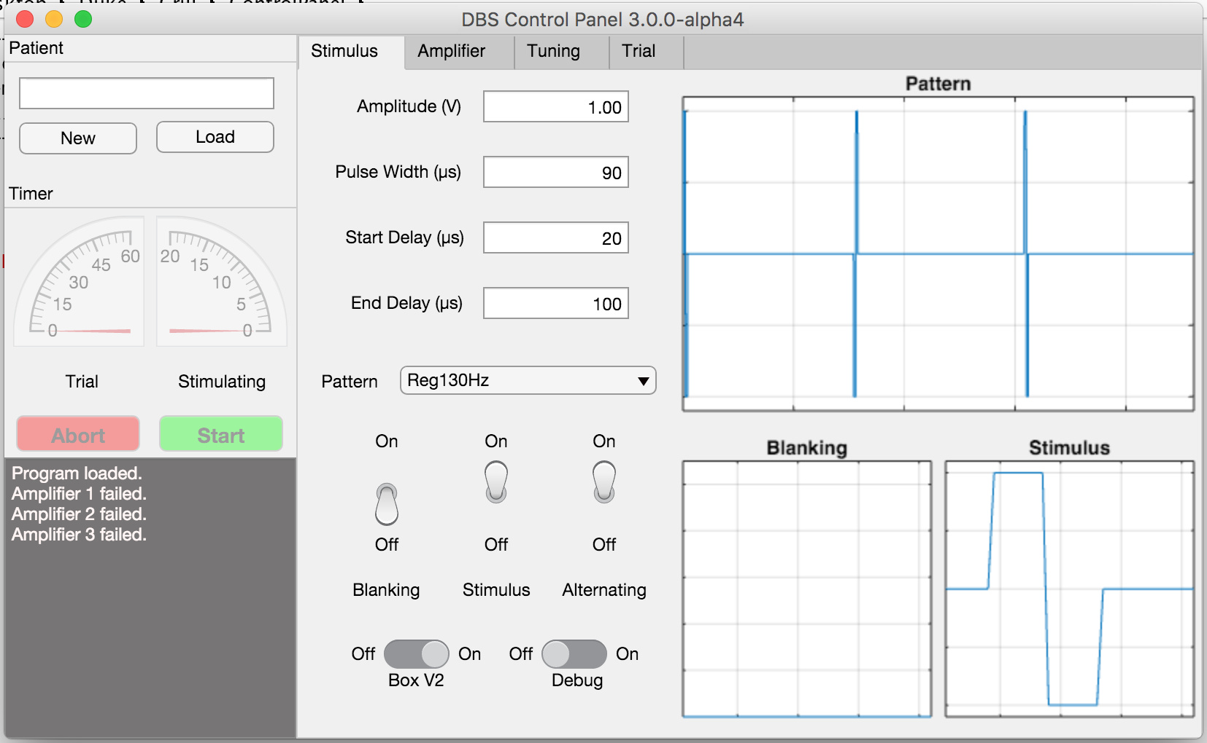
Logo Detection Using A-SIFT versus Machine Learning
Matias Lopez †∂, Lucia Martos†, Alex Zaldastani†
† Department of Electrical Engineering, Duke University, Durham, NC ∂ Department of Biomedical Engineering, Duke University, Durham, NC
Abstract
Methods
Methods: ASIFT
Deep brain stimulation (DBS) is a clinical therapy for treatment of several neurological conditions, including movement disorders such as Essential Tremor (ET) and Parkinson’s Disease (PD). While DBS is clinically efficacious, much work remains to be done in terms of understanding how DBS stimuli affect surrounding neural elements, which can have major implications for clinical outcomes. Neural recordings such as Evoked Compound Action Potentials (ECAPs) or Local Field Potentials (LFPs) may offer valuable insight. However, a major technical barrier for using ECAPs to analyze DBS is the presence of stimulation artifacts that are orders of magnitude larger in amplitude than the desired ECAP signal. Artifacts contaminate the integrity of neural recordings, complicate isolation of potentially meaningful signals, and easily saturate amplifiers. The objective of this project is to make improvements upon existing recording equipment in order to increase the fidelity of acquired neural signals, an advancement that may greatly enhance the utility of ECAPs recordings for clinical use. Here, a user interface was written and a connection hub was designed to control stimulation and recording. The efficacy of the build is currently being tested in vitro using a passive volume conductor model of brain tissue. Successful completion of this project should substantially improve the quality of ECAPs recorded during DBS, which may ultimately facilitate the translation of ECAPs analysis into clinically meaningful outcomes.
Simulating Deep Brain Stimulation
Scale Invariant Feature-Transform is a good algorithm to detect if a feature like a logo is present in an image.
Affine SIFT or ASIFT is used instead because SIFT is limited to features with the same orientation as the original image.
ASIFT performance drastically drops when the image quality drops, and improves when the image region of interest is isolated.
The reference image tested on is a good quality image of a Coca Cola can.
The electrode lead is a standard clinical lead, and each contact can be independently used for recording or stimulation.
Recordings are conducted with a 3-electrode technique in 1x Phosphate-buffered Saline.
The test image is a scene from a TV show featuring a similar can, and a third image zooms in the can featured in this scene.
Figures: Kent, 2012
Enhancing Algorithms Used
Custom affine anisotropic filter
Gradient multiplied filter
Gaussian deconvolution
Directional gradient weighted average Filter
Non-equalized median filter
Color contour averaging
Non-equalized Inverse gradient dependent median filter
Reference trained sparse encoding
Equalized median filter
Objectives
Results: Modular Design
Improve the recording equipment already used to study the effects of DBS.
Long Term: Relate Evoked Compound Action Potentials (ECAPs) to motor function and develop a closed-loop DBS system.
Successful completion of this project will improve the quality of ECAPs recorded during DBS and facilitate more efficient conduct of research studies
User
User Interface
File Manager
People
Software
Stimulation Pattern
Recording File
Hardware
Fixed
Results: ASIFT
Conclusions
The largest problem with enhancement is that while features were sharpened, so was the noise in the image.
Developed a modular, easily reproducible platform that will be used to investigate Deep Brain Stimulation.
Modular programming is faster to implement and easier to reuse
With a few files, all parts can be ordered/machined/assembled increasing reproducibility
Ongoing testing to ensure reliability of the new build
Isolator
DAQ
Secondary Input Device
Filters a through i are shown left to right, top to bottom
Optical Relay
Analog to Digital
Amplification and Filtering
Detection of the Coke can in the test image was not successful.
ASIFT was not robust enough to handle finding a logo in different images when the resolution is low.
The only improvement in detection of low quality images came at a large computational cost
References
[1] A R Kent and W M Grill 2012 Recording evoked potentials during deep brain stimulation: development and validation of instrumentation to suppress the stimulus artefact J. Neural Eng. 9 036004
[2] A R Kent et al 2014 Measurement of evoked potentials during thalamic deep brain stimulation Brain Stim. 8 42-56
Lead Selection
Each block is a functional group
Filtering is the target that addresses amplifier saturation
Each functional group can be made independently of one another
Simulated
Acknowledgements
DBS Lead
Subject
Improving
This work was supported by BioCoRE, Duke University Summer Research Opportunity Program, and NIH R01NS079312. I would also like to extend the thanks to Gilda Mills for her help with background logistics and Alex Kent whose project I am continuing.
Results: Software Development
Although very computationally costly, the trained sparse encoder performed the best at improving detection.
Twice as fast using object oriented programing (OOP , modular programming), as opposed to writing all in a single program.
Modular: all parts of the program can be used in a different study protocol with little modification.
Filters a through i are plotted left to right
Worsening
However ASIFT did not find any significant matches in the test image, meaning the improvements were still unsuccessful
ECE 590: Image and Video Processing – Spring 2017

