Slide 1

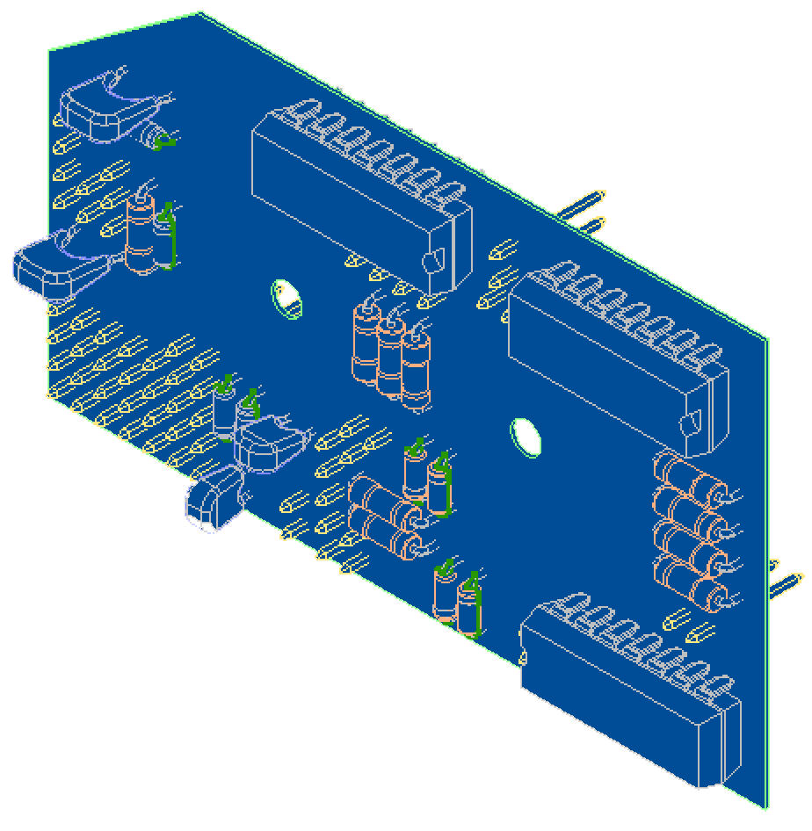
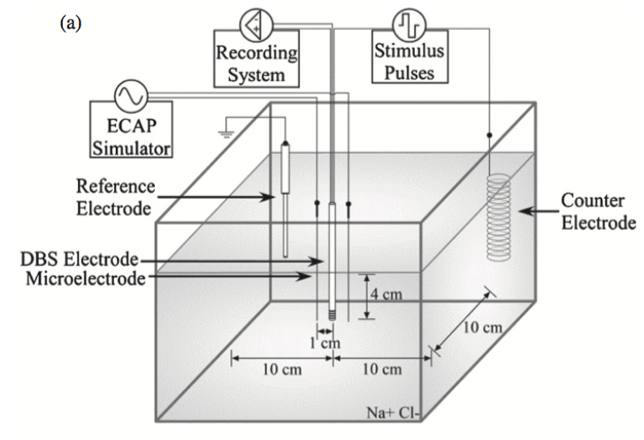
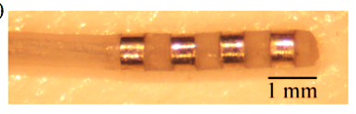
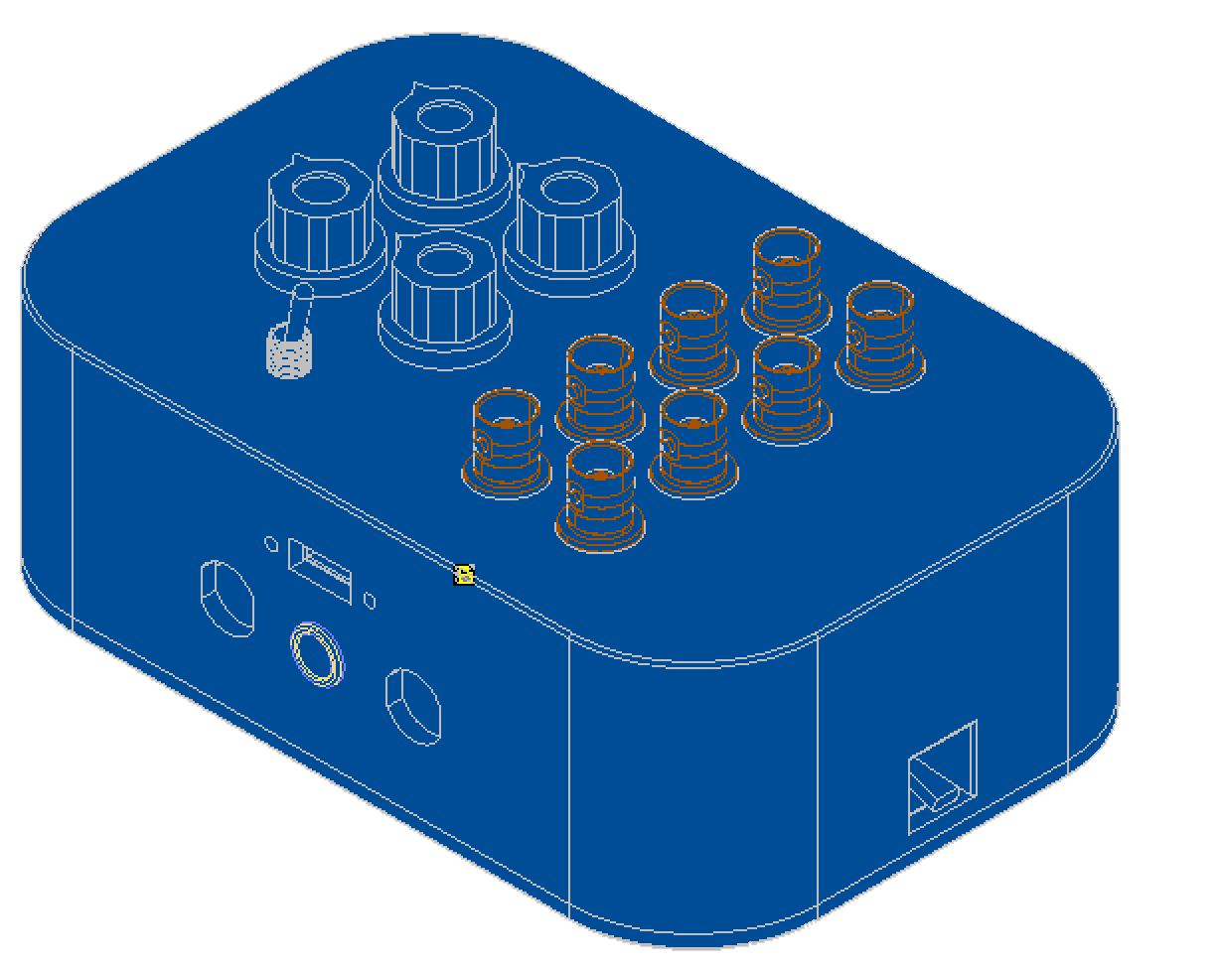
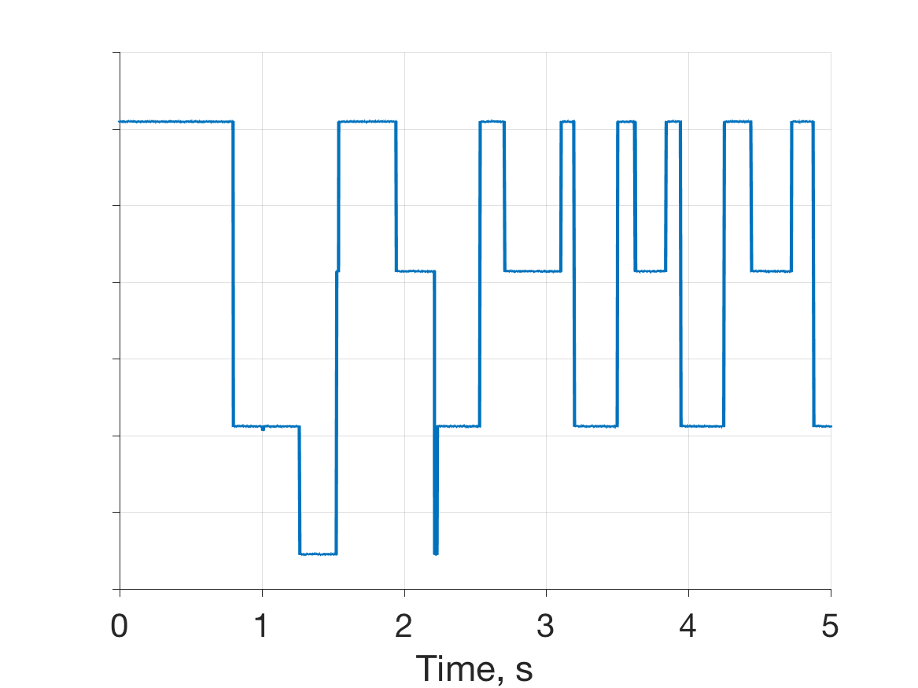
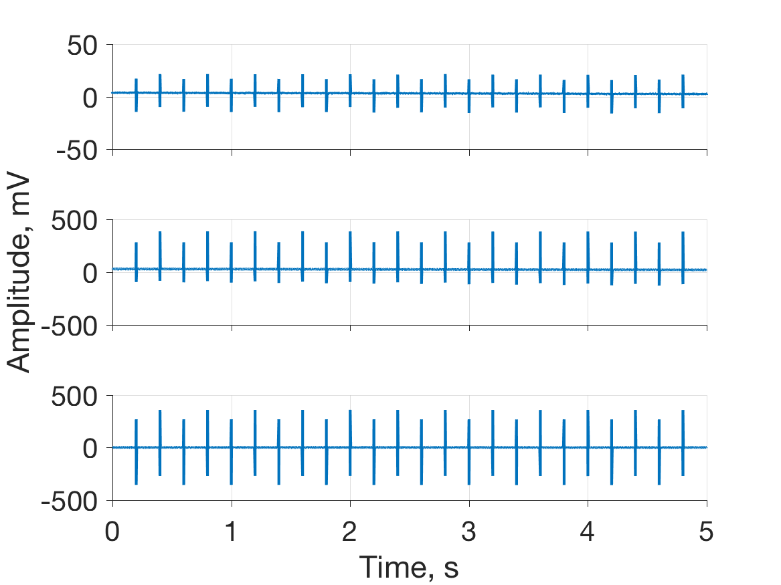
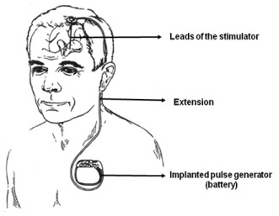
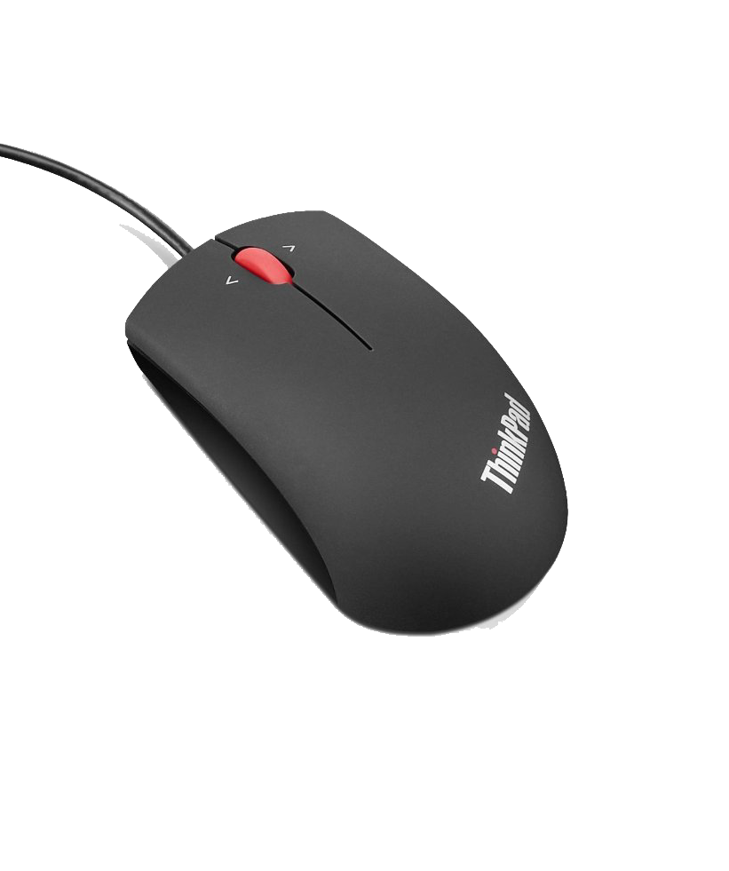
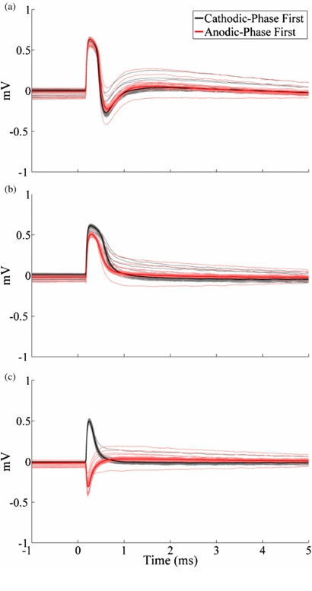
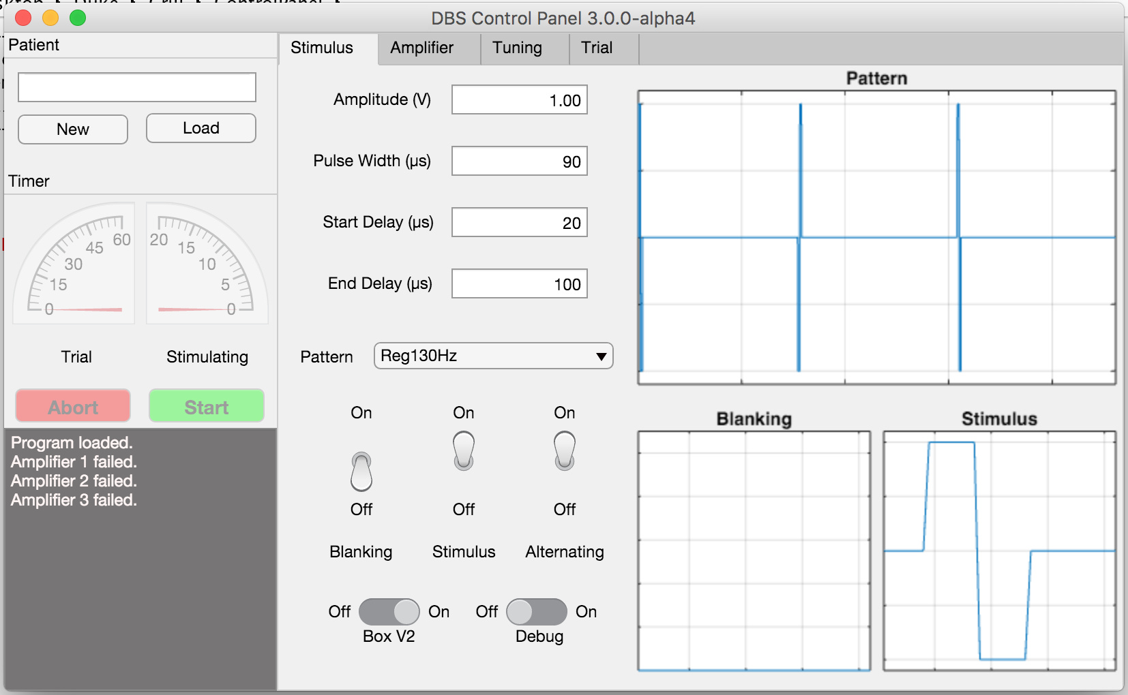
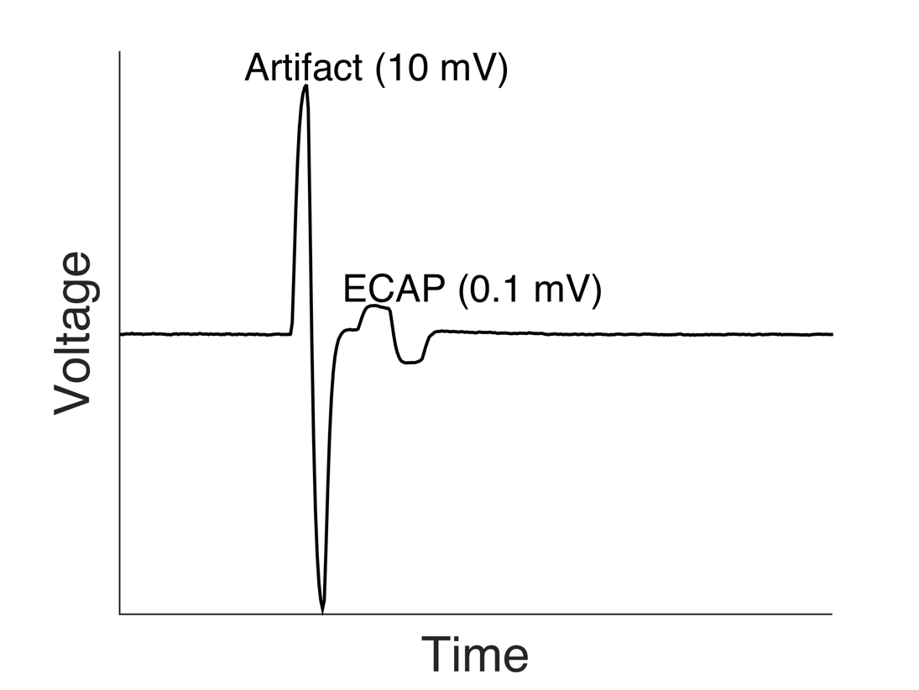
Logo Detection Using A-SIFT versus Machine Learning
Matias Lopez †∂, Lucia Martos†, Alex Zaldastani†∂
† Department of Electrical Engineering, Duke University, Durham, NC ∂ Department of Biomedical Engineering, Duke University, Durham, NC
Abstract
Methods
Results: Hardware Design
Deep brain stimulation (DBS) is a clinical therapy for treatment of several neurological conditions, including movement disorders such as Essential Tremor (ET) and Parkinson’s Disease (PD). While DBS is clinically efficacious, much work remains to be done in terms of understanding how DBS stimuli affect surrounding neural elements, which can have major implications for clinical outcomes. Neural recordings such as Evoked Compound Action Potentials (ECAPs) or Local Field Potentials (LFPs) may offer valuable insight. However, a major technical barrier for using ECAPs to analyze DBS is the presence of stimulation artifacts that are orders of magnitude larger in amplitude than the desired ECAP signal. Artifacts contaminate the integrity of neural recordings, complicate isolation of potentially meaningful signals, and easily saturate amplifiers. The objective of this project is to make improvements upon existing recording equipment in order to increase the fidelity of acquired neural signals, an advancement that may greatly enhance the utility of ECAPs recordings for clinical use. Here, a user interface was written and a connection hub was designed to control stimulation and recording. The efficacy of the build is currently being tested in vitro using a passive volume conductor model of brain tissue. Successful completion of this project should substantially improve the quality of ECAPs recorded during DBS, which may ultimately facilitate the translation of ECAPs analysis into clinically meaningful outcomes.
Simulating Deep Brain Stimulation
The electrode lead is a standard clinical lead, and each contact can be independently used for recording or stimulation.
Recordings are conducted with a 3-electrode technique in 1x Phosphate-buffered Saline.
Model for 3D printing was designed including all cutouts for any connection necessary
A printed circuit board can be swapped depending on different protocol requirements
Each element requires minimal alteration to repurpose for different research questions.
Figures: Kent, 2012
Results: Modular Design
Results: Preliminary Prototype Testing
Objectives
Secondary Input Device Test
Signal Amplification
Improve the recording equipment already used to study the effects of DBS.
Long Term: Relate Evoked Compound Action Potentials (ECAPs) to motor function and develop a closed-loop DBS system.
Successful completion of this project will improve the quality of ECAPs recorded during DBS and facilitate more efficient conduct of research studies
User
User Interface
File Manager
People
N
Software
Stimulation Pattern
Recording File
Hardware
L
Fixed
Background
Isolator
DAQ
Secondary Input Device
R
Deep Brain Stimulation (DBS)
LR
DBS is a surgical therapy for neurological diseases, including
Parkinson’s Disease
Essential Tremor
Target symptoms treated include
Bradykinesia (slowness of movement)
Tremor
Optical Relay
Analog to Digital
Amplification and Filtering
With minimal modifications to a USB mouse, one can successfully detect whether the left, right or both buttons have been pressed.
Shown are recordings of artifacts resulting from 1 V, 5 Hz bipolar stimulation. They are amplified 1x, 20x, 100x top to bottom.
Clipping is working as expected, because the amplified recordings have not reached the expected amplitudes, but are much lower.
Lead Selection
Photo: UC Denver, Neurosurgery
Each block is a functional group
Filtering is the target that addresses amplifier saturation
Each functional group can be made independently of one another
Simulated
Evoked Compound Action Potentials (ECAPs)
Postmortem in Vivo ECAPs from a cat at (a) 1 (b) 3 (c) 5 minutes after euthanasia¹.
DBS Lead
Subject
Conclusions
DBS activates a neural population around the lead. Membrane currents create measurable potentials.
ECAP recordings can be used to:
Interpret activated neural elements
Define signatures of clinical effectiveness
Developed a modular, easily reproducible platform that will be used to investigate Deep Brain Stimulation.
Modular programming is faster to implement and easier to reuse
With a few files, all parts can be ordered/machined/assembled increasing reproducibility
Ongoing testing to ensure reliability of the new build
Results: Software Development
Twice as fast using object oriented programing (OOP , modular programming), as opposed to writing all in a single program.
Modular: all parts of the program can be used in a different study protocol with little modification.
References
Figure: Kent, 2014
[1] A R Kent and W M Grill 2012 Recording evoked potentials during deep brain stimulation: development and validation of instrumentation to suppress the stimulus artefact J. Neural Eng. 9 036004
[2] A R Kent et al 2014 Measurement of evoked potentials during thalamic deep brain stimulation Brain Stim. 8 42-56
Stimulus Artifact
Acknowledgements
Goal: Prevent amplifier saturation by Stimulus Artifact.
Amplifier saturation distorts the ECAP
This work was supported by BioCoRE, Duke University Summer Research Opportunity Program, and NIH R01NS079312. I would also like to extend the thanks to Gilda Mills for her help with background logistics and Alex Kent whose project I am continuing.
Duke Summer Research Opportunities Program 2016
Contact: imatlopez.com

