Slide 1
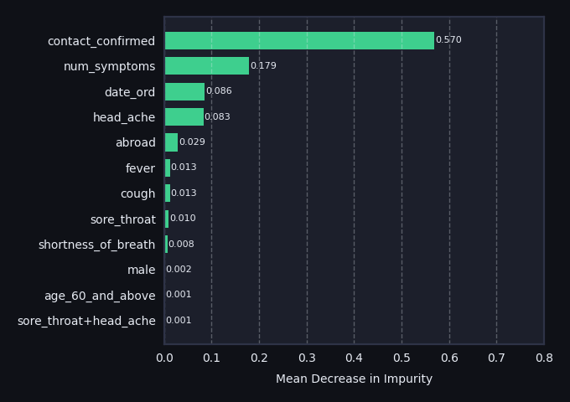
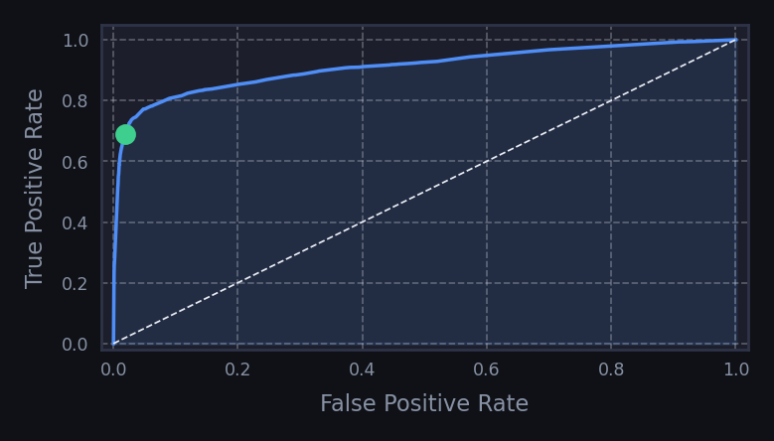
Model: Random Forest Classifier
COVID-19 Diagnosis Prediction | L7 Hackathon
PERFORMANCE METRICS
MODEL PARAMETERS
FEATURES & PRE-PROCESSING
Tuned via RandomizedSearchCV with StratifiedKFold (3 splits) with 35 iterations
Symptoms – Raw Boolean values
0.9102
cough, fever, sore_throat, shortness_of_breath, head_ache
criterion
entropy
max_depth
11
Demographic - Filled nulls
ROC-AUC | 55k Test Set | 0.25 Decision Threshold
age_60_and_above, male
max_features
18 (of 21)
Test Date - Converted to ordinal integer
0.680
0.682
0.685
0.679
n_estimators
25
date_ord
PR-AUC
F1 Score
Recall
Precision
min_samples_leaf
9
Indicators - Extracted confirmed contact and abroad status
contact_confirmed, abroad
CONFUSION MATRIX
min_samples_split
9
 | Predicted Negative | Predicted Positive
Actual Negative | True Negative 51,090 | 92.90% | False Positive 956 | 1.74%
Actual Positive | False Negative 928 | 1.69% | True Positive 2,018 | 92.9%
min_impurity_decrease
0.00015
Symptom Combinations - Boolean values for each combination and a count of total symptoms
min_impurity_decrease
0.00015
num_symptoms, 10x combinations of symptom features
RSCV Best Score on Training Data
0.9707
FEATURE IMPORTANCE
WAYS TO IMPROVE
With only 105 iterations of the random search, these parameters work well but further searching (or a full grid search) would be useful to determine if they are the best model configuration.
ROC CURVE
Whilst the training dataset is large at 219k samples, there is more data available which could be used to increase both the test and train dataset, or to use as an unseen validation dataset.
0.25 threshold
Feature engineering: The symptom combinations were not useful for the model’s predictive power and could likely be removed to reduce the complexity. Instead, I would try adding to the training data using external features. One idea is to try to capture the seasonality of illness, through use of daily temperature data.
AUC = 0.910
The symptom combination features are not shown as these resulted in an importance less than or equal to 0.001.

