Slide 1
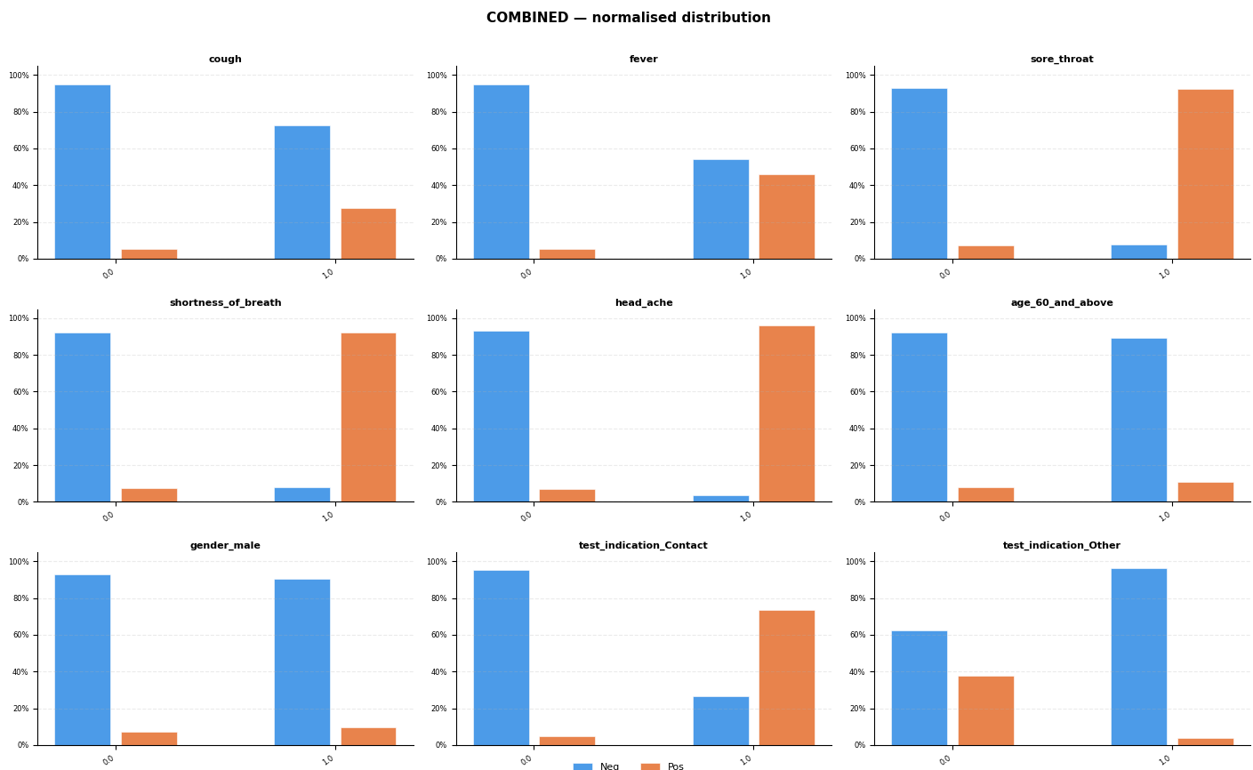
XGBOOST
Data cleaning approach similar to paper :
Training data contains all occurrences from 22/03/2020 to 31/03/2020 (51814 data points)
Test data contains all occurrences from 01/04/2020 to 07/04/2020 (47175 data points)
All NaN dropped for XGBOOST
Hot encoding of ‘test_indication’ feature = [‘Other’, ‘Abroad’, ‘Contact’]
9 features in total : Cough, Fever, sore_throat, shortness_of_breath, head_ache, age_60_and_above, gender_male, test_indication_Contact, test_indication_Other

Slide 2
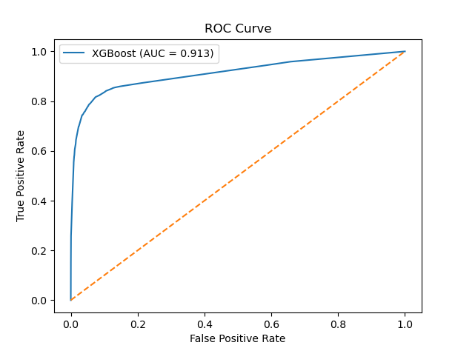
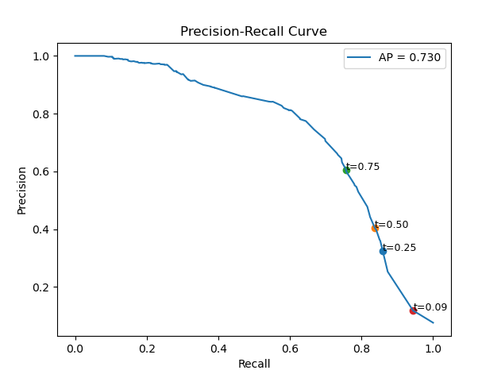
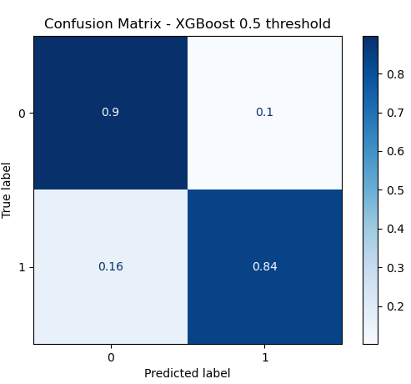
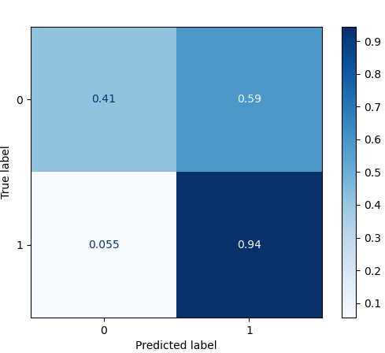
XGBOOST
Hyperparameters tunning with random search
Ran with 3 stratifiedKfold to optimise roc_auc score
ROC AUC score achieved of 0.913 similar to paper 0.9
AUPRC score of 0.73 outperform paper (0.66)
Model is highly sensitive to threshold selection with a trade-off between recall and precision as shown in the PR curve
Lower threshold will increase recall (up to 0.94) which can be desirable for medical screening where missing positive cases is undesirable.
However precision reduces significantly with higher False positive 59%.
Confusion Matrix – XGBoost 0.09 threshold

