Slide 1
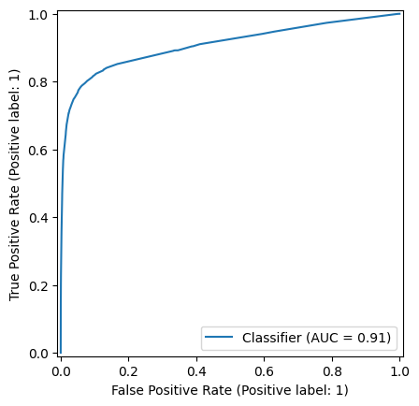
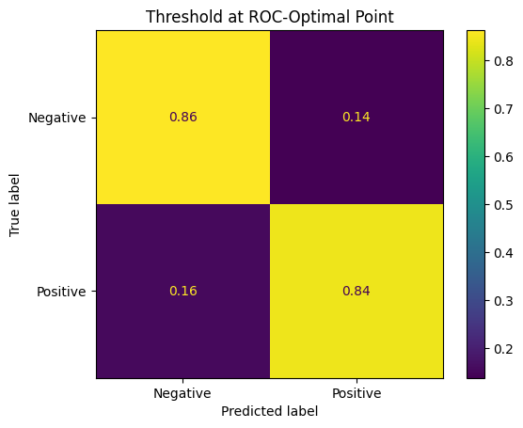
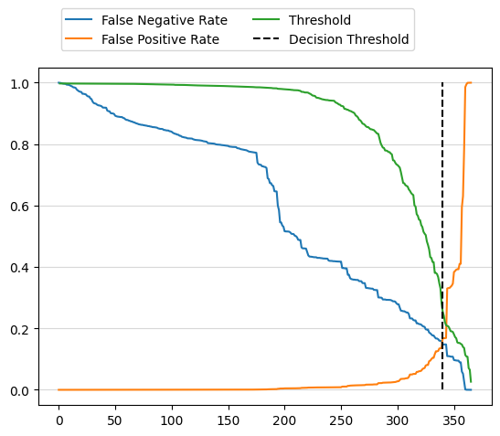
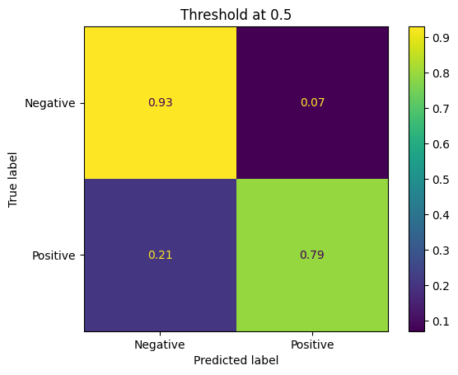
LightGBM
Preprocess:
Drop corona_result=“other”.
Drop test_date column.
corona_result: bool
All other cols: category. Model handles NaN, so kept in.
Train/test splits; stratify to keep imbalance.
Train using AUC-ROC metric.
Want to find a threshold for probabilities to minimise false negatives, also important to minimise false positives.
Chose threshold where false neg becomes less than false pos. False pos start to increase steeply on further reduction of false neg.
Comparing to threshold of 0.5 we see the increase of false neg.

