Slide 1
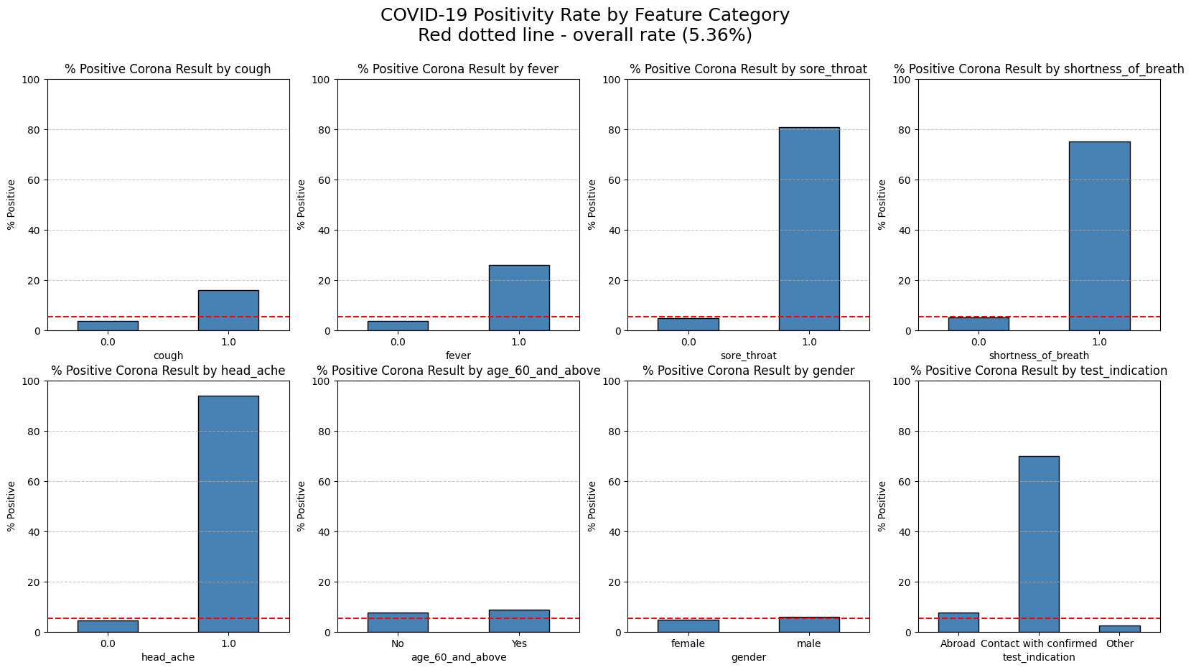
Exploratory Data Analysis
Imbalanced target: ~5% positive cases.
Some features have much higher rate based on positive value; sore_throat, shortness_of_breath, head_ache, test_indication.
One feature age_60_and_above had high null values: ~46%.

