Slide 1
Introduction to Amazon Web Services
Module 1
Notes:
Welcome to Module 1: Introduction to Amazon Web Services.

Slide 2

Module 1 objectives
In this module, you will learn how to:
Describe three cloud computing deployment models
Describe six benefits of cloud computing
Notes:
In this module, you will learn how to:
Describe three cloud computing deployment models
Describe six benefits of cloud computing

Slide 3
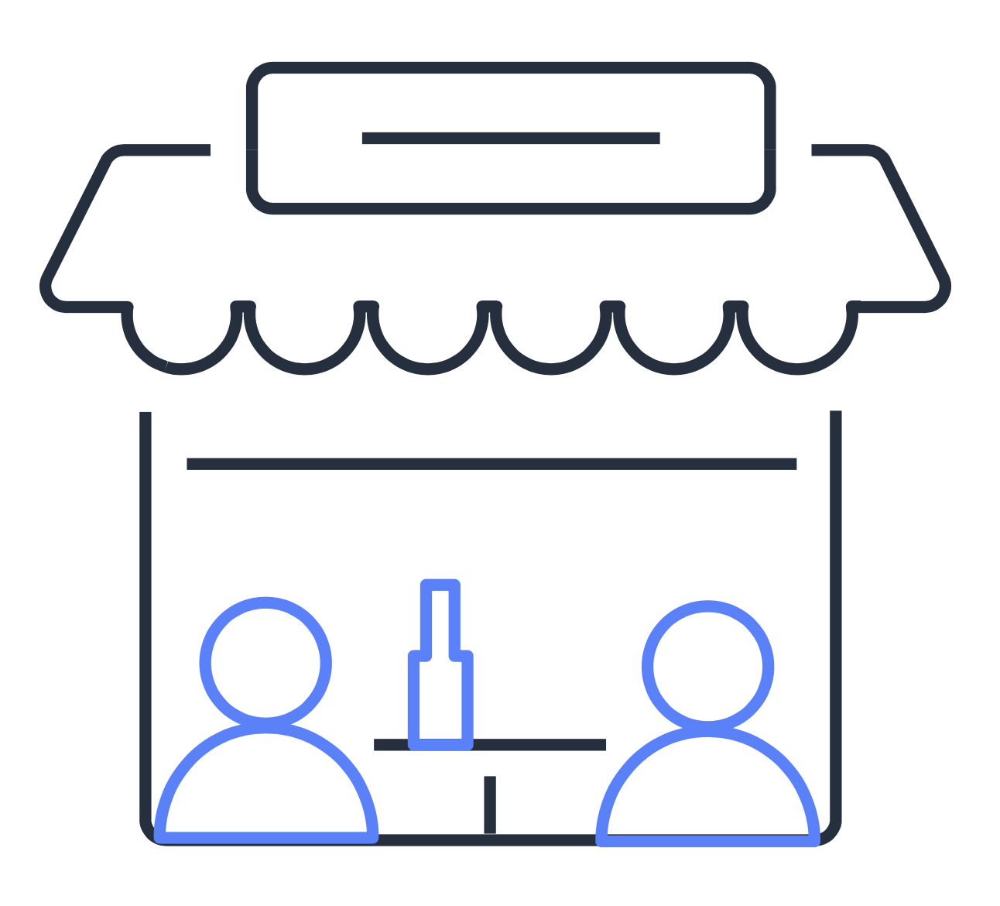



Welcome to the coffee shop
Customer
Barista
A customer makes a request.
A barista fulfills the customer’s request.
Notes:
Throughout this course, you will learn essential information about the breadth and depth of Amazon Web Services (AWS) offerings, and how AWS products and services can benefit companies. To help you understand some of these pieces, you will examine them through the metaphor of a coffee shop.
Almost all modern computing centers around a basic client-server model, which uses transactions similar to coffee shop transactions. In a coffee shop, a customer makes a request for a cup of coffee. This request is fulfilled when the barista prepares the order and provides it to the customer.

Slide 4



Client and server model
Client
Server
A client makes a request.
A server fulfills the client’s request.
Notes:
In computing, the “customer” is the client. A client can be a web browser or desktop application that a person interacts with to make a request to a computer server. The server is like the “barista” in the coffee shop. A server can be a service like Amazon Elastic Compute Cloud (Amazon EC2), a type of virtual server.
For example, suppose that a client requests a coffee order, coupons, promotions, and so on. The server evaluates the request and fulfills it by returning the information to the client.

Slide 5
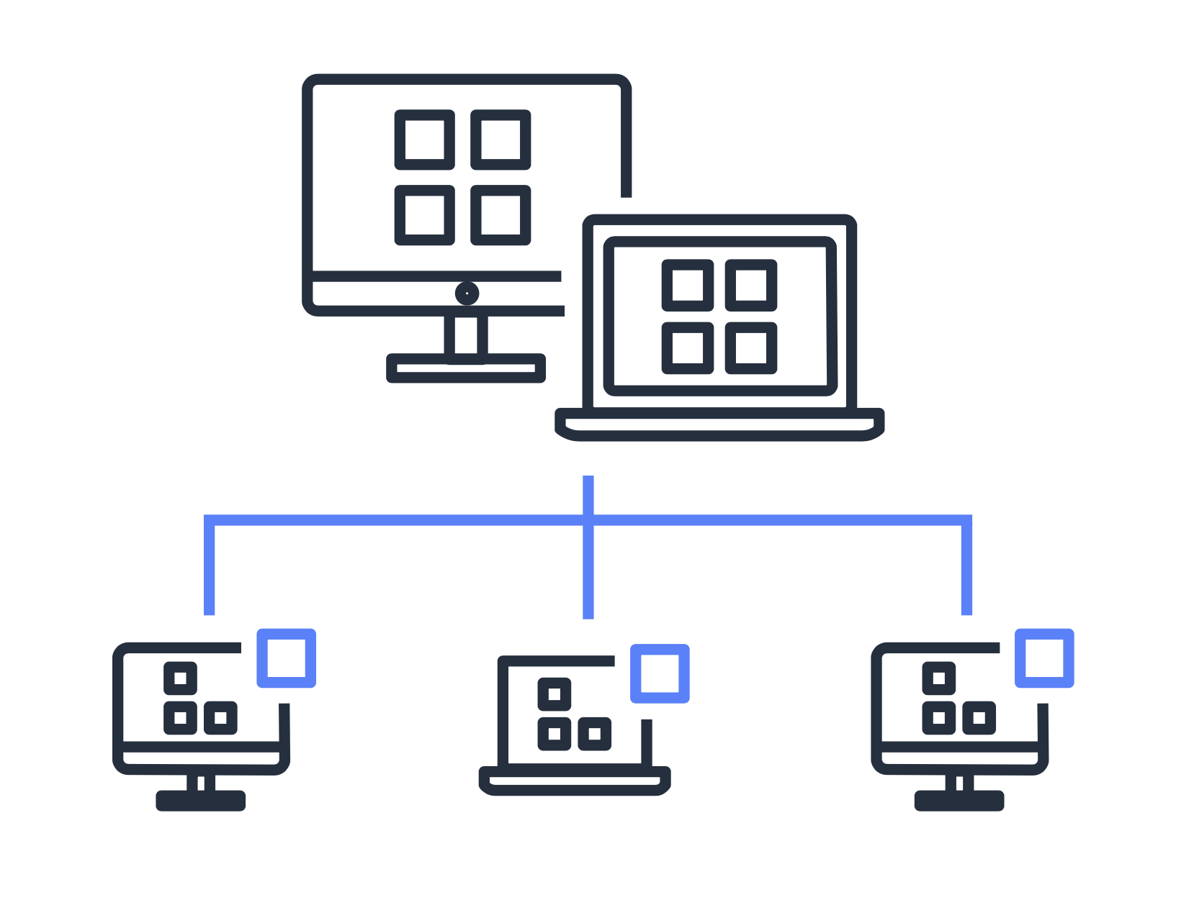

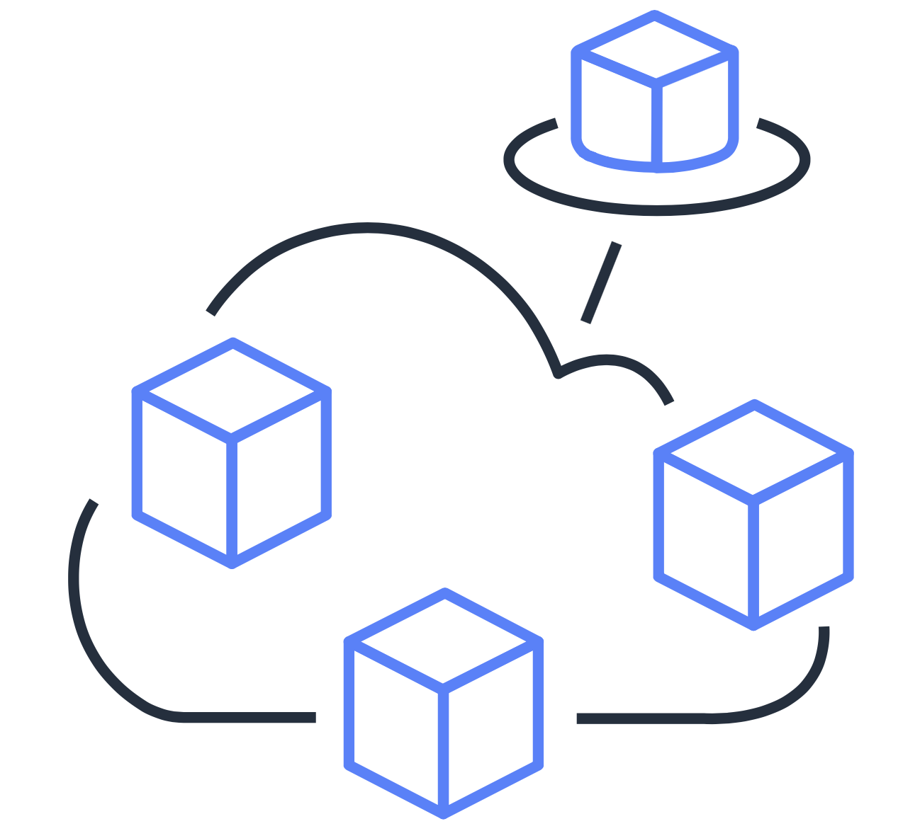

Cloud computing
What is cloud computing?
Access services
on demand
Avoid large upfront investments
Provision computing resources as needed
Pay only for what you use
Notes:
The client-server model enables cloud computing. Cloud computing refers to the on-demand delivery of IT resources and applications through the internet.
With cloud computing, you don’t need to make large upfront investments in hardware, or spend time and resources managing hardware. Instead, you can provision exactly the right type and size of computing resources that you need to power your newest idea or operate your IT department. You can access as many resources as you need, and pay only for what you use.
This course begins by exploring principles and benefits of cloud computing. Then, you will examine a variety of AWS services that can be used for creating cloud-based applications and solutions.

Slide 6
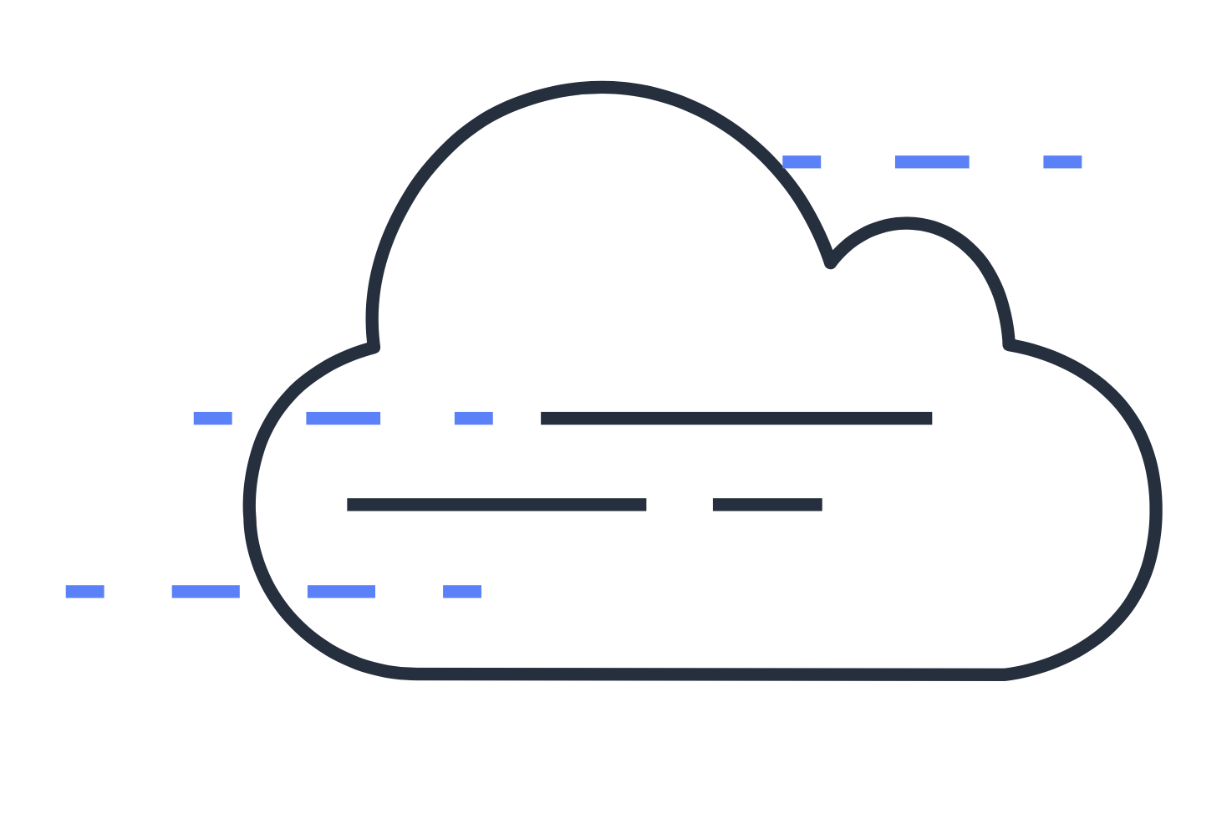


Cloud computing deployment models
Cloud
On premises
Hybrid
Notes:
When selecting a cloud deployment strategy, a company must consider factors such as required cloud application components, preferred resource management tools, and legacy IT infrastructure requirements.
The three cloud computing deployment models are cloud-based, on-premises, and hybrid deployments.

Slide 7
Cloud-based deployment
Run all parts of the application in the cloud
Migrate existing applications to the cloud
Design and build new applications in the cloud
Cloud
Notes:
In a cloud-based deployment model, you can migrate existing applications to the cloud, or you can design and build new applications in the cloud. You can build the applications on low-level infrastructure that requires your IT staff to manage them. Or, you can build them using higher-level services that reduce the management, architecting, and scaling requirements of the core infrastructure.
For example, a company might create an application consisting of virtual servers, databases, and networking components that are fully based in the cloud. This would reduce the company’s management, architecting, and scaling requirements.

Slide 8
On-premises deployment
Use virtualization and resource management tools to deploy resources
Use application management and virtualization technologies to increase resource usage
On premises
Notes:
The second cloud computing deployment model is on-premises deployment.
This is also known as a private cloud deployment. In this model, resources are deployed on premises by using virtualization and resource-management tools.
For example, you might have applications that run in your on-premises data center. While this model is like a legacy IT infrastructure, its incorporation of application management and virtualization technologies can help increase resource usage.

Slide 9
Hybrid deployment
Connect cloud-based resources to on-premises infrastructure
Integrate cloud-based resources with legacy IT applications
Hybrid
Notes:
The third cloud computing deployment model is hybrid deployment.
In a hybrid deployment, cloud-based resources are connected to an on-premises infrastructure. You might want to use this approach in a number of situations. For example, you might have legacy applications that are better maintained on premises, or government regulations require your business to keep certain records on premises.
Suppose that a company wants to use cloud services that can automate batch data processing and analytics. However, the company has several legacy applications that are more suitable on premises and will not be migrated to the cloud. With a hybrid deployment, the company could keep the legacy applications on premises, and use the data and analytics services that run in the cloud.
Now that you have a general understanding of cloud computing, you will explore AWS Cloud offerings.

Slide 10
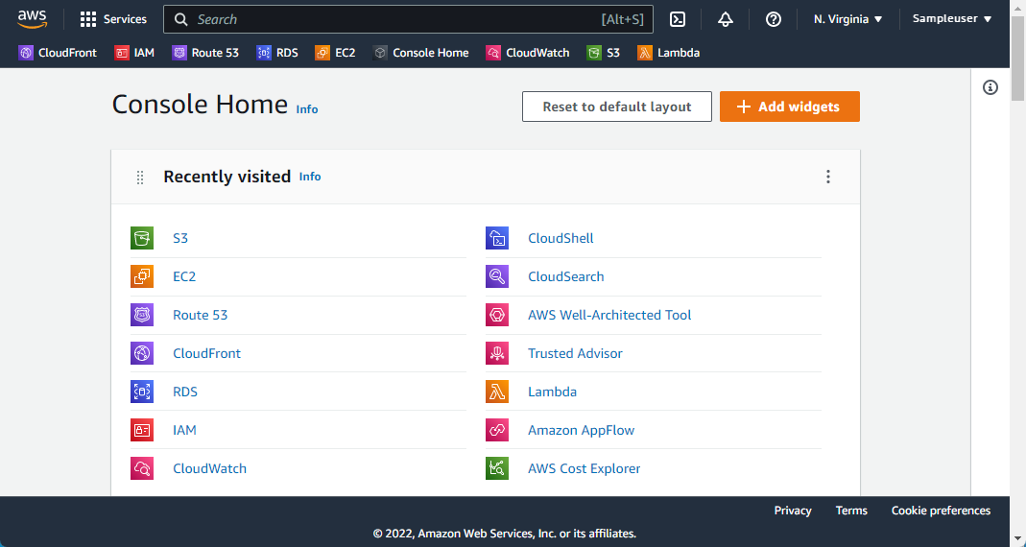
AWS Cloud
Notes:
In 2006, AWS began offering IT infrastructure services to businesses as web services. This is now commonly known as cloud computing.
AWS services can be implemented for use cases across industries and businesses of varying sizes. These businesses include enterprises, startups, small- and medium-sized businesses, and AWS customers in the public sector. Even if you have not yet created your own AWS account, you have probably used applications that run in the AWS Cloud. Some examples of applications that run in the AWS Cloud include video streaming services, photo hosting applications, hotel reservation websites, and more.
The AWS Cloud is a comprehensive and broadly adopted cloud service. AWS offers more than 200 services from data centers globally. Some of the service categories included in the console are Compute, Containers, Storage, and Database. You do not need to know all the services. This course focuses on foundational concepts of the AWS Cloud. In the next section, you will explore some of the benefits of cloud computing.

Slide 11
Cloud computing benefits
Notes:
As you begin to learn about cloud computing, also consider why a company might choose a particular cloud computing approach to address their business needs.
This section of the course explores six benefits of cloud computing. As you learn about each benefit, think about how you might have experienced the benefit at work or during other computing activities.

Slide 12

Variable expenses
Upfront expenses
Variable expenses
Invest in technology resources before using them
Pay only for what you use
Notes:
With cloud computing, you can trade upfront expenses for variable expenses.
Upfront expenses refer to data centers, physical servers, and other resources that you invest in before using them. Variable expenses mean that you only pay for computing resources that you consume instead of investing heavily in data centers and servers before you know how you will use them.
By taking a cloud computing approach that offers the benefit of variable expenses, companies can implement innovative solutions while saving on costs.

Slide 13
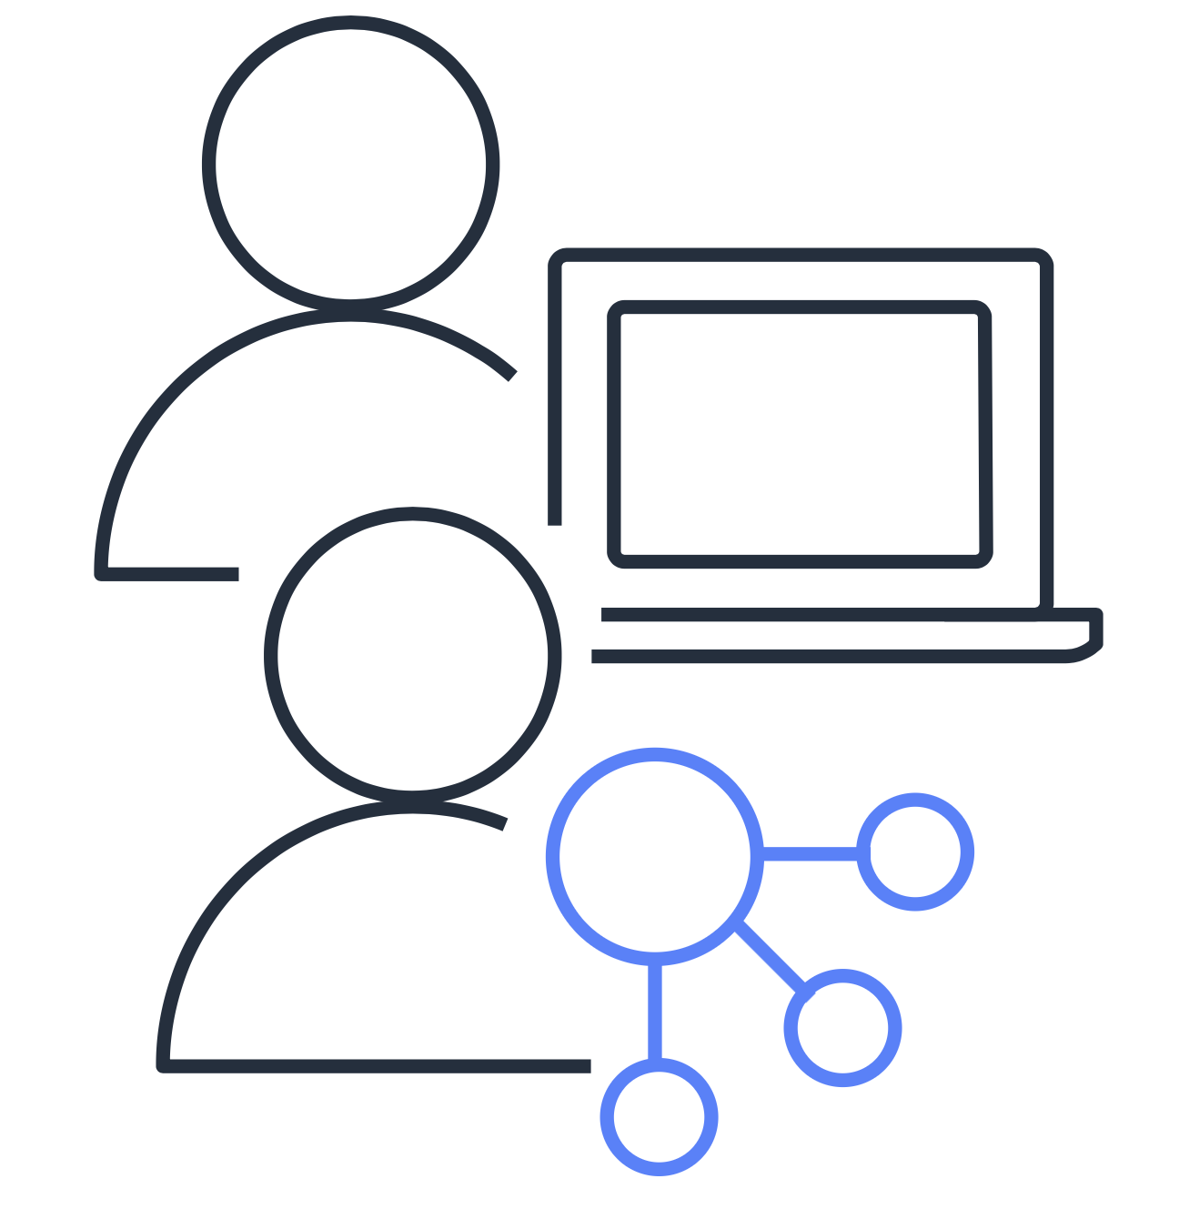
Cost optimization
Run data centers
Focus on applications and customers
Investment
Notes:
With cloud computing, you can optimize costs by no longer needing to spend money on running and maintaining data centers.
Computing in data centers often requires you to spend more money and time managing infrastructure and servers.
A benefit of cloud computing is the ability to focus less on those tasks and more on applications and customers.

Slide 14
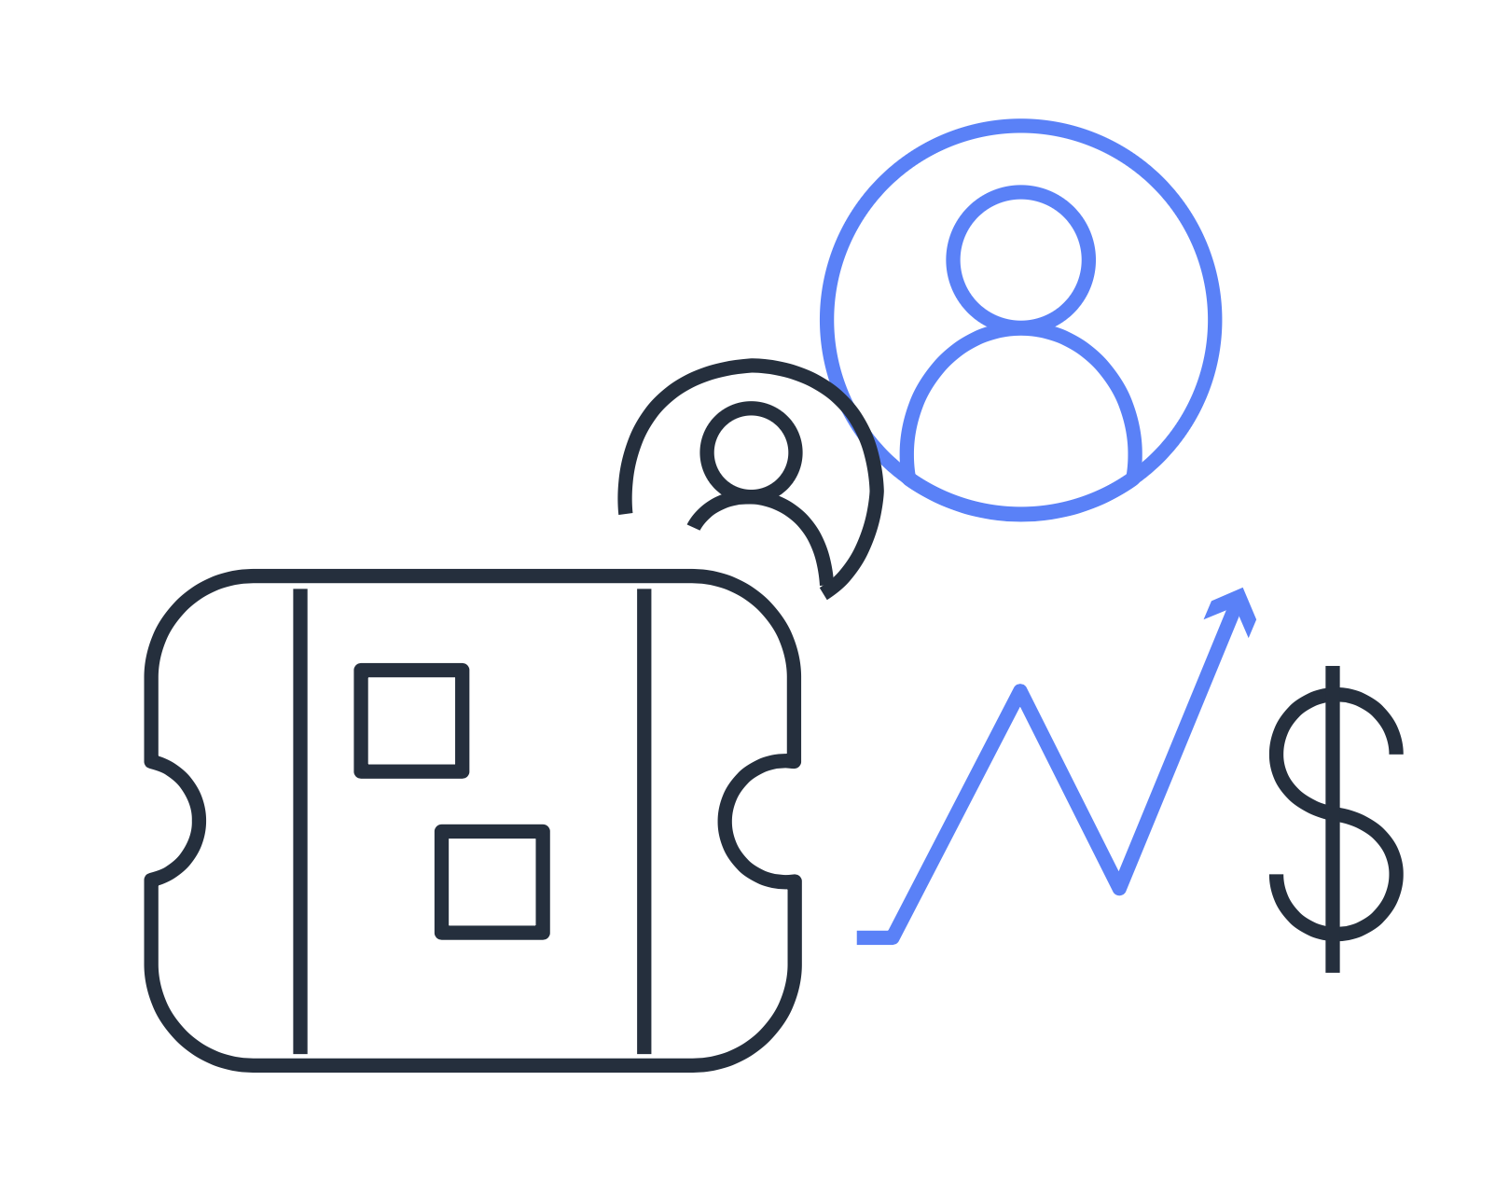

Capacity
Stop guessing on your infrastructure capacity needs
Scale in and scale out as needed
Notes:
You can stop guessing capacity.
With cloud computing, you don’t have to predict how much infrastructure capacity you will need before deploying an application.
For example, you can launch Amazon EC2 instances when needed, and pay only for the compute time you use. Instead of paying for unused resources or dealing with limited capacity, you can access only the capacity that you need. You can scale in or scale out in response to demand.

Slide 15

Economies of scale
Smaller scale
Economies of scale
Pay higher prices based on only your own usage
Benefit from customers’ aggregated usage
Notes:
You can benefit from massive economies of scale.
By using cloud computing, you can achieve a lower variable cost than you can get on your own.
Because usage from hundreds of thousands of customers can aggregate in the cloud, AWS can achieve higher economies of scale. The economy of scale translates into lower pay-as-you-go prices.

Slide 16


Speed and agility
Data centers
Cloud computing
Weeks between wanting resources and having resources
Minutes between wanting resources and having resources
Notes:
You can increase speed and agility.
The flexibility of cloud computing makes it easier for you to develop and deploy applications. This flexibility provides you with more time to experiment and innovate.
When computing in data centers, it might take weeks to obtain new resources that you need. In comparison, cloud computing enables you to access new resources in minutes.

Slide 17
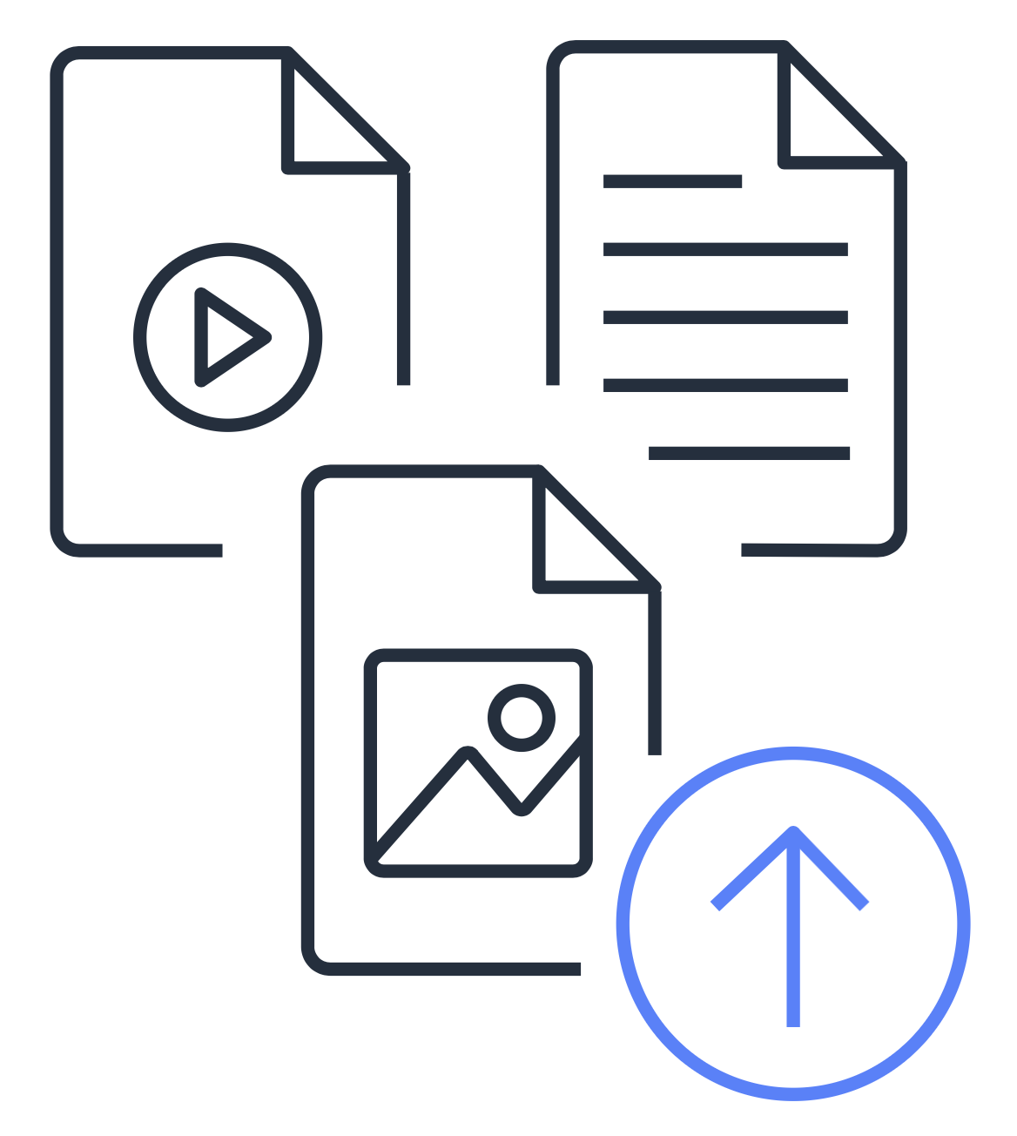

Global in minutes
Quickly deploy applications worldwide
Use the AWS global infrastructure.
Notes:
You can go global in minutes.
The global footprint of the AWS Cloud enables you to deploy applications to customers around the world quickly, while providing them with low latency. This means that even if you are located in a different part of the world than your customers, customers can access your applications with minimal delays.
Later in this course, you will explore the AWS global infrastructure in greater detail. You will examine some of the services that you can use to deliver content to customers around the world.

Slide 18

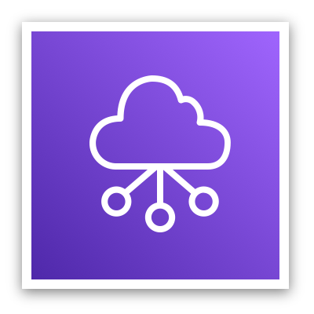

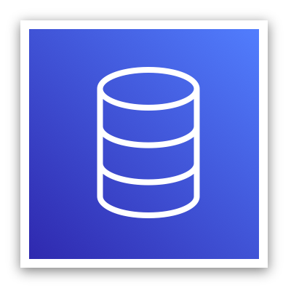


AWS core service categories
Compute
Networking and Content Delivery
Storage
Database
Security, Identity, and Compliance
Management and Governance
Notes:
Throughout this course, you will explore AWS services in categories such as:
Compute
Networking and Content Delivery
Storage
Database
Security, Identity, and Compliance
Management and Governance
As you begin to learn about AWS services, consider the features and benefits of a single service in addition to how you can potentially combine the services to offer a solution for your business needs.
For example, suppose that the owners of the coffee shop want to create a new application for customers. They might use the following types of services:
Database service to store customer information
Management and governance services to ensure that the application is designed in accordance with AWS best practices
Networking and content delivery services to deliver websites and videos to customers
As a reminder, you do not need to know all the services that AWS offers. This course focuses on foundational concepts of the AWS Cloud.

Slide 19
Knowledge check
Module 1
Notes:
There are no notes on this slide.

Slide 20

Knowledge check question 1
What is cloud computing?
Backing up files that are stored on desktop and mobile devices to prevent data loss
Deploying applications that are connected to an on-premises infrastructure
Using on-demand delivery of IT resources and applications through the internet
Running code without needing to manage or provision servers
Notes:
What is cloud computing?
Backing up files that are stored on desktop and mobile devices to prevent data loss
Deploying applications that are connected to an on-premises infrastructure
Using on-demand delivery of IT resources and applications through the internet
Running code without needing to manage or provision servers

Slide 21
Knowledge check answer 1
What is cloud computing?
Backing up files that are stored on desktop and mobile devices to prevent data loss
Deploying applications that are connected to an on-premises infrastructure
Using on-demand delivery of IT resources and applications through the internet (correct)
Running code without needing to manage or provision servers
Notes:
The correct response option is C. Using on-demand delivery of IT resources and applications through the internet.
The other response options are incorrect because:
A. While you can back up files to the cloud, this response option does not describe cloud computing as a whole.
B. Response B describes a sample use case for a hybrid cloud deployment. Remember that cloud computing has cloud and on-premises (or private cloud) deployment models.
D. AWS Lambda is an AWS service that lets you run code without needing to manage or provision servers. This description does not describe cloud computing as a whole. AWS Lambda is explained in greater detail in the next module.

Slide 22
Knowledge check question 2
What is another name for on-premises deployment?
Cloud-based application
Hybrid deployment
Private cloud deployment
AWS Cloud
Notes:
What is another name for on-premises deployment?
Cloud-based application
Hybrid deployment
Private cloud deployment
AWS Cloud

Slide 23
Knowledge check answer 2
What is another name for on-premises deployment?
Cloud-based application
Hybrid deployment
Private cloud deployment (correct)
AWS Cloud
Notes:
The correct response option is C. Private cloud deployment.
The other response options are incorrect because:
A. Cloud-based applications are fully deployed in the cloud and do not have any parts that run on premises.
B. A hybrid deployment connects infrastructure and applications between cloud-based resources and existing resources that are not in the cloud, such as on-premises resources. However, a hybrid deployment is not equivalent to an on-premises deployment, because it involves resources that are located in the cloud.
D – The AWS Cloud offers three cloud deployment models – cloud, hybrid, and on-premises. This response option is incorrect because the AWS Cloud is not equivalent to only on-premises deployment.

Slide 24
Knowledge check question 3
How does the scale of cloud computing help you save costs?
You do not have to invest in technology resources before using them.
The aggregated cloud usage from a large number of customers results in lower pay-as-you-go prices.
Accessing services on-demand helps prevent excess or limited capacity.
You can quickly deploy applications to customers and provide low latency.
Notes:
How does the scale of cloud computing help you save costs?
You do not have to invest in technology resources before using them.
The aggregated cloud usage from a large number of customers results in lower pay-as-you-go prices.
Accessing services on-demand helps prevent excess or limited capacity.
You can quickly deploy applications to customers and provide low latency.

Slide 25
Knowledge check answer 3
How does the scale of cloud computing help you save costs?
You do not have to invest in technology resources before using them.
The aggregated cloud usage from a large number of customers results in lower pay-as-you-go prices. (correct)
Accessing services on-demand helps prevent excess or limited capacity.
You can quickly deploy applications to customers and provide low latency.
Notes:
The correct response option is B. The aggregated cloud usage from a large number of customers results in lower pay-as-you-go prices. This answer describes how customers can benefit from massive economies of scale in cloud computing.
The other response options are incorrect because:
A. This option relates to the concept of “trade upfront expense for variable expense.”
C. This option relates to the concept of “stop guessing capacity.”
D. This option relates to the concept of “go global in minutes.”

Slide 26
Module 1 summary
In this module, you learned about:
Three cloud computing deployment models
Six benefits of cloud computing
Notes:
In this module, you learned about three cloud computing deployment models:
Cloud
On premises
Hybrid
You also explored six benefits that cloud computing offers:
Trade capital expenses for variable expenses
Stop spending money running and maintaining data centers
Stop guessing capacity
Benefit from massive economies of scale
Increase speed and agility
Go global in minutes
With cloud computing, you can access services on demand, provision computing resources as needed, and save on costs by paying only for what you use.
The next module explores some of the compute services that AWS offers.

