Slide 1
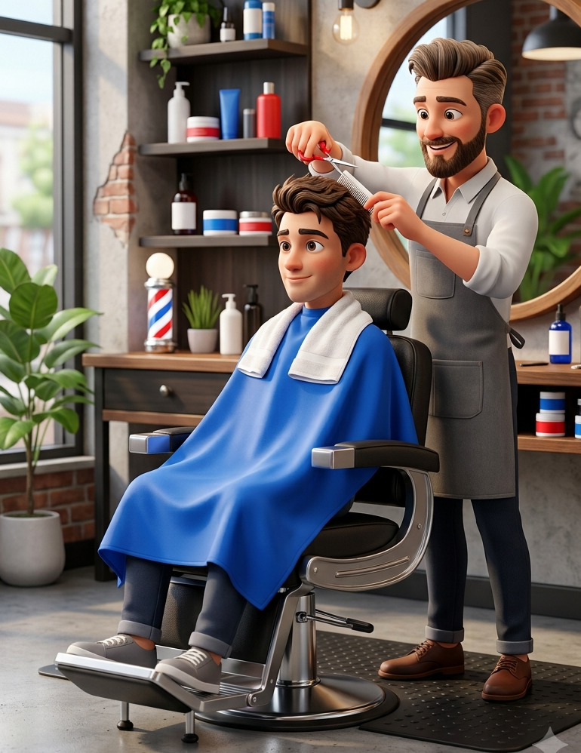
BARBER
By: ana lopes
UFCD LEA_B3_A

Slide 2
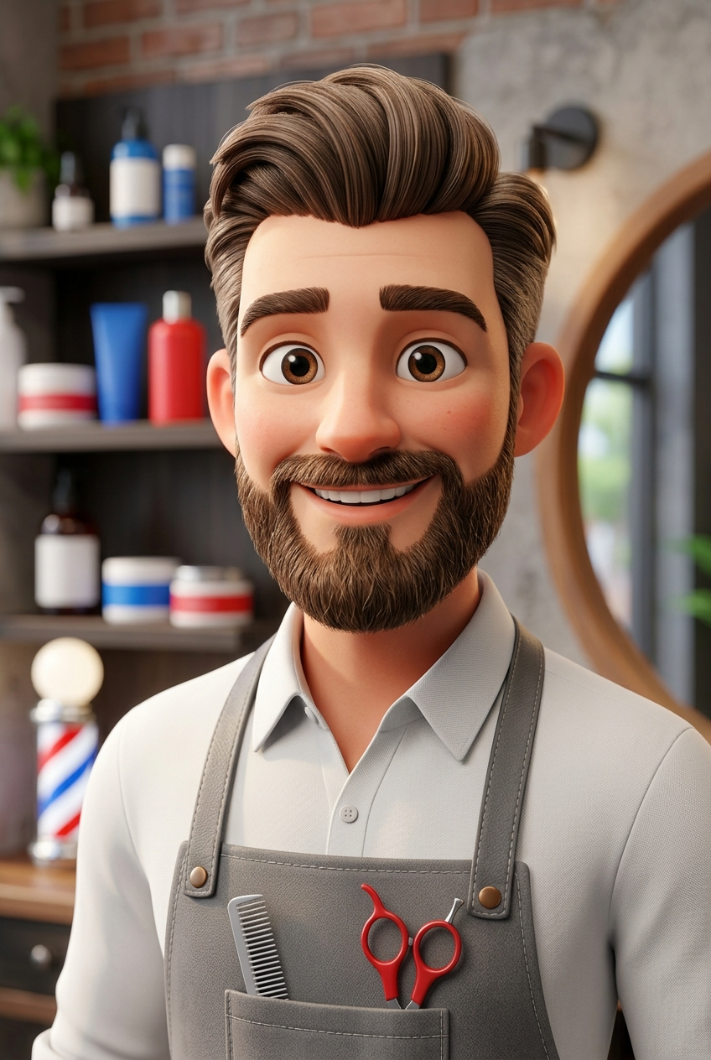
Choose a Job
He is a barber.
He cuts hair and trims beards.
He helps people look good.
Barbers have worked for hundreds of years.

Slide 3
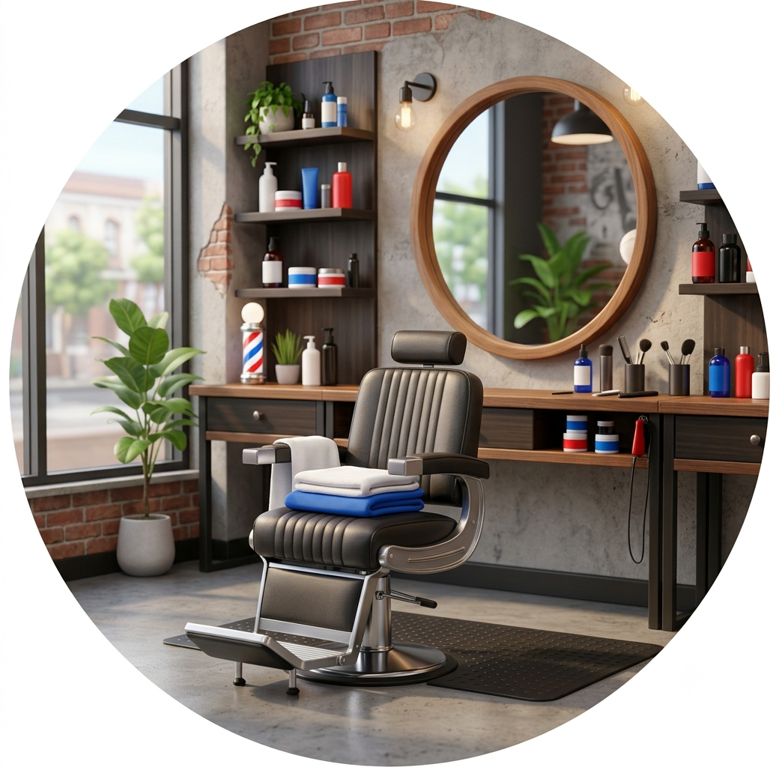
Where He Works
He works in a barbershop.
He uses scissors, clippers and combs.
He works with many customers.
Many barbershops are places where people like to talk and relax.

Slide 4
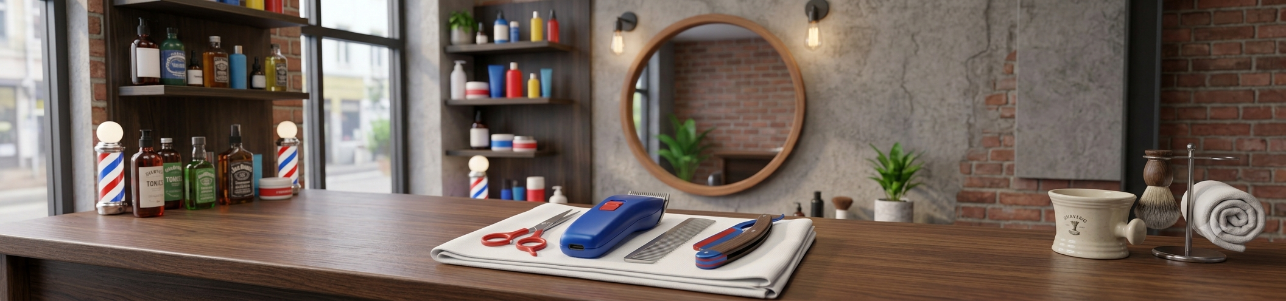
What He Does
He cuts and styles hair.
He trims beards and moustaches.
He keeps his tools clean.
A barber needs good hand skills and patience.

Slide 5
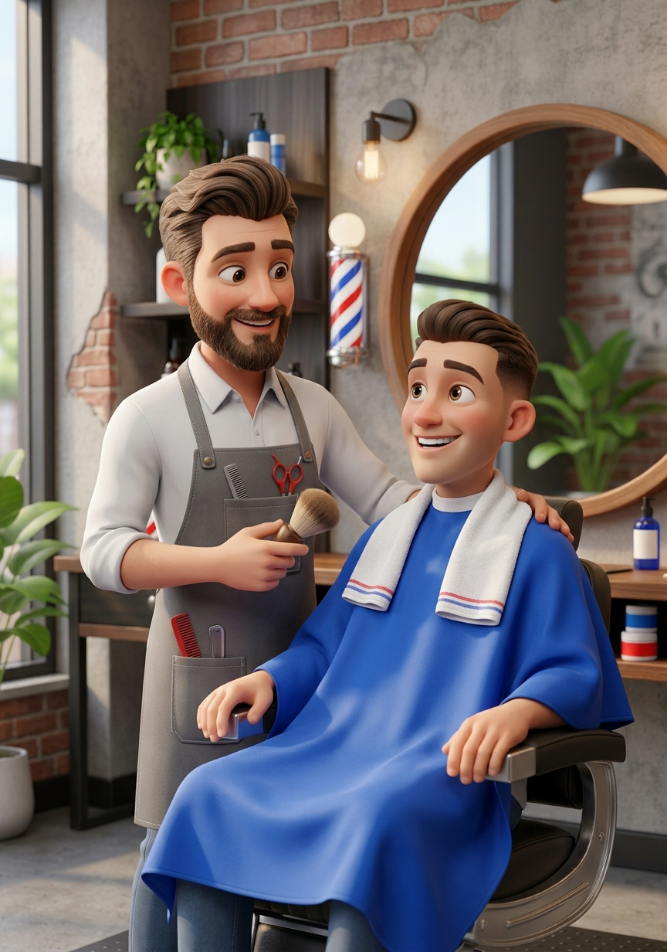
Positive and Negative Points
Positive
He loves helping people.
Every day is different.
Negative
He doesn't like standing for many hours.
The job can be tiring.
A happy customer often comes back to the same barber.

Slide 6
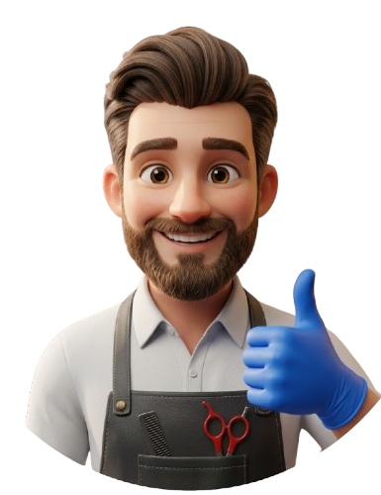
THANK YOU!
By: ana lopes
UFCD LEA_B3_A

