Slide 1

Weather Forecasting
Submitted By:
Jitender Pratap Singh (IT2) - 00651207719
Komal Kumar (IT2) - 00351207719

Slide 2
Abstract
Weather forecasting has been playing an important factor due to it’s applications in the various sectors such as in agriculture, utility company and in day to day life.
Weather forecasting details predicting how the present state of the atmosphere will change.
For effective analysis of the weather, it is necessary to understand various influencing factors that cause the weather changes
Weather forecasting is the process of recording the parameters of weather like wind direction, wind speed, humidity, rainfall, temperature etc
we applied linear regression to predict the weather such as temperature, rainfall etc

Slide 3
Contents
Introduction
Applications
Different Approaches
First Approach
Second Approach
Conclusion

Slide 4
Introduction
Weather Forecasting is the prediction of the state of the atmosphere for a given location using the application of science and technology.
Weather conditions changes rapidly, so `weather forecasting’ is a vital process.
This includes temperature, rain, cloudiness, wind speed and humidity.

Slide 5
Applications
Following are some area where weather forecasting are useful-
Air traffic
Agriculture
Forestry
Reduce loss in disasters like cyclone, flood etc.
Navy, Military
And many more.

Slide 6
Different Approaches
Machine Learning Approach (Linear Regression)
Deep Learning Approach (LSTM)

Slide 7
Machine Learning Approach
Here we have used linear regression. Now learning of the linear regression model could be done by four ways, from which we have only used following two ways-
OLS method,
Regularization method.
Learning a linear regression model means estimating the values of the coefficients used in the representation with the data that we have available.

Slide 8

Temperature prediction
Dataset used here is available on Open Government Data
Linear regression model used here was trained on technique called OLS
Result obtained-

Slide 9
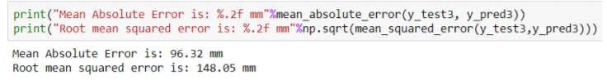
Rainfall prediction
Dataset used here is available on Open Government Data
Linear regression model is trained on the Regularization
Result-

Slide 10
Deep Learning Approach Wind Prediction
Mainly, we used LSTM(long short term memory) here.
LSTM networks are a type of recurrent neural network capable of learning order dependence in sequence prediction problems.
A common LSTM unit is composed of a cell, an input gate, an output gate and a forget gate.

Slide 11
LSTM cont.
Forget Gate- This gate decides what information should be thrown
away or kept.
Update/Input Gate- To update the cell state, we have the input gate.
Output Gate- The output gate decides what the next hidden state should be.
Each LSTM cell works similarly.

Slide 12
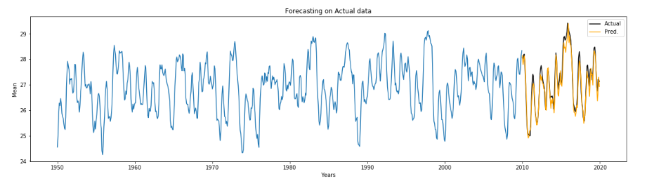
Wind Result

Slide 13
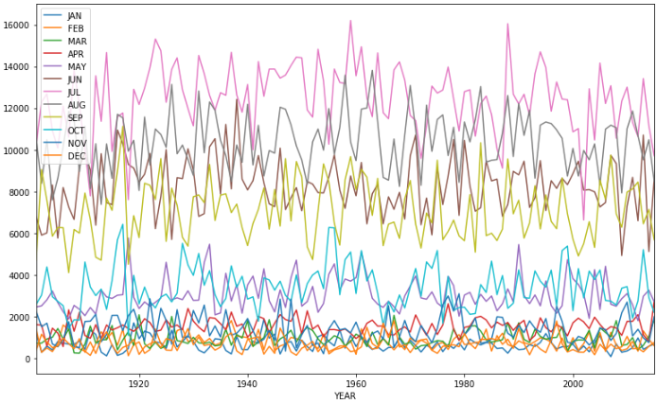
Rainfall Result

Slide 14
Conclusion
Deep learning approach outperform linear regression approach.
The Error in linear regression was higher in comparison to error in deep learning approach.
This is so because deep learning model build a complex relation between features and outcomes where linear regression fails to build such complex relation.

Slide 15
Future Work
For future improvements, following step we thought to took-
Replacing model with a latest/different model
Using other robust datasets
Predicting result on more attributes
Training model on higher session

Slide 16
References
Parmar, Aakash & Mistree, Kinjal & Sompura, Mithila. (2017). Machine Learning Techniques for Rainfall Prediction: A Review.
Pooja Malik, Prof. Saranjeet Singh, Binni Arora. An Effective Weather Forecasting Using Neural Network
Abhishek, Kumar & Singh, M. & Ghosh, Saswata & Anand, Abhishek. (2012). Weather Forecasting Model using Artificial Neural Network. Procedia Technology. 4. 311–318. 10.1016/j.protcy.2012.05.047
Long Short-Term Memory Recurrent Neural Network Architectures for Large Scale Acoustic Modeling. Has¸im Sak, Andrew Senior, Franc¸oise Beaufays
Mateo, Fernando & Carrasco, Juan José & Sellami, Abderrahim & Millán-Giraldo, Mónica & Domínguez, Manuel & Olivas, Emilio. (2013). Machine learning methods to forecast temperature in buildings.

Slide 17
Thank You :)

