Slide 1
A Brief Introduction

Slide 2
What is GRPC?
Stands for gRPC Remote Procedure Calls
Allows you to define a service interface using an IDL
Data types - Input / Output types
Operations (methods/function signatures)
Uses v3 .proto files
Provides tooling to generate (compile) language specific data types and client/server implementations
You just implement server-side function bodies (business logic)
In Java terminology the generated server is an abstract class you extend
Currently supports:
10 different languages - including Java, Scala, PHP, Node (JavaScript / TypeScript)
Web browser support currently in Beta - general availability expected end of Oct 2018

Slide 3

Who is using it?
Originally created inside google, and later open sourced
Companies using it you will have heard of:
Google (obviously)
Square
Netflix
Docker
Cisco
Juniper Networks
Google are using it to make billions of calls per second
Therefore: GRPC == battle tested
Adopted by the Cloud Native Computing Foundation (CNCF)
Has over 17,000 stars on GitHub
AKKA has ~9,000,

Slide 4
How does it work?
First define your service and messages in a .proto
This is a Google protobuf (v3) file
Generate messages, client and server using build tool (e.g. sbt, mvn)
Build tool wraps the “protoc” compiler
Extend generated server to implement service functions
Instantiate server (create an instance)
Instantiate client (create an instance)
Use client to call the server
Note: You can use the generated (protobuf) messages without GRPC
i.e. if you want to serialise them to JSON or binary to send or store somewhere (file/DB)

Slide 5
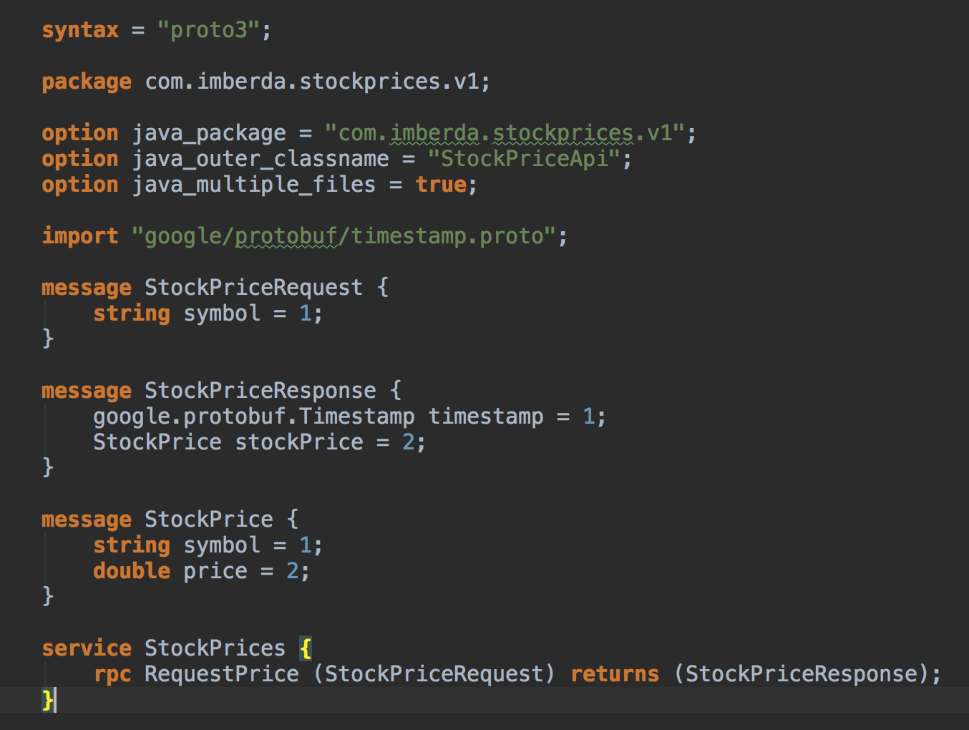
Example Service Definition

Slide 6
Very Quick Demo…

Slide 7
Performance
Compared to REST-JSON - benchmarks often report ⁺⁺
More than x5 ops/sec
Reduction in CPU of over 25%
How?
Uses HTTP/2.0
Compressed binary headers
Multiplexing of requests within single connection
Uses long-live connections between client and server
Uses binary compact serialisation format (avoid string lexing/parsing)
⁺⁺ Warning: Your Milage May Vary
“If you torture the data long enough, it will confess to anything”
Run your own tests using reflecting your own use cases

Slide 8
REST is Best!
"A presumptive architecture is a software architecture that is dominant in a particular domain. Rather than justifying their choice to use it, developers in that domain, may have to justify a choice that differs from their presumptive architecture. Non-curious developers may not even seriously consider other architectures, or have the apprehension that all software should conform to the presumptive architecture.”
(George Fairbanks)
Some of the great things about REST are that its ubiquitous:
Supported by all languages
Excellent tooling (practically no tooling required)
Simple to understand
We’ve been doing it for years and understand its dark corners
However….
Lots of boilerplate when writing a REST service
Typically clients for n languages need n implementations
The debate around what is “RESTful” is seemingly endless (😡)
Need to be creative to handle large amounts of data (pagination, ndjson)
Need to assemble your stack (http client, web framework, marshaller, etc.)

Slide 9
Where to use GRPC?
REST makes total sense to clients we don’t own on the Internet (browsers)
Does it make sense to use REST between services in the same racks of our data centre, where we can control everything?
Makes sense to use GRPC service-to-service where:
You need (or potentially need) to handle very high load
You want client, server or client-and-server streaming
Environments where you want to generate clients for n languages
You want or need well-defined interfaces
You want or need well-understood & documented compatibility rules

Slide 10
Side Effects
Business logic doesn’t easily leak into bloated client libraries
They’re generated so you get what you get (give or take config and interceptors)
You have DTOs that can’t be anything other than DTOs
Means you don’t mix-up your domain model with your interface API model
Another option when integration testing
If you are testing Service A which depends on Service B
You can easily instantiate Server B as GRPC server - just create a subclass
Provide mock responses
Very realistic as you use the same serialisation and wire protocol handling
Sane semantics around error handling
Just return an exception with the appropriate content
Different version / location for interface vs. implementation?
Your server interface (.proto) can be in a separate module / project / repository
Possibly separately versioned

Slide 11
Final Thoughts
There is a Scala protoc compiler (scalapb) that generates nice Scala (case) classes. We already use it for protobuf.
NGINX recently (Q1 2018) added support for reverse proxying GRPC (including load-balancing)
Istio (service mesh) support GRPC in addition to HTTP
Very interesting in a post Kubernetes migrated world
There are CURL and (poor man’s) Postman type tools available

Slide 12
Want to Know more?
Code used in demo:
https://github.com/imberda/grpc-demo
Links:
https://grpc.io/
https://github.com/grpc-ecosystem/awesome-grpc
https://www.nginx.com/blog/nginx-1-13-10-grpc/
https://github.com/fullstorydev/grpcurl
https://scalapb.github.io/grpc.html

