Slide 1

Overview page
Collaboration point
A meeting point for collaboration between geoinformation software developers, data providers and mapping organizations worldwide
Unified and Convenient Approach
A unified and convenient approach to different geoinformation software and data
Worldwide Cloud Based Infrastructure
A powerful and scalable worldwide cloud based computer infrastructure for mapping organizations
Pay-per-Use model
Pay-per-use or subscription models for software and data utilization for mapping organizations
Direct Approach
A direct approach to free and pay-per-use GeoData
Scalable and Always Available
Scalable and always available computer environment – computers, storage, web.

Slide 2
Collaboration point
Government
Local Authorities
Remote Sensing
Geodesy/Mapping
GeoData
Providers
Software Developers
Academy
Research Institutes
A meeting point for collaboration between geoinformation software developers, data providers and mapping organizations worldwide

Slide 3
Unified and Convenient Approach
Data
Airborne
DSM/DTM
AT
DSM/DTM
Ortho
Stereo
3D City
GIS
Orthophoto
Measurements
RS
Satellite
Bingo
PATB
.....
.....
LAStools
TerroSolid
…..
PCI
INFO
PixelFactory
…..
Photomod
DAT/EM
AtlasKLT
SocetGXP
…..
SURE
ContextCapture
Photoscan
PhotoMesh
…..
ArcGIS
SuperMap
GlobalMapper
TatukGIS
…..
IMC
ERDAS
ENVI
…..
A unified and convenient approach to different geoinformation software and data
Customers

Slide 4
Worldwide Cloud Based Infrastructure
A powerful and scalable worldwide cloud based computer infrastructure for mapping organizations

Slide 5
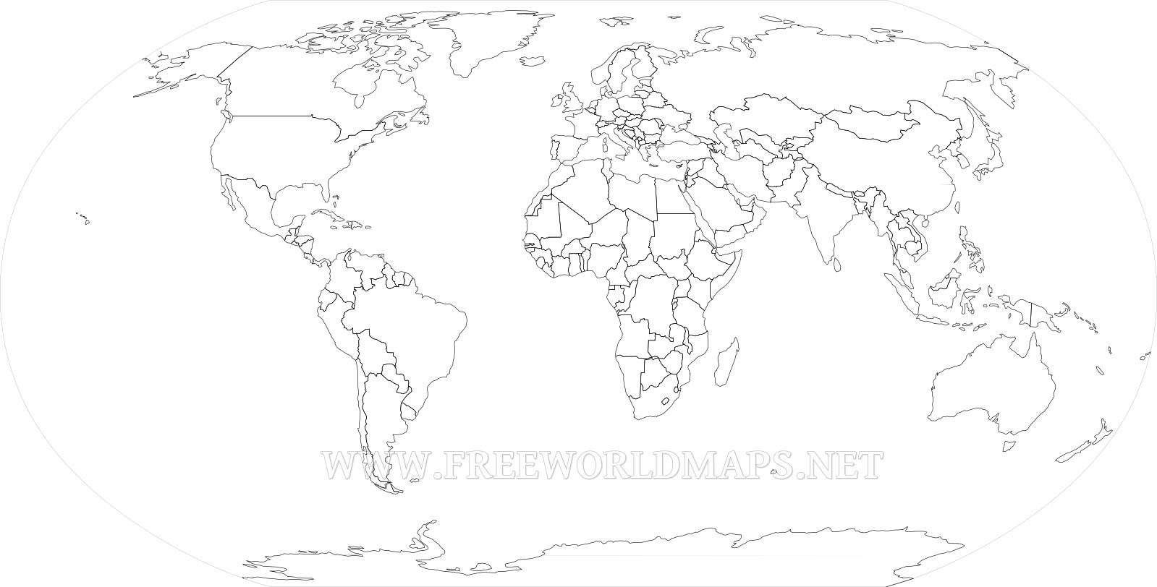
Worldwide Cloud Based Infrastructure
Ireland
Sweden
UK
Germany
Canada
France
China
S.Korea
US West
Japan
US East
India
Singapore
A powerful and scalable worldwide cloud based computer infrastructure for mapping organizations
Brazil
Australia
Existing AWS data centers
Coming soon AWS data centers

Slide 6

Pay-per-Use model
Pay-per-Use
Purchase
RS app
DPS app
DPS app
GIS app
GIS app
RS app
Pay-per-use or subscription models for software and data utilization for mapping organizations

Slide 7


Pay-per-Use
Purchase
RS app
DPS app
DPS app
GIS app
GIS app
RS app

Slide 8
Pay-per-Use
Purchase
RS app
DPS app
DPS app
GIS app
GIS app
RS app

Slide 9


Pay-per-Use
Purchase
RS app
DPS app
DPS app
GIS app
GIS app
RS app

Slide 10
Direct Approach
Airborne
DSM
Ortho
3D City
Satellite
Maps
SAR
GIS
A direct approach to free and pay-per-use GeoData

Slide 11
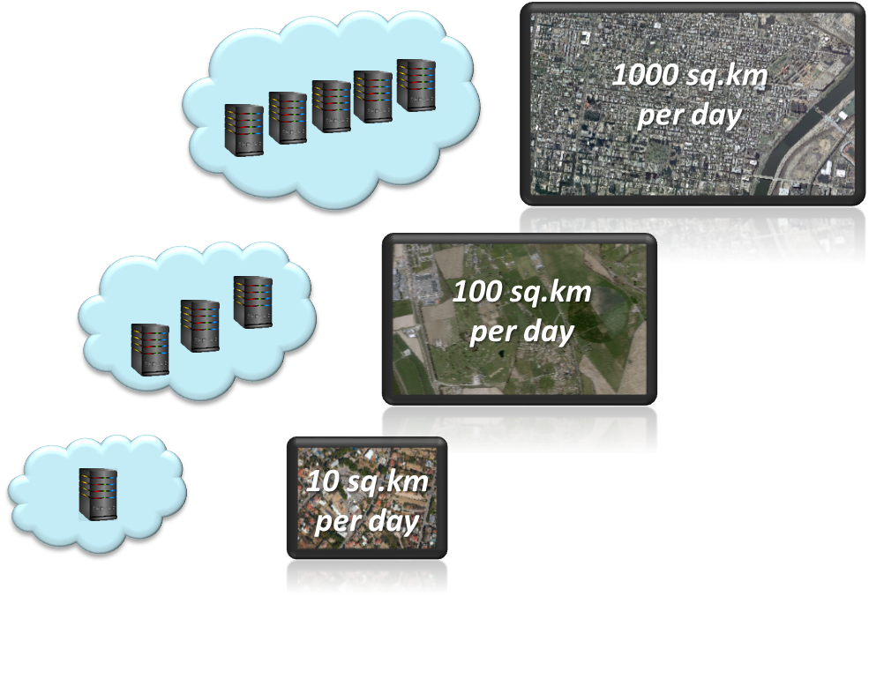
Scalable and Always Available
Scalable and always available computer environment – computers, storage, web.

Slide 12
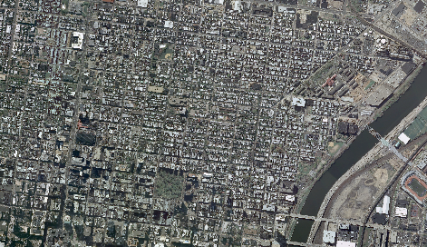

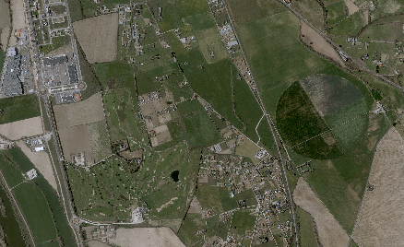
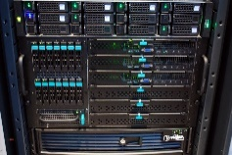
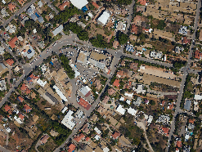

1000 sq.km
per day
100 sq.km
per day
10 sq.km
per day

Slide 13

1000 sq.km
per day
100 sq.km
per day
10 sq.km
per day

Slide 14

1000 sq.km
per day
100 sq.km
per day
10 sq.km
per day

