Slide 1
Git Work flows
Also Presentation skills

Slide 2

Git as a Team
Vincent Driessen's model --------------------------------->
Notes:
Pic: http://nvie.com/posts/a-successful-git-branching-model/

Slide 3
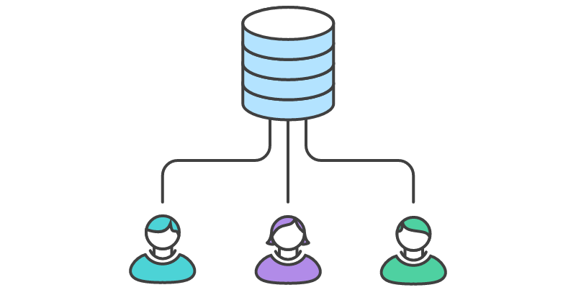
Central Repo Problems
Notes:
https://www.atlassian.com/git/tutorials/comparing-workflows/centralized-workflow

Slide 4
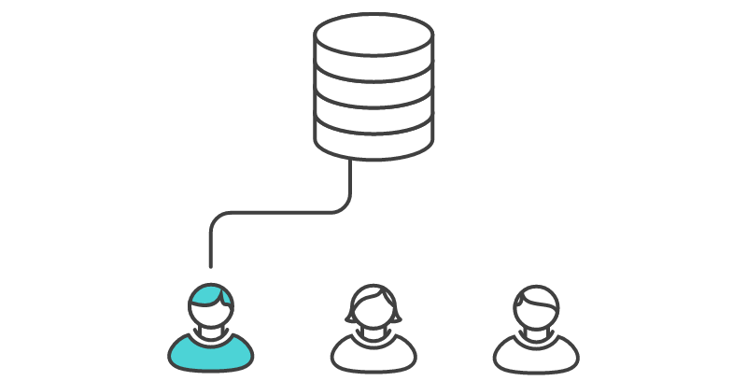
Central Repo Problems
Notes:
https://www.atlassian.com/git/tutorials/comparing-workflows/centralized-workflow

Slide 5
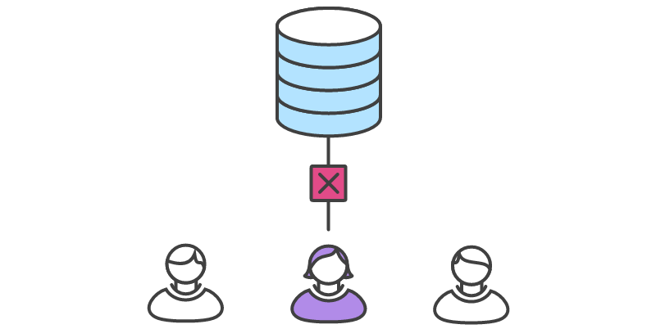
Central Repo Problems
Notes:
https://www.atlassian.com/git/tutorials/comparing-workflows/centralized-workflow

Slide 6
Central Repo Problems
Notes:
https://www.atlassian.com/git/tutorials/comparing-workflows/centralized-workflow

Slide 7
Central Repo Problems
#2
Notes:
https://www.atlassian.com/git/tutorials/comparing-workflows/centralized-workflow

Slide 8
Central Repo Problems
#2
Notes:
https://www.atlassian.com/git/tutorials/comparing-workflows/centralized-workflow

Slide 9
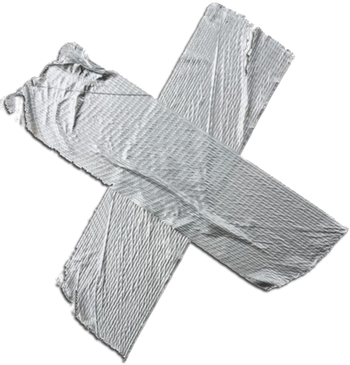
Central Repo Problems
Notes:
https://www.atlassian.com/git/tutorials/comparing-workflows/centralized-workflow

Slide 10
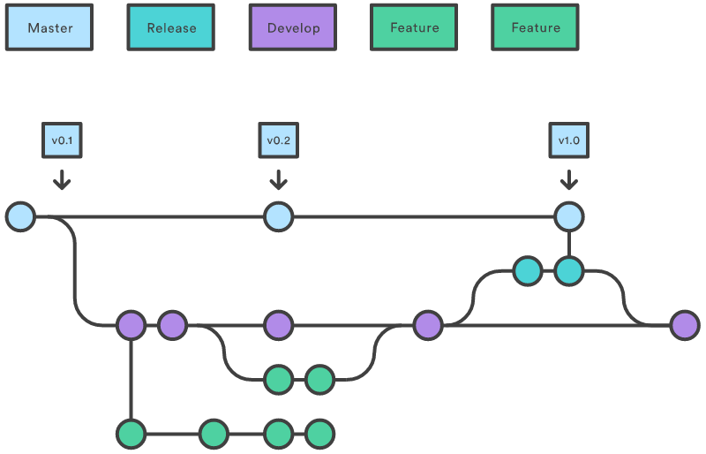
Solution Dev/Release/Feature
Keep Clean Versions
Freedom for new ideas
Notes:
https://www.atlassian.com/git/tutorials/comparing-workflows/centralized-workflow

Slide 11
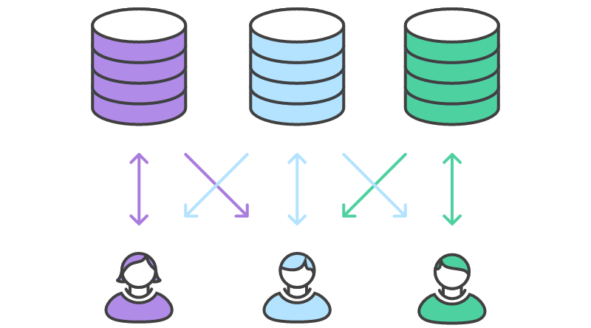
Solution Forking/Pull Requests
Permissions
Code Reviews
Notes:
https://www.atlassian.com/git/tutorials/comparing-workflows/centralized-workflow

Slide 12
References
Atlassian:
https://www.atlassian.com/git/tutorials/comparing-workflows/centralized-workflow Vincent Driessen:
http://nvie.com/posts/a-successful-git-branching-model/
Try github:
https://try.github.io/levels/1/challenges/1
Visual Explainations:
http://www.wei-wang.com/ExplainGitWithD3/

Slide 13
Presentation Skills
Tips and tricks

Slide 14
Requirements
12-20 Minutes Including questions (revised to 10 minutes)
Unique aspects of Team's Solution
Answering Questions
Notes:
https://www.atlassian.com/git/tutorials/comparing-workflows/centralized-workflow

Slide 15
Slide Deck
Easy Mode
PowerPoint/libreOffice
Google Presentation
Intermediate
Microsoft Sway
Prezi
SlideShare
Advanced
Reveal.js
HTML Framework
Notes:
https://www.atlassian.com/git/tutorials/comparing-workflows/centralized-workflow

Slide 16
Structured Presentation
Establish problem that your group faced
Always be addressing the Problem
Notes:
https://www.atlassian.com/git/tutorials/comparing-workflows/centralized-workflow

Slide 17
Demo
Prepare ahead of time
Consider using Video instead of live
Highlight features that were unique to your team
Practice your demo if you're live demoing!
Notes:
https://www.atlassian.com/git/tutorials/comparing-workflows/centralized-workflow

Slide 18
Good Luck!
Notes:
https://www.atlassian.com/git/tutorials/comparing-workflows/centralized-workflow

