Slide 1
Computer System Overview
Chapter 1
Operating Systems Concepts
Mirela Gutica
BCIT
Based on: Eighth Edition By William Stallings

Slide 2
Operating System
Resource Manager
Exploits the hardware resources of one or more processors
Process scheduling
Manages memory and virtual memory
Manages secondary memory and I/O devices
Manages the file system
User Interface
Provides a set of services to system users

Slide 3
Basic Elements of a Computer System
Processor
Main Memory
referred to as real memory or primary memory
volatile
I/O modules
secondary memory devices
communications equipment
terminals
System bus
communication among processors, memory, and I/O modules

Slide 4
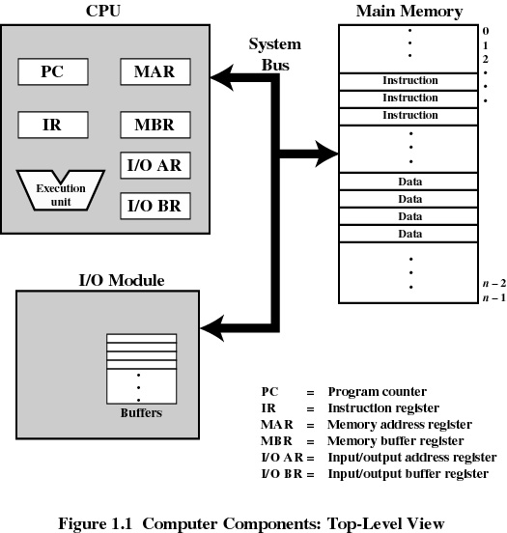
Top-Level Components
Notes:
The OS has privileged access to registers
The OS is either built on a specific hardware, or has a component (Hardware Abstraction Layer or HAL for Windows; the Hardware Control for UNIX) that creates the interface with the hardware.

Slide 5
Processor Registers
User-visible registers
Are used in the machine language:
accumulator, data registers
address registers: index, stack pointer, segment pointer etc.
Enable programmers to write code in low level C or assembly language
Available to all programs - application programs and system programs
Control and status registers
Used by processor
Used by operating-system routines to control the execution of programs
Notes:
A register is a data-holding place in a computer processor. A register can hold an instruction, a storage address, or any kind of data.

Slide 6
User-Visible Registers
Address Registers
Index
involves adding an index to a base value to get an address
Segment pointer
when memory is divided into segments, memory is referenced by a segment and an offset
Stack pointer
points to top of stack

Slide 7
Index Register
The contents of an index register is added to (or subtracted from) an immediate address (one that is part of the instruction itself) to form the "effective" address of the actual data (operand)
Used during the run of a program, typically for doing vector/array operations

Slide 8
Control and Status Registers
Program Counter or Instruction Pointer (PC or IP )
Contains the address of an instruction to be fetched
Instruction Register (IR)
Contains the instruction most recently fetched
Program Status Word or Flag Register (PSW)
Condition codes
Interrupt enable/disable
Supervisor or privileged mode/User mode

Slide 9
Control and Status Registers
Condition Codes or Flags
Bits set by the processor hardware as a result of operations
Can be accessed (read) by a program but not altered
Examples
Positive/negative result
Zero
Overflow
Interrupt
Notes:
We discussed positive/negative, zero, and overflow in Comp 1113.

Slide 10
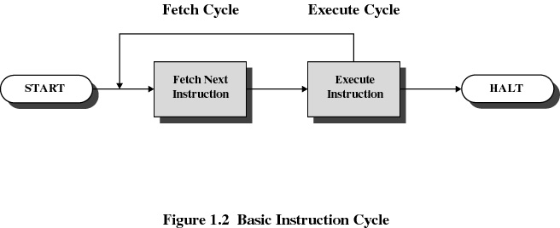
Instruction Cycle

Slide 11
Instruction Fetch and Execute
The processor fetches the instruction from memory
Program counter (PC) holds address of the instruction to be fetched next
Program counter is incremented after each fetch

Slide 12
Instruction Register
The fetched instruction is placed in the instruction register
Types of instructions
Processor-memory
transfer data between processor and memory
Processor-I/O
data transferred to or from a peripheral device
Data processing
arithmetic or logic operation on data
Control
alter sequence of execution (e.g., loops, comparissons, etc.)

Slide 13
Example of Program Execution (1)
https://www.youtube.com/watch?v=04UGopESS6A

Slide 14
Example of Program Execution (2)
Consider a hypothetical machine with three instructions:
0001 = Load AC from memory
0010 = Store AC to memory
0101 = Add to AC from memory
Consider the 16 bits instruction format as 4 bits for opcode and 12 bits for address
Consider a program that adds the contents of the memory word at address 940H to the contents of the memory word at the address 941H and stores the result in the later location.

Slide 15
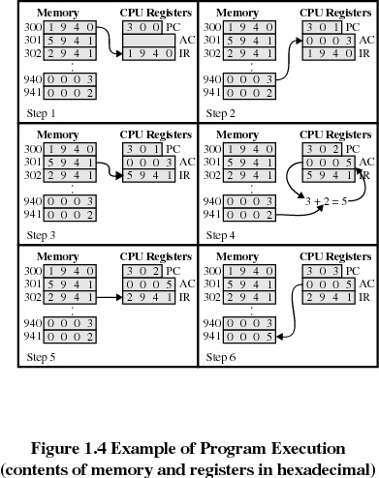
Example of Program Execution (3)

Slide 16
Direct Memory Access (DMA)
I/O exchanges occur directly with memory
The processor grants I/O module authority to read from or write to memory
Relieves the processor responsibility for the exchange
The processor is informed when the transfer finished via an interrupt
The processor is free to do other things
If the processor and the DMA module share the same bus, some bus cycles are used by processor, some by DMA.

Slide 17
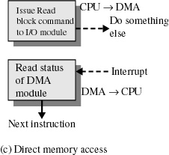
Direct Memory Access
Transfers a block of data directly to or from memory
An interrupt is sent when the task is complete
The processor is only involved at the beginning and end of the transfer
Notes:
I/O operations are time consuming. If the processor is involved in each I/O operation, execution will be very slow

Slide 18
Interrupts
An interruption of the normal sequence of execution
Improves processing efficiency
Allows the processor to execute other instructions while an I/O operation is in progress
A suspension of a process caused by an event external to that process and performed in such a way that the process can be resumed
Notes:
.

Slide 19
Classes of Interrupts
Hardware failure
Timer (periodic interrupt)
I/O

Slide 20
What is not an Interrupt
Program
arithmetic overflow
division by zero
execute illegal instruction
reference outside user’s memory space

Slide 21
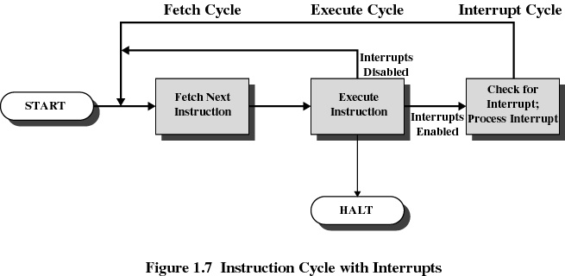
Interrupt Cycle

Slide 22
Interrupt
while (fetch next instruction) {
run instruction;
if (there is an interrupt) {
process interrupt
}
}

Slide 23
Interrupt Cycle
Processor checks for interrupts
If no interrupts fetch the next instruction for the current program
If an interrupt is pending, suspend execution of the current program, and execute the interrupt handler

Slide 24
Interrupt Handler
A program that determines nature of the interrupt and performs whatever actions are needed
Control is transferred to this program
Generally part of the operating system

Slide 25
System calls vs. Interrupts
Performing an operating system call is not an interrupt (e.g., normal keyboard, sending a job to a printer, receiving an end-of-job signal from a printer)
In this case we deal with a “switch” from a process to another and from user mode to kernel mode (privileged) mode

Slide 26
Disabling Interrupts
Is this possible? Who can disable interrupts?
The operating system can enable/disable interrupts
Why?
E.g., to prevent preemption of kernel-mode code
http://www.makelinux.net/books/lkd2/ch06lev1sec7

Slide 27
Writing Interrupt Handlers
Is this possible?
In what language?
Yes, in assembly and C programmers can write interrupt handlers
Why?
Write specialized applications like embedded systems and operating systems
In C, programmers can enable and disable interrupts by calling the functions EnableInterrupts() and DisableInterrupts() respectively

Slide 28
Multiple Interrupts Priorities
Higher priority interrupts cause lower-priority interrupts to wait
Causes a lower-priority interrupt handler to be interrupted
Example
When input arrives from communication line, it needs to be absorbed quickly to make room for more input
Ctrl-Alt-Del is a high priority interrupt

Slide 29
Multiprogramming
Processor has more than one program to execute
The sequence the programs are executed depend on their relative priority and whether they are waiting for I/O
After an interrupt handler completes, control may not return to the program that was executing at the time of the interrupt

Slide 30
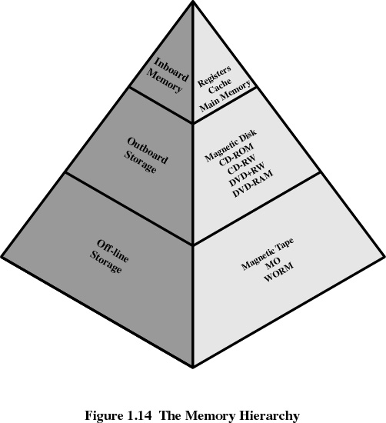
Memory Hierarchy

Slide 31
Going Down the Hierarchy
Decreasing cost per bit
Increasing capacity
Increasing access time
Decreasing frequency of access of the memory by the processor
Last two goals are helped by the design of the operating system

Slide 32
Disk Cache
A portion of main memory used as a buffer to temporarily to hold data for the disk
Disk writes are clustered
Some data written out may be referenced again.
Data is retrieved rapidly from the software cache instead of slowly from disk

Slide 33
Cache Memory
Invisible to the operating system; however OS is involved in data transfer from RAM or virtual memory to the processor
Increase the speed of accessing data
CPU does not have to use the motherboard’s system bus for data transfer
Processor’s speed is faster than memory’s speed
Processor first checks the cache memory
If not found in cache, the block of memory containing the needed data (or instruction) is moved to the cache

Slide 34
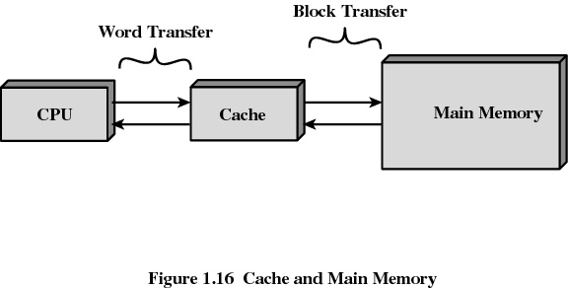
Cache Memory

Slide 35
Cache Memory
Cache built into the CPU itself is referred to as Level 1 (L1) cache
Cache that resides on a separate chip next to the CPU is called Level 2 (L2) cache
Some CPUs have both L1 and L2 cache built-in and designate the separate cache chip as Level 3 (L3) cache

Slide 36
Cache Algorithms
Cache memory works according to algorithms, which decide what data has to be stored
Algorithms use probability calculation based on past observation to decide which data would be most frequently needed

Slide 37
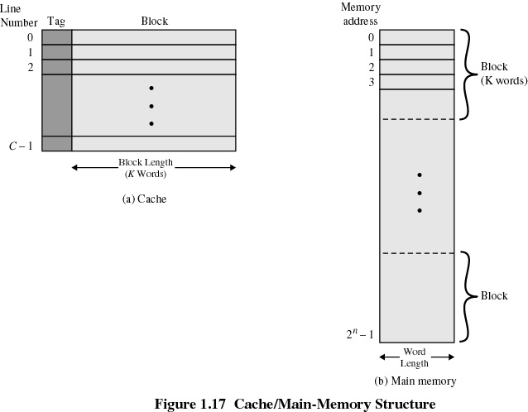
Cache/Main Memory System

Slide 38
Cache Design
Mapping function
determines which cache location the block will occupy
Replacement algorithm
determines which block to replace
Least-Recently-Used (LRU) algorithm

