Slide 1
Operating Systems Concepts
Operating System Overview
Mirela Gutica
BCIT
Based on: Eighth Edition By William Stallings

Slide 2
Operating System
Resource Manager
Exploits the hardware resources of one or more processors
Process scheduling
Manages memory and virtual memory
Manages secondary memory and I/O devices
Manages the file system
User Interface
Provides a set of services to system users

Slide 3
Operating System Objectives (1)
Convenience
Makes the computer more convenient to use
Efficiency
Allows computer system resources to be used in an efficient manner
Ability to evolve
Permit effective development, testing, and introduction of new system functions without interfering with service

Slide 4
Operating System Objectives(2)
Reliability
The operating system should be reliable for its users
Stability
The operating system should not crash or act non-deterministic
Security
The information should be safe (protected)
The operating system code should be safe

Slide 5
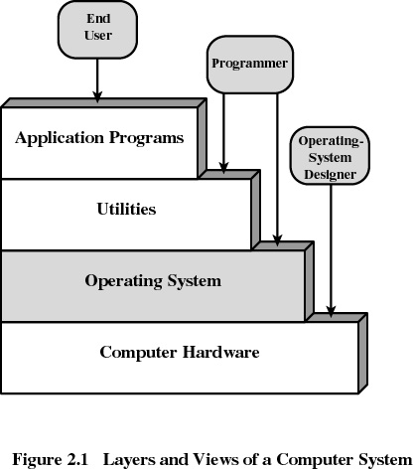
Layers of Computer System

Slide 6
Services Provided by the Operating System(1)
Program development
IDEs
Editors
Debuggers
Program execution
The operating system controls the program execution: start, resources requests, errors, finish, etc.
Memory management
The operating system controls how memory is divided between applications
Access to I/O devices
Uniform interface that hides the details of the I/O device implementation
Controlled access to files
The operating system provides the file model
The controlled access to files is provided by protection

Slide 7
Services Provided by the Operating System(2)
System access to resources
In a public, multi-user system, the user has access to resources via OS
Error detection and response
Internal and external hardware errors
Memory error
Device failure
Software errors
Arithmetic overflow
Access to forbidden memory locations
If an error is detected, the operating system cannot grant request of application

Slide 8
Services Provided by the Operating System(3)
Accounting
collect statistics
monitor performance
used to anticipate future enhancements
used for billing users

Slide 9
Why is an Operating System a Special Program?
An Operating System functions in the same way as ordinary computer software (it is executed on the processor, needs memory, I/O devices, communication lines).
Operating system relinquishes the control of the processor to execute other programs.

Slide 10
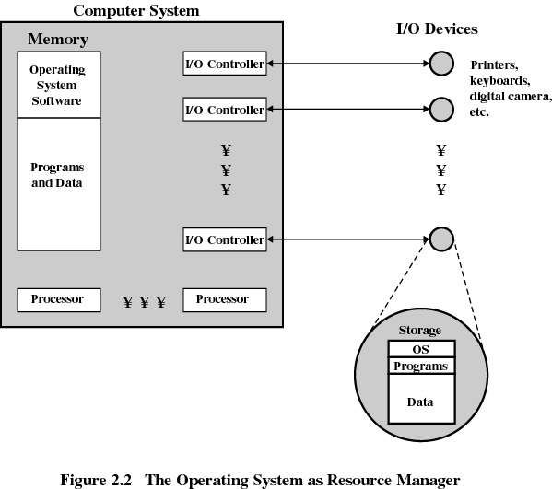

Slide 11
Kernel
Portion of operating system that is in a protected area of main memory
Portion of the operating system that contains the most important and the most frequently used functions
Also called the nucleus

Slide 12
Evolution of Operating Systems
An Operating system evolves because:
Hardware upgrades to more performance
New devices
New types of hardware are developed
New services are added because of the user demand (GUI Operating Systems)
Applications are larger and need more memory (virtual memory)
Internal errors are fixed.

Slide 13
Evolution of Operating Systems
Serial Processing
No operating system
Machines run from a console with display lights and toggle switches, input device, and printer
Setup included loading the compiler, source program, saving compiled program, and loading and linking

Slide 14
Evolution of Operating Systems
Simple Batch System – the grand-grandfather of the current Operating Systems
Developed in mid 50s by General Motors for an IBM 701
More Simple Batch Systems in the 60s
Named “Monitors”
Software that controls the running programs
Batch jobs together
Program branches back to monitor when finished
Resident monitor is in main memory and available for execution
Notes:
Do not confuse this with the Monitor for synchronization

Slide 15
Job Control Language (JCL)
In order to help the batch systems, a special language have been developed: Job Control Language
Special type of programming language which provides instruction to the monitor:
what compiler to use
what data to use

Slide 16
Hardware Features of a System Running a Monitor
Memory protection
does not allow the memory area containing the monitor to be altered
Timer
prevents a job from monopolizing the system

Slide 17

Uniprogramming
Processor must wait for I/O instruction to complete before preceding

Slide 18
Important Concepts
Multiprogramming
Time Sharing

Slide 19
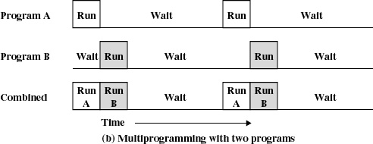
Multiprogramming
When one job needs to wait for I/O, the processor can switch to the other job

Slide 20
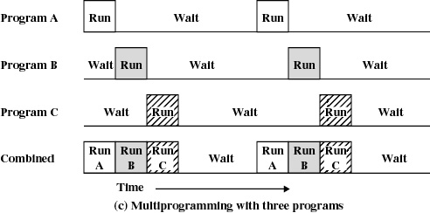
Multiprogramming

Slide 21
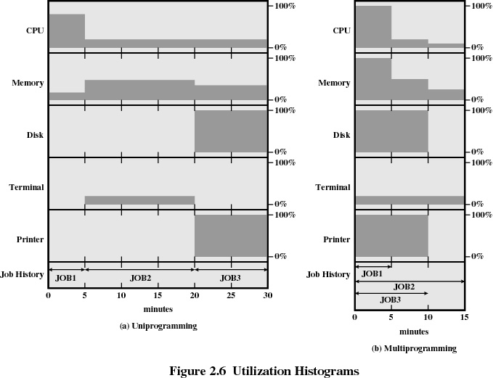

Slide 22
Example
JOB1 JOB2 JOB3
Type of job Heavy compute Heavy I/O Heavy I/O
Duration 5 min. 15 min. 10 min.
Memory required 50M 100 M 80 M
Need disk? No No Yes
Need terminal? No Yes No
Need printer? No No Yes

Slide 23
Effects of Multiprogramming
Uniprogramming Multiprogramming
Processor use 20% 40%
Memory use 33% 67%
Disk use 33% 67%
Printer use 33% 67%
Elapsed time 30 min. 15 min.
Throughput rate 6 jobs/hr 12 jobs/hr
Mean response time 18 min. 10 min.

Slide 24
Time Sharing
Using multiprogramming to handle multiple interactive jobs
Processor’s time is shared among multiple users
Multiple users simultaneously access the system through terminals
Example CTSS, IBM 709, PDP 11
CTSS design is primitive, but effective
http://cm.bell-labs.com/who/dmr/picture.html

Slide 25
Batch Multiprogramming versus Time Sharing
 | Batch Multiprogramming | Time Sharing
Principal objective | Maximize processor use | Minimize response time
Source of directives to operating system | Job control language commands provided with the job | Commands entered at the terminal

Slide 26
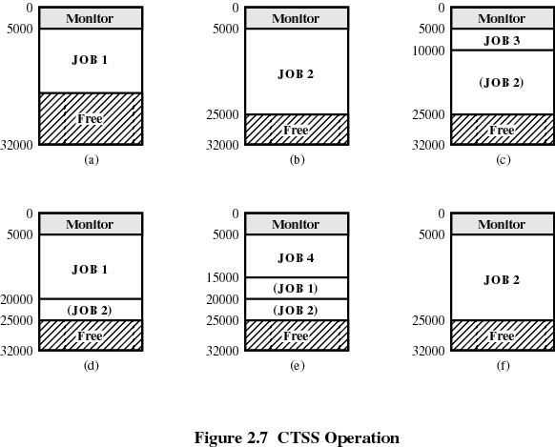

Slide 27
Major Achievements for Modern Operating Systems
Processes
Threads
a unit of dispatching inside a process
Memory Management
Scheduling and resource management
System structure (better internal design of OS).
Better file systems (larger files, recovery mechanisms)
Information protection
Security
Multithreaded and multi-user environment

Slide 28
System Structure
View the system as a series of levels
Each level performs a related subset of functions
Each level relies on the next lower level to perform more primitive functions
This decomposes a problem into a number of more manageable sub problems

Slide 29
Operating System Design Hierarchy
Level Name Objects Example Operations
13 Shell User programming Statements in shell language
environment
12 User processes User processes Quit, kill, suspend, resume
11 Directories Directories Create, destroy, attach, detach,
search, list
10 Devices External devices, such Open, close,
as printer, displays read, write
and keyboards
9 File system Files Create, destroy, open, close
read, write
8 Communications Pipes Create, destroy, open. close,
read, write

Slide 30
Operating System Design Hierarchy
Level Name Objects Example Operations
7 Virtual Memory Segments, pages Read, write, fetch
6 Local secondary Blocks of data, device Read, write, allocate, free
store channels
5 Primitive processes Primitive process, Suspend, resume, wait, signal
semaphores, ready
list

Slide 31
Operating System Design Hierarchy
Level Name Objects Example Operations
4 Interrupts Interrupt-handling Invoke, mask, unmask, retry
programs
Procedures Procedures, call stack, Mark stack, call, return
display
2 Instruction Set Evaluation stack, micro- Load, store, add, subtract
program interpreter, branch
scalar and array data
1 Electronic circuits Registers, gates, buses, Clear, transfer, activate,
etc. complement

Slide 32
Characteristics of Modern Operating Systems
Microkernel architecture
assigns only a few essential functions to the kernel
multithreading support
address space
interprocess communication (IPC)
basic scheduling
Opposed to a big monolithic kernel (including memory management, the file system, device drivers, etc.)

Slide 33
Characteristics of Modern Operating Systems
Multithreading
A process is divided into threads that can run simultaneously
Thread
Dispatchable unit of work
Executes sequentially and is interruptable by OS (preemptive)
A process is a collection of one or more threads

Slide 34
Characteristics of Modern Operating Systems
Symmetric multiprocessing
There are multiple processors
These processors share same main memory and I/O facilities
All processors can perform the same functions

Slide 35
Characteristics of Modern Operating Systems
Distributed operating systems
Provides the illusion of a single main memory and single secondary memory space
Used for distributed file system

Slide 36
Characteristics of Modern Operating Systems
Modular design
Used for adding modular extensions to a small kernel
Enables programmers to customize an operating system without disrupting system integrity
Easy to debug if errors
Provides data encapsulation

