Slide 1
Team DuckDuckGo
BIO727P – Software Development Group Project for MSc. Bioinformatics
Nasim Mohamed, Lewis James, Apoorva Perepogu, Gabriel Frazer, Nadia Choudhury

Slide 2
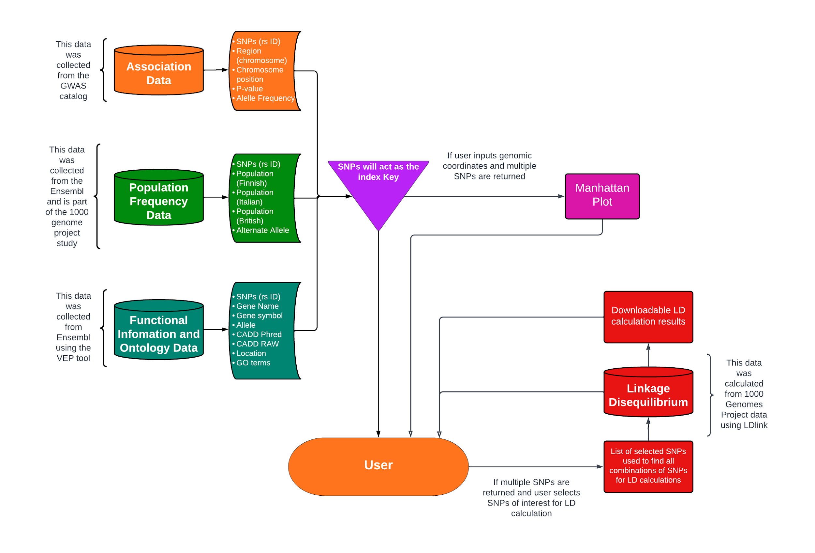
Software Schematic
Notes:
LEWIS

Slide 3
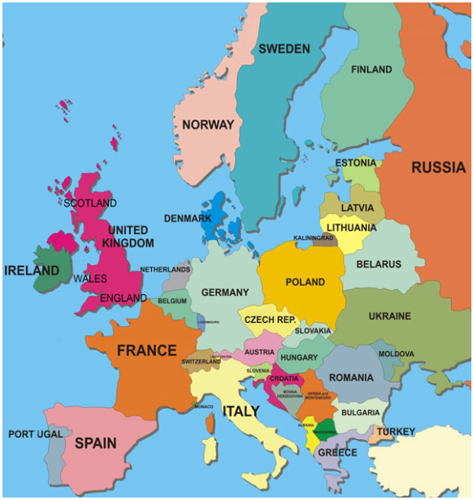
Populations Studied
1000 Genomes Project populations for each T1DM SNP in the EBI GWAS dataset was used and we narrowed down to these 3 locations:
Finland
Colloidal amorphous silica (ASi) present in the Finnish environment.
Italy (Toscani)
evidence of high rates of T1D in Northern Italy due to genetic risk.
Britain (England and Wales)
increasing variance of T1D incidence.

Slide 4
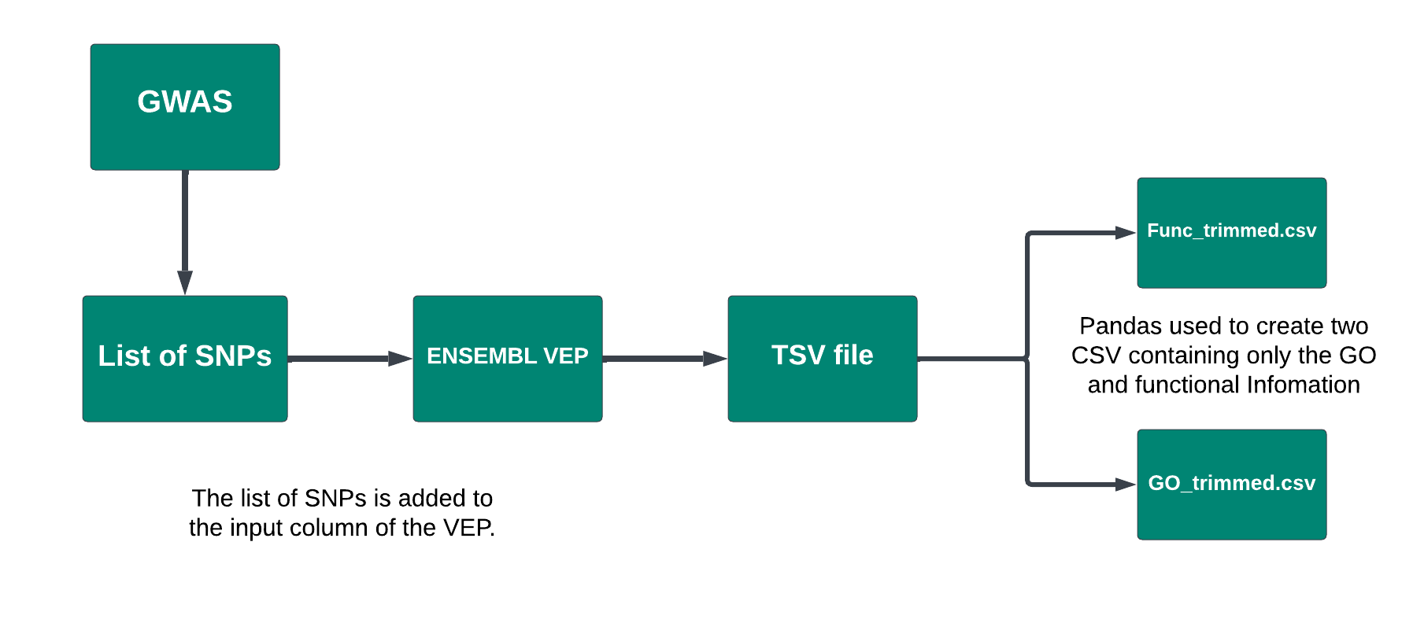
Functional Information and Gene Ontology

Slide 5
Why CADD?
One advantage of CADD over other measures of functional impact such as SIFT or PolyPhen is that CADD integrates a larger and more diverse set of functional annotations.
It also considers the effects of variants on non-coding regions of the genome, which can be important for understanding the functional consequences of variants that are not in protein-coding regions.

Slide 6
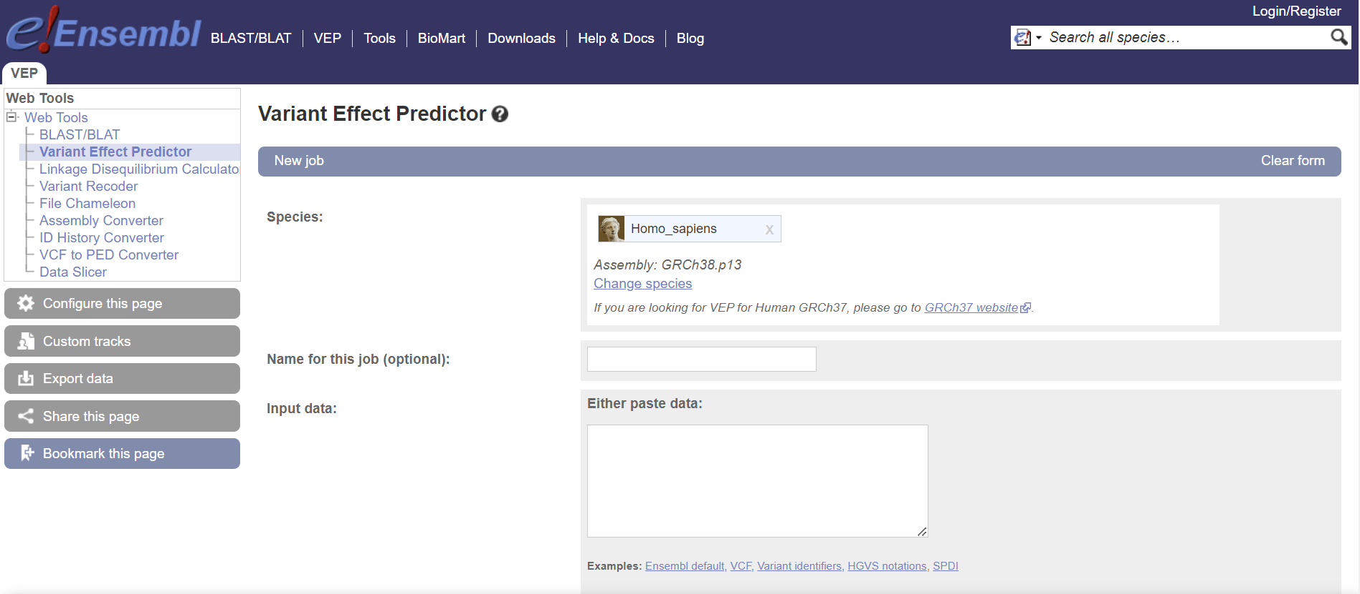
To collect out Functional Information and our Gene Ontology terms Ensembl's Variant Effect Predictor (VEP) web tool the rsID’s that we gathered from GWAS were all entered into the input data box.

Slide 7
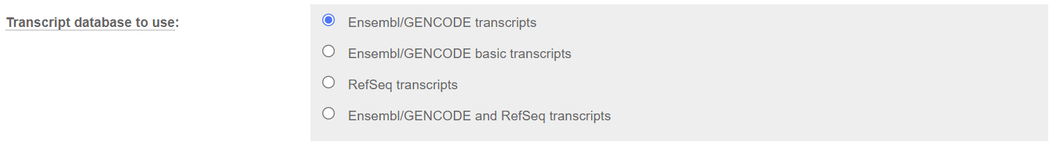
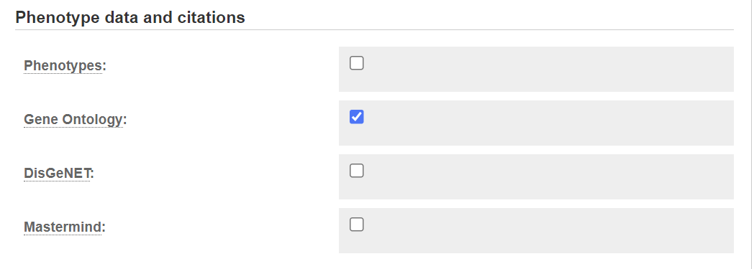
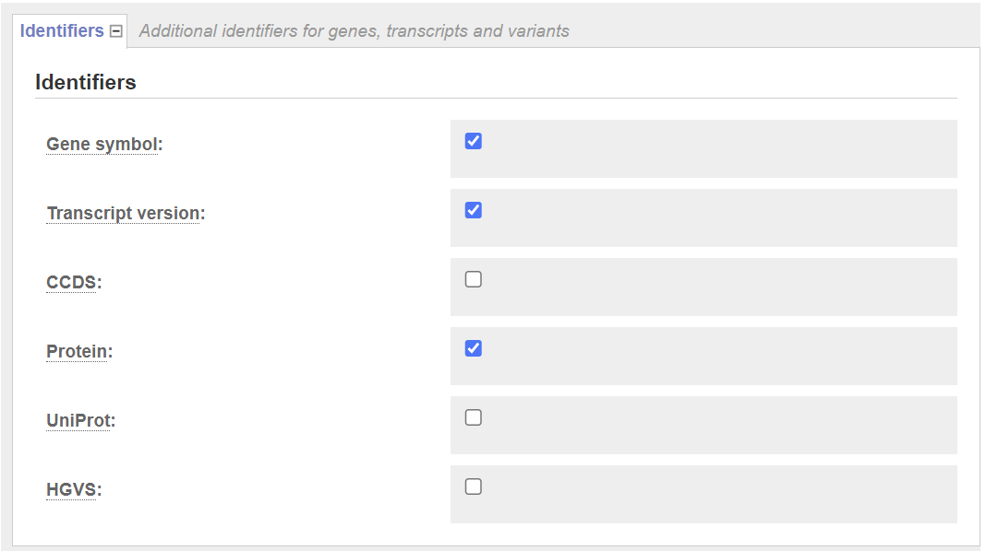
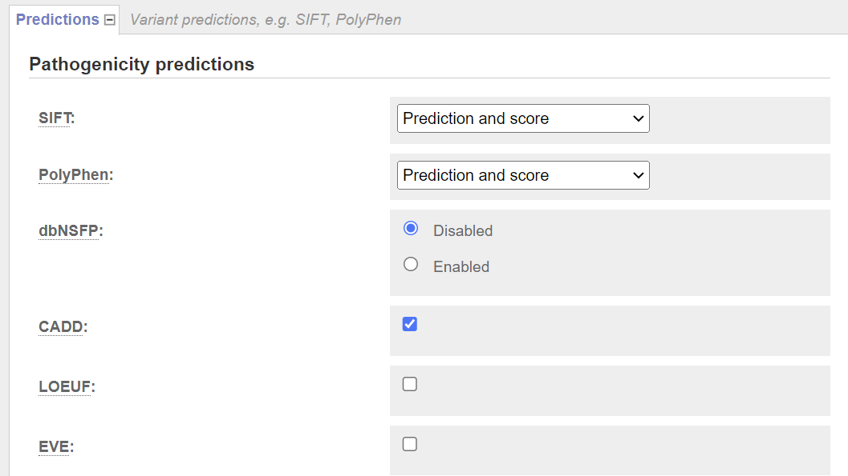
Select the database and from the Additional identifiers tab select Gene Symbol, Protein and the Gene Ontology. Allows us to associate the ontology terms with Genes and Protein names.
CADD was selected in the Prediction column to add a column containing the Raw CADD score and the CADD Phred score.

Slide 8
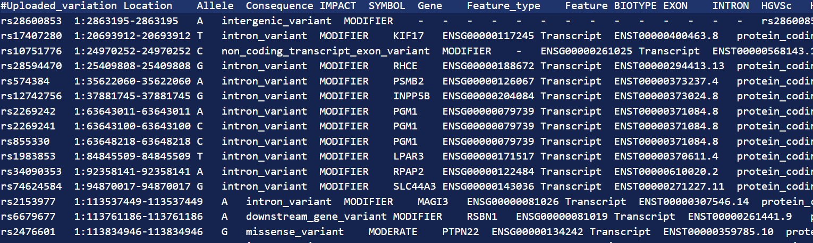
This gave us a TSV file containing all the CADD scores and GO terms these were then separated out in two two dataframes and then CSV files which

Slide 9
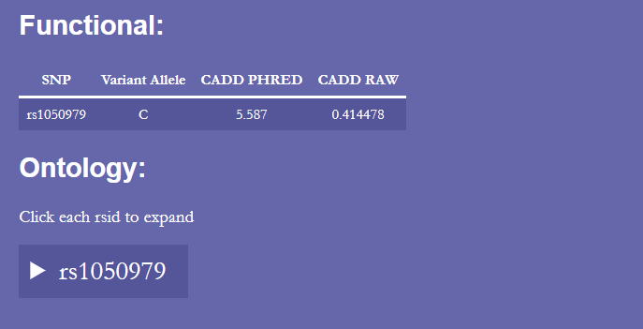
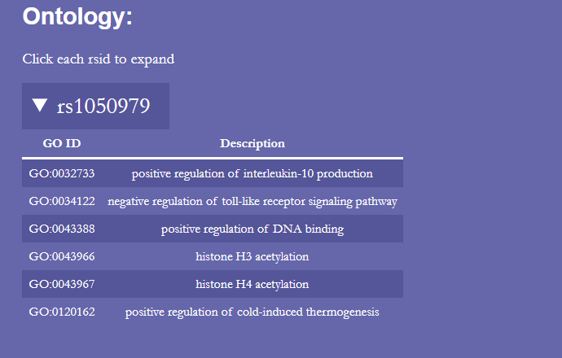

Slide 10
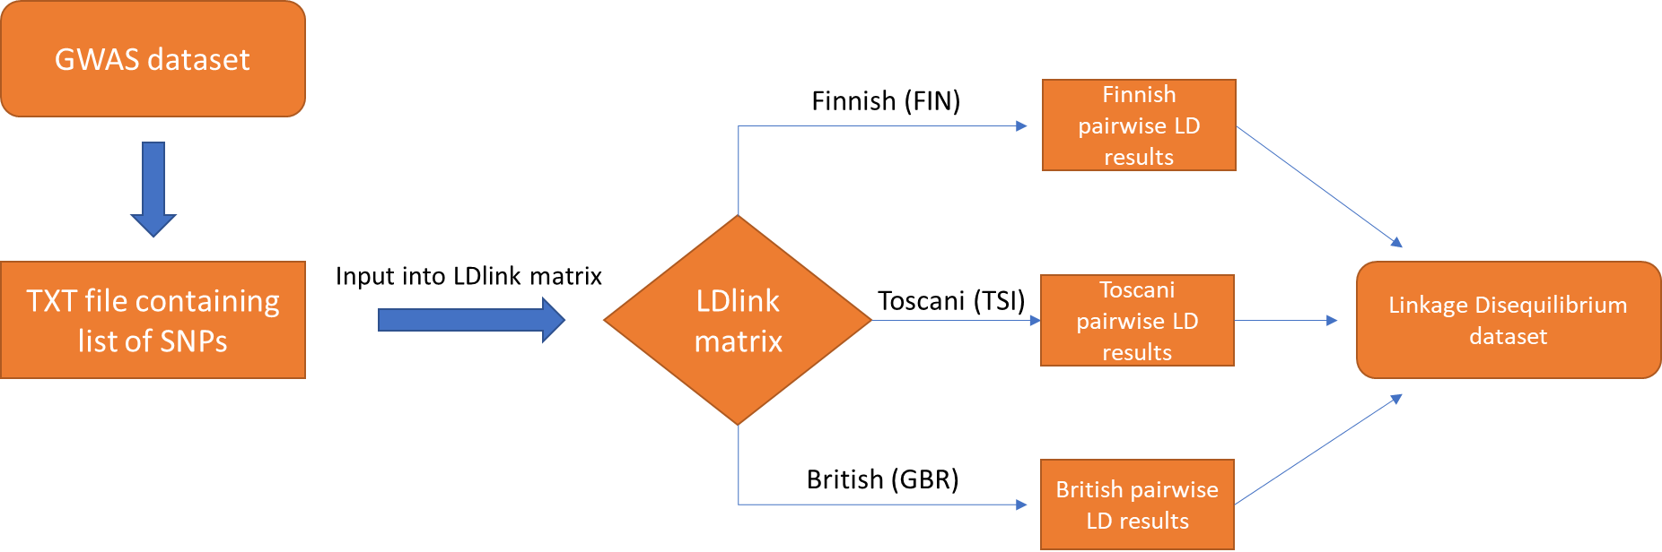
Linkage Disequilibrium

Slide 11
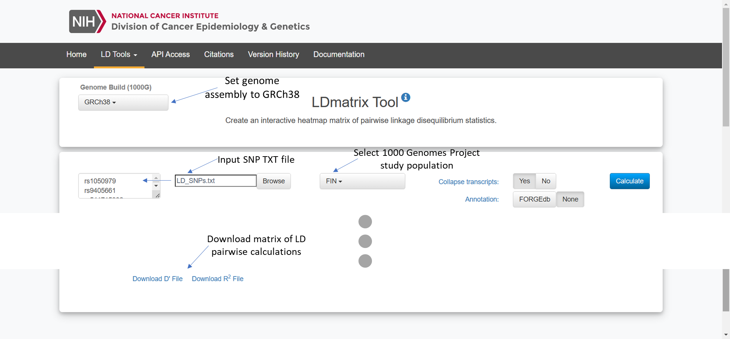

Slide 12
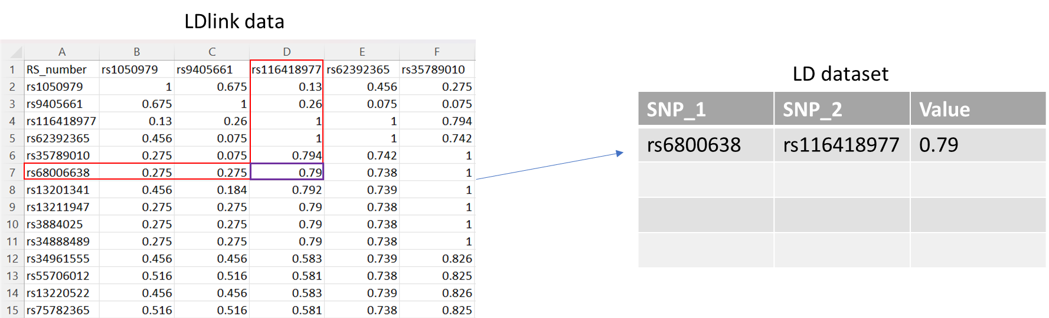

Slide 13
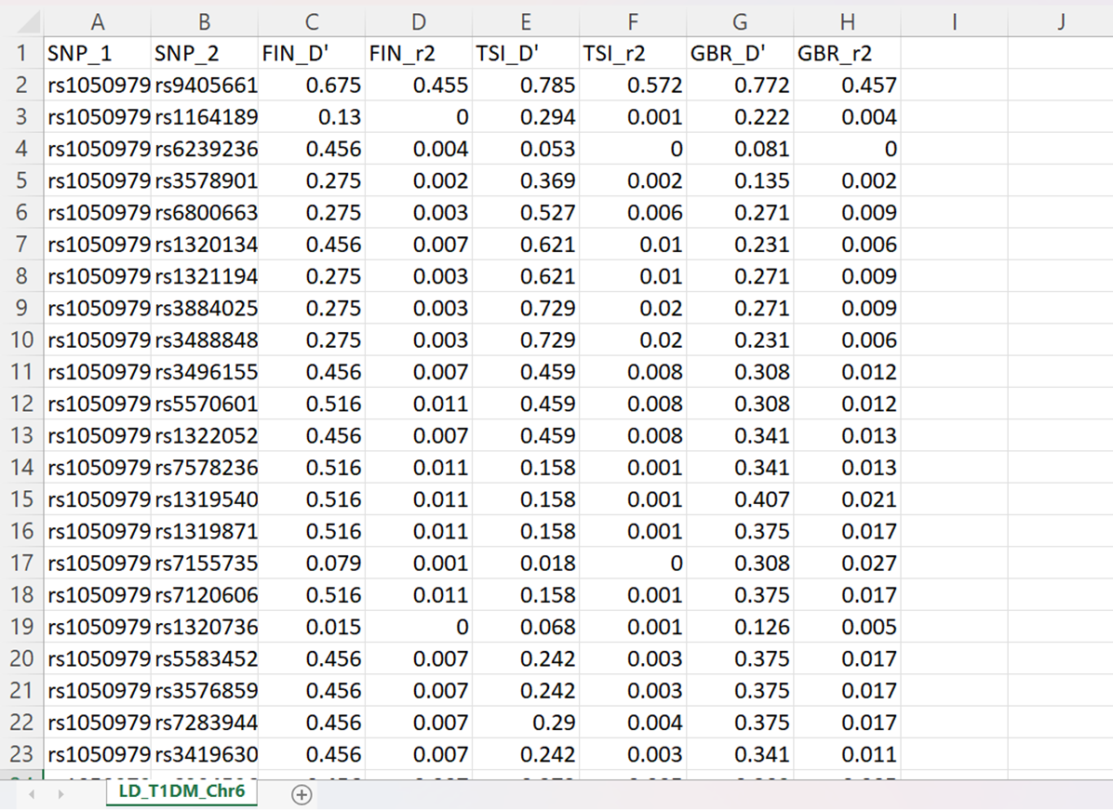

Slide 14
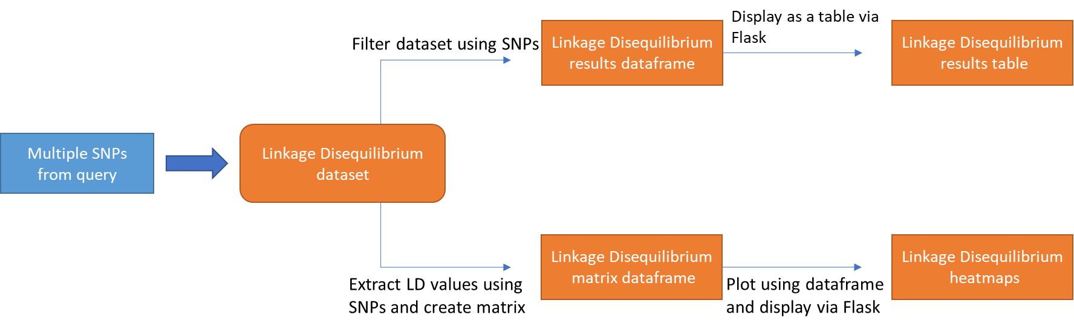

Slide 15
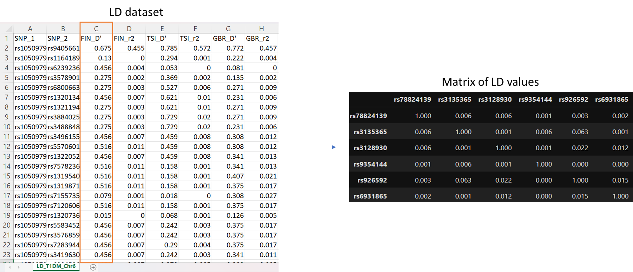

Slide 16
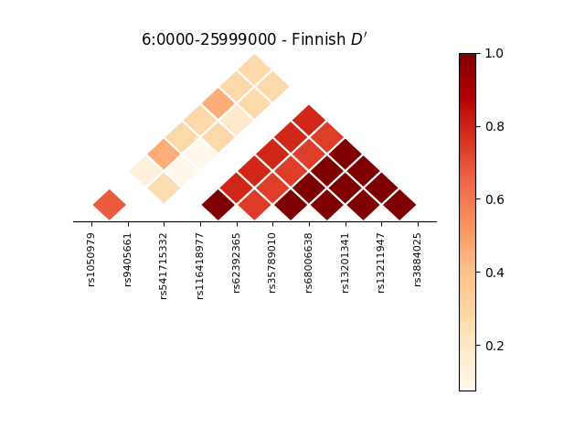
Linkage Disequilibrium plot
Colour bar
Heatmap
SNP labels

Slide 17
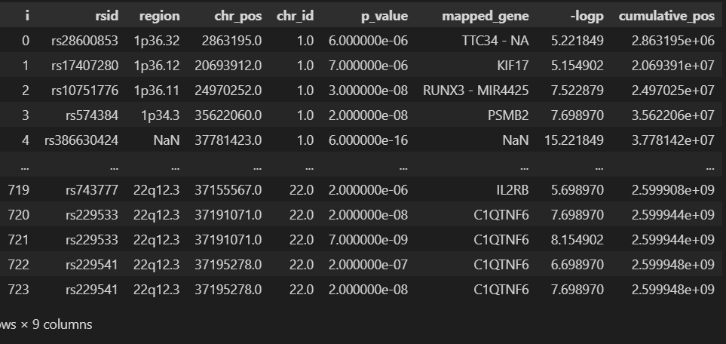
Manhattan Plot
Adding cumulative position and -log p columns

Slide 18
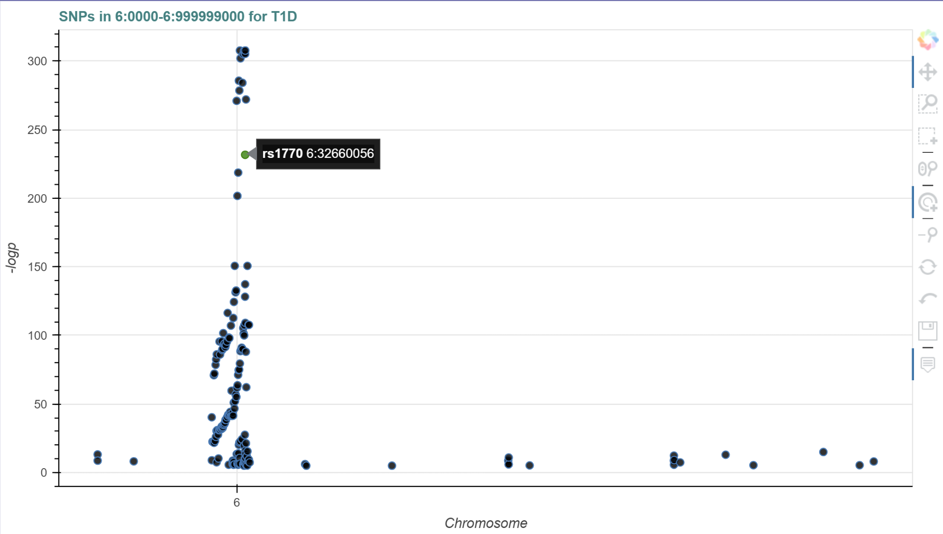
Chromosome 6
Title for region searched
Pan tool
Box zoom
Box select
Wheel zoom
Tap
Zoom out
Reset
Undo
Save
Hover feature

Slide 19
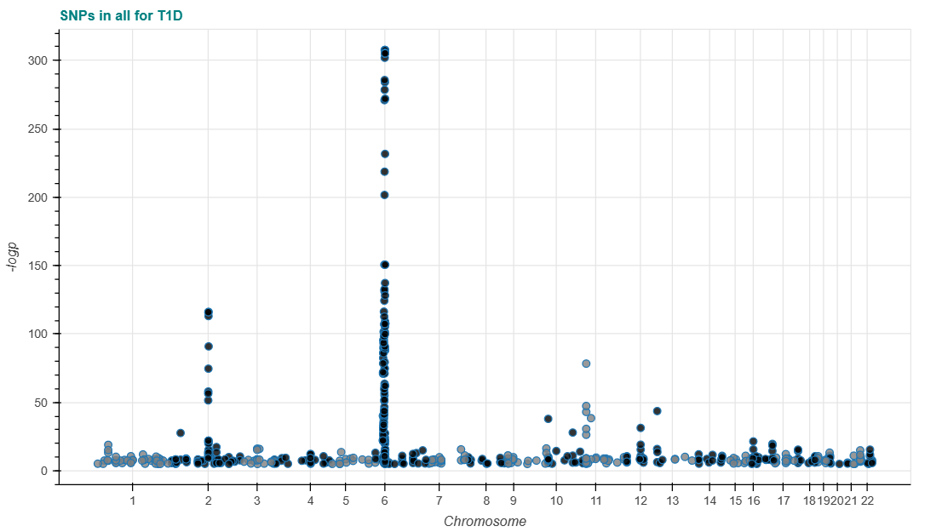
Manhattan Plot

Slide 20
User Feedback
10 molecular/microbiologists, aged 25-60 were given the opportunity to use the software to search for either a SNP, region or Gene. They were then asked to either retrieve GO data, Linkage Disequilibrium plot, or the Manhattan plot.
Colours/Themes: users found it easier to read with a darker theme; background was made darker. Other colours also added for different visual impairments.
Font size/style: users found the font easy to read and see, including users with visual impairments.
Quick links: users did not like scrolling through to find the data they were looking for; adding the quick links makes it quicker to get to the terms.
Return home button: this feature was added to all pages to allow user to return to the main page.
Notes:
Gabe

Slide 21
Questions?

