Slide 1
Solving Tetris With RL
Gheorghe Marius-Cătălin - 351
Hodoroagă Andrei - 351

Slide 2
About (modern) Tetris
generally played on a 10x20 board
you get to hold a piece for later use (for example, if placing it now puts you at a disadvantage)
piece generation uses the 7 bag algorithm (take an array of the 7 pieces, shuffle it, add to queue, repeat)
has a very competitive multiplayer scene, but only a handful of top tier competitive bots, none of which use Reinforcement Learning
uses rotation tables (if rotating a piece in place fails, it will try to move the piece up to 4 times until it finds a valid placement)

Slide 3
Challenges
creating an agent that plays forever (in single player mode)
creating an agent that learns entirely through self-play (minimal input from us)
creating an agent that learns the strategies to play multiplayer competitively

Slide 4
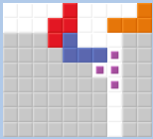


Multiplayer mode
solving the game in single player mode was easy, and we achieved this with all of our algorithms
multiplayer mode turned out to be much harder, as the agent has to learn that certain board states are good a few moves before actually getting a good reward (correlated to sending attacks to opponents)
Setting up T-Spins.
Source: harddrop.com

Slide 5
Our Approach
Environment: created from scratch in Python
Reward: an evaluation of the board the agent ends up in after taking an action (based on the board height, gaps, how many lines it cleared, etc.)
State-action pair Q(s, a) evaluation:
linear combination of features (we provide the features, the agent has to learn only the weights)
Deep-Q network: the agent learns to evaluate the board entirely on its own

Slide 6
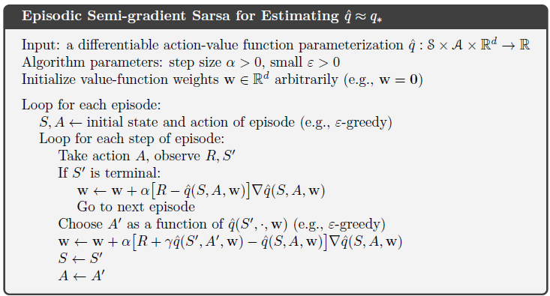
The first algorithm - Sarsa
each episode, it takes an action and updates the weights in the direction of the target
required some tweaking of the step size in order to get good results
Source: Sutton & Barto, Reinforcement Learning: An Introduction [1]

Slide 7
Sarsa - results
achieved infinite single player play
first benchmark:
Average reward over 10 runs of 1000 pieces: -1.588
Average max height over 10 runs of 1000 pieces: 3.465
second benchmark:
tests if the agent takes the best action for some boards defined by us
6 / 10 passed

Slide 8
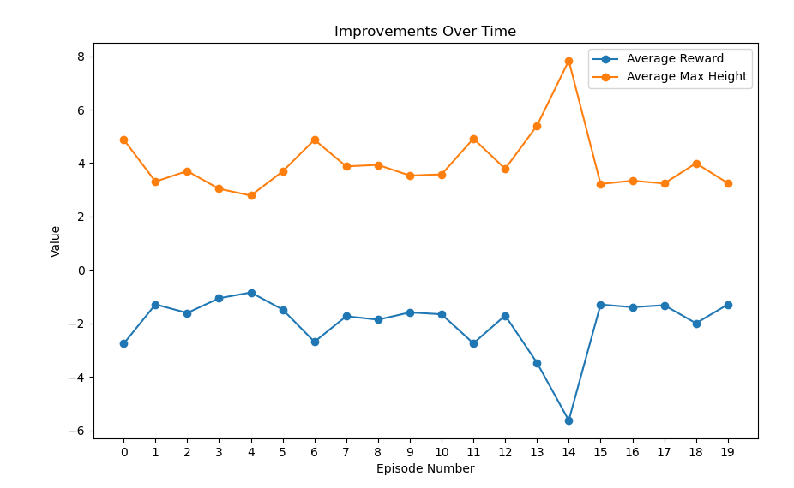
Sarsa - graph

Slide 9
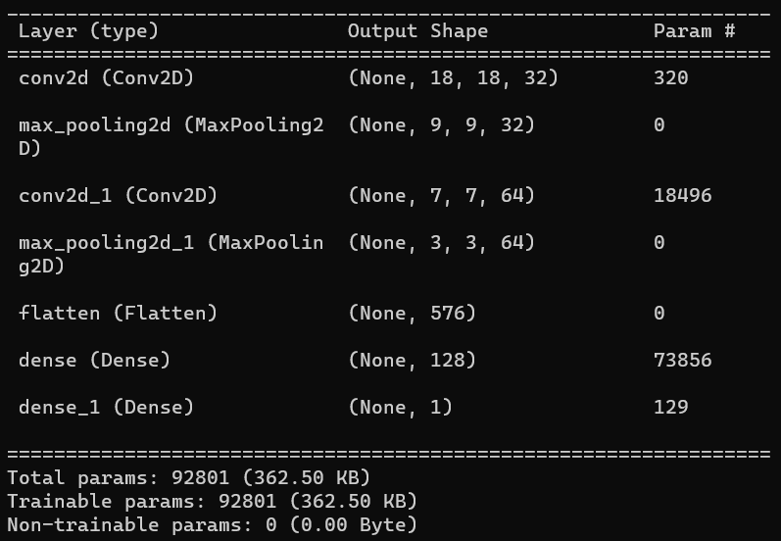
Deep-Q Network
the next step was to get rid of the features and make the agent learn how to evaluate the board on its own
we implemented a 100k parameter network to do linear regression on board states
the agent starts playing with an exploration rate of 100%, decays it over time, and saves (state, reward, next_state) transitions in a memory buffer that we use to train the neural network
network architecture

Slide 10
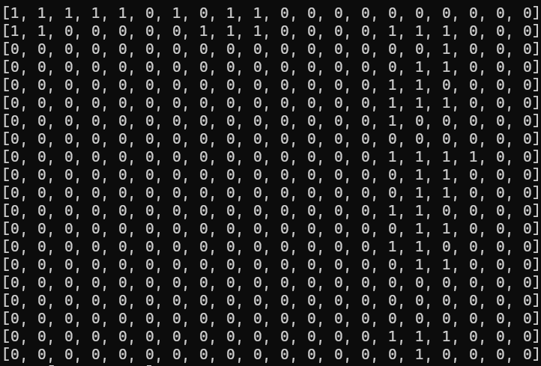
Deep-Q Network (contd.)
inputs: we took the 20x10 board and added the pieces on the right to make it similar to what a player would see
when the agent is playing, it selects an action by doing a forward pass through the network for all possible next states and chooses according to an epsilon greedy policy
when training, it does gradient descent towards target_q - expected_q
an input of the neural net

Slide 11
Deep-Q Network - results
we experimented with many different configurations for exploration, reward, network architecture, etc. The best achieved these results:
Benchmark 1:
Average reward over 10 runs of 1000 pieces: -0.981
Average max height over 10 runs of 1000 pieces: 2.6855
Benchmark 2:
7 / 10 passed

Slide 12
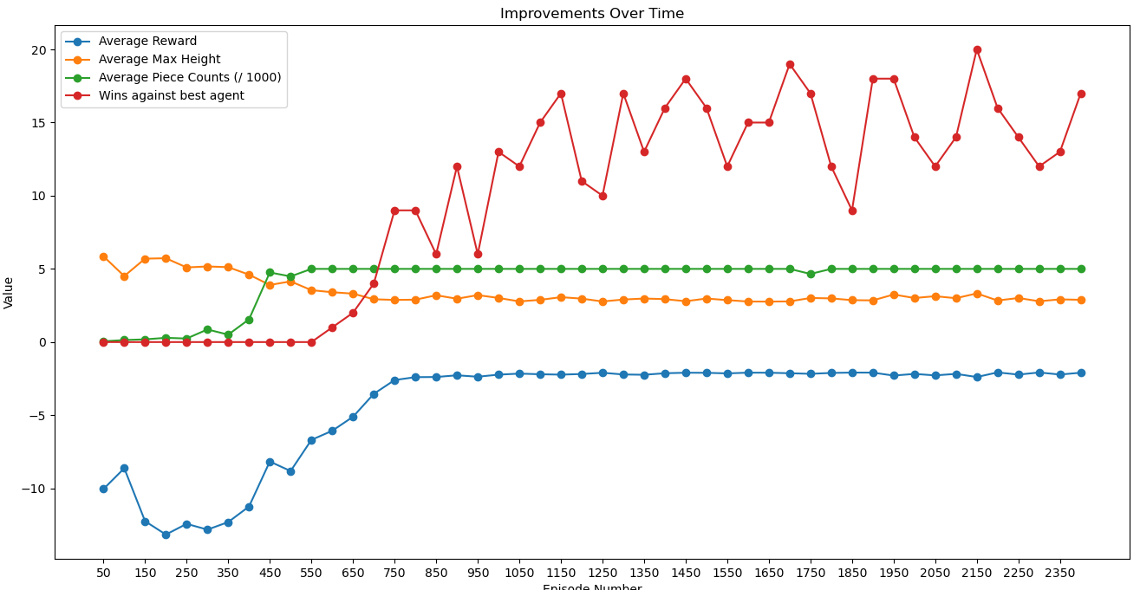
Deep-Q Network - graph

Slide 13
Comparing algorithms
 | One-step best reward | Sarsa | Sarsa-lambda | DQN
Play-time (in pieces) | ~500 | infinite | infinite | infinite
Benchmark 1 | -6.75 reward 8.9 height | -1.58 reward 3.46 height | -1.66 reward 3.57 height | -0.98 reward 2.68 height
Benchmark 2 | 4/10 | 6/10 | 6/10 | 7/10

Slide 14
References
Bodoia, M., & Puranik, A. (2012). Applying Reinforcement Learning to Competitive Tetris, Stanford University CS229 Project, https://cs229.stanford.edu/proj2012/BodoiaPuranik-ApplyingReinforcementLearnin gToCompetitiveTetris.pdf.
Sutton, R. S., & Barto, A. G. (2018), Reinforcement Learning: An Introduction (2nd ed.), The MIT Press.
Mnih, V., Kavukcuoglu, K., Silver, D., Graves, A., Antonoglou, I., Wierstra, D., & Riedmiller, M. (2015), Playing Atari with Deep Reinforcement Learning, Nature, 518(7540), 529-533. DOI: 10.1038/nature14236. Retrieved from: https://www.cs.toronto.edu/~vmnih/docs/dqn.pdf

