Slide 1
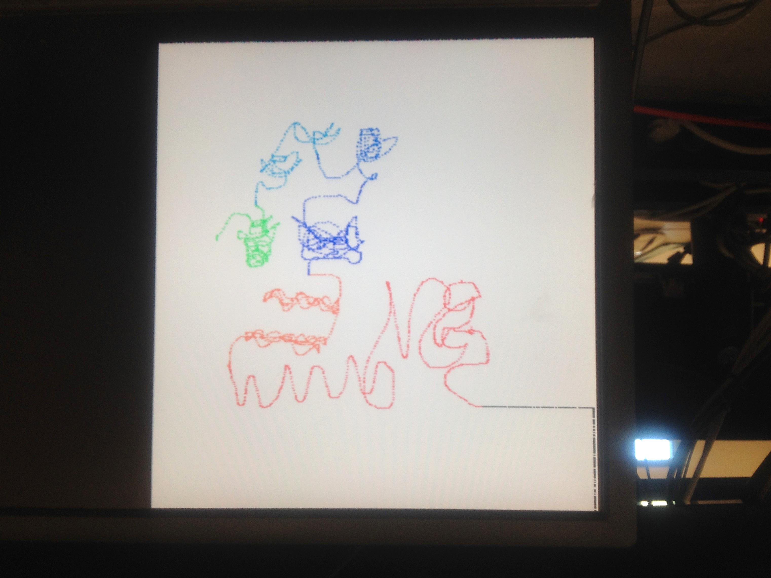
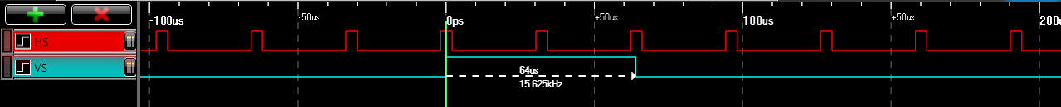
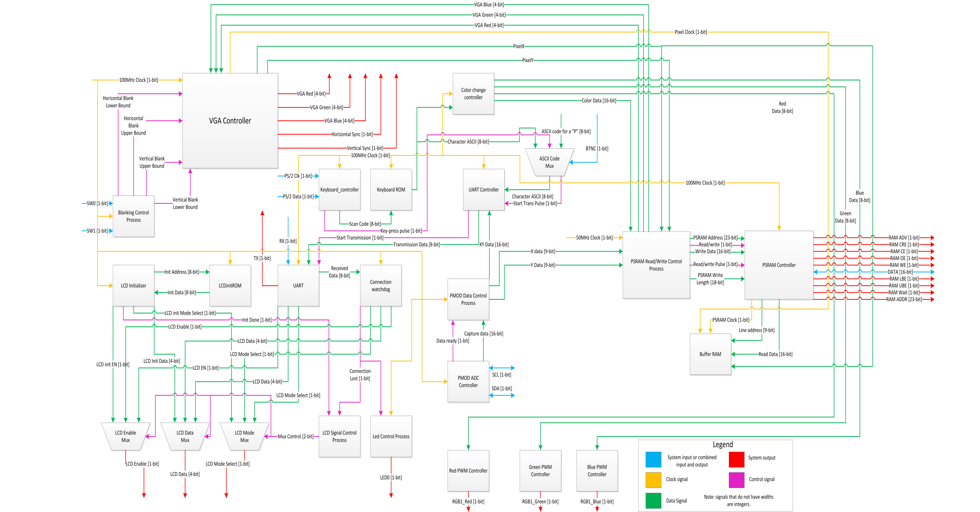
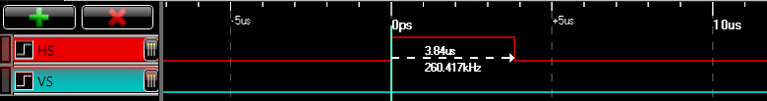
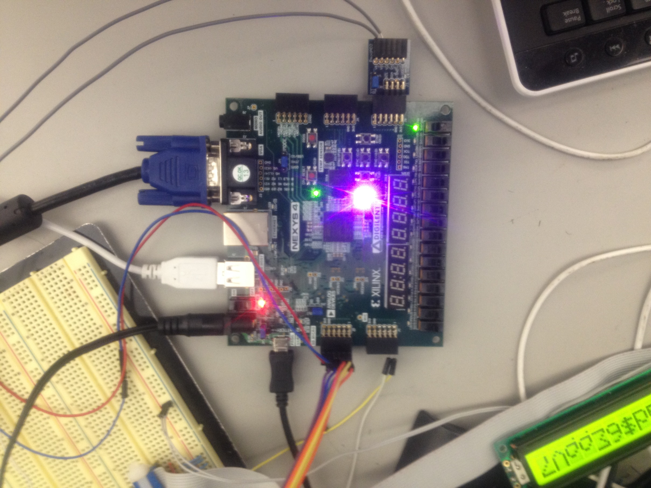
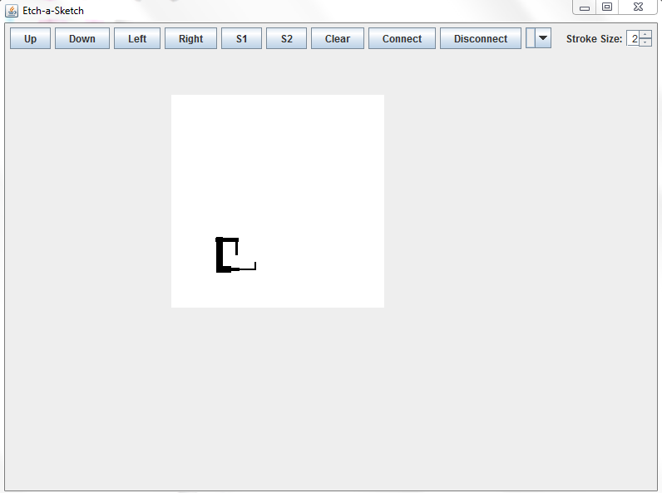
Electronic Etch-A-Sketch
EE316 Computer Engineering Jr. Lab
Ian McCann, Joseph Crandall and Joseph Koone
Professor Abul Khondker.
Abstract
The purpose of this design was to recreate the functionality of a simple etch-a-sketch. The design also incorporated the use of software to mirror the drawing made with the hardware in software. A user may change the color of the paintbrush and change the size of the drawing canvas.
Horizontal and vertical synchronization signal timings for a VGA monitor displaying 640x480 at 60Hz
Design Principle
This design made use of a Digilent Nexys 4 FPGA development board. The design also used an external LCD display and a PMOD 12-bit ADC to convert the voltages from the potentiometers into data that can be used by the system. The system uses the VGA video format and is capable of displaying 640x480 pixels and the software makes use of Java (GUI of software below).
Features
The user draws with two potentiometers, one for x-axis movement and one for y-axis movement.
The use can use the PS/2 keyboard connected to the Nexys 4 to change the color of the paintbrush.
The user has 4096 colors to choose from.
The user may change the canvas size from the default 256x256 pixels to 362x362 pixels to the largest size of 450x450 pixels.
The user may also save what they have drawn on the software by pressing BTNC on the Nexys 4 board.
A tri-color LED that represents the current paintbrush color (visible in the picture to the right, the LED is representing the color pink).
Communication with the software through Bluetooth.

