Slide 1
Competition and Other (non-price) Outcomes 1.) Eliason et al., 2020 2.) Craig, Grennan, and Swanson, 2021
Liz Staton
Health Economics II

Slide 2
Eliason, Paul J, Benjamin Heebsh, Ryan C McDevitt, and James W Roberts. 2020. “How Acquisitions Affect Firm Behavior and Performance: Evidence from the Dialysis Industry.” Quarterly Journal of Economics 135 (1): 221–67.

Slide 3
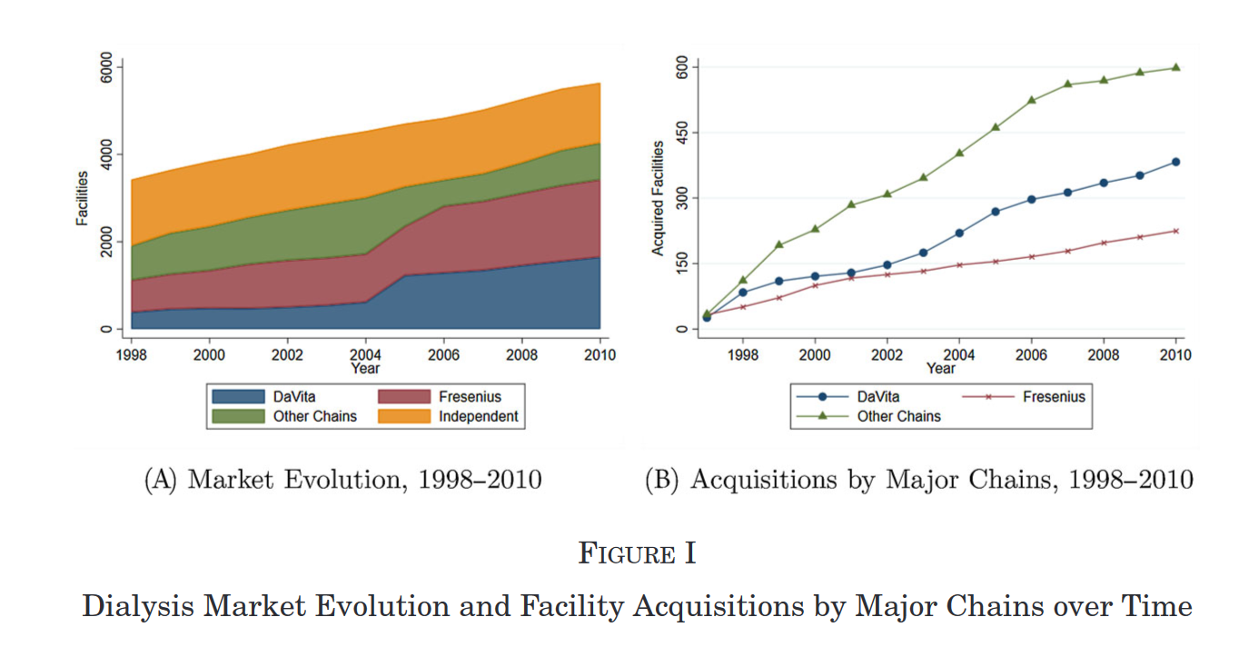
Source: Eliason et al., 2020

Slide 4
Overview
Research question
Broad: How do mergers and acquisitions in health care industries affect spending and outcomes?
Specific: How does acquisitions of independent dialysis facilities by large chains change their behavior?
Key findings: acquired facilities adopt behavior of parent company– increase use of highly reimbursed Rx, replace high-skill nurses with technicians, and decrease waitlisting of patients for transplant; resulting in worse patient health outcomes and greater Medicare spending
Empirical strategy
12-year panel data using Medicare claims for ~1 million dialysis patients, identifying >1,200 facility acquisitions
Observe patients with same characteristics being treated at the same facility before and after acquisition to identify effects of acquisition based on within-facility changes in ownership
Notes:
Geographic Variation in Healthcare Utilization: The Role of Physicians (nber.org)
Sources of Geographic Variation in Health Care: Evidence From PatientMigration (repec.org)

Slide 5
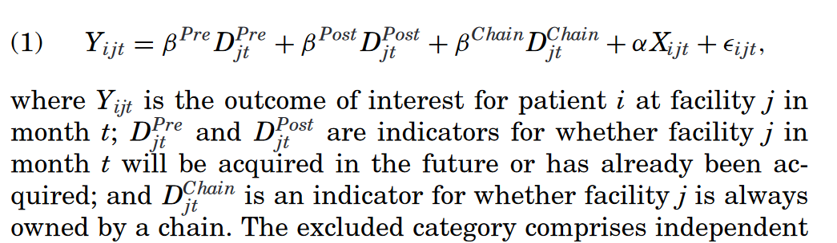
Main estimation model
Notes:
DiD comparing independent vs acquired by chain facilities with year, state and facility FE

Slide 6
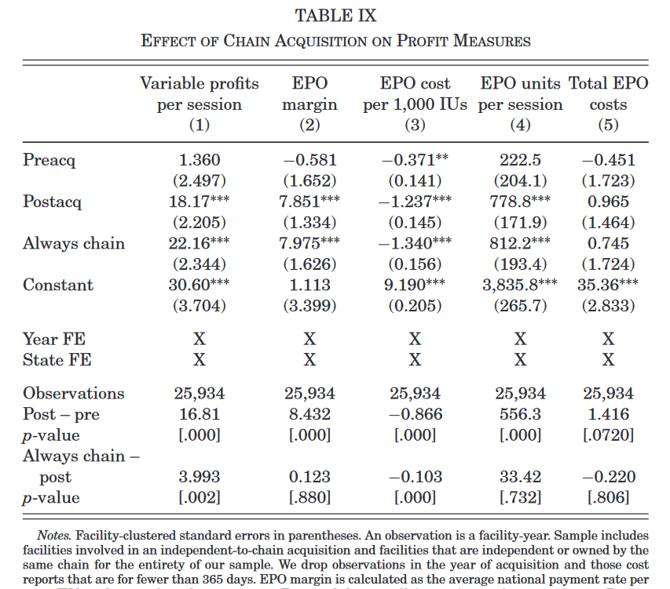
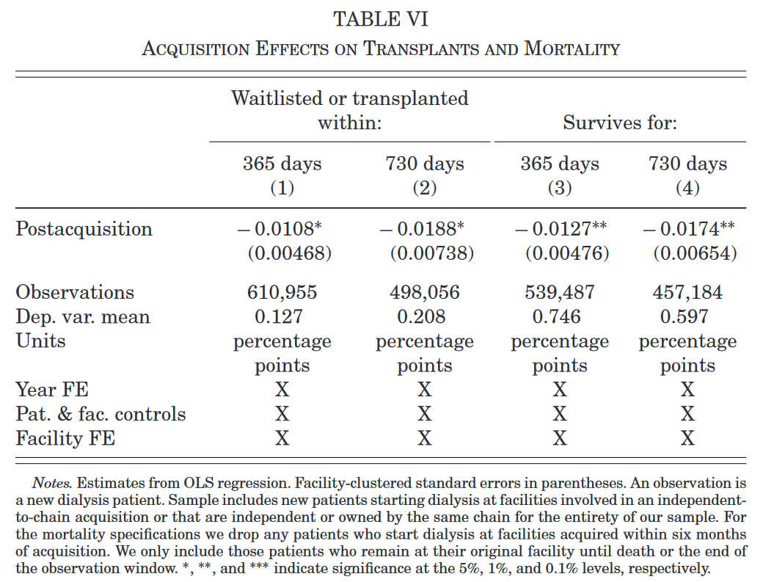
Main results

Slide 7
Craig, Stuart V., Matthew Grennan, and Ashley Swanson. 2021. “Mergers and Marginal Costs: New Evidence on Hospital Buyer Power.” The RAND Journal of Economics 52 (1): 151–78.

Slide 8
Overview
Research question
What is the effect of hospital mergers on marginal costs?
To what extent do differences in buyer power explain treatment effect heterogeneity?
Empirical strategy
2009-2015 PriceGuide data on sample of hospitals’ medical supply transactions to investigate whether there are cost savings attributable to mergers using DD models that compare cost trends at target and acquiring hospitals
Context & Background
Hospital supply product markets account for 23% of hospital operating costs
Variation in prices paid between hospitals and potential ability for greater buyer power to lower costs is among the arguments for horizontal mergers
Notes:
Contribution: fine grained nature of cost data- precise prices and quantities

Slide 9
Key findings
The net effect of merging on any party’s costs is small
Target:
Hospital post-merger savings driven by 3.4% decrease in prices within specifically physician preference item (PPI) brands (expensive implantable devices), attributable to targets negotiating lower prices and larger for local mergers
No significant savings on non-PPI supplies and no sign. Effect of merging on targets’ standardization rates
Acquirers:
1.7% within brand and 1.2% within category cost savings in PPI costs post
Costs of a merger disrupting management may outweigh benefit from improved buyer power when there is relatively small size increase
Overall:
Savings mediated by supplier concentration or change in downstream market power
No evidence that merger savings larger when hospitals are standardized

Slide 10
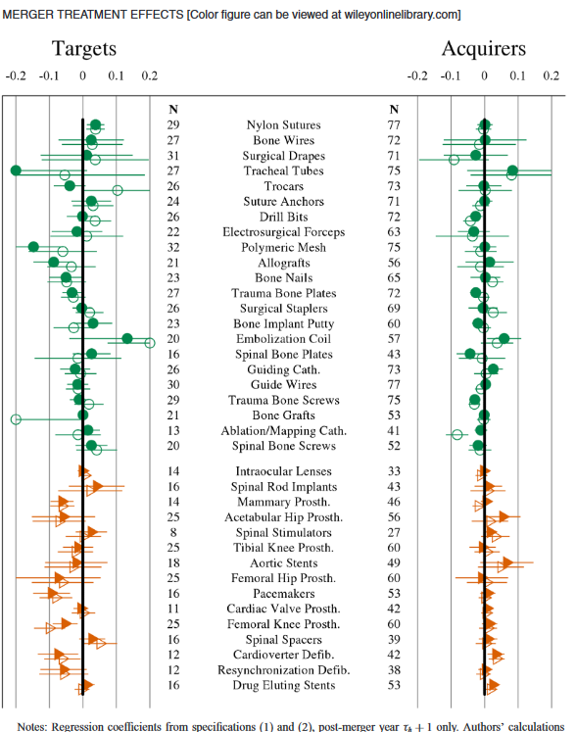
Main Results (1): DD
Empirical specification for first DD:
u : unit prices for each product type,
h : hospital, j : brand,
m : month, y : year
Green/circle markers: non-PPIs vs. Orange triangles: PPIs
Ordered by increasing total expenditure in database
Figure 1:
Notes:
withinhospital-category estimates (hollow markers) closely mimic the within-hospital-brand estimates (solid markers), and the point estimates of the two are rarely statistically significantly different. This suggests that there is not a prevalence of large changes in composition of products purchased to higher or lower dollar products post-merger. Given this, and given our concerns that any such switching might have ambiguous welfare effects, we focus most of our discussion on withinhospital-brand differences moving forward.
Next, we focus on the left panel: merger effects on target hospitals. Among non-PPIs (circle markers), there is no discernible pattern of savings post-merger. Point estimates are a near equal mix of positive and negative, with most small in magnitude and not statistically different from zero. Exceptions include significant price decreases within-hospital-brand of 3% and 15%, respectively, for trauma bone plates and polymeric mesh. In contrast, among PPIs (triangle markers), the majority of within-hospital-brand price effect point estimates are negative. Also, several of these effects are significant at the category level, including decreases on the order of 5% to 9% for cardioverter defibrillators, femoral knee prostheses, mammary prostheses, and pacemakers. We observe a dramatically different pattern for acquirers in the right panel of Figure 1. Price effects are generally more precise, as expected given the larger sample of acquirers. The point estimates are also clustered much closer to zero for both non-PPI products and PPI products. Among non-PPI products, we observe several negative and significant results on the order of 2% to 4% for bone implant putty, drill bits, spinal bone plates, trauma bone plates, and trauma bone screws. Second, in contrast to the target results, the coefficient estimates for some PPIs are positive, ranging from 2% to 5% for acetabular hip prostheses, cardioverter defibrillators, drug eluting stents, and spinal stimulators.

Slide 11
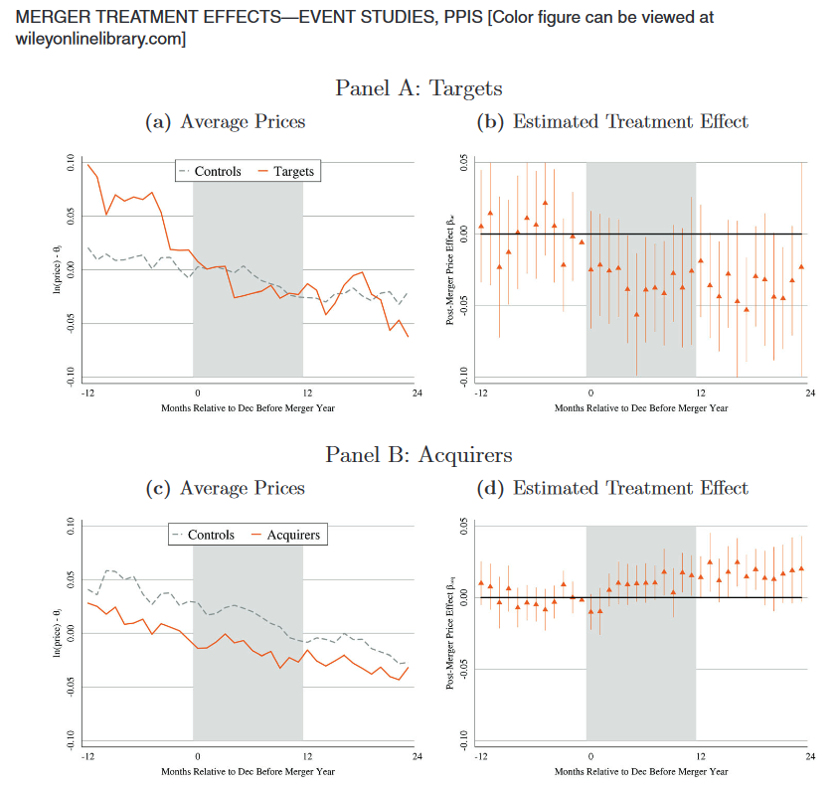
Main Results (2): Event Studies
Examining whether DD results are driven by
preexisting differential trends in price among merging facilities or
biased due to merger effects that develop slowly over time
Right panel: pooled event studies within brand
Left panel: pooled raw average price trends
(omitted key results on merger treatment effects heterogeneity, table 5)
Figure 2:
Notes:
the left panels show pooled raw average price trends, controlling only for brand-category fixed effects to account for the fact that hospitals may use very different amounts of various products. The right panels show the pooled event studies for the within-brand version of the above difference-in-differences specification, fully controlling for hospital-brand effects and brand-specific time trends.

Slide 12
Takeaways
The dialysis market does not follow the assumptions of standard models of regulated markets with endogenous product quality which would predict facilities would compete on quality given prices are set administratively (Eliason et al., 2020)
Hospital mergers have a small but significant effect on marginal costs, primarily due to negotiated PPIs and this benefit is greater for the acquired/target hospital (Craig et al., 2021)

Slide 13
Discussion
Were any of the findings surprising to you?
Areas for future work:
Craig et al.: because of potential simultaneity of input and output market negotiation– “Matching hospital purchasing data with private insurer claims and modeling demand and negotiated prices explicitly in upstream and downstream markets.”
Eliason et al.:
“consider how the effects of acquisitions differ in markets characterized by extensive government intervention, such as health care and education, compared to those without it, such as restaurants, as well as how these effects differ depending on how well patients or consumers can observe quality.”

