Slide 1
Adverse Selection and Insurance Networks Mark Shepard, 2022, “Hospital Network Competition and Adverse Selection: Evidence from the Massachusetts Health Insurance Exchange,” AER
Liz Staton
Health Economics II
Notes:
Health Economics II - Adverse Selection (ianmccarthyecon.com)
Again on the area of adverse selection, we’ll discuss Shepard (2022) in class. This paper considers the interplay between hospital network competition and adverse selection, focusing on the Massachusetts health insurance exchange. The authors advance the literature on health insurance markets by introducing the concept of hospital network competition into the discussion of adverse selection. Traditionally, studies have focused on premiums, plan benefits, and individual consumer attributes in analyzing adverse selection. This paper broadens this perspective by showing that the networks of hospitals associated with insurance plans are also crucial in shaping consumer behavior and the overall dynamics of adverse selection in the market. This novel approach enriches the understanding of the multifaceted nature of health insurance markets and highlights the importance of considering a broader range of factors in studying these market

Slide 2
Overview
Research Question
What is the role of selection when insurers compete on a key aspect of network quality: coverage of the top “star” hospitals in a market?
Empirical Strategy
Variation in pre-ACA insurance exchange coverage of Mass. top star hospital system
Key findings
Substantial selection incentives to exclude star providers that persist despite risk adjustment intended to offset adverse selection
Notes:
star hospitals tend to share two features. First, they are known for advanced medical treatment and research—e.g., reflected in US News and World Report’s “Best Hospitals” rankings. Second, they tend to be expensive both because they deliver more intensive services (Newhouse 2003) and because they command high prices (Ho 2009). As such, insurers’ motives for excluding them may involve both cost cutting and selection. While star hospitals are often seen as “must-cover” in employer insurance, they are regularly excluded in the ACA insurance exchanges (Coe, Lamb, and Rivera 2017). Understanding the reasons is important for interpreting this trend both in the ACA and insurance markets more generally.\
Massachusetts exchange (RomneyCare) setting is ideally suited to this topic because plan financial benefits (cost sharing and covered services) are standardized.
the state’s top star hospital system: Partners Healthcare, the state’s largest health system which includes Mass general and brigham and women’s
Variation: large plan that drops Partners as a natural experiment

Slide 3
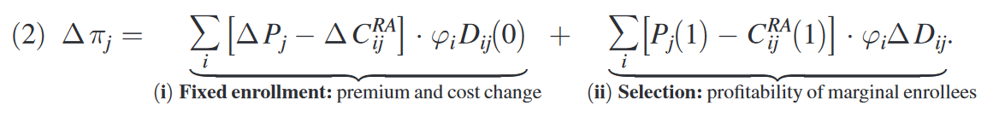
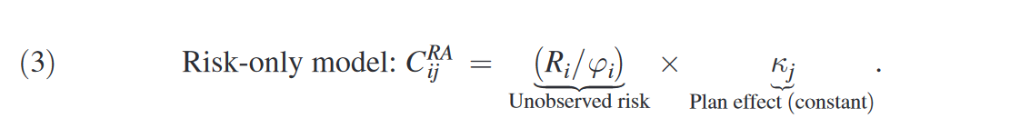
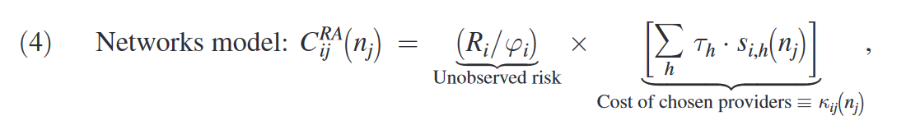
Theoretical Framework
How insurer j’s profits change when it covers star hospital
2 models for costs:
Limits of risk adjustment to account for cost heterogeneity
Notes:
CommCare features substantial variation in enrollee premiums that is useful for estimating a model of insurance choices. This variation comes from two sources. First, insurers vary prices over time as they acclimate to the new market and adjust strategy. Of course, these price changes may be endogenous to shifts in plan quality. Therefore, I also use a second source of variation: subsidies that differ by income group and that affect premium differences across plans. Notably, enrollees earning below 100 percent of poverty are fully subsidized, paying zero for all plans. Higher-income enrollees get the same plans but pay more on the margin for higher (presubsidy) price plans. This sets up a natural identification strategy for premium coefficients in my plan demand model.

Slide 4
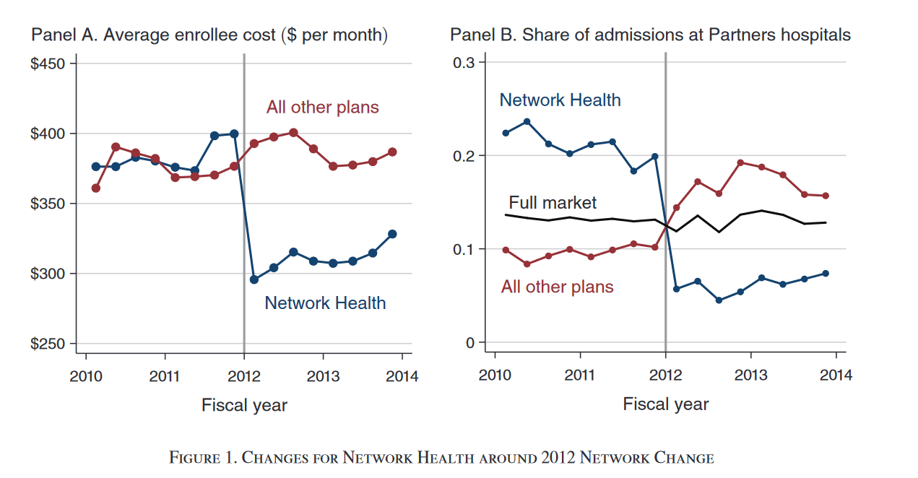
Set up of empirical analysis
2012 event: Network Health dropped the Partners hospitals and associated physicians, plus several less prestigious hospitals
Notes:
2010–2013: 5 insurers, ~170,000 enrollees

Slide 5
Evidence of risk selection & roles of sickness and preferences
Patients who value the excluded providers to switch plans to keep access to their preferred hospital or doctor. Because these enrollees have high risk-adjusted costs, this switching benefits Network Health via favorable selection
Strong correlates of demand for Partners:
Being sicker/medical risk → accounts for 53% of switchers’ higher costs
Preference measures (e.g., distance or provider loyalty)
Notes:
Figure 2 shows evidence of a large spike in switching out of Network Health in 2012, driven by consumers likely to have higher demand for Partners and other dropped hospitals. For the plan overall, the switching rate spikes to 11.3 percent, more than four times the 2.4 percent rate in 2010–2011.
The fact that it holds for patients both of Partners and the other dropped hospitals suggests a general mechanism, not something specific to star hospitals. High rates of plan switching occur despite the well-known fact of inertia in plan choice (Handel 2013, Ericson 2014). One possible reason—for which there is anecdotal evidence from my discussions with providers—is that the dropped hospitals contact their patients and encourage them to switch plans. This provision of advice may represent an important mechanism through which plan networks influence enrollee choices.
Panel A shows that the 2012 spike was concentrated among people living closer to a Partners hospital, consistent with distance as a driver of provider choice. Switching rates spike to 22 percent for people within 5 miles of Partners, versus a steady 5 percent rate for those more than 25 miles away. Panel B shows that switching was even more concentrated among prior-year patients of the dropped hospitals (for outpatient care), a revealed preference indicator of demand. For prior-year Partners patients, the switching out rate spikes to 45 percent—a more than twentyfold increase over the rate for the prior two years (2.1 percent). Switching also jumps to 24 percent for patients of other dropped hospitals (versus 1.7 percent in the prior two years). By contrast, switching for all other enrollees was much lower (3 percent) and essentially flat versus prior years.23

Slide 6
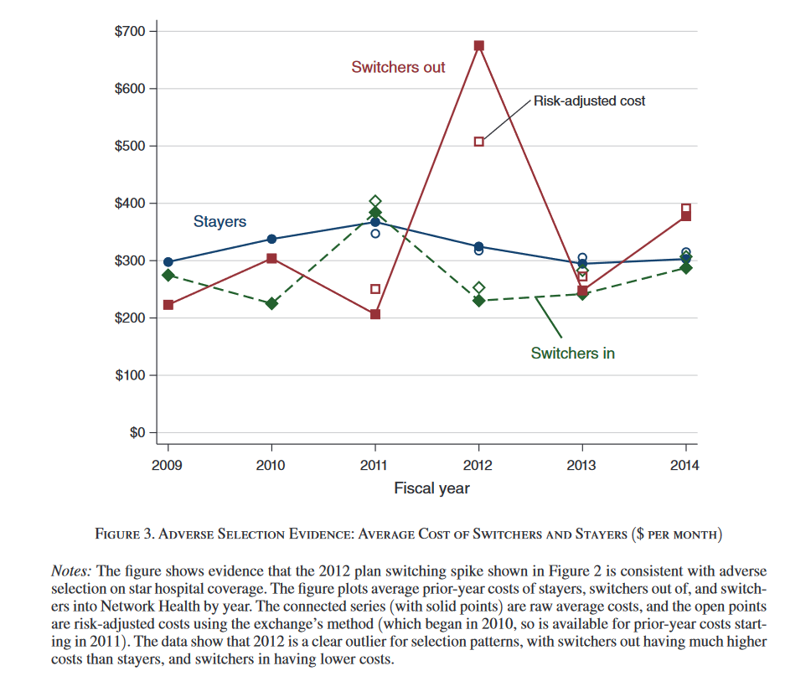
Switching patterns & costs
Partners patients are most likely to switch after 2012 coverage change, and those who live closest to a Partners hospital have a higher likelihood of switching than those who live further (Fig 2)
Switchers have higher average costs, even after risk adjustment (Fig 3)
Notes:
Figure 2 shows evidence of a large spike in switching out of Network Health in 2012, driven by consumers likely to have higher demand for Partners and other dropped hospitals. For the plan overall, the switching rate spikes to 11.3 percent, more than four times the 2.4 percent rate in 2010–2011.
Panel A shows that the 2012 spike was concentrated among people living closer to a Partners hospital, consistent with distance as a driver of provider choice. Switching rates spike to 22 percent for people within 5 miles of Partners, versus a steady 5 percent rate for those more than 25 miles away. Panel B shows that switching was even more concentrated among prior-year patients of the dropped hospitals (for outpatient care), a revealed preference indicator of demand. For prior-year Partners patients, the switching out rate spikes to 45 percent—a more than twentyfold increase over the rate for the prior two years (2.1 percent). Switching also jumps to 24 percent for patients of other dropped hospitals (versus 1.7 percent in the prior two years). By contrast, switching for all other enrollees was much lower (3 percent) and essentially flat versus prior years.23

Slide 7
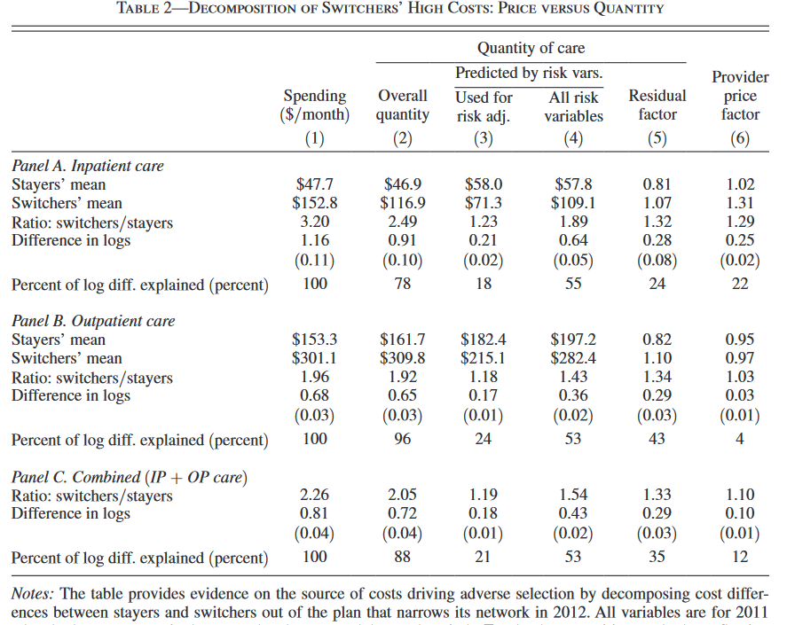
Decomposition analysis of switchers’ high costs
Theorized Mechanisms
Unobserved medical risk (sickness)
People who demand star hospital coverage have higher costs because they use its expensive care (provider price factor)

Slide 8
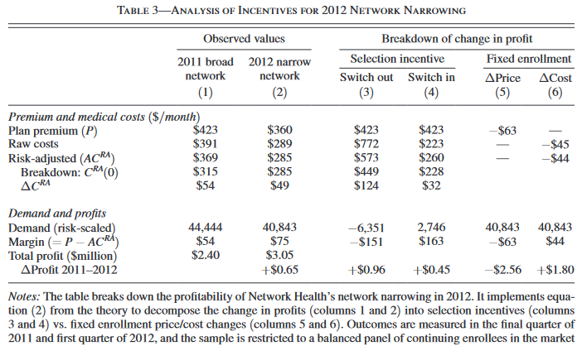

Insurance demand for star hospitals
Shepard estimates consumers’ willingness to pay for star hospital coverage with a multinomial logit plan choice model with subsidized premiums, network value, inertia of current enrollment, and plan dummy variables
Enrollees are price sensitive but because premiums are low, the implied consumer demand elasticity is -1.48
less negative for higher income, sicker, and older enrollees, who also have higher utility of networks covering their desired providers. Implies higher willingness to pay for provider coverage
Insurer cost model
Analysis of the role of selection vs moral hazard incentives involved in 2012 network narrowing decision
After further WTP and cost curve analysis of star hospital coverage, the basic finding that costs of star hospital coverage are larger than consumers’ WTP appears robust
Notes:
plan utility depends on four plan characteristics: (i) subsidized premiums, (ii) provider networks, (iii) inertia for current enrollees in their current plan, and (iv) unobserved quality, captured by a rich set of plan dummy variables.
I allow utility coefficients to vary with a rich set of consumer characteristics (Zit), including income groups, age-sex groups, immigrant status, and deciles of the HCC risk score (plus an additional dummy for the top 5 percent)
identification comes only from premium variation across consumers within a plan-region-year cell.
This identification strategy is analogous to DD in a nonlinear model. As in standard DD, I include fixed effects to absorb all premium variation driven by endogenous factors, leaving only the exogenous (subsidy-driven) variation for identification. The assumption is that there are no further income group-specific demand trends/ shocks (for a given plan in a given region)—i.e., no ξj,Reg,Inc,Yr—that are correlated with premium changes. One simple test of this assumption is to examine whether demand trends are parallel between “treatment” (above-poverty) and “control” (below-poverty) groups around premium changes. Online Appendix Figure A.23 shows such a test, finding that monthly market shares are flat and parallel for treatment and control groups at all times except for the treatment group at the expected time (when premiums change at the start of each year).
Inertia : 4.413 (standard error = 0.007)
Part 2
Even though the plan cuts its premium substantially (by $63 per month), average costs fall by an even larger $102 (or 26 percent)
Columns 1 and 2 show Network Health’s premium, demand, costs, and profits for these two periods
Columns 3 and 4 show the large role of adverse selection in these changes, corresponding to the profitability of switchers in/out of the plan. The very high risk-adjusted costs of switchers out implies that the plan lost money on these enrollees (a margin of −$151 per month);

Slide 9
Discussion questions
1
Shepard identifies the policy dilemma of demand for star hospitals being driven by both sickness (warranting policies to ensure star hospital coverage) and preferences (based on which he says regulators “might be comfortable letting coverage unravel”). What do you think about this policy dilemma as described?
Is there anything you think may have changed since the date range (2010-2013) of this analysis if this were to be replicated using more current data (assuming similar empirical example of selection on hospital network quality available)?
2
Notes:
1) Contained within preferences are factors related to access to care that influence health, such as distance.

