Slide 1

The Behavioral Foundations of Default Effects: Theory and Evidence from Medicare Part D
Paper by Brot-Goldberg et al. (2023)
Presented by Freddie Yang (Emory)

Slide 2
Setting / Data / Terminology
Medicare, Medicaid, Dual Eligible
Low-Income Subsidy (LIS)
Default Plan, Plan renew, Plan Exit
Data: publicly available administrative datasets from the CMS 2007-2015

Slide 3
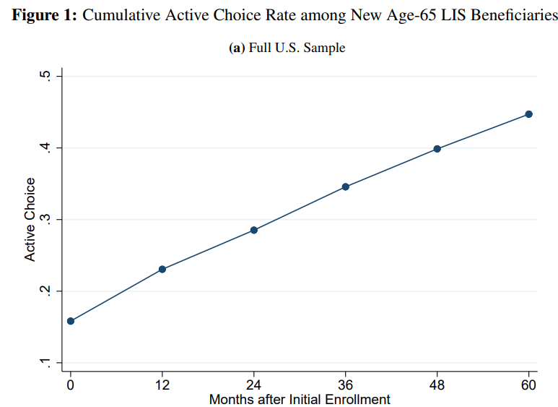
Do people switch plans (from default)?
Answer: No
Why?
Reason #1 (Neo-classical): People are happy with their default assignment?
Unlikely. 55% of people stick with original default plan after 5 years

Slide 4
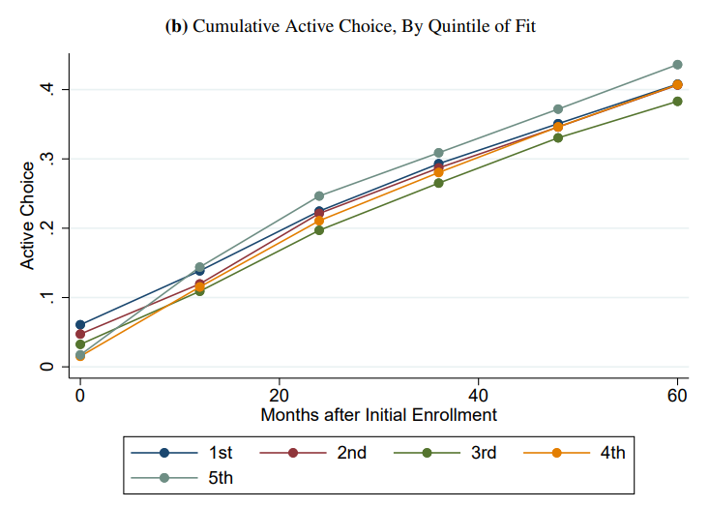
Are people happy with their plans?
Objectively measure a plan’s “fit”
Least “fit” quintile vs. Best “fit quintile” (least happy vs. most happy)
“fit” doesn’t matter!!! People don’t switch!!!
Drugs taken before turning 65 | Plan 1 | Plan 2 | Plan 3 | Plan 4 | Plan 5
Apple | 10% | 30% | 50% | 80% | 100%
Banana | 100% | 100% | 100% | 100% | 100%
Person | Default Plan "Fit" quintile
Abby | 1
Beth | 2
Carol | 3
Dirk | 4
Ethan | 5
Freddie | 1

Slide 5
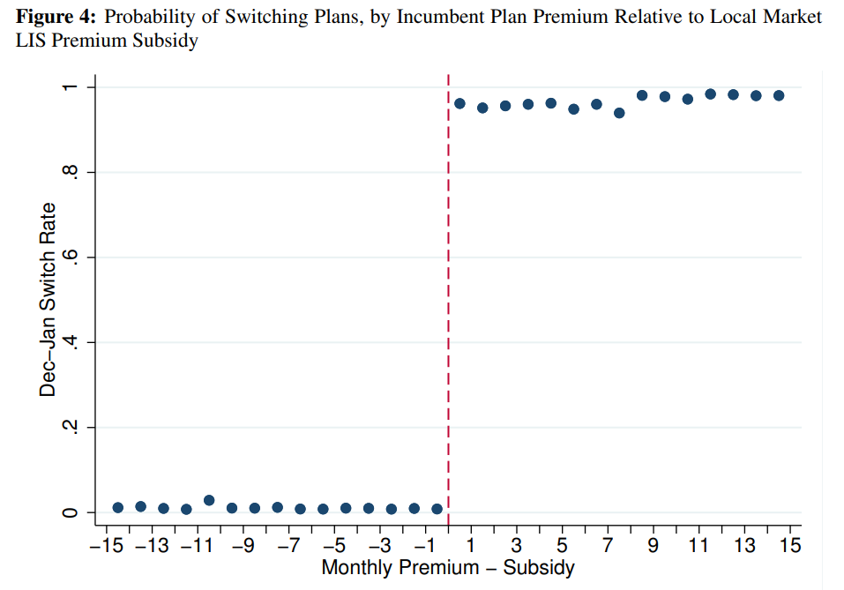
Other explanations?
Switch costs are high vs. “default effect” (unknown persistence)
To decide which one is correct: natural experiment (plans renew annually):
Two cases: (1) Incumbent plan < benchmark vs. (2) Incumbent plan > benchmark
If the “high switch costs” makes sense + case(2) -> re-enroll to incumbent
If the “default effect” makes sense + case(2) -> automatically re-assign

Slide 6
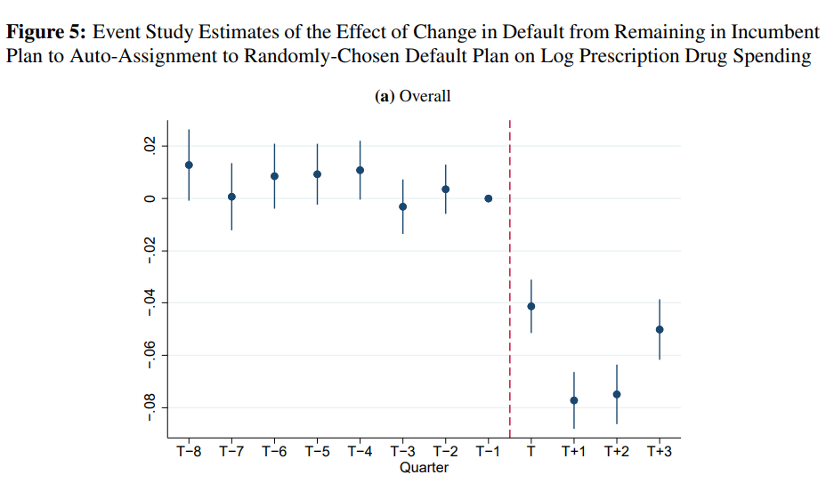
The default effect reduces welfare
6.4% drop in allowed drug spending ($213 per year)
Empirical Strategy: DID (presenter will draw graph on whiteboard)
Parallel trends:
1. Similar characteristics around benchmark
2. Event study coefficients stable before renew

Slide 7

Theory: Frictional vs. Mental Gap
Payoff of active choice ($v^{∗}$), cost (c), default payoff ($v^{d}$), $NV=v^{∗}−c−v^{d}$
Make active choice when $A\left(v^{∗},c,v^{d},…\right)≥0$. Usually, $A\left(v^{∗},c,v^{d},…\right)=NV$
Welfare: $W=\operatorname{Pr}\left\{A≥0\right\}E\left[v^{∗}−c | A≥0\right]+\operatorname{Pr}\left\{A<0\right\}E\left[v^{d} | A<0\right]$
$\frac{∂W}{∂v^{d}}=1−a+\frac{∂a}{∂v^{d}}E\left[NV | A=0\right], a=\operatorname{Pr}\left\{A≥0\right\}$
Frictional: $\frac{∂a}{∂v^{d}}<0$ vs. Mental Gap: $\frac{∂a}{∂v^{d}}=0$

Slide 8


Estimate $\frac{∂a}{ ∂v^{d}}$
Two regressions:
$allowedDrugSpending= β\left(faced plan reassign\right)+δ\left(faced plan reassign∗lowest quintile\right)+ fixed effects+ error term$
$β+δ=−12.6\%$(very big in price)
$propensityToMakeActiveChoice= β\left(faced plan reassign\right)+δ\left(faced plan reassign∗lowest quintile\right)+fixed effects+ error term$
$β+δ=−10.1\%$ (very big in percentage sense)
Big change in allowed spending -> small change in propensity-> $\frac{∂a}{∂v^{d}}≈0$

Slide 9

More evidence for mental gap model
Model latent attention: $A_{it}=c_{i}+k_{it}$
Frictional model: $k_{it}=0$ (people’s attitudes (passive vs. active) don’t change)
But, 26.5% of people are “sometimes choosers”
MLE / Gaussian quadrature: $k_{it}$ accounts for 66.6% of variance in $A_{it}$
This is further evidence against the frictional model

Slide 10

Conclusion
Default choice matters (persistence + welfare loss)
Policy maker should use “paternalistic defaults”
Discussions:
1. How to interpret the first component of the $\frac{∂W}{∂v^{d}}$ equation?
2. Would the RD (page #5) be compromised if there is bunching below the benchmark price? (i.e. Insurance companies strategically set their plans’ prices below the benchmark to induce more people to enroll in their plans)

